Slide 1

Experience Required:
Building Supervisory Skills When You’re Not a Manager
April 17, 2020

Slide 2
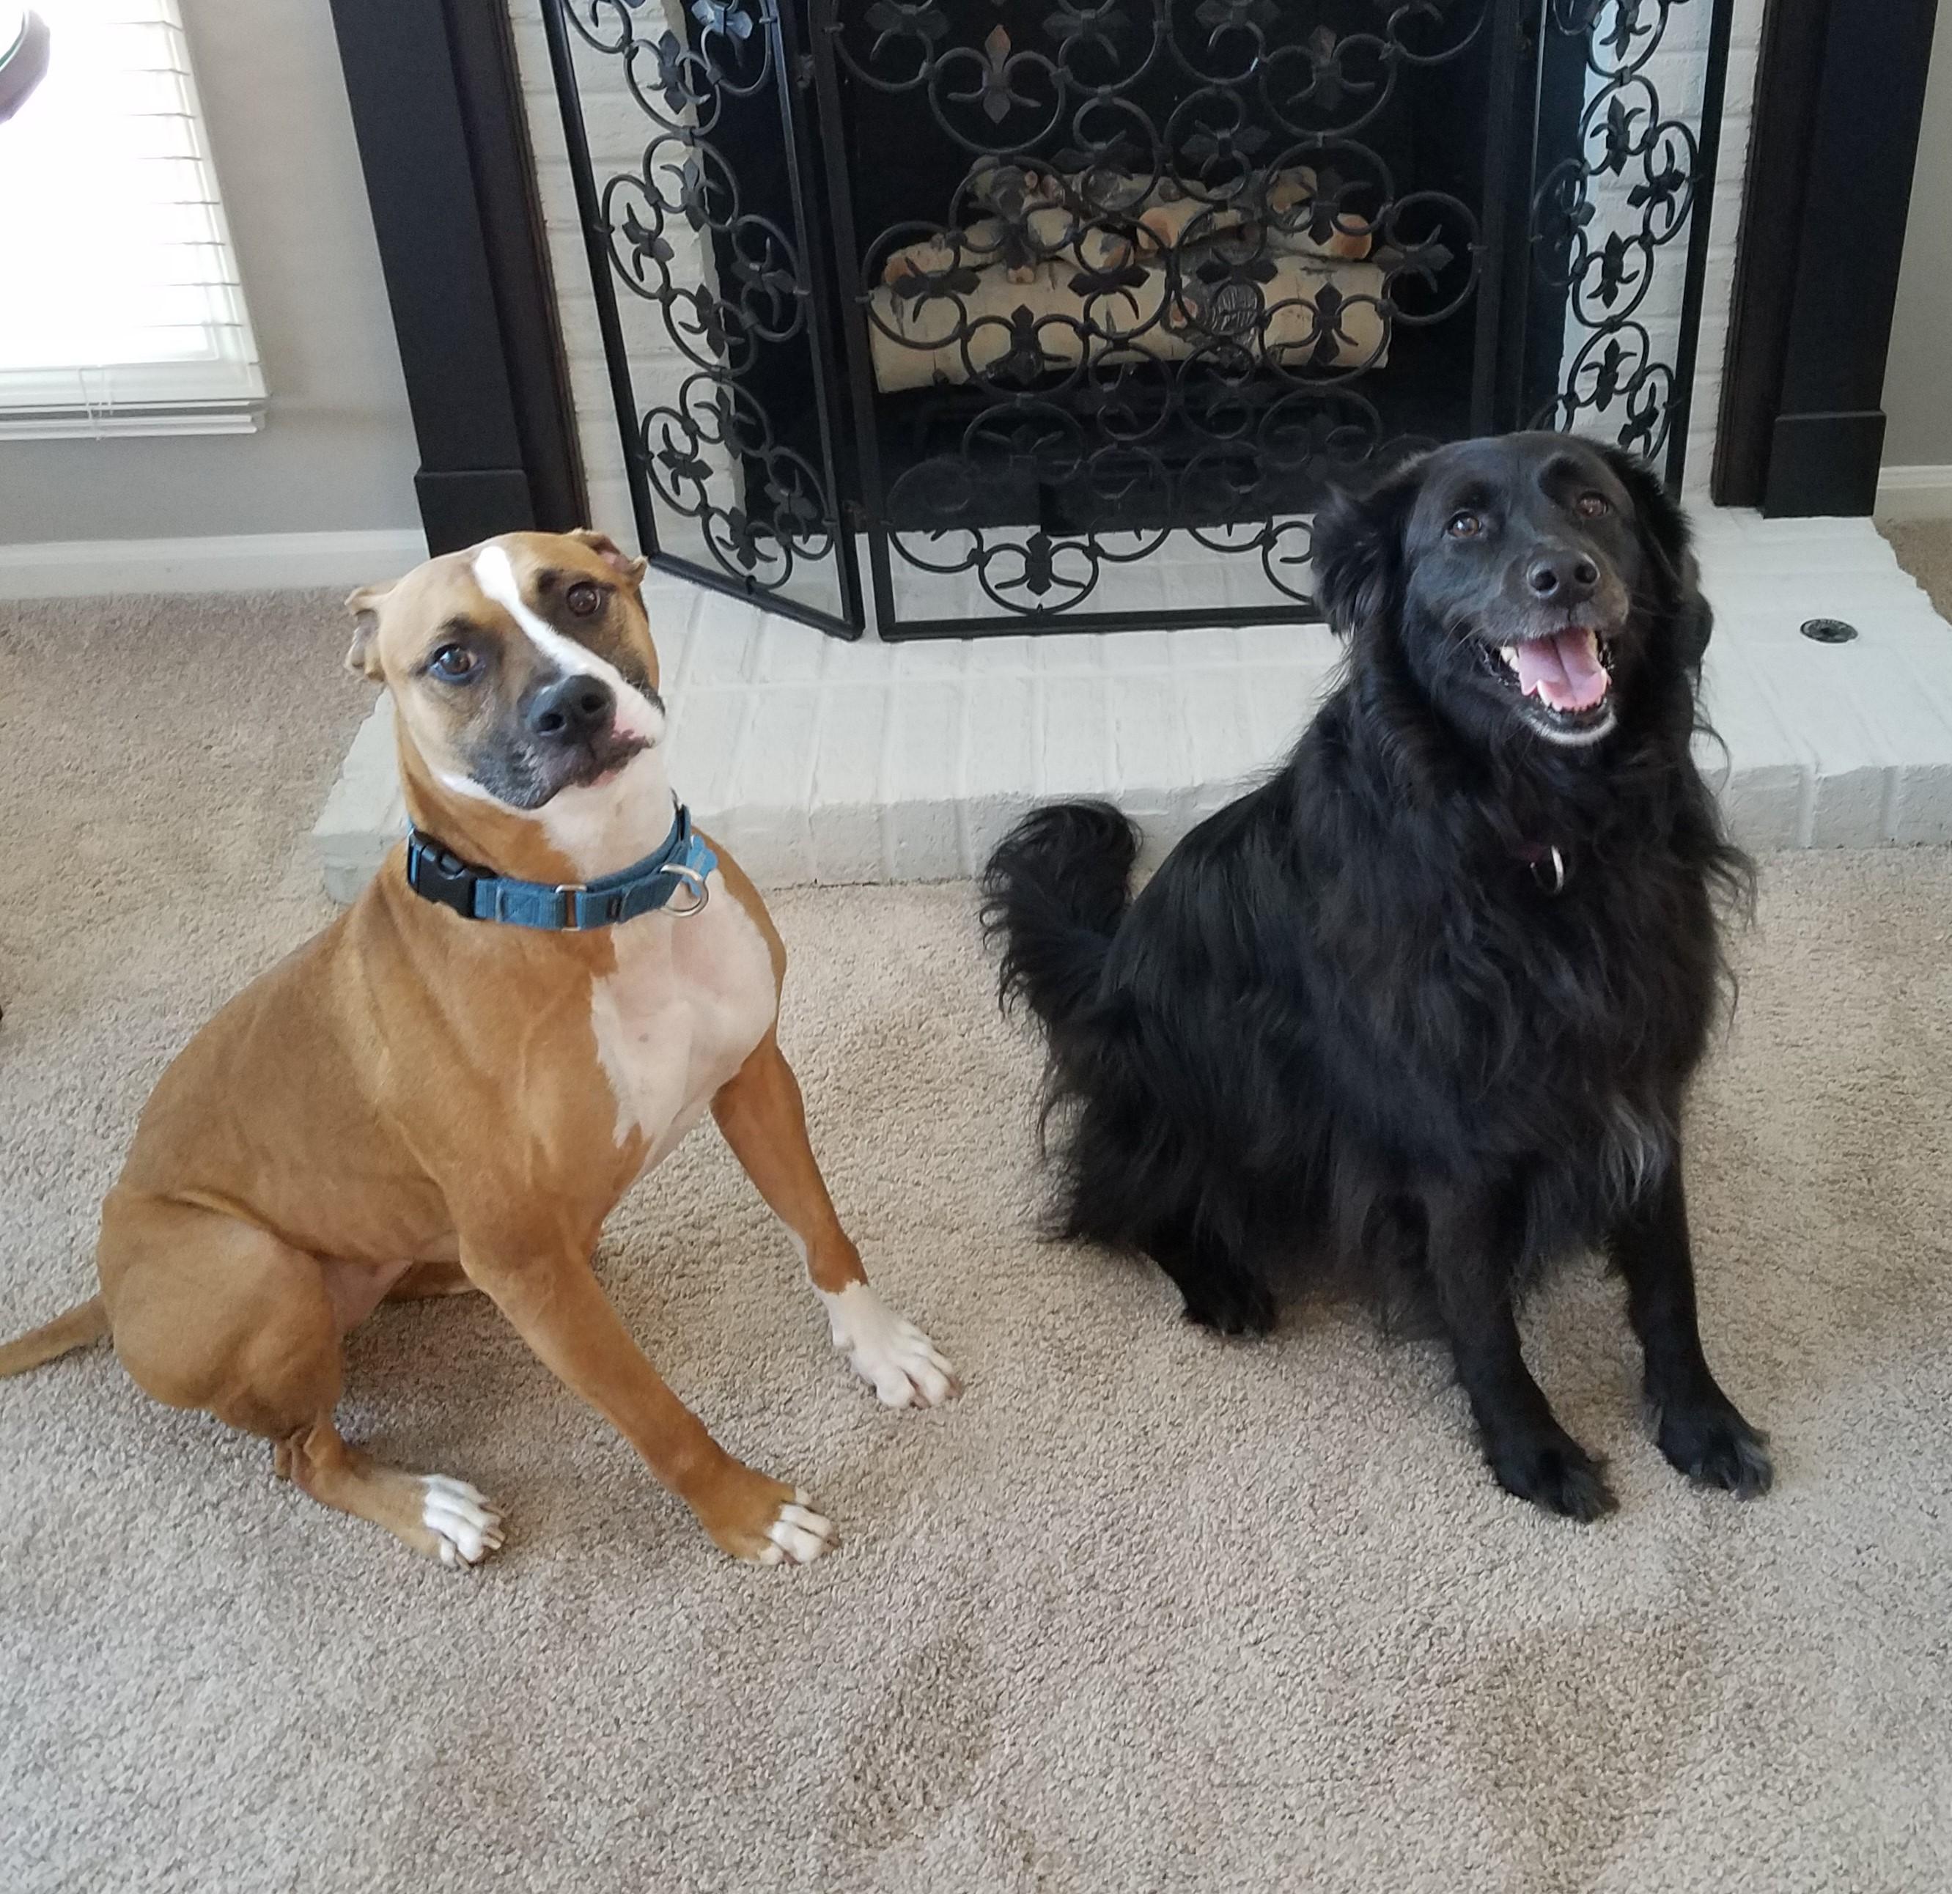
Presenter Bio
Rachel Shulman
Head of Youth & School Services
District library in Lincolnshire, population 42,000
Started 10 years ago as a part-time youth librarian
Internal promotion to department head 7 years ago
Currently supervise 15 employees
https://www.vapld.info/

Slide 3
Learning Outcomes
  Articulate leadership qualities you admire and want to develop.
  Identify experiences that can build supervisory skills.
  Gain practical tools to use for management-level responsibilities.

Slide 4


3-5 characteristics that describe your ideal manager

Slide 5
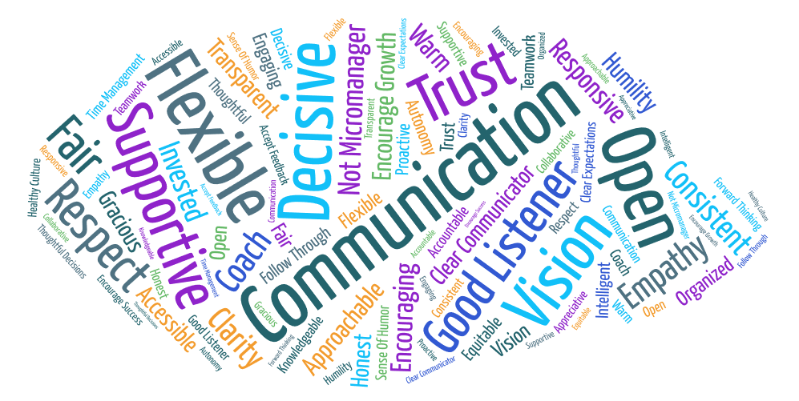
Ideal Manager Characteristics Word Cloud from attendees
ILA Annual Conference 2019 Experience Required Presentation
Ideal Manager Traits List & Word Cloud
Notes:
Please see the handout titled “ILA2019_ExperienceRequired_IdealManagerTraits”: https://drive.google.com/file/d/1Ke5kvIb9Q0LuL1v0fOH8Qqp0_IcXmr7Q/view?usp=sharing

Slide 6
Self-reflection
Why do you want to become a manager?
What are your current strengths and weaknesses?
SELF AWARENESS = KEY TO SUCCESS
Ask a Manager website:
  “Managers were promoted into management roles because they were good at something else. . . . They get little or no training in how to manage well.”
https://www.askamanager.org/2013/11/why-are-there-so-many-terrible-managers.html
Notes:
Are you ready to let go of current job responsibilities? As a manager, you no longer do the tasks, you manage the people who do.

Slide 7
Experiences
Supervise library volunteers
Train & mentor new co-workers
Interviews
Budgeting practice
Scheduling practice
Notes:
Supervise volunteers:
Ongoing tasks
Special projects
Teen volunteers
Program assistance
Train & mentor new co-workers:
Offer to train new hires in your department
Informal mentorship or coaching
Be the go-to person for new employees
Interviews
Can you join your manager in candidate interviews?
Learn how to evaluate job applicants
Their thought process is often more important than their answer
Budgeting practice
If you manage a collection, track your spending and pace it out each month
Propose a program with a budget and report on the ROI (return on investment)
Offer to apply for and manage a grant
Scheduling practice
Offer to make a desk schedule
Track your time on a log to evaluate your productivity
Schedule volunteers, outreach events, school visits

Slide 8

Library Volunteers
Notes:
Supervise volunteers:
Ongoing tasks
Special projects
Teen volunteers
Program assistance

Slide 9

Training & Mentoring
Notes:
Train & mentor new co-workers:
Offer to train new hires in your department
Informal mentorship or coaching
Be the go-to person for new employees

Slide 10

Interviewing
Notes:
Interviews
Can you join your manager in candidate interviews?
Learn how to evaluate job applicants
Their thought process is often more important than their answer

Slide 11

Budgeting practice
Notes:
Budgeting practice
If you manage a collection, track your spending and pace it out each month
Propose a program or special project with a budget and report on the ROI (return on investment)
Offer to apply for and manage a grant

Slide 12

Scheduling practice
Notes:
Handout titled “RF2020_ExperienceRequired_SchedulingPractice” is located on the conference website.
Scheduling practice
Offer to make a desk schedule
Track your time on a log to evaluate your productivity
Schedule volunteers, outreach events, school visits

Slide 13
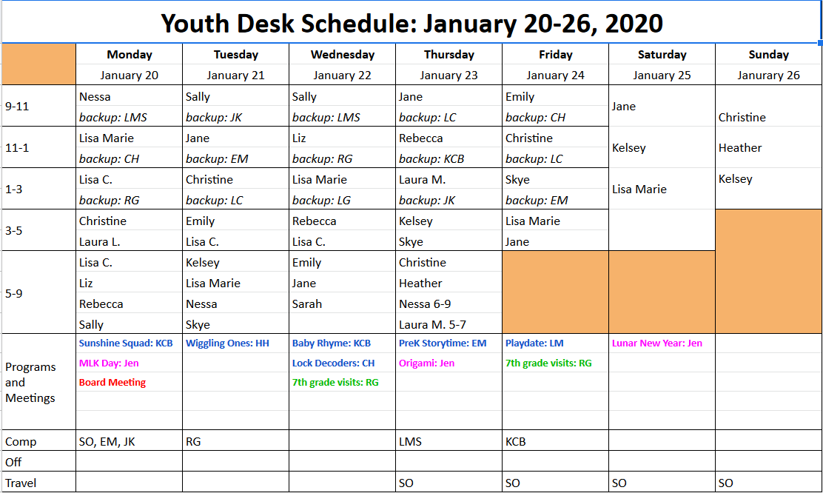
Notes:
Schedule examples here?

Slide 14
Get Involved
Professional committees
    ILA, RAILS, ALA, PLA, LLAMA
Library committees
    Our library has a “Green Team” and a staff association
    What committee, staff group, or task force opportunities does your library have?
Community Involvement
As a representative/liaison for your library
OR
Personally volunteer outside of work

Slide 15
ILA Committees & Forums
  Advocacy Committee
  Awards Committee
  Best Practices Committee
  Conference Program Committee
  Diversity Committee
  Fundraising Committee
  ILA Reporter Advisory Committee
  Intellectual Freedom Committee
  iREAD Committee
  Nominating Committee
  Public Policy Committee
  https://www.ila.org/about/committees
  Illinois Association of College & Research Libraries Forum (IACRL)
  Library Trustee Forum
  Marketing Forum
  Public Library Forum
  Reaching Forward Forum
  Resources & Technical Services Forum
  Small & Rural Libraries Forum
  Students & New Professionals Forum
  Young Adult Services Forum
  Youth Services Forum
  https://www.ila.org/forums

Slide 16
Intangibles
Emotional intelligence
Communication
People skills & conflict resolution
Organizational commitment
Initiative & confidence
Notes:
What characteristics have you identified?

Slide 17
Rachel Shulman rshulman@vapld.info

Slide 18

Ideal Manager Characteristics Word Cloud from attendees
Notes:
https://www.ila.org/events/reaching-forward-Fridays
https://www.ila.org/events/remote-learning

