Slide 1
Taking the Best of our Pandemic Programming into Our Post-Pandemic Future
Lyndsey Carney - Normal Public Library
Mimi Davis - Bloomington Public Library
Christie Lau - Carlock Public Library District
Rhiannon Shoults - Normal Public Library

Slide 2
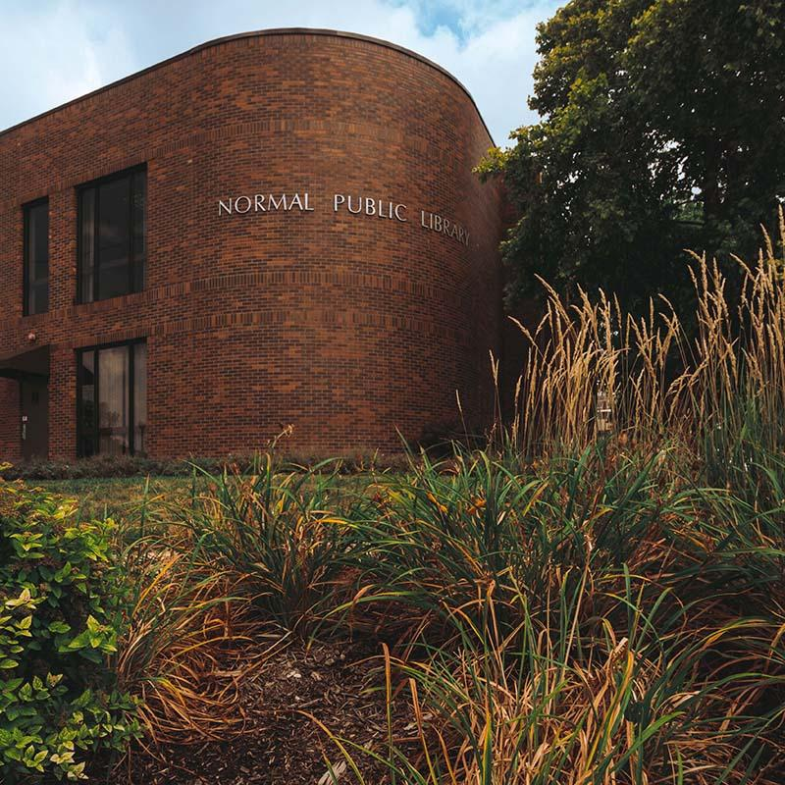
Normal Public Library (Normal, IL)
Service population: 52,497
In central Illinois, 40 miles southeast of Peoria.
Library building is adjacent to Illinois State University campus.
Twin cities with Bloomington.
Home to Rivian Automotive, which is fueling rapid growth in all area communities.
Median household income: $58,381
Racial demographics
80.8% White
11.5% Black
5.2% Hispanic or Latino
3.8% Asian
3.6% Multiracial

Slide 3
Bloomington Public Library (Bloomington, IL)
Service population: 76, 610
Currently undergoing a major renovation project.
Home to State Farm corporate headquarters.
Median household income: $66,861
Racial demographics:
77.3% White
9.7% Black
8.6% Asian
6.2% Hispanic or Latino
2.9% Multiracial

Slide 4
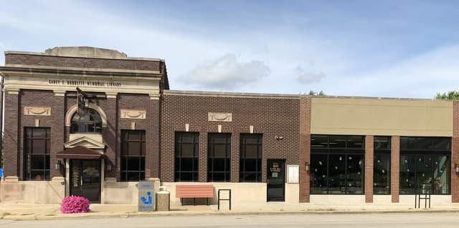
Carlock Public Library District
(Carlock, IL)
Service population: 2,904
Bedroom community to Bloomington-Normal
Median household income: $69,167
Racial demographics
79.6% White
13.2% Black
3.5% Multiracial
0.5% Asian

Slide 5
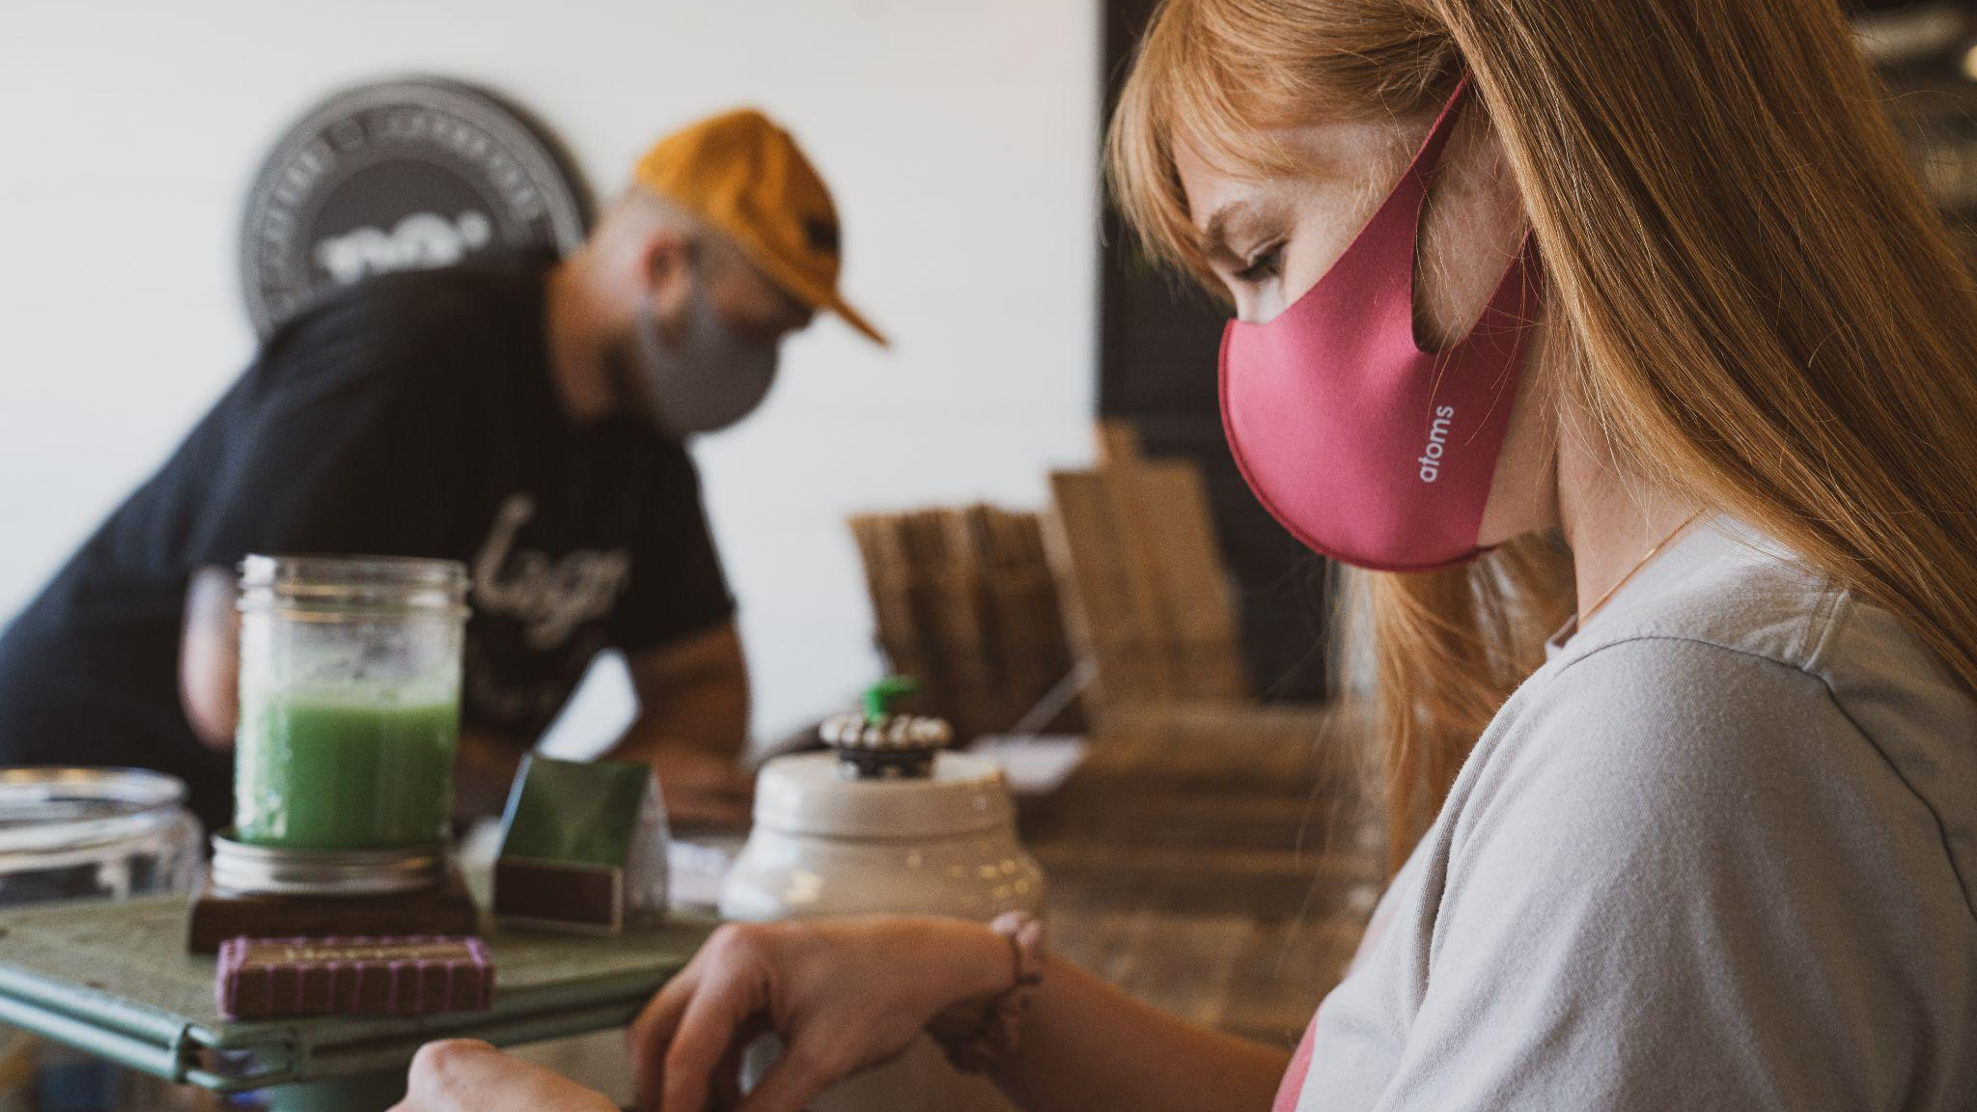
How did we adapt?
What did we learn?
Where are we going from here?
Pandemic Programming
Notes:
The pandemic forced us to be creative in developing new program models, since we couldn’t welcome people into our buildings.
We will discuss a variety of program models, some which were pre-pandemic programs that we had to adapt, and some which were new programs created for our new circumstances.
We will examine what we learned from changing the way we thought about our programs. Did some models allow us to expand access to patrons we weren’t previously reaching due to schedules, transportation access or medical concerns? What worked well and what didn’t?
Now that most of our pandemic-related restrictions have been lifted, what do these program models look like now? What are we keeping, and what are we leaving behind?
Our libraries serve different communities, of different sizes, and what worked well for some of us did not work for others; we will dig into that as well.

Slide 6
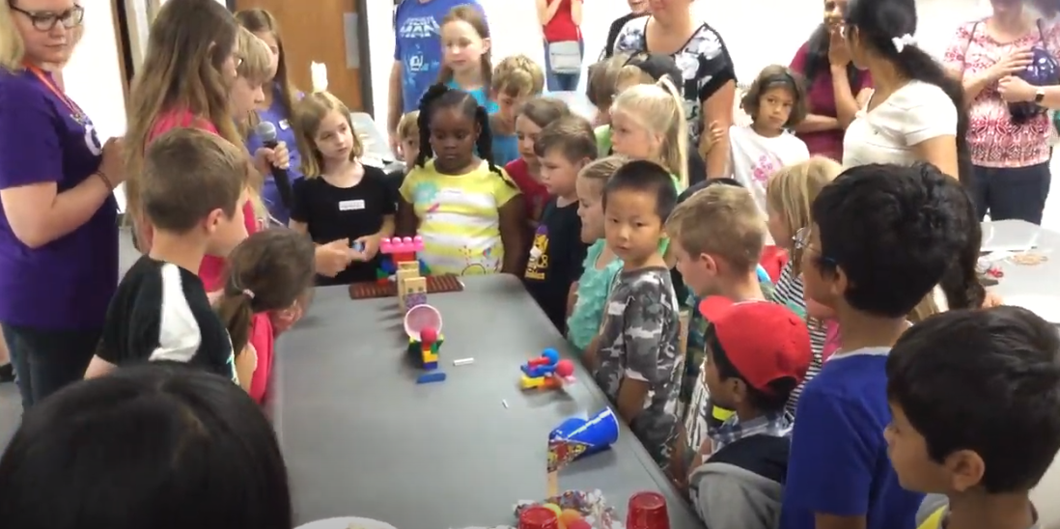
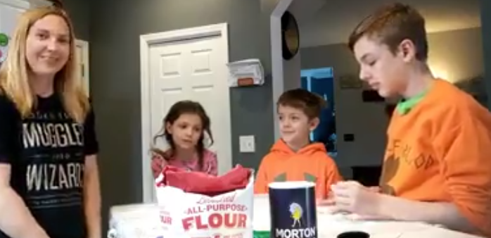
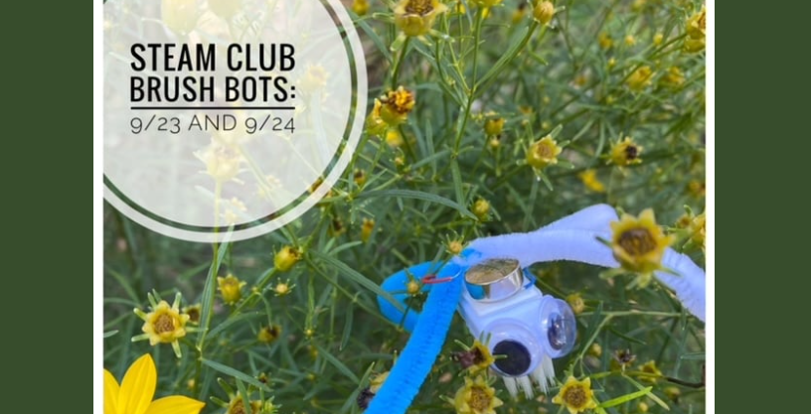
STEAM Club
Pre-pandemic:
Large groups
No registration required
Open to families
March 2020:
Make it with NPL
Library was completely closed.
Videos were pre recorded and posted on facebook and youtube.
September 2021:
Kit + Zoom for specific ages Registration was required
Pick up kit ahead of time and then log in to Zoom with a librarian to complete the project.
Notes:
Existing club that we offered pre-covid for 8-12 year olds and family style
During covid, we presented this virtually with a kit pickup
Met with kids at a planned time on Zoom, walked through the activities, presented through slides, during building presented a book that went with the activity.
Went well for many activities - building and reading was an element that we liked and have kept in some ways. Pairing a book with the steam activity. There were some activities that children needed more help with and that was hard through the screen (circuits, beady buddies)
Some that went very well (roller coasters, forensic science, cave/geodes)

Slide 7
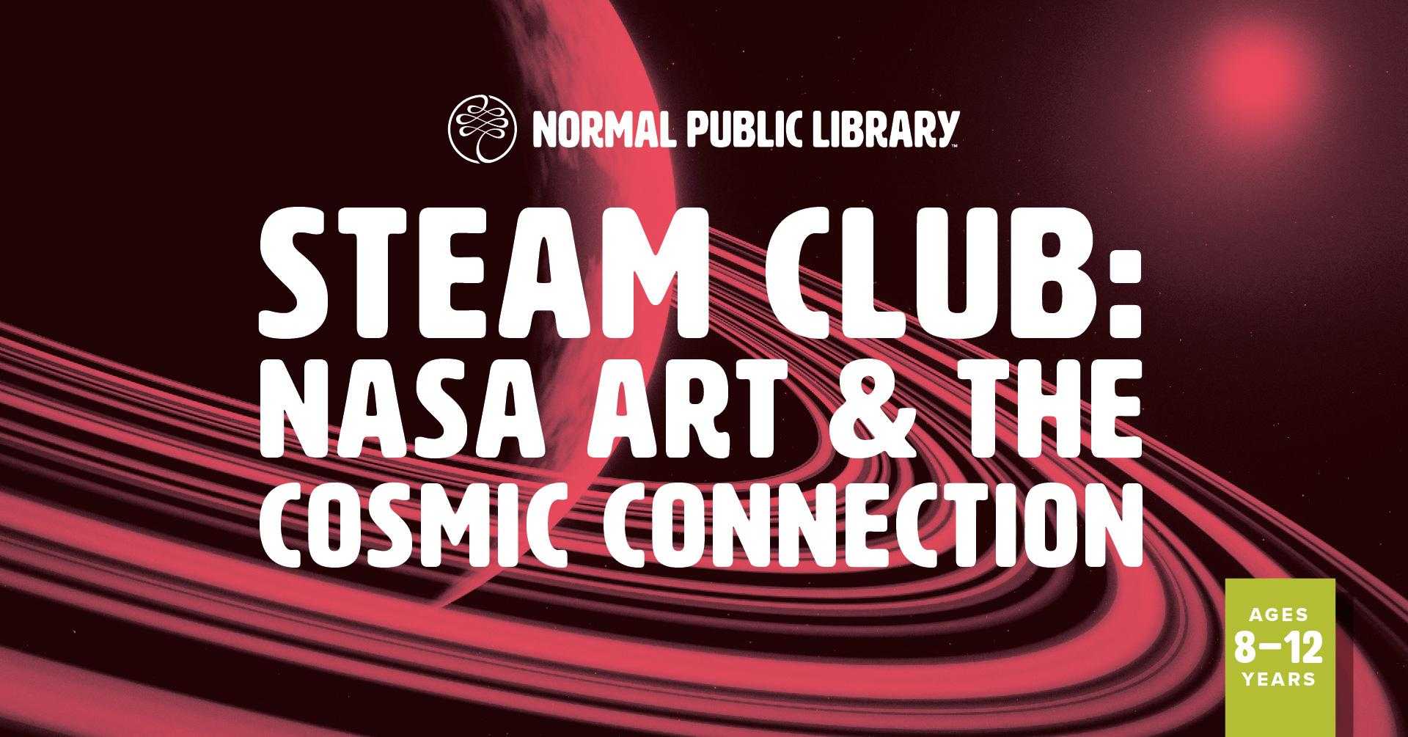
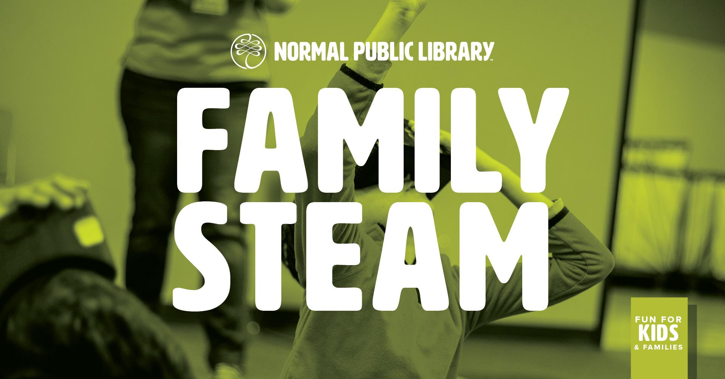
STEAM Club Now
Back in person Started with masks, spread out and no shared supplies.
Pick Up options Pick up the kit ahead of time
Additional Zoom if needed Hybrid option did not work well, so we provide an additional assistance if needed
Staff Time
Notes:
As we moved back through stages we found that having a hybrid program was difficult, felt like watching chaos through a screen without help. So we modified, we still offered the kit and a time to log in together for those who wanted to stay virtual. Still offered an in person option with fewer registered, social distancing, and masking.
Have continued the kit pick up option for the program, while still hosting a majority in person

Slide 8
Small Libraries
Faced Unique Challenges
CHALLENGES
Limited:
Budget
Space
Staff
Technology
SOLUTIONS
Creative modifications of popular programs
Re-imagined holiday celebrations
Partnered with other libraries
Upped our technology game and offered virtual programs for the first time

Slide 9
Modified Popular Program:
Story Time
Pre 2020
Our most popular program!
In-library activities for:
Infant to two years
Three to five year olds
2020 - 2021
Patrons still wanted story time!
Moved to Community Center with social distancing
Moved to local park when weather was nice
Now
Back to in-library most weeks
Move to park sometimes
Individually wrapped snacks

Slide 10
Story Hour
Pre-pandemic
May 2020 - December 2021
January 2022 to current
March 2020
Open drop-in story hours Classroom style for 3,4,5 year olds
Created Move and Groove Scavenger Hunt story hour, fast paced, movement based, ILA 2020 for Move and Groove
Pre March 2020 |  |  |  | 2020 - 2021 |  |  |  |  |  |  |  | 2022
Ready, Set, Read! Registered, with a caregiver, practice based, highlighting early literacy and classroom skills. Added drop in storytime and outdoor options as well
Library closed completely Pre-recorded story times Some dedicated followers
Notes:
One of our best ideas to use the element of play online was to use a scavenger hunt for items around your house. We called this program "Move and Groove Story Hour." We wanted to try to incorporate the elements of story time with a big play and movement element. These scavenger hunts went over SO well! We started with music, songs, and the scavenger hunt. The items children found we then used in the story that we told. Our ability to call back to the items they found and to use them in the story was huge! It was a great success for this program.
In bringing our story times back in person we have kept many of these elements. We still offer a variety of storytimes for preschoolers, some that are more open as well as some with more structure. In our prek storytime, Read, Set, Read! we continue to use the ECRTR curriculum to connect our program to practice. We have developed and outline activities for these elements and have shared this with parents. We have also continued to learn from our covid, online programs and implement activities that keep kids moving and interacting with the story. Poster session presented at ILA 2020 for Move and Groove

Slide 11
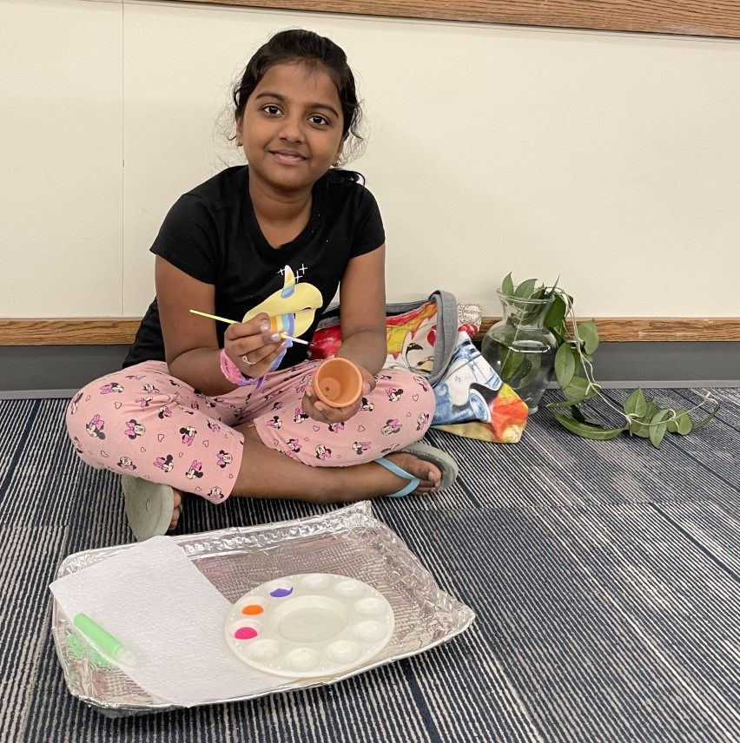
Branching Out With Plant Swaps
Low to no cost, low risk, can be held outdoors
One of our highest attended programs
Children’s Department hosted crafts to make it an all ages event
Featured in American Libraries (6/2022)
Notes:
Originally planned as a pre-pandemic program, this turned out to be one of the only in person programs I could offer. It was easy to adapt it to outside, and the first time we held it we required masks and had hand sanitizer stations upon arrival. We spread out our tables and were able to social distance. Post pandemic, this is still one of our most popular programs and though we lost our space at BPL temporarily due to construction, we partnered with a local nonprofit at their request to host a pop up plant swap at their harvest festival on 10/22. This program lends itself well to a popup format, which we found accessible and easy to plan both during and after the pandemic.

Slide 12
Grab & Go Spice & Tea Kits
July 2021:
Armchair Traveler Gourmet
4 different spice blends from different countries, 4 recipes, bookmark with herbs/spices related reads
(25 kits, $150)
January 2022:
National Hot Tea Month
2 different loose leaf teas, tea brewing tips, bookmark with tea related reads
(25 kits, $100)
July 2022:
Self care with green tea kit
1 Green tea with DIY facial scrub recipe, bookmark with self-care and DIY spa titles
(50 kits, $100)
All spices and teas were from Bloomington SpiceWorks, they also promoted at their store
Notes:
I realized our library didn’t have cool things for adults to pick up during the pandemic like we had for kids and teens. A library friend in Ohio shared that she hosted a grab and go spice kit and that staff was measuring out spices in their workroom and bagging it themselves with grocery store supplies. I realized we had an opportunity to help an independent local spice store who could professional pack and seal sample sizes because at this stage in the pandemic, so much was unknown and people were wary of “many hands”. We gained new library supporters that were wanting to support Bloomington Spice Works and he got new customers that were library patrons unfamiliar with the store. It was so popular (and our library board went nuts for it) and had long waiting lists. We realized there is a need for adult age targeted take and makes, something our library never did before the pandemic.

Slide 13
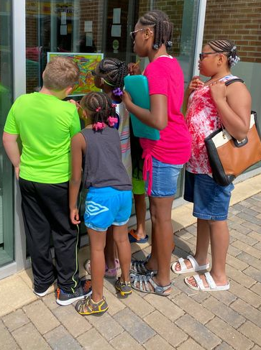
Partner Projects!
Code Hunters
Looking for active participation
Outside for all ages
I Spy style posters at 12 different locations
Summer Edition and Winter Edition
Partnered with Uptown Partners and our Parks and Rec Department
Low to no cost
Notes:
Community Wide Scavenger Hunts: Had not done previously. Needed a safe way to interact with our patrons while our library was closed or while we could not do in person programs. Partnered with our downtown area to display "I SPY" like posters in their windows, families collected and unscrambled letters to win prizes. Code Hunters. This began as a summer program, but then we repeated another version during the winter. This helped to engage families in those colder months and also brought more business to Uptown.
We also hosted scavenger hunts in the town parks. Families would start at one yard sign in the park and have to use codes, unscramble riddles, or perform activities to get to the next clue in the park. (pirate and knight themed) We will continue these types of scavenger hunts. They helped the library and Uptown. In addition to scavenger hunts, we have also increased our story walks. These are hosted at more parks, we have expanded to provide story walks for wider audiences and not just kids (poetry walk, history walk, spooky stories).
We were able to take and continue to move programming outside of our building and have reached more people throughout the community.

Slide 14
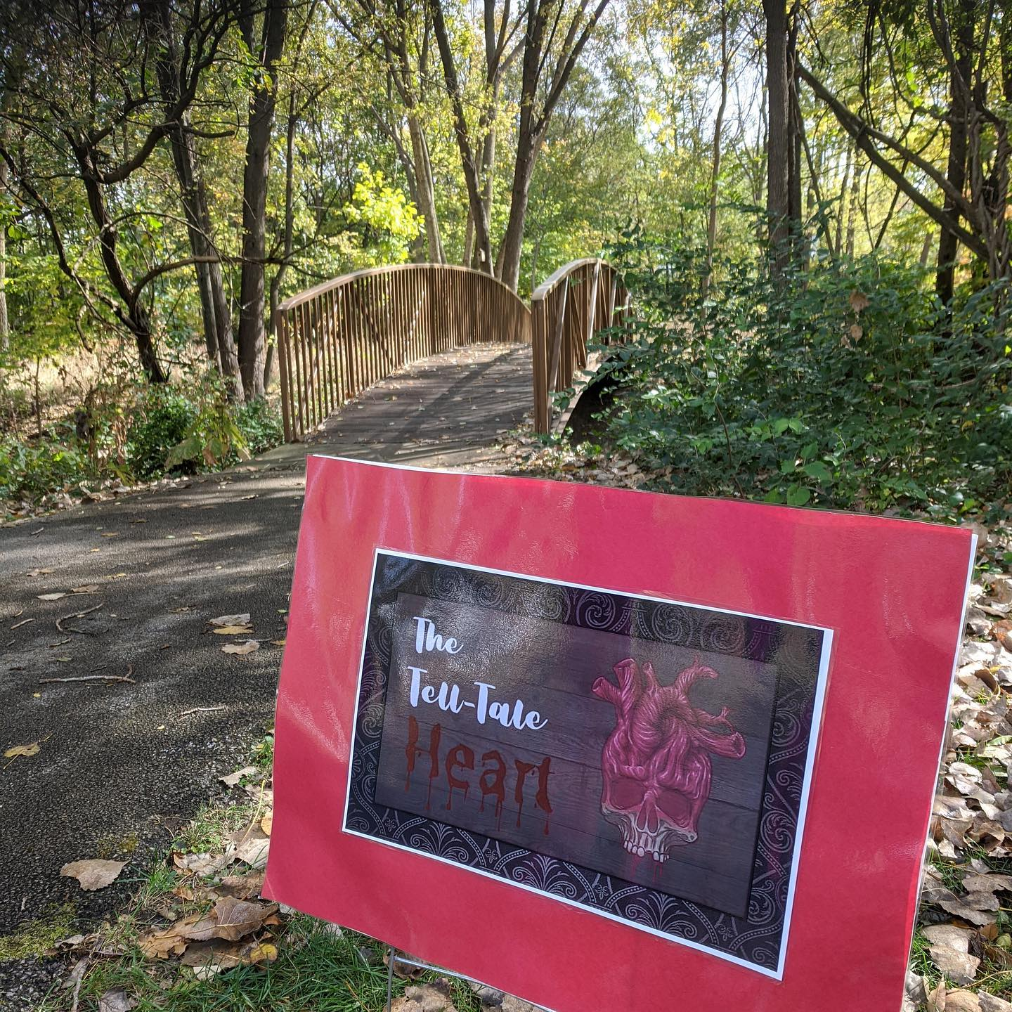
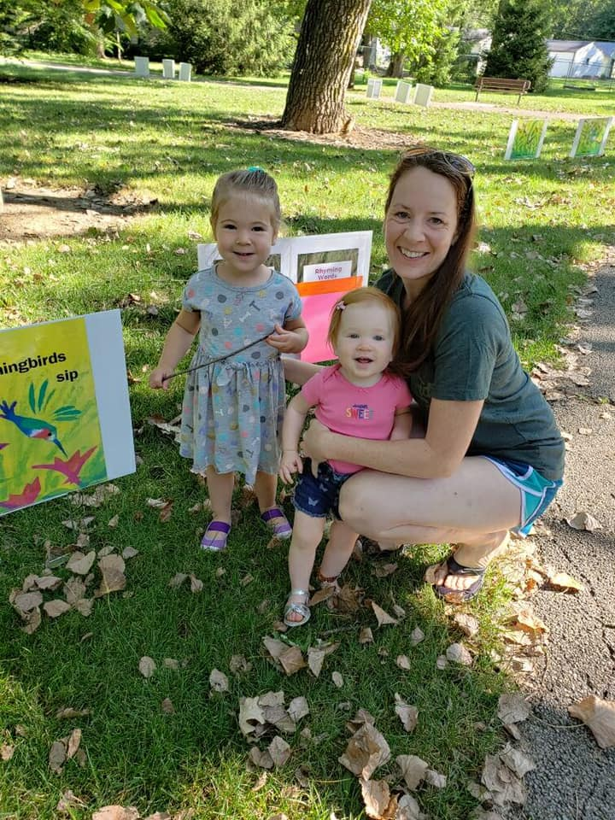
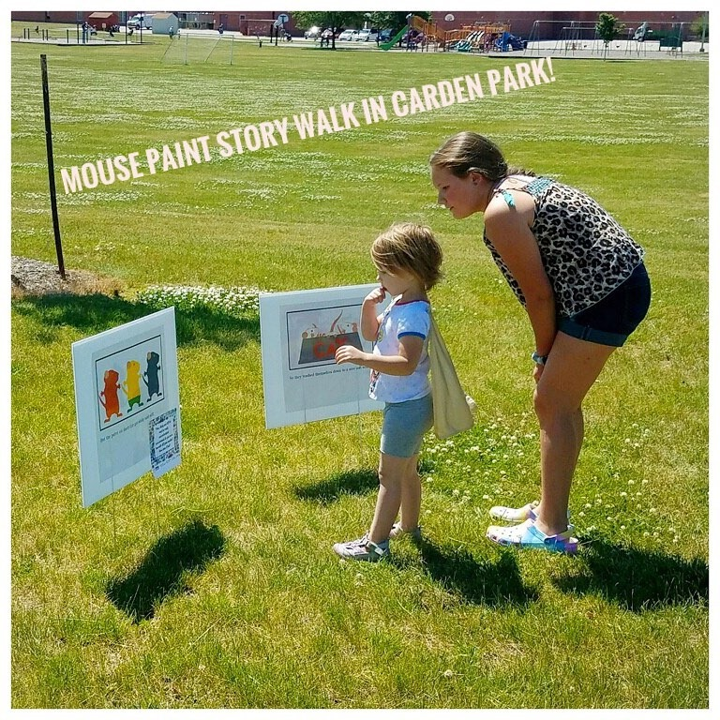
Story walks and Poetry walks

Slide 15
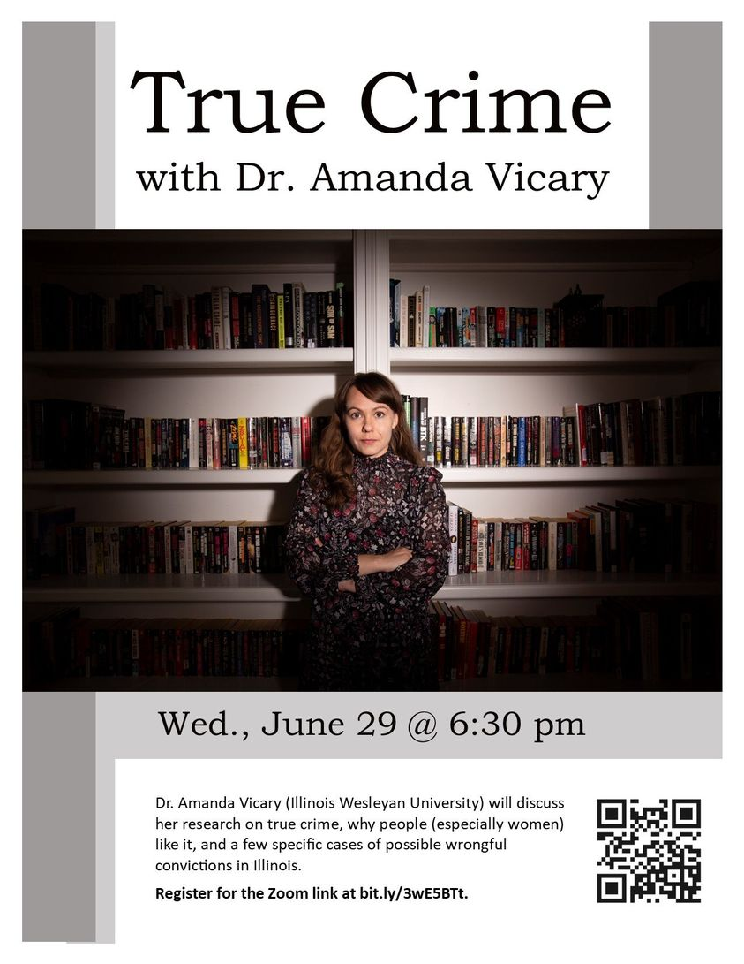
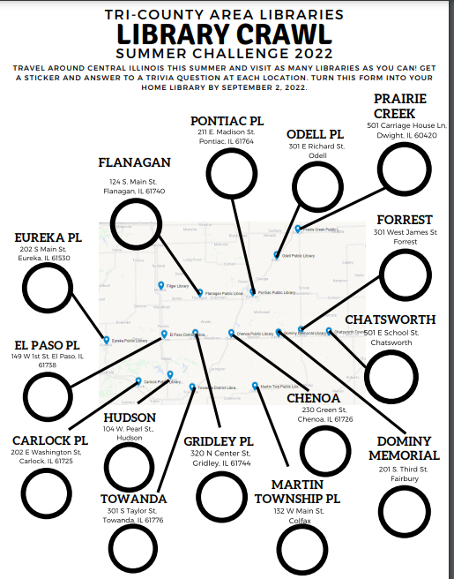
Partnered with other libraries:
Virtual programs and beyond
Local speaker shared by
Chillicothe Public
Library District
Partnership with
Tri-County Area libraries

Slide 16
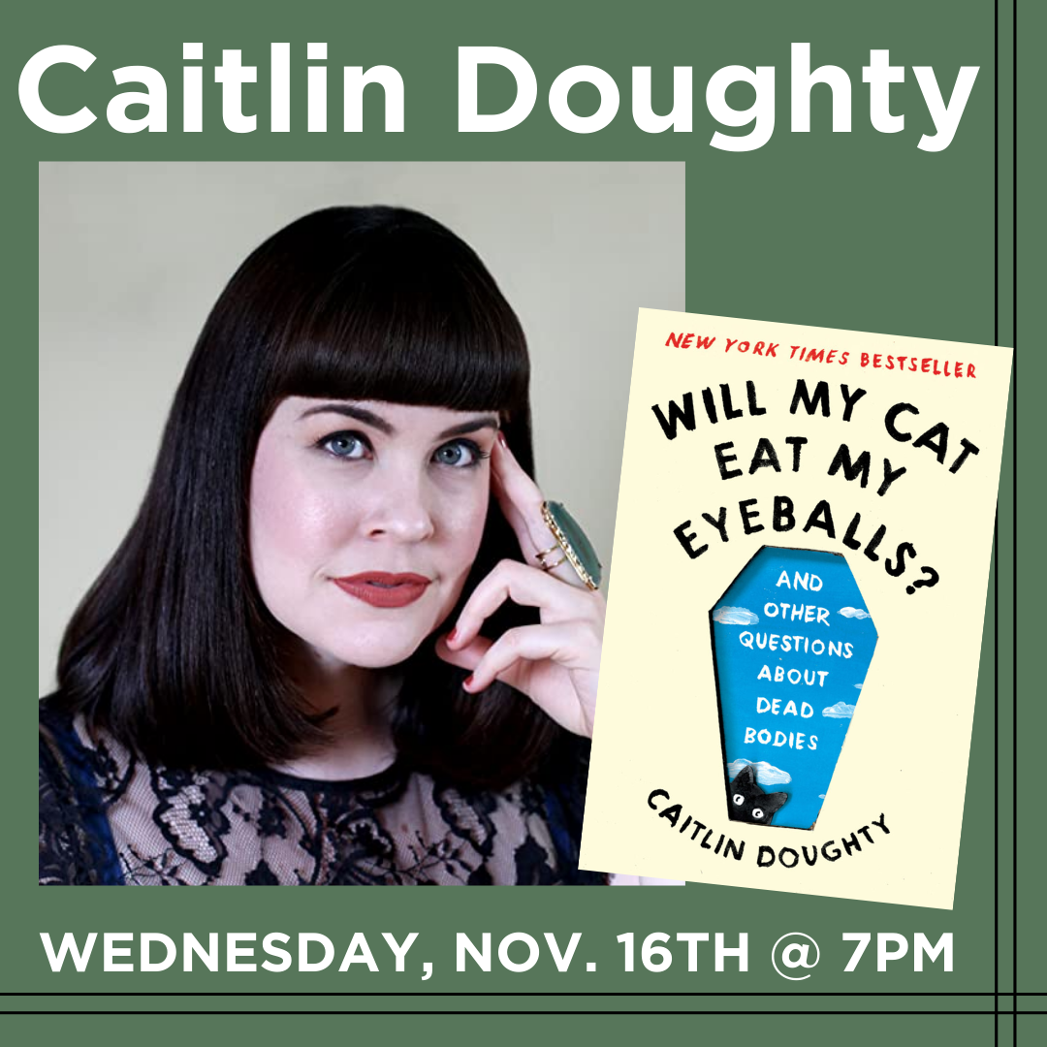
Team Up Virtually!
Illinois Libraries Present
Opportunities for all library sizes
Tip: Target marketing to the speaker’s audience
Story for illustration purposes only
Notes:
Virtual events are still popular and this particular program (IL Libraries Present) gives us the ability to book big speakers we wouldn’t normally be able to afford. That said, it takes good marketing efforts on your part to boost participation. Our largest draw so far was Nick Offerman. If I do special promotions of the event the turnout is much larger. Example: I had our marketing team make bookmarks to put in the authors books one month ahead of the event. This leads to higher attendance. For this program, I’m leaving free bookmarks at our local “goth shop” The Haunted Wraith, who also kindly promotes my true crime book club in a similar way. These programs often depend on social media for their success as well. People may love the author but if they can’t do zoom they won’t go.

Slide 17
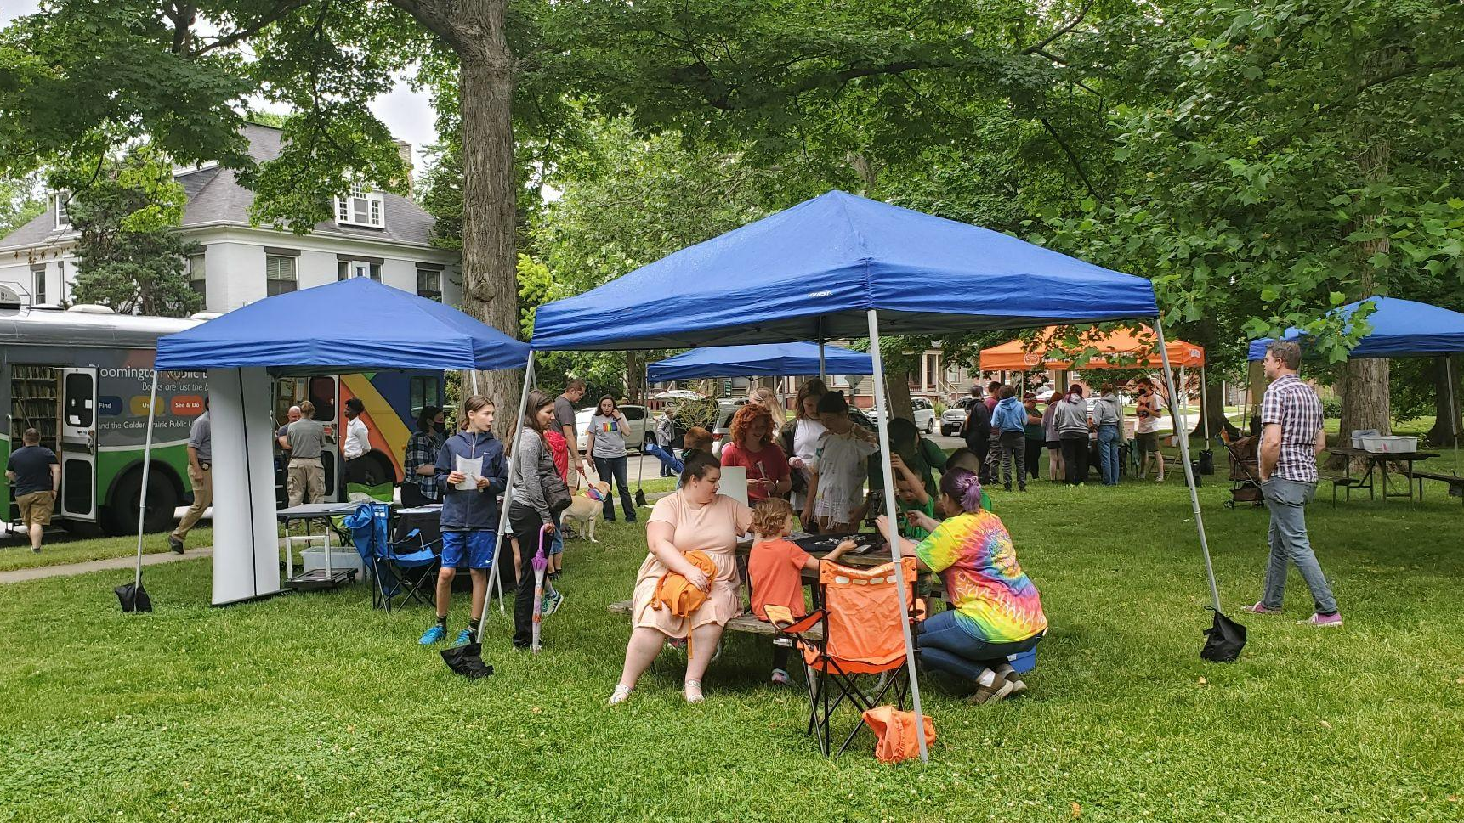
Team Up In Person!
Example:
We hosted a Pride in the Park event with our neighbors: Normal Public Library, Bloomington City Police, Illinois State University Police, PFLAG B-N, and Prairie Pride Coalition.
Example:
We co-hosted a beekeeping program with our neighbors at the Normal Public Library which led to 2 libraries sharing the information- we had good feedback and attendance.
Notes:
If you are an introvert like me this may be uncomfortable to hear but my best events have come about because I’ve made connections with colleagues at other libraries and also introduced myself to local organizations and asked to brainstorm about how we can work together :) Making friends! We never could have pulled off Pride in the Park alone. We reached out to our friends at NPL, and I had made connections with PFLAG B-N and Prairie Pride Coalition at an earlier community event. I asked if they would be interested in having an outdoor event at a bookmobile stop at a local park. They agreed and brought ISU police and Bloomington City Police as both of those departments had staff that wanted to participate. We had crafts, take and make pins, a story time, and swag/informational materials from all organizations involved. Later this summer we didn’t let our building construction keep us from offering in person programs, which our patrons were starting to request again. One of our librarians reached out to NPL and we co-hosted a beekeeping program at their library as a program that benefited both communities!

Slide 18
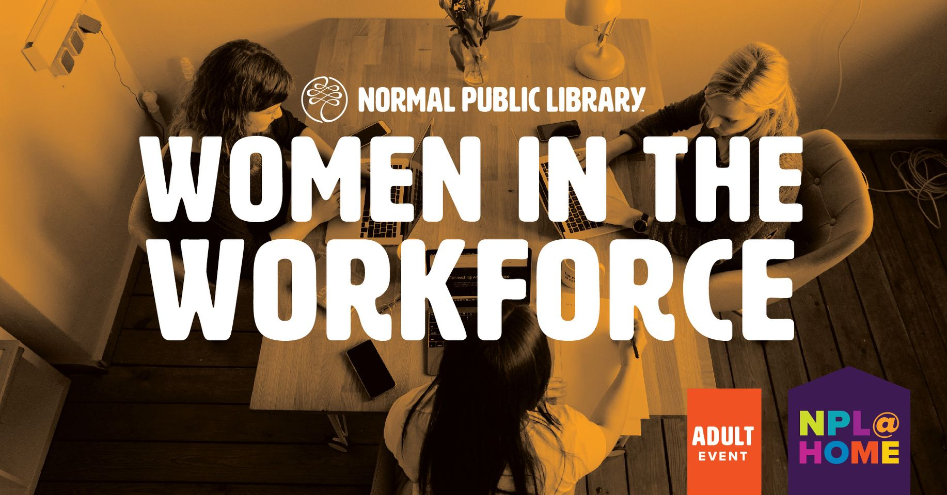
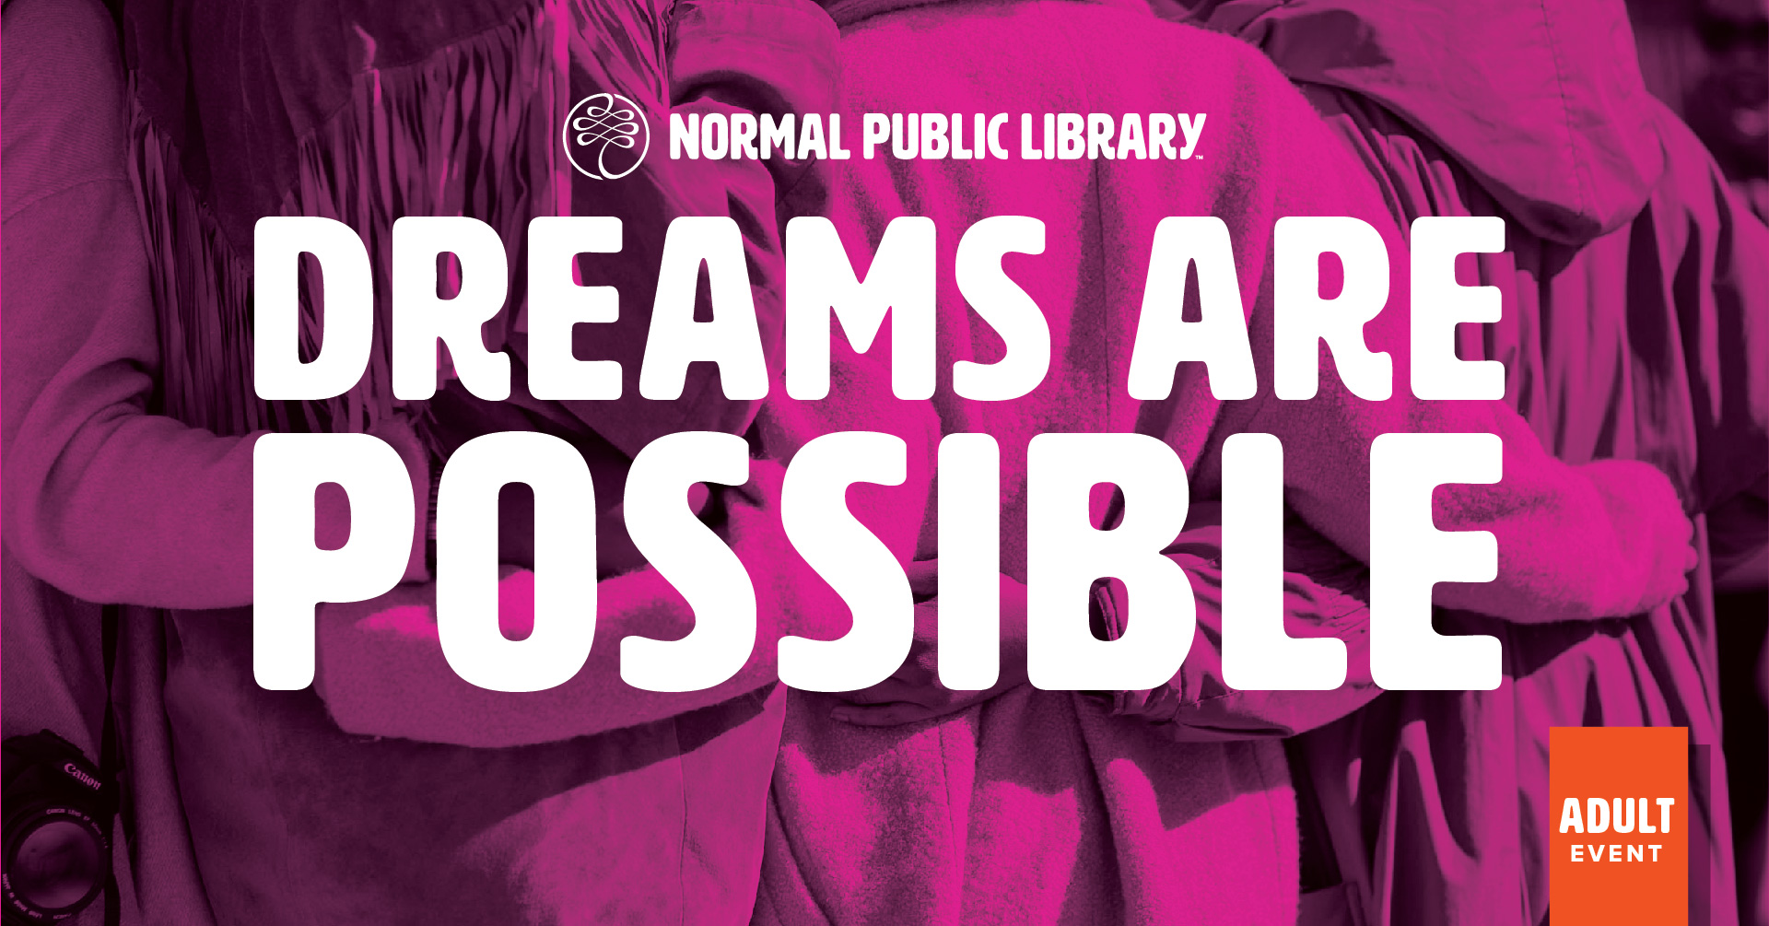
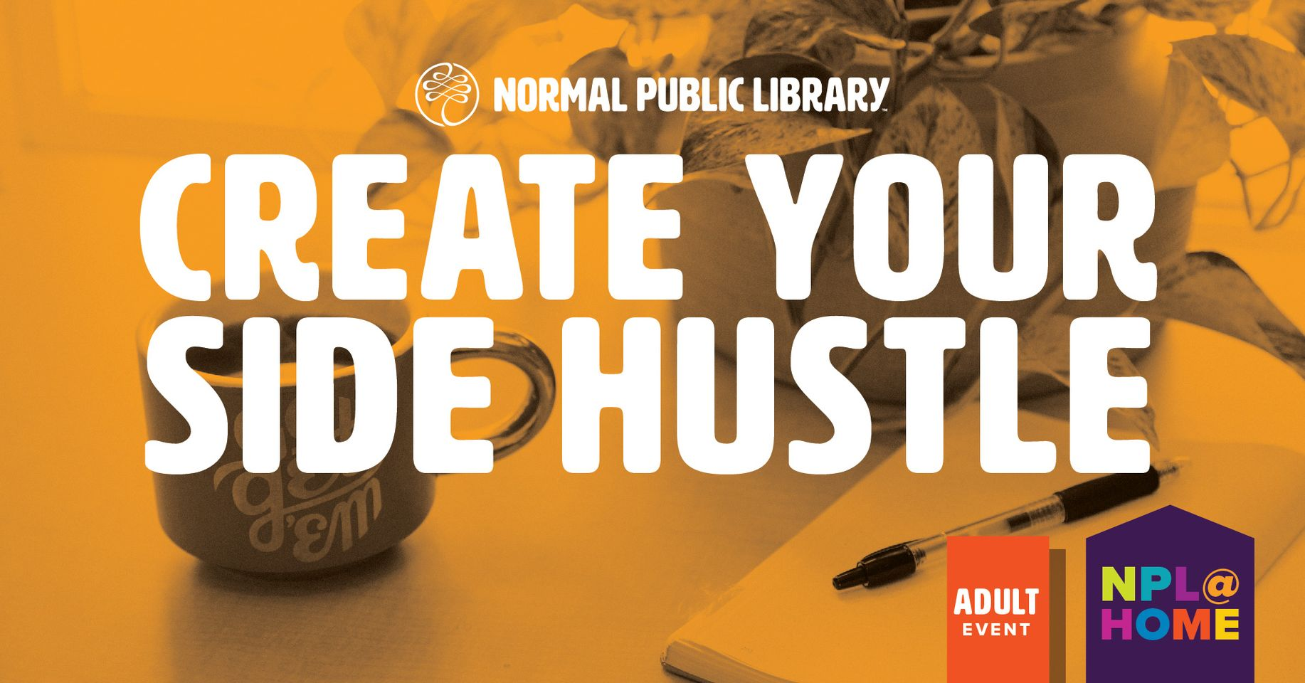
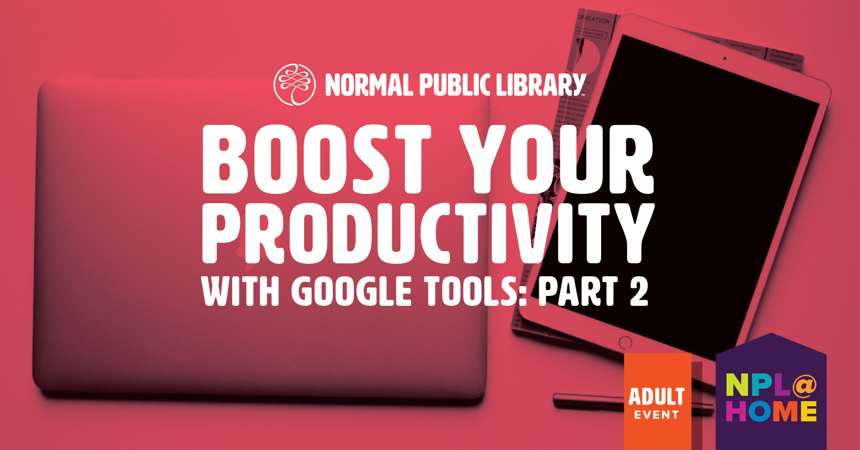
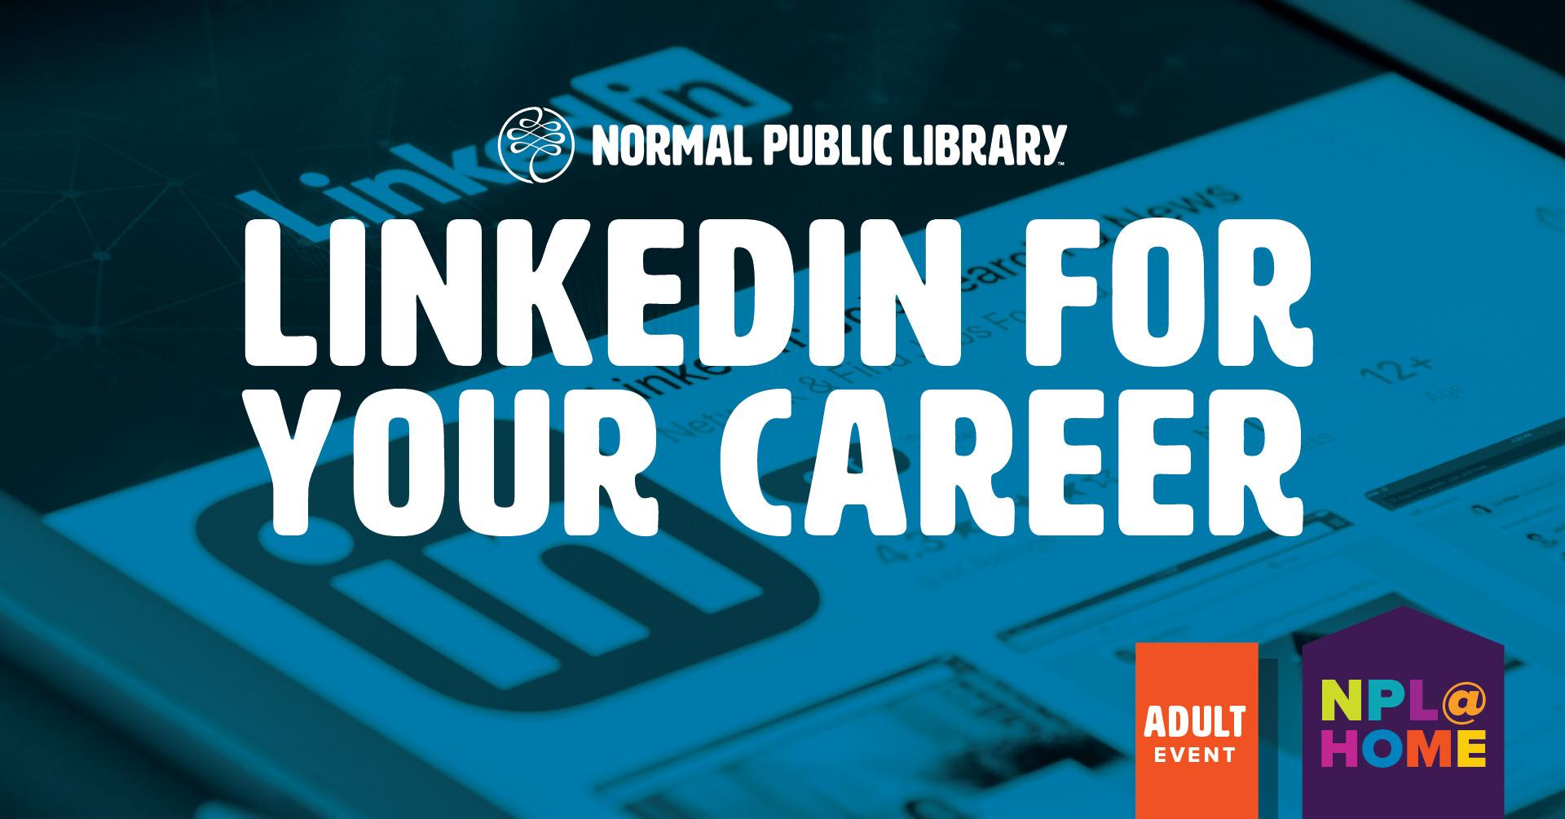
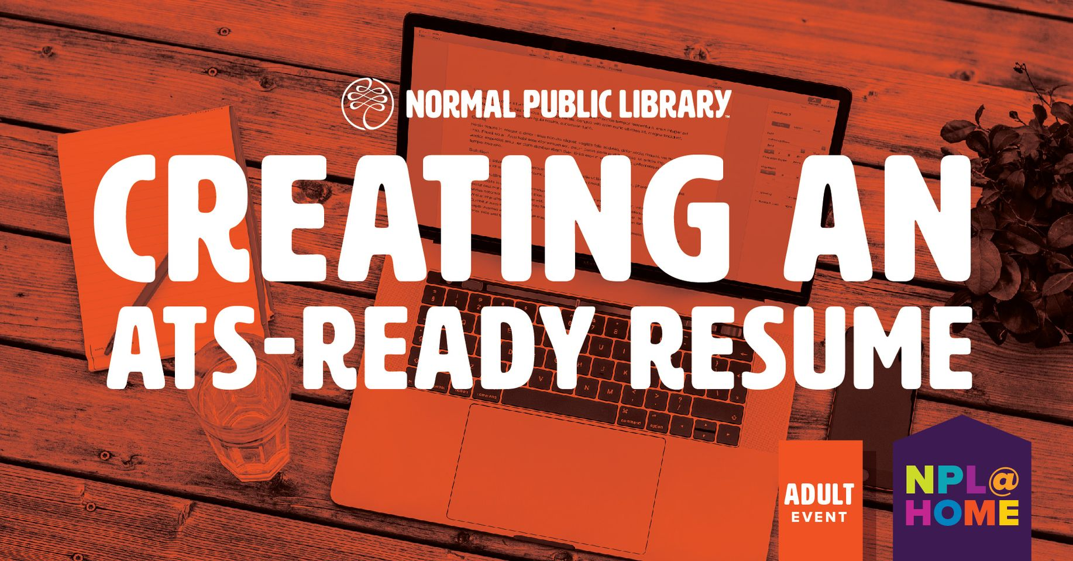
Notes:
New program, funded by a grant awarded by the Illinois State Library, using funds provided by the American Rescue Plan Act of 2021 (ARPA).
15 planned programs, 3/month for January-May 2022.
Three types of programs
Job search/career development programs from professional speakers. These were all presented virtually. The virtual format allowed me to book speakers from outside our area. Programs took place on weekday evenings and were well received.
Presentations from local groups like Dreams Are Possible (helps women retrain into higher paying jobs) and CareerLink (our local WorkNet center) about services they provide. Scheduled these as hybrid programs. Most attended virtually (for Dreams Are Possible, we canceled in-person because everyone had signed up for virtual).
Classes from library staff (me) on digital tools and skills related to employment/job searching. Presented virtually during the day.

Slide 19
Feedback on the Formats
For informational / lecture style programs, participants preferred virtual.
Praise for the evening time slots, as well as the virtual lunch and learns.
For more hands-on technology classes, participants would have preferred in-person instruction.
Notes:
For the virtual programs from outside presenters, very positive feedback. One survey respondent asked for more virtual career programs, particularly in the evenings.
For staff-led programs, received praise for the virtual lunch and learn format. It seemed to work well for more lecture-style programs, such as Free Online Learning Opportunities, LinkedIn, and ATS-Ready Resumes.
For staff-led programs that got more in-depth on digital products, like the Google Tools series, did receive feedback asking for more in-person technology classes once the pandemic has passed.
Don’t have these particular programs planned at the moment, but learned a lot about job/tech class formats for the future.
Many of these programs were done by library staff or by community partners for free, only cost is time and an institutional Zoom license.

Slide 20
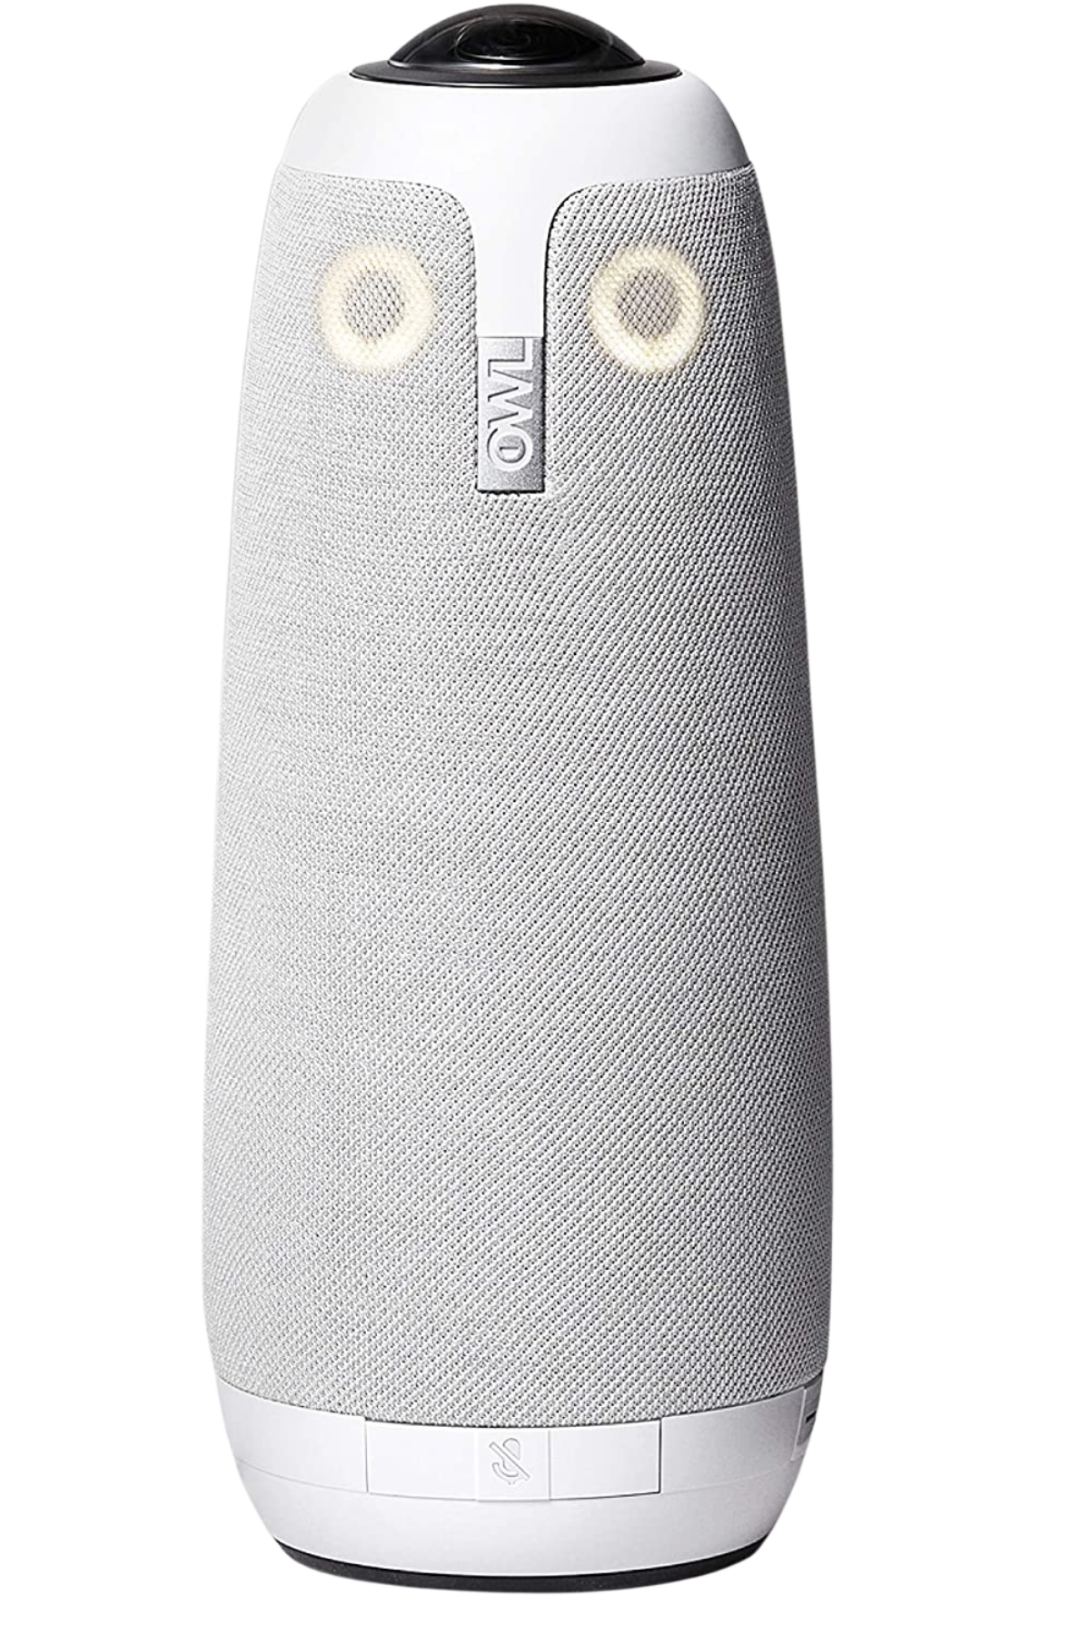
Lectures - clearing clutter, healthy eating, local history
Discussions - genealogy meetup, book clubs
Out of town participation
For most events, either in-person or virtual appears to work better, rather than both.
Discussion programs work well hybrid.
Hybrid Programs
Hybrid programming webinar series:
ALA Public Programs Office. (2022, May 4). Hybrid Programming Webinar Series. Programming Librarian. https://programminglibrarian.org/articles/hybrid-programming-webinar-series
Notes:
Purchased a Meeting Owl, began to use in January 2022.
Combination speaker, microphone and 360-degree camera, integrates with Zoom. Camera automatically follows person who is speaking, also has a presenter lock mode. More robust hybrid experience than a static camera.
Two types of programs
Lecture programs - Clearing Clutter in the New Year, Healthy Lifestyle That Lasts, History of McLean County
Discussion programs - Genealogy meetup, book discussions
Programs that were primarily attended online
Clearing clutter, healthy eating, career programs
For A History of New Philadelphia, we canceled the in-person component because almost all registrations were virtual, and the presenters would have been driving in. I used the Owl to create a hybrid program from our meeting room because people showed up at the library, not realizing the event was virtual (they had not registered).
Programs that were primarily attended in-person
Local history author writing A History of McLean County. He has a local following and people wanted to talk to him.
Programs that are attended by both
Genealogy meetup, book clubs
Virtual option allows people to join from further away.
For most events, one or the other seems to work better, and I have started planning accordingly.
For the discussion-format programs, hybrid seems to be working well and we are continuing with that.
If a Meeting Owl is not in your library’s budget, there are other options. Recommend checking out Programming Librarian webinar series on hybrid programs.

Slide 21
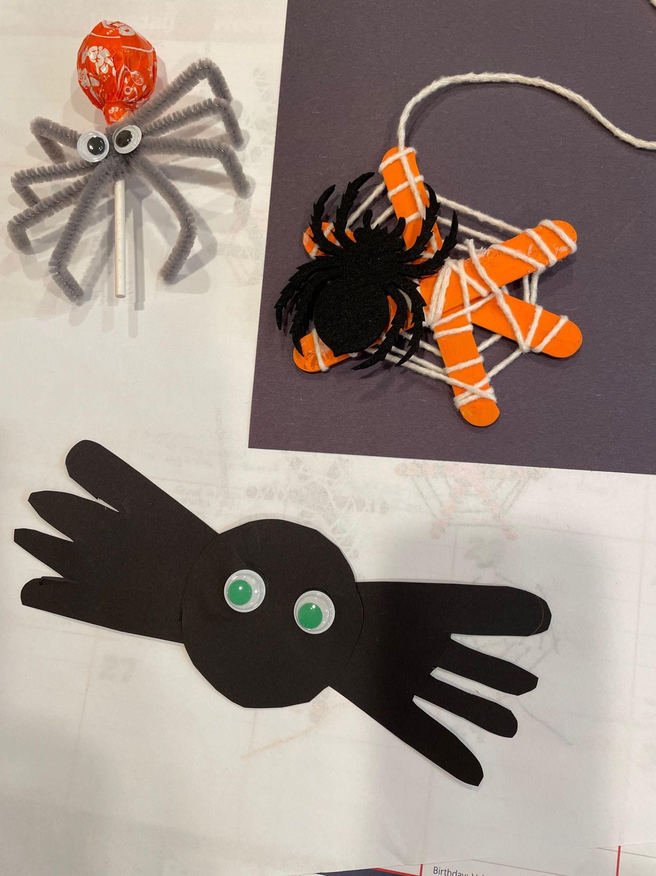
Changed it up:
Holiday celebrations
Halloween 2021
Party all day!
Set up activities throughout the library
Take and make crafts
Individually wrapped treats
So popular that we continue to use this model for holiday celebrations!

Slide 22
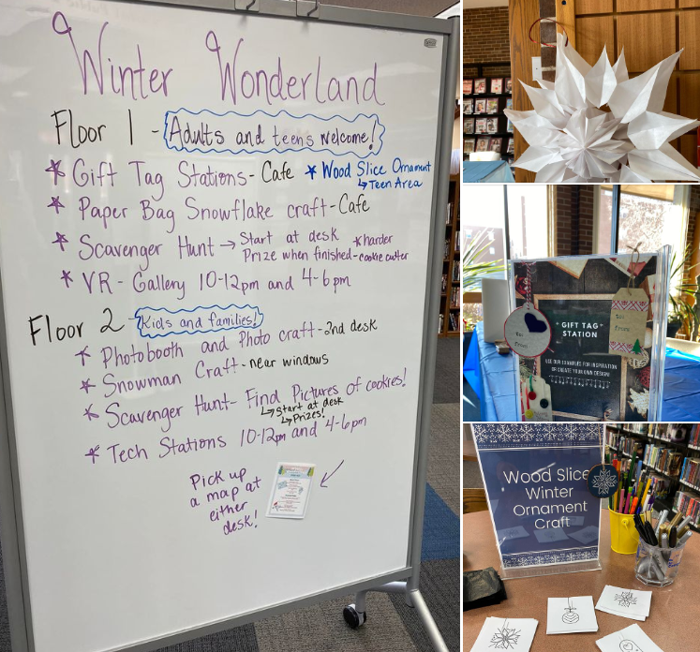
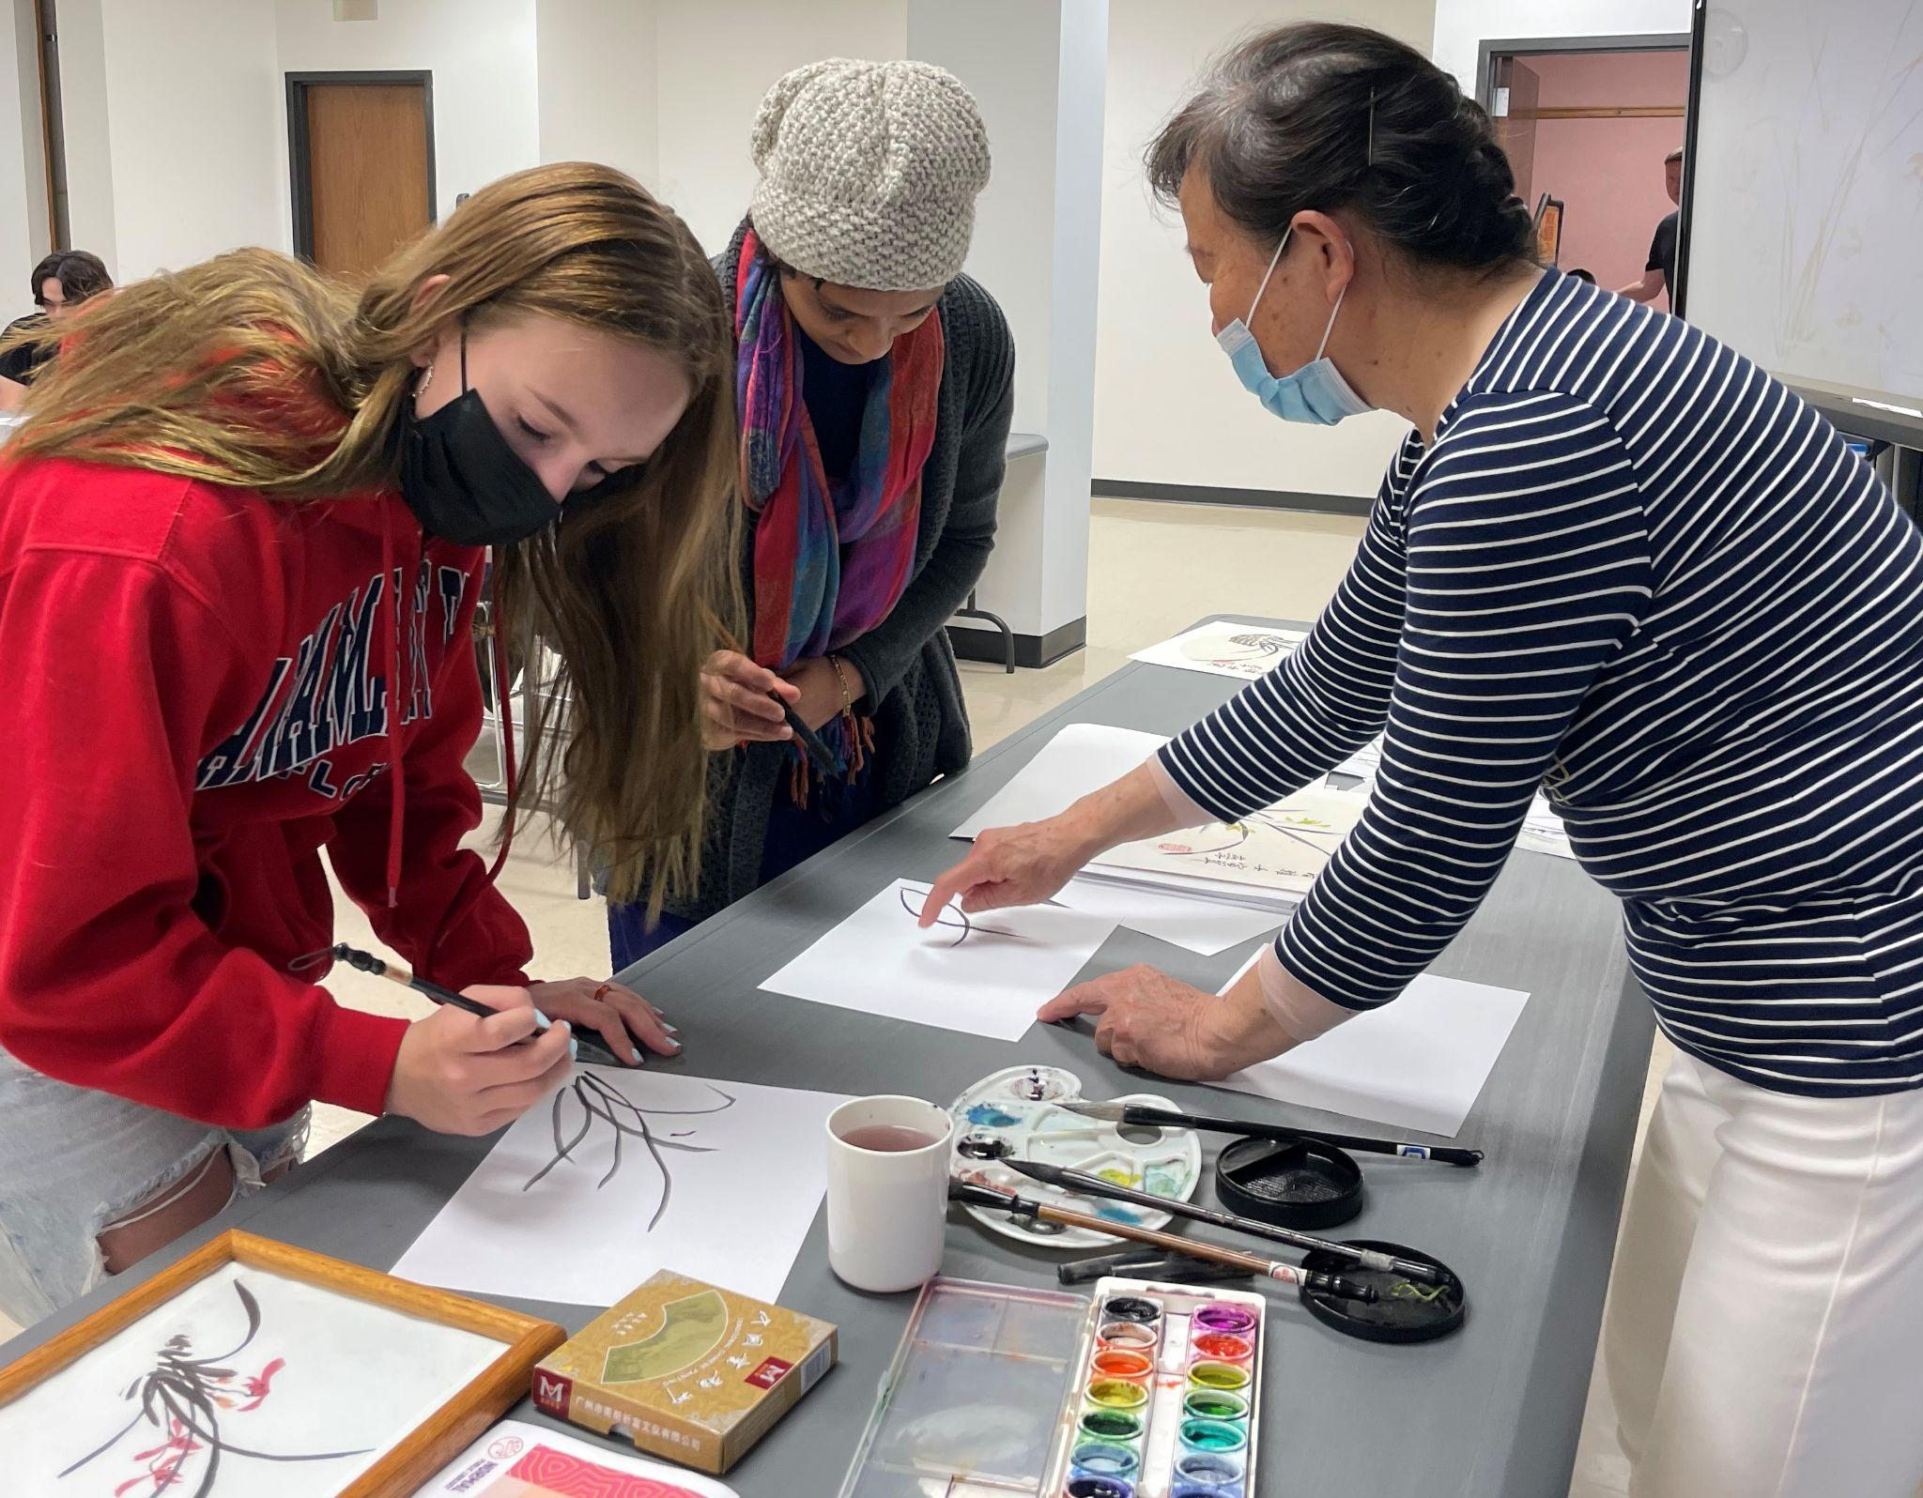
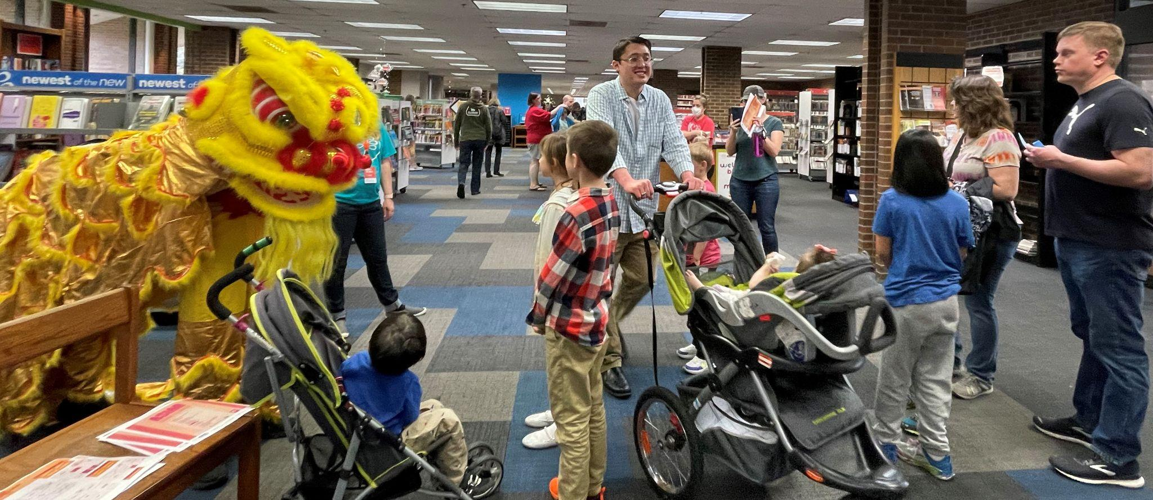
Library Wide
All ages
Throughout the library
Staffing
Longer time periods
Seasonal
Cultural Events
Winter Wonderland, Hearts and Crafts, Asian Heritage Festival, El día de los libros
Notes:
Library wide programming
Pre pandemic we did little library wide programming. In looking to bring patrons back into our building, we were looking for a way to create community and to keep crowds low. In order to do this we planned library wide activities. We took advantage of all of the different spaces available. Patrons participated in crafts stations, VR stations, a seek and find, and were able to collect prizes throughout the day. We rolled this model out for winter in a program called, Winter Wonderland and continued on through the seasons with Hearts and Crafts in February and Staycation in March. Additionally we realized this model opened up possibilities to host not just seasonal programs but also larger cultural programs. We have expanded those offerings to include all ages. Examples of this include our Asian Heritage Celebration and Dia de los Libros. All of these programs saw a wide range of ages and everyone was able to participate in some way throughout the day. Some patrons stayed all day, while others popped in and out. The success of this model was that it could be modified so easily for any theme.

Slide 23
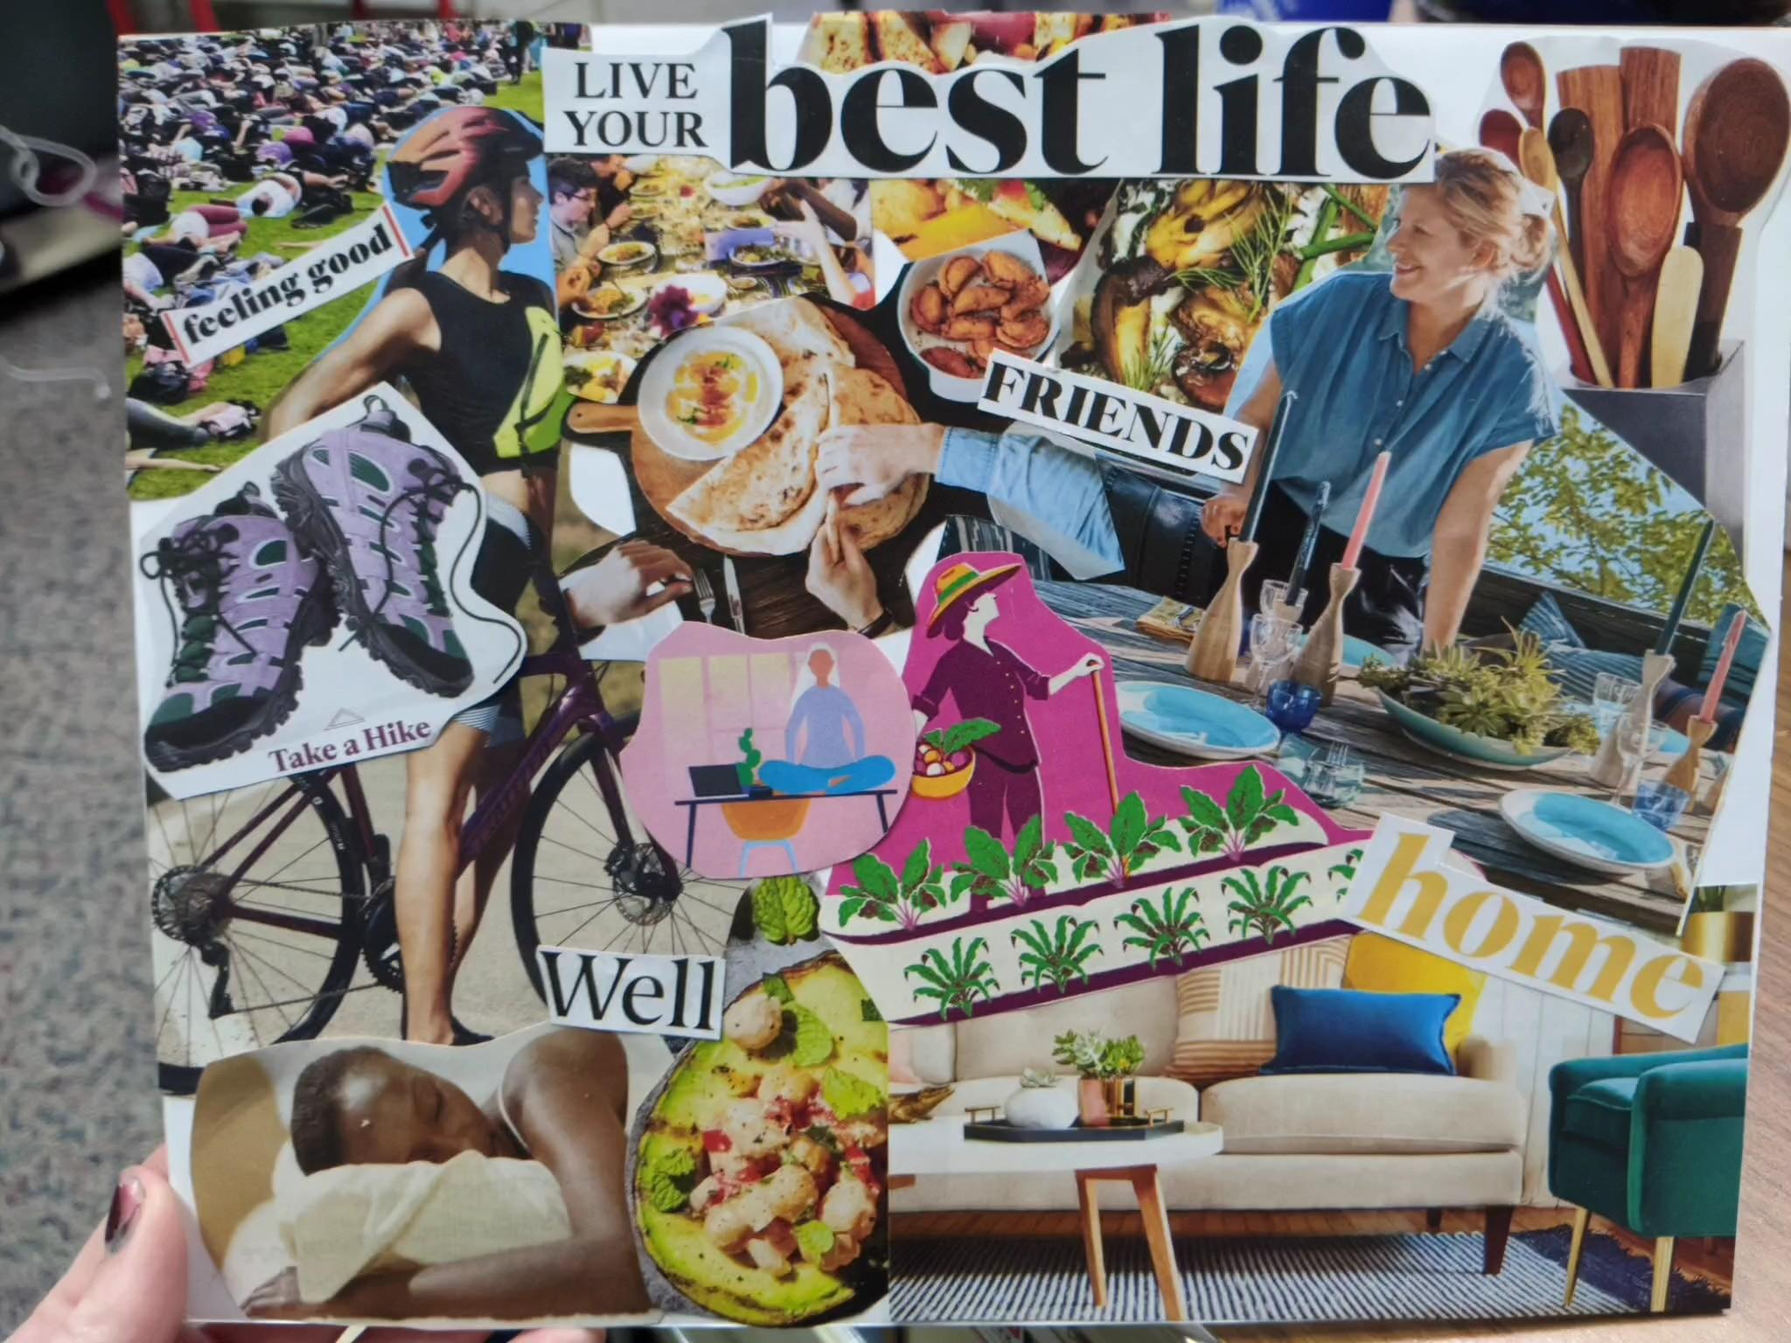
Drop-In & Passive Programs
Drop-In VR
Pronoun Pins
Vision Boards
Notes:
Something most of us were doing pre-pandemic, but expanding these has made a lot of sense. The expanded time frames work well for a variety of schedules, allow people to choose times when they are not around as many other people.
Allow for serendipity - I typically run these in very public areas of the library, like our cafe, which is near the front desk. People drop in who did not know a program was taking place.
VR
Did similar programs pre-pandemic.
Ran a drop-in program for AAPI Heritage Month on Asian American History.
Pronoun Pins
Drop-in, very popular
Vision Boards
Passive - just left supplies out all day, tidied up occasionally.
These programs work particularly well for times like December, when schedules are very busy and people are less likely to come to the library for a synchronous program (and staff have less time and energy to execute a program).
Passive and drop-in programs can be done at any budget.

Slide 24
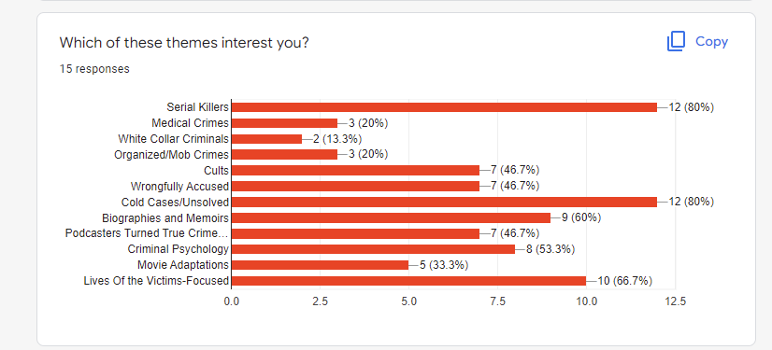
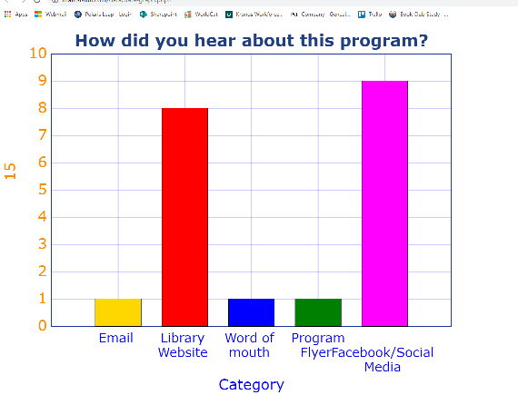
Survey Your Virtual Attendees
Tip:
Use Google Forms to create surveys for your virtual participants
Reward!

Slide 25
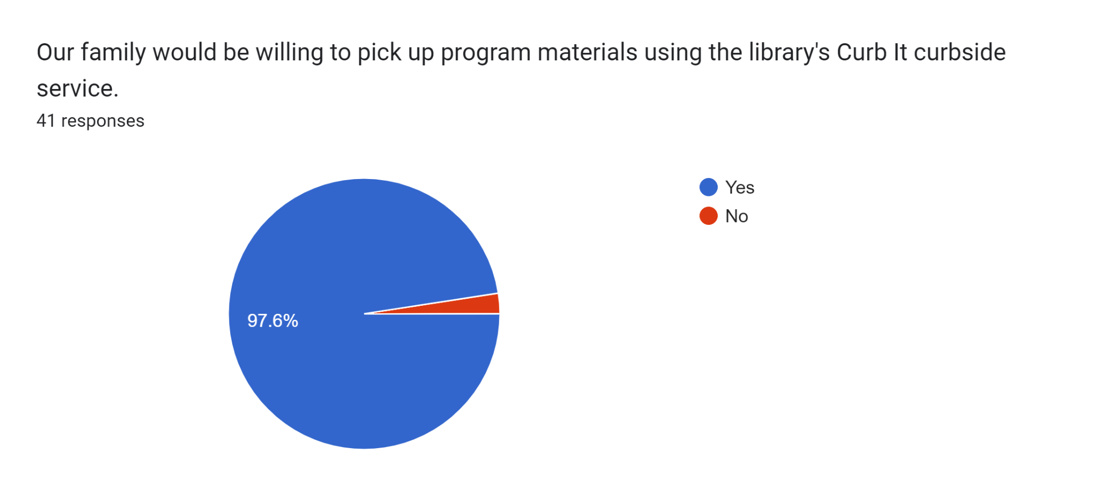
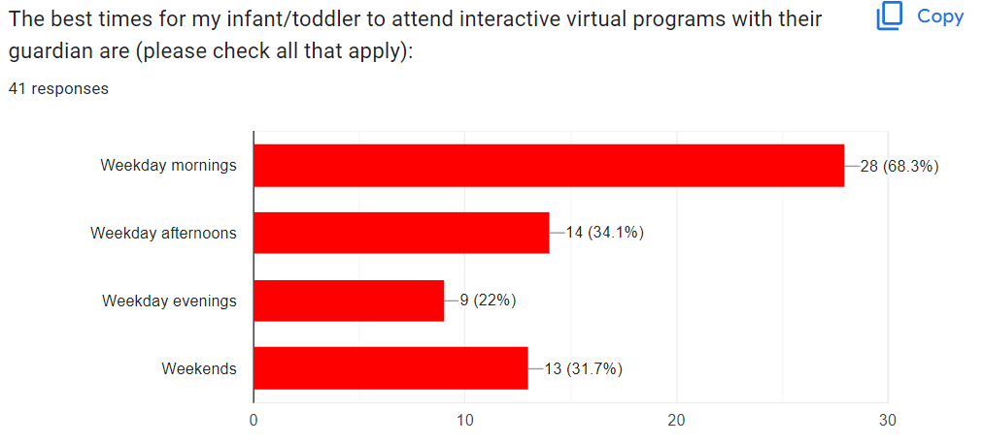
Survey Says…
.
Notes:
Fall Programs Survey

Slide 26
Our Conclusions
and Your Questions
Lyndsey Carney - Normal Public Library, lcarney@normalpl.org
Mimi Davis - Bloomington Public Library, mimid@bloomingtonlibrary.org
Christie Lau - Carlock Public Library District, carlocklib@yahoo.com
Rhiannon Shoults - Normal Public Library, rhiannon@normalpl.org
Notes:
The reason why there is no simple matrix or formula for determining what should be in-person, virtual, hybrid, etc. is that every community is different. What works in one library does not necessarily work in another. I changed libraries during the pandemic and the level of interest in virtual programs varied greatly from one community to the other, for instance.
We are open for questions, and our email addresses are listed there on the slide, so you can contact us individually.

