Slide 1
Presenting Early Literacy Programming with a Culturally Aware and Inclusive Lens
Katie Clausen
Sophie Kenney
Notes:
Intro- both KC and SK

Slide 2
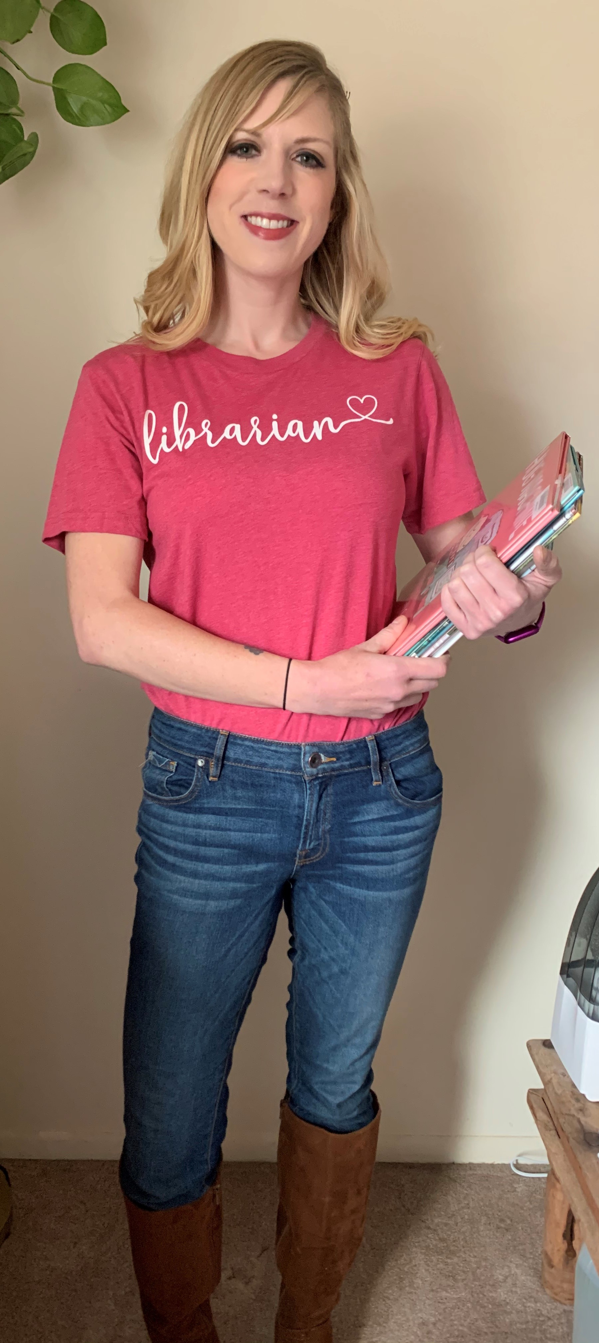
Introductions
Katie Clausen
Sophie Kenney
Early Literacy Services Manager
Gail Borden Public Library
Youth Department Assistant Director
Glen Ellyn Public Library
Notes:
Both KC and SK

Slide 3
Overview
Acknowledgements
Learning Outcomes
General Best Practices
Presenting Outside Your Lived Experience
Supporting Inclusivity Through Planning
Resources
Notes:
KC

Slide 4
Acknowledgements
Land Acknowledgement
The Glen Ellyn Public Library is grateful for its place in the Village of Glen Ellyn and the land we are able to inhabit. We acknowledge the peoples who were here long before the village was formed: the Ojibwe, Odawa, and Potawatomi who are also known as the Council of Three Fires. Others such as the Očhéthi Šakówiŋ, Kickapoo, Peoria, Miami, Sauk, Fox, and Illinois also settled on and moved through this land.
The Gail Borden Public Library is grateful for its place in Elgin, Illinois and the land we are able to inhabit. We acknowledge the peoples who were here long before the city was formed: the Bodwéwadmi, Myaamia, Očhéthi Šakówiŋ, Hoocąk, and Kiikaapoi settled on and moved through this land.
Presenting Early Literacy Programming with a Culturally Aware and Inclusive Lens, Clausen & Kenney 2022

Slide 5
Growth Mindset
Reframe your perspective
How do you recognize bias?
What do you with this knowledge?
How does my bias impact our interactions with young people and their families?
Is my bias impacting outcomes for the community I serve?
Presenting Early Literacy Programming with a Culturally Aware and Inclusive Lens, Clausen & Kenney 2022

Slide 6
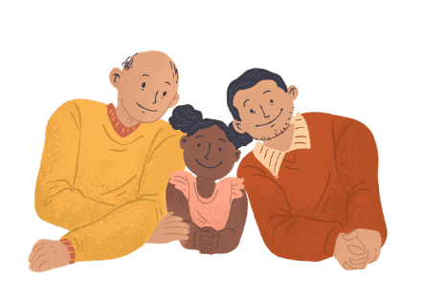
Learning Outcomes
Identify and implement best practices for delivering culturally aware and inclusive storytimes
Self-awareness. Understanding your own implicit bias to respect lived experiences to avoid stereotypes
Learn strategies to collaborate with your community to build authentic connection
Notes:
Both SK and KC

Slide 7
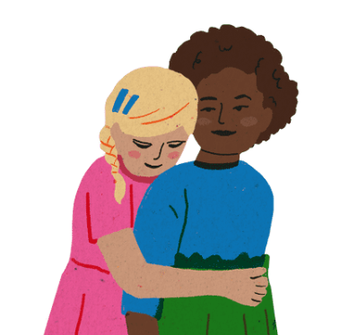
Best Practices for All Presenters
1. Recognize your power
Presenting Early Literacy Programming with a Culturally Aware and Inclusive Lens, Clausen & Kenney 2022
Notes:
SK

Slide 8
Best Practices for All Presenters
2. Celebrate—not tokenize—a culture
Notes:
KC

Slide 9
Best Practices for All Presenters
3. Use "I" Statements
Notes:
KC

Slide 10
4. Use Neutral Language
Use
Friends
Preschoolers
"One-year-olds, "Two-year-olds"
Grown-ups
Caregivers
Folks
Kiddos
Everyone
Ask about name pronunciations
Avoid
Girls & Boys
Parents
Grandparents
Specifically pointing kids out

Slide 11
5. Steer clear of assumptions
Gender
Culture
Disability
Family Structure
Generalizations

Slide 12
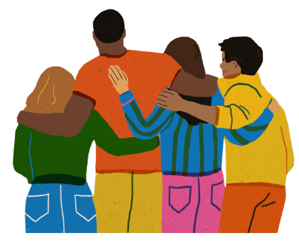
Presenting Outside Your Lived Experience
State the facts of who you are
Don't purposefully avoid books; intentionally include
Admit your mistakes
Ask for clarifications when appropriate
Be aware of cultural appropriation & cultural tourism
Notes:
KC

Slide 13
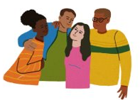
Presenting Outside Your Lived Experience
Avoid songs with racist histories
Share why being anti-racist and inclusive matters
Recognizing and portraying everyday diversity
Be okay with not having answers to questions
Partner with others

Slide 14
Supporting Inclusivity With Intentional Planning
Staff Buy-In
Ongoing Training
Utilizing Existing Staff
Community Partnerships
Equitable Scheduling and Locations
Notes:
SK

Slide 15
Supporting Inclusivity With Intentional Planning
Staff Buy-In
Providing the "why"
Community demographics
Collection support
Personal connections
Library culture or vision statement
Audits and Goals
Evaluations
Notes:
SK

Slide 16
Supporting Inclusivity With Intentional Planning
Ongoing training
Regular training for existing presenters
Make including diverse materials foundational in training new presenters
Attend networking meetings to learn about new books, songs, rhymes
Keep a running list that can be filtered, searched
Notes:
SK

Slide 17
Supporting Inclusivity With Intentional Planning
Utilizing diverse staff
Find interested staff who have the capacity to help present
Doesn't have to be the entire program, they can be a featured presenter
Let them have agency in choosing the material they present
Notes:
SK

Slide 18
Supporting Inclusivity With Intentional Planning
Community Partnerships
Build relationships with community organizations to meet mutually beneficial outcomes
Provides authentic representation and increases the awareness of library and programs
Expand to include nontraditional partners
Notes:
SK

Slide 19
Supporting Inclusivity With Intentional Planning
Equity in scheduling and locations
Provide evening and weekend programs to accommodate different schedules
Provide programming in venues/locations that meet underserved communities where they are
Promote events through authentic channels
Provide programming in native languages
Notes:
SK

Slide 20
Resources
Project Ready
Embrace Race
Teaching for Change
Learning for Justice
Let's Talk About Race in Storytime by Jessica Bratt
Clint Smith
Jason Reynolds
Presenting Early Literacy Programming with a Culturally Aware and Inclusive Lens, Clausen & Kenney 2022

Slide 21
Thank you!
Katie Clausen
kclausen@gailborden.info
847-608-5205
Sophie Kenney
Skenney@gepl.org
Sophiekenney09@gmail.com

