Slide 1
Let’s Talk:
Creating Community Conversations
Presented by Summer Kosuge and Caitlyn Hannon

Slide 2
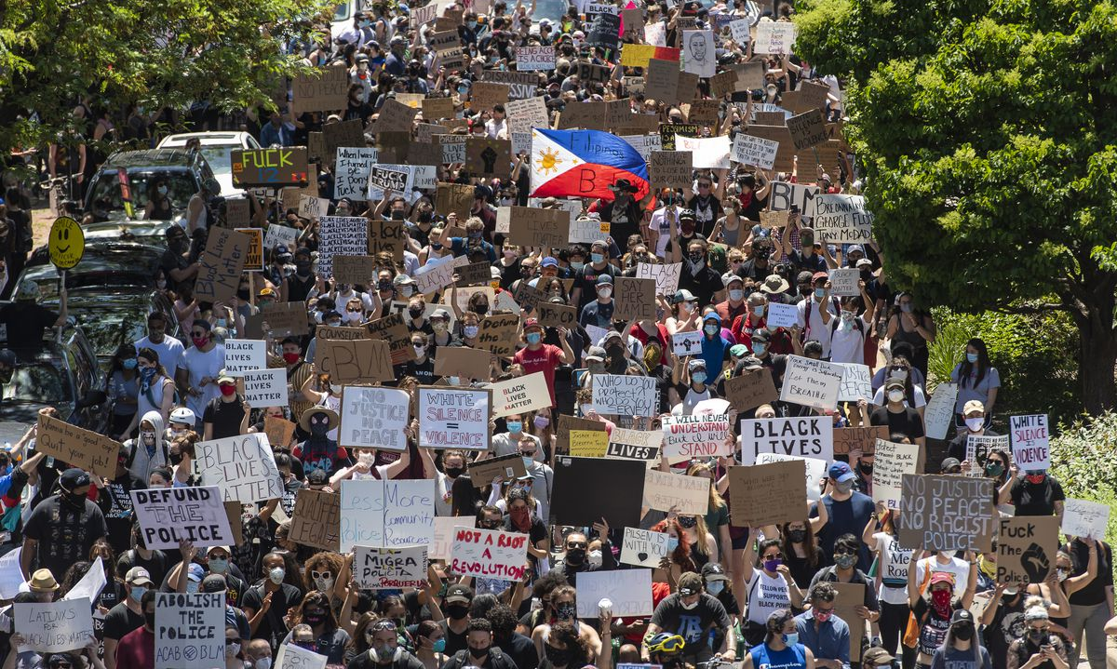
HOW IT STARTED
Associated Press, Photographer Nam Y. Huh, June 6, 2020

Slide 3
COMMITTEE STRUCTURE
STEERING WORKGROUP
CHARGE: Oversee the direction, projects, progress, and communication with the staff, community, and various stakeholders.
STAFF TRAINING WORKGROUP
CHARGE: Develop and implement staff focused initiatives, training, and learning to ensure a welcoming, diverse, and equitable library.
PROGRAMMING WORKGROUP
CHARGE: Develop and implement patron facing programs and initiatives to promote learning around equity, diversity, and inclusion in the community of Northbrook.

Slide 4
Let’s Talk
Need to address racism by having the hard conversations
Create conversation-based program series
Invite speakers from different backgrounds to discuss pertinent topics related to structural inequality, racism, bias, and other personal experiences

Slide 5
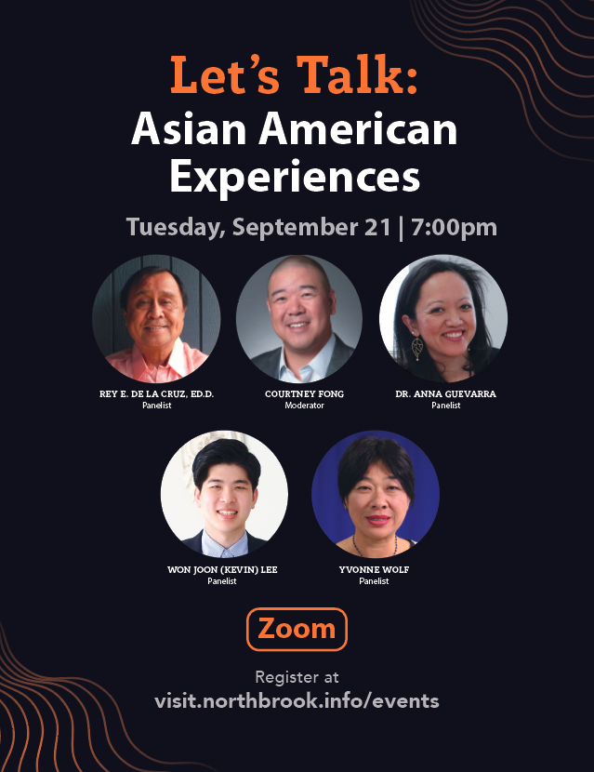
Completed “Let’s Talk” Programs
Asian American Experiences in the U.S.
Understanding Gender Identity
Understanding the Border Crisis
Black American Experiences

Slide 6
5 Aspects of Hosting an EDI Panel Discussion
Pick the discussion topic
Create a planning timeline and budget
Structure the panel
Evaluate the discussion questions
Program planning challenges

Slide 7
Pick the Discussion Topic
Largely influenced by requests from our community and timely events
“Asian American Experiences”- rise in hate crimes against Asian Americans during the pandemic
“Gender Identity”- feedback from teen patrons requesting more info

Slide 8
Create a Planning Timeline and Budget
Usually takes 4 to 6 months to fully plan
Need to work within library’s newsletter deadline
The further in advance speakers can be booked, the better
Honorarium for panelists

Slide 9
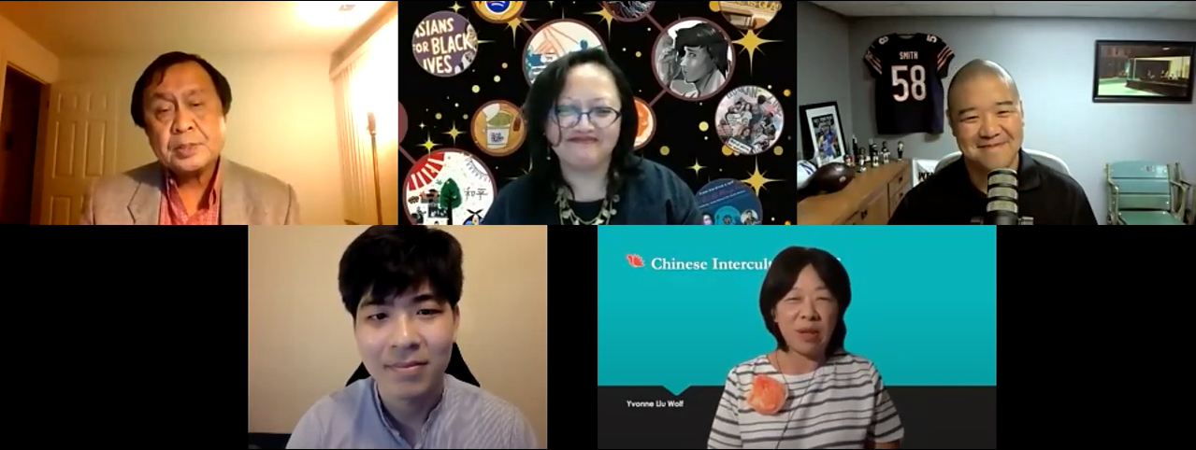
Structure the Panel
Originally decided to have 4 speakers and 1 moderator, but now vary the conversation formats
Finding speakers:
Community recommendations
Asking speakers for suggestions
Past library program presenters
Universities, local organizations
Online research

Slide 10
Evaluate the Discussion Questions
Want panel discussion to be diverse and representative of subject matter being covered
Have person/people leading the discussion craft the questions
Encourage people attending to submit questions

Slide 12
Program Planning Challenges
Finding speakers
Inflammatory comments from audience
Pushback from people outside the library
Too political?

Slide 13
CHANGES
Northbrook Public Library, All Are Welcome Mural, Artist Bonnie Lecat

Slide 14
Questions
Caitlyn Hannon: channon@northbrook.info
Summer Kosuge: skosuge@northbrook.info

