Slide 1
Building, Marketing, and Promoting Diverse Collections
Robin Bradford
October 18th 2022
Illinois Library Association

Slide 2
Being Anti-Racist means…
“No one is born racist or antiracist; these result from the choices we make. Being antiracist results from a conscious decision to make frequent, consistent, equitable choices daily. These choices require ongoing self-awareness and self-reflection as we move through life. In the absence of making antiracist choices, we (un)consciously uphold aspects of white supremacy, white-dominant culture, and unequal institutions and society. Being racist or antiracist is not about who you are; it is about what you do.”
National Museum of African American History & Culture

Slide 3
Windows, Mirrors, Sliding Glass Doors
“Books are sometimes windows, offering views of worlds that may be real or imagined, familiar or strange. These windows are also sliding glass doors, and readers have only to walk through in imagination to become part of whatever world has been created and recreated by the author. When lighting conditions are just right, however, a window can also be a mirror. Literature transforms human experience and reflects it back to us, and in that reflection, we can see our own lives and experiences as part of the larger human experience.”
Dr. Rudine Sims Bishop

Slide 4
Listen and Think
Whose voice are we missing in the collection?
How do I increase those voices?
Not every problem has a correct answer
Some issues just need to be kept in mind, even if there is no immediate solution to them.

Slide 5
Old stories

Slide 6
New Life

Slide 7
But what happens if it fails?
Allow
Allow for a disconnect – not everything will be a success.
Let
Let the thing that is unsuccessful stand on its own.
Don’t impute
Don’t impute failure to everything that might share ethnic or cultural similarities

Slide 8
Mechanics

Slide 9
The Ground Rules
You will never be caught up
You must be curious
You must be adaptable
You will make mistakes
It won’t get done unless you do it
Your job is to open the floodgates, not be a gatekeeper

Slide 10
Discoverability
Where are you looking for materials?
Are you only looking at what is shown to you, or do you go out looking for other items?
Melanin in YA
LGBTQ Reads
#RomanceClass
Crime Writers of Color
You have to go look for the books
Sometimes, the best sites go away. Constant searching.
We Need Diverse Books

Slide 11
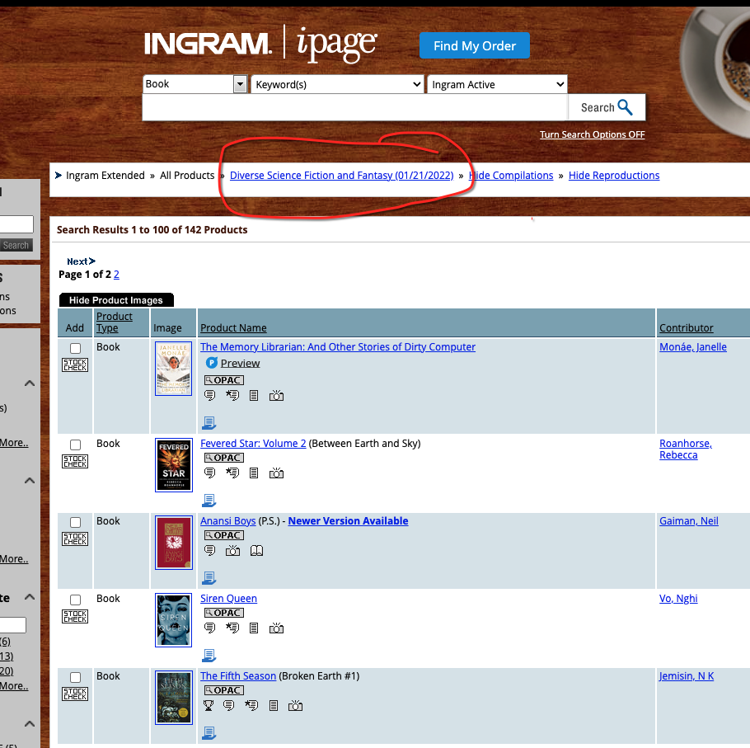
Use the tools
Vendors want your money
Let them help you help yourself

Slide 12
Another major vendor tool

Slide 13
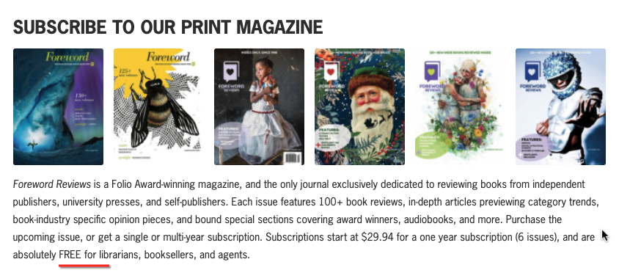
Did somebody say FREE?
Forward Reviews

Slide 14
Sidebar about reviews…
Think about why you’re using them. Is it discoverability or gatekeeping?
Think about whether you’re using them equitably. Are there things you buy even without reviews?
Think about who is choosing what gets reviewed and whether that should be a bar to entry to the collection.
Think about who is doing the reviewing and whether that should be a bar to entry to the collection.
Think about who you’re buying for and whether a review, or lack thereof, should be a bar to the collection.

Slide 15
Edelweiss as selection tool

Slide 16
Edelweiss 2

Slide 17
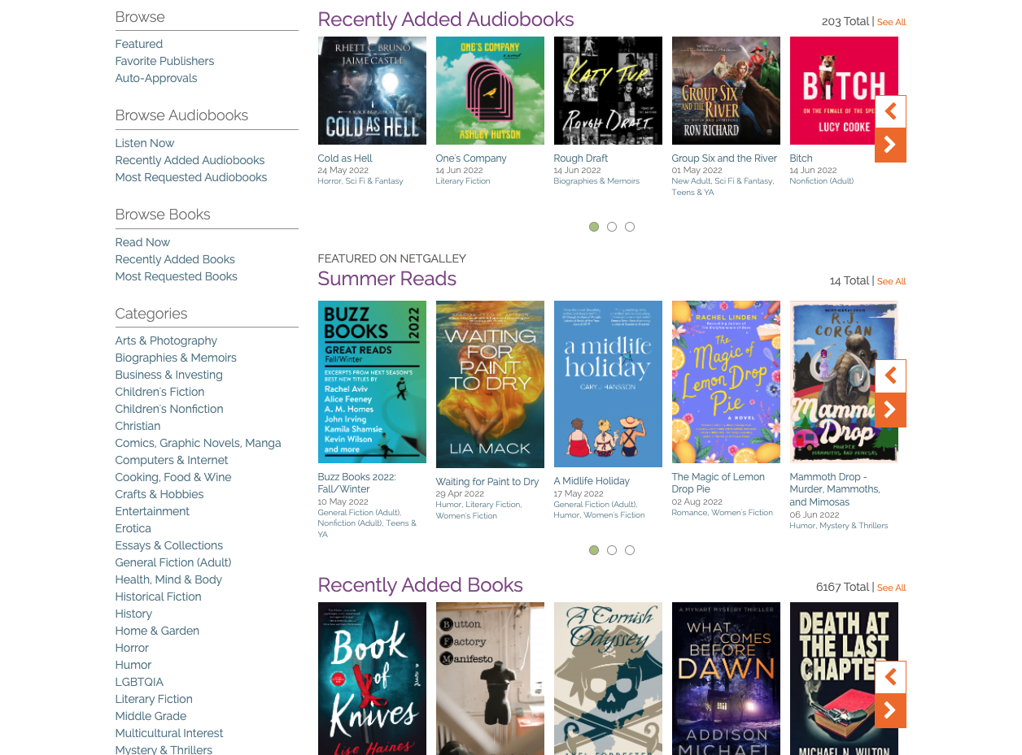

Slide 18
A quick word about purchasing

Slide 19
The NEW OVERNIGHT SENSATION!

Slide 20
But only after a lot of work

Slide 21
I know it exists…

Slide 22
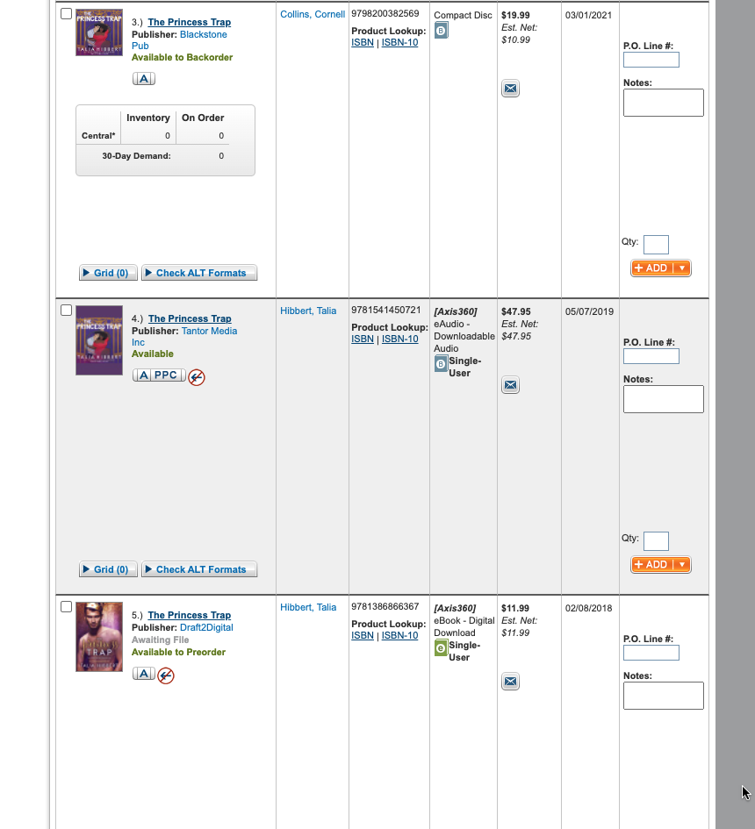
But does it?

Slide 23
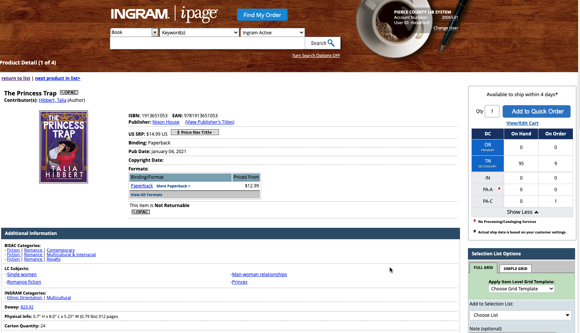
Success!

Slide 24
Promotion and Marketing
Or…I bought it, now what?

Slide 25
We have the books, now what?
Don’t ignore the items you just added to the collection.
1
Remember them for displays and lists and every other way you market your collection.
2
Remember that books have many entry points, so it is much easier to celebrate them than we think.
3

Slide 26
If your patrons love former police officers turned private investigators like the Elvis Cole/Joe Pike series…

Slide 27
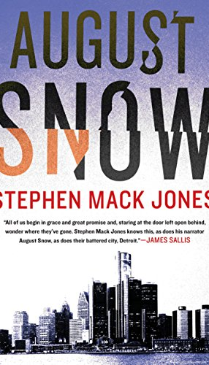
They might also enjoy…

Slide 28
Not just for Pride month
You don’t have to wait until June to feature books with LGBTQ+ characters and/or authors.
Yes, trans inclusive, non-binary author
Spaceships/Generational Ships
Echoes of Antebellum South/Slavery
Even some similarities to the show Snowpiercer.

Slide 29
Generational Ship Stories

Slide 30
Decolonize your thinking
Don’t limit your diverse books to subjects you think diverse people should be experts in.
Promote for the subject of the book the way you promote for author identity.
This doesn’t mean stop buying books about racism, sociology, civil rights, and BIPOC history.
This isn’t an Either/Or proposition, it’s a Both/And proposition.

Slide 31
We absolutely still need

Slide 32
Physics

Slide 33
Personal Finance

Slide 34
Sewing

Slide 35
Adventure

Slide 36
Yoga

Slide 37
Read!
You clearly don’t have to read every book but reading widely is very beneficial.
If you’re not reading more books, read more things ABOUT books so you have more to know about and to offer – even if it’s something you don’t have in your collection.

Slide 38
YOU are the valuable commodity
Books may be the picture, but you and your skills and knowledge are the frame.
Without you, none of this works on any level
Diverse books exist and have existed for years. YOU are the bridge that gets them in to patron hands. Buy them, read them, recommend them, and your patrons will do the same.

Slide 39
Thank you!
Reach out with more questions
Email: robin.bradford@gmail.com
Twitter: @tuphlos

