Slide 1
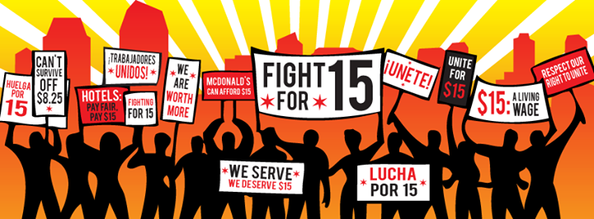
By the Numbers:
Explaining the Minimum Wage Increase
Ryan A. Franklin
Illinois State Library
Michael Baumann
Toulon Public Library

Slide 2
Employee Portion
Gross Pay
Wage per hour or
Salary
Benefits / Requirements
Various
Net
Pay
Take home after benefits are deducted from the gross amount
Employee Benefits and Requirements
  Federal Tax
  State Tax
  FDIC
  Medical
  Retirement
  Union
  etc

Slide 3
Employer Portion
Gross Pay
Wage per hour or
Salary
Required
Employer Portion
FDIC 7.65 % Currently
Benefits Employer Portion
Retirement
Federal Unemployment 6%
State Unemployment 3.175%*
Health
Other
Payroll per person
Total of everything above
Vacation and Sick Days
* State unemployment rate various by business type, how long in business, number of employees, etc.

Slide 4

Current Employee Example
Employee Work Schedule
Employee Title | Part Time
Minimum Wage | $8.25
Hours Worked per week | 20
Weeks in the year | 52
Total Wage (gross) | $8,580.00
Employer Portions
FICA Rate: 7.65% | $656.37
Fed. Unemployment: 6% | $514.80
State unemployment 3.175% | $1.65
Total Employer Portion | $1,172.82
Total funds from Library budget | $9,752.82
Other Added Benefits
Retirement (varies) (EX 10%) | $0.00
Health (Varies, Normally flat fee for single another for family) (EX $300 S, $1000Family) | $0
Total Funds From LB 2 | $9,752.82

Slide 5




Current Staff Example
Employee Work Schedule
Employee Title | Part Time |  | Full Time |  | Longevity/Level |  | Director
Minimum Wage | $8.25 |  | $8.25 |  | $11.00 |  | $20.00
Hours Worked per week | 20 |  | 40 |  | 40 |  | 40
Weeks in the year | 52 |  | 52 |  | 52 |  | 52
Total Wage (gross) | $8,580.00 |  | $17,160.00 |  | $22,880.00 |  | $41,600.00
Employer Portions
FICA Rate: 7.65% | $656.37 |  | $1,312.74 |  | $1,750.32 |  | $3,182.40
Fed. Unemployment: 6% | $514.80 |  | $1,029.60 |  | $1,372.80 |  | $2,496.00
State unemployment 3.175% | $1.65 |  | $1.65 |  | $1.65 |  | $1.65
Total Employer Portion | $1,172.82 |  | $2,343.99 |  | $3,124.77 |  | $5,680.05
Total funds from Library budget | $9,752.82 |  | $19,503.99 |  | $26,004.77 |  | $47,280.05
Other Added Benefits
Retirement (varies) (EX 10%) | $0.00 |  | $1,716.00 |  | $2,288.00 |  | $4,160.00
Health (Varies, Normally flat fee for single another for family) (EX $300 S, $1000Family a month) | $0 |  | $12,000 |  | $12,000 |  | $12,000
Total Funds From LB 2 | $9,752.82 |  | $33,219.99 |  | $40,292.77 |  | $63,440.05

Slide 6
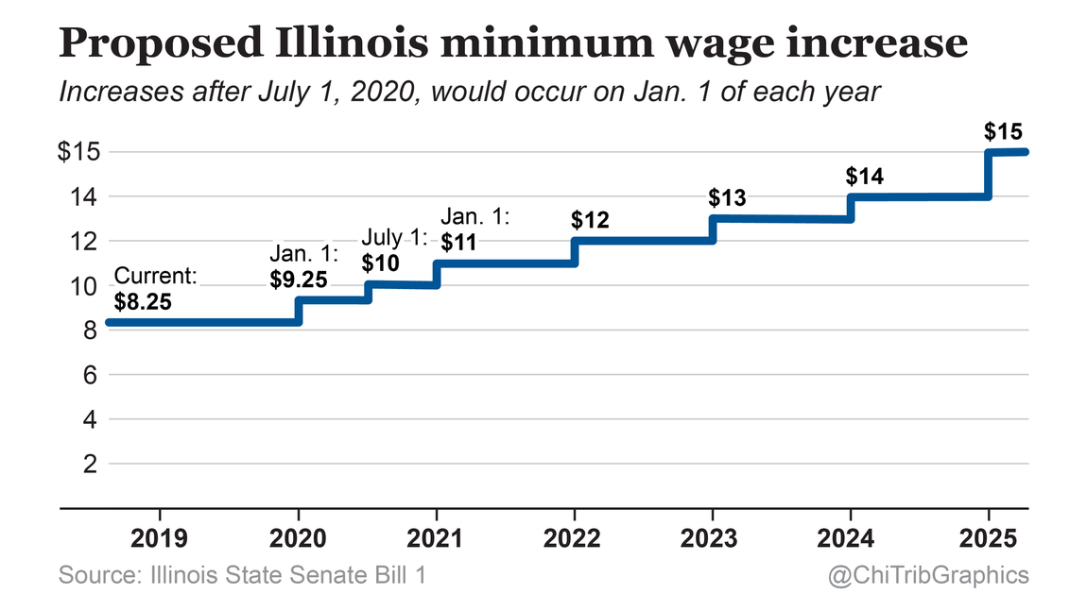
$15 per hour by 2025
Lifting Up American Working Families Act
  Signed by Governor Pritzker 2.19.19
    SB-0001
    PA 101-0001
Date | Rate | % ^
January 1, 2020 | $9.25 | 12%
July 1, 2020 | $10 | 7.50%
January 1, 2021 | $11 | 9.09%
January 1, 2022 | $12 | 8.33%
January 1, 2023 | $13 | 7.69%
January 1, 2024 | $14 | 7.14%
January 1, 2025 | $15 | 6.66%

Slide 7
Minimum Wage Outlook
Employee Work Schedule
Employee Pay: Part Time | Current | 2020 pt 1 | 2020 pt 2 | 2021 | 2022 | 2023 | 2024 | 2025
Minimum Wage | $8.25 | $9.25 | $10.00 | $11.00 | $12.00 | $13.00 | $14.00 | $15.00
Hours Worked per week | 20 | 20 | 20 | 20 | 20 | 20 | 20 | 20
Weeks in the year | 52 | 52 | 52 | 52 | 52 | 52 | 52 | 52
Total Wage (gross) | $8,580.00 | $9,620.00 | $10,400.00 | $11,440.00 | $12,480.00 | $13,520.00 | $14,560.00 | $15,600.00
Employer Portions
FICA Rate: 7.65% | $656.37 | $735.93 | $795.60 | $875.16 | $954.72 | $1,034.28 | $1,113.84 | $1,193.40
Fed. Unemployment: 6% | $514.80 | $577.20 | $624.00 | $686.40 | $748.80 | $811.20 | $873.60 | $936.00
State unemployment 3.175% | $1.65 | $1.65 | $1.65 | $1.65 | $1.65 | $1.65 | $1.65 | $1.65
Total Employer Portion | $1,172.82 | $1,314.78 | $1,421.25 | $1,563.21 | $1,705.17 | $1,847.13 | $1,989.09 | $2,131.05
Total funds from Library budget | $9,752.82 | $10,934.78 | $11,821.25 | $13,003.21 | $14,185.17 | $15,367.13 | $16,549.09 | $17,731.05
Additional funds needed | 0 | $1181.96 | $887.00 | $1181.96 | $1181.96 | $1181.96 | $1181.96 | $1181.96
$7978.76
Increase in staffing budget

Slide 8




Increase Across Staff
Employee Work Schedule
Employee Pay: Part Time | Current | 2020 pt 1 | 2020 pt 2 | 2021 | 2022 | 2023 | 2024 | 2025
Minimum Wage | $8.25 | $9.25 | $10.00 | $11.00 | $12.00 | $13.00 | $14.00 | $15.00
Total Funds From LB 2 | $9,752.82 | $10,934.78 | $11,821.25 | $13,003.21 | $14,185.17 | $15,367.13 | $16,549.09 | $17,731.05 | $7,978.23
Employee Pay: Full Time | Current | 2020 pt 1 | 2020 pt 2 | 2021 | 2022 | 2023 | 2024 | 2025
Minimum Wage | $8.25 | $9.25 | $10.00 | $11.00 | $12.00 | $13.00 | $14.00 | $15.00
Total Funds From LB 2 | $33,219.99 | $35,791.91 | $37,720.85 | $40,292.77 | $42,864.69 | $45,436.61 | $48,008.53 | $50,580.45 | $17,360.46
Employee Pay: Longevity/Level | Current | 2020 pt 1 | 2020 pt 2 | 2021 | 2022 | 2023 | 2024 | 2025
Wage | $11.00 | $11.00 | $11.00 | $11.00 | $12.00 | $13.00 | $14.00 | $15.00
Total Funds From LB 2 | $40,292.77 | $40,292.77 | $40,292.77 | $40,292.77 | $42,864.69 | $45,436.61 | $48,008.53 | $50,580.45 | $10,287.68
Employee Pay: Director | Current | 2020 pt 1 | 2020 pt 2 | 2021 | 2022 | 2023 | 2024 | 2025
Wage | $20.00 | $20.00 | $20.00 | $20.00 | $20.00 | $20.00 | $20.00 | $20.00
Total Funds From LB 2 | $63,440.05 | $63,440.05 | $63,440.05 | $63,440.05 | $63,440.05 | $63,440.05 | $63,440.05 | $63,440.05 | $0.00
 |  | $3,753.88 | $2,815.41 | $3,753.88 | $6,325.80 | $6,325.80 | $6,325.80 | $6,325.80 | $35,626.37
$35,626.37
Increase in staffing over 6 years
*Assumes retirement and medical benefits stay constant

Slide 9


Equal Wage Increase Across Staff
Employee Pay: Part Time | Current | 2020 pt 1 | 2020 pt 2 | 2021 | 2022 | 2023 | 2024 | 2025
Minimum Wage | $8.25 | $9.25 | $10.00 | $11.00 | $12.00 | $13.00 | $14.00 | $15.00
Total Funds From LB 2 | $9,752.82 | $10,934.78 | $11,821.25 | $13,003.21 | $14,185.17 | $15,367.13 | $16,549.09 | $17,731.05 | $7,978.23
Employee Pay: Full Time | Current | 2020 pt 1 | 2020 pt 2 | 2021 | 2022 | 2023 | 2024 | 2025
Minimum Wage | $8.25 | $9.25 | $10.00 | $11.00 | $12.00 | $13.00 | $14.00 | $15.00
Total Funds From LB 2 | $33,219.99 | $35,791.91 | $37,720.85 | $40,292.77 | $42,864.69 | $45,436.61 | $48,008.53 | $50,580.45 | $17,360.46
Employee Pay: Longevity | Current | 2020 pt 1 | 2020 pt 2 | 2021 | 2022 | 2023 | 2024 | 2025
Wage | $11.00 | $12.00 | $12.75 | $13.75 | $14.75 | $15.75 | $16.75 | $17.75
Total Funds From LB 2 | $40,292.77 | $42,864.69 | $44,793.63 | $47,365.55 | $49,937.47 | $52,509.39 | $55,081.31 | $57,653.23 | $17,360.46
Employee Pay: Director | Current | 2020 pt 1 | 2020 pt 2 | 2021 | 2022 | 2023 | 2024 | 2025
Wage | $20.00 | $20.75 | $21.75 | $22.75 | $23.75 | $24.75 | $25.75 | $26.75
Total Funds From LB 2 | $63,440.05 | $65,368.99 | $67,940.91 | $70,512.83 | $73,084.75 | $75,656.67 | $78,228.59 | $80,800.51 | $17,360.46
 |  | $7072.78 | $6429.8 | $7715.76 | $7715.76 | $7715.76 | $7715.76 | $7715.76 | $52,081.38
$52,081.38
Increase in staffing over 6 years
*Assumes retirement and medical benefits stay constant

Slide 10


Equal % Increase Across Staff
Employee Pay: Part Time | Current | 2020 pt 1 | 2020 pt 2 | 2021 | 2022 | 2023 | 2024 | 2025
Minimum Wage | $8.25 | $9.25 | $10.00 | $11.00 | $12.00 | $13.00 | $14.00 | $15.00
Total Funds From LB 2 | $9,752.82 | $10,934.78 | $11,821.25 | $13,003.21 | $14,185.17 | $15,367.13 | $16,549.09 | $17,731.05 | $7,978.23
Employee Pay: Full Time | Current | 2020 pt 1 | 2020 pt 2 | 2021 | 2022 | 2023 | 2024 | 2025
Minimum Wage | $8.25 | $9.25 | $10.00 | $11.00 | $12.00 | $13.00 | $14.00 | $15.00
Total Funds From LB 2 | $33,219.99 | $35,791.91 | $37,720.85 | $40,292.77 | $42,864.69 | $45,436.61 | $48,008.53 | $50,580.45 | $17,360.46
Employee Pay: Longevity | Current | 2020 pt 1 (12%) | 2020 pt 2 (7.5%) | 2021 (9.09%) | 2022 (8.33%) | 2023 (7.69%) | 2024 (7.14%) | 2025 (6.66%)
Wage | $11.00 | $12.32 | $13.24 | $14.45 | $15.65 | $16.85 | $18.06 | $19.26
Total Funds From LB 2 | $40,292.77 | $43,687.71 | $46,064.16 | $49,160.44 | $52,255.77 | $55,351.31 | $58,446.48 | $61,539.70 | $21,246.93
Employee Pay: Director | Current | 2020 pt 1 (12%) | 2020 pt 2 (7.5%) | 2021 (9.09%) | 2022 (8.33%) | 2023 (7.69%) | 2024 (7.14%) | 2025 (6.66%)
Wage | $20.00 | $22.40 | $24.08 | $26.27 | $28.46 | $30.65 | $32.83 | $35.02
Total Funds From LB 2 | $63,440.05 | $69,612.66 | $73,933.48 | $79,563.09 | $85,190.96 | $90,819.21 | $96,446.79 | $102,070.83 | $38,630.78
 |  | $12,139.46 | $8,626.22 | $11,297.81 | $11,295.11 | $11,295.72 | $11,294.66 | $11,289.19 | $77,238.17
$77,238.17
Increase in staffing over 6 years
*Assumes retirement and medical benefits stay constant

Slide 11

“Standard” Library Budget Breakdowns
70% Staffing
  45% Salary
  25% Benefits
12% Collection
18% Everything Else
Example $100,000
  $70,000 Staff
  $12,000 Collection
  $18,000 Everything Else
Example $500,000
  $350,000 Staff
  $60,000 Collection
  $90,000 Everything Else
*% from Standards for Illinois Libraries 3.0

Slide 12
Standard Library Budget Increase
0-5% per year
Minimum Wage Increase
6-12% per year

Slide 13

Barriers in increasing the Library Budget
PTELL/Tax Caps
Referenda
Elections
Public Outcry

Slide 14
How to Afford the increase
Payoff longstanding debt
  Building maintenance
  New Structures
Put off big projects
  New structures
  Department updating
Realign budget percentages
  Put of long term maintenance
  Lower collection budget
  Decrease in programs or program spending
Realign workflow
  Decrease staff and/or staff hours
  Remove/lower benefits
  Add more self service
  Decrease service desks
Adjust Hours
  Longer hours in winter, shorter in summer (or vice versa)
  Permanent change in hours to shorter days, or fewer days open (pushes against current standards or various rules)
Other
  Climatic changes in building
  Decrease services
  Increase or introduce fess for certain services
  MASSIVE FUNDRAISING

