Slide 1
Practical (Magic) Leadership: Tips & Tricks from Youth Services Managers For all Youth Services Leaders

Slide 2
Hello!
We are Youth Services Managers here to share information we have gathered on leadership.
Jen Abler
Oaklawn Public Library
Youth Services Department Head
Christy Kepler
Head of Youth Services
Oswego Public Library
Kelly Stulgate
St. Charles Public Library
Youth Services Manager

Slide 3
Library Leadership Survey
Leaders
?’s
Information

Slide 4
Question #1
1
What do you find challenging about being a manager?

Slide 5
TOP Response:
Juggling competing interests
and balancing demands.
Notes:
Kelly and I are Children's Services Managers, so we share the survey more within our own networks. However, we feel that leadership advice can come from anyone who has served in a leadership position, so we opened up our survey to more than just Children's Services Supervisors.

Slide 6
Question #2
2
How do you deal with interpersonal issues within your department/library?

Slide 7
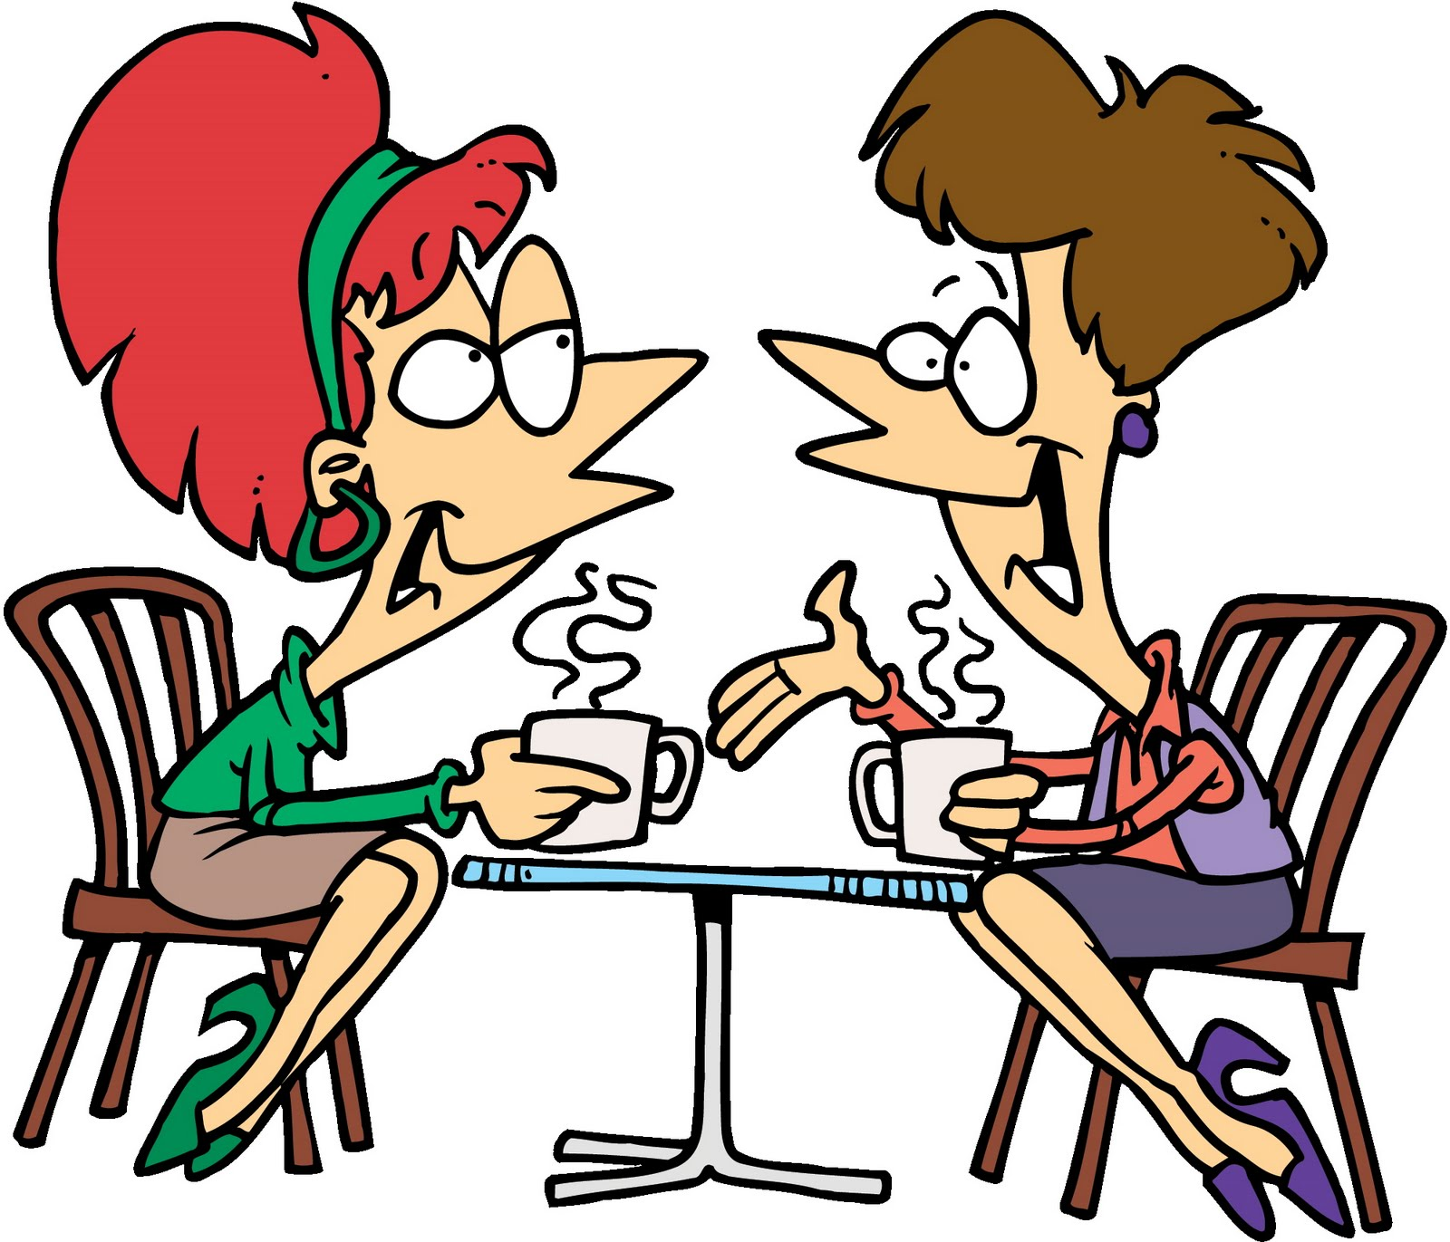
TOP Response:
Talk and Listen.

Slide 8
Question #3
3
How do you motivate your staff?

Slide 9
TOP Responses:
Positive feedback and encouragement
Allowing ownership over work
Being flexible
Trusting

Slide 10
Question #4
4
What is your main method of communicating with your staff?

Slide 11
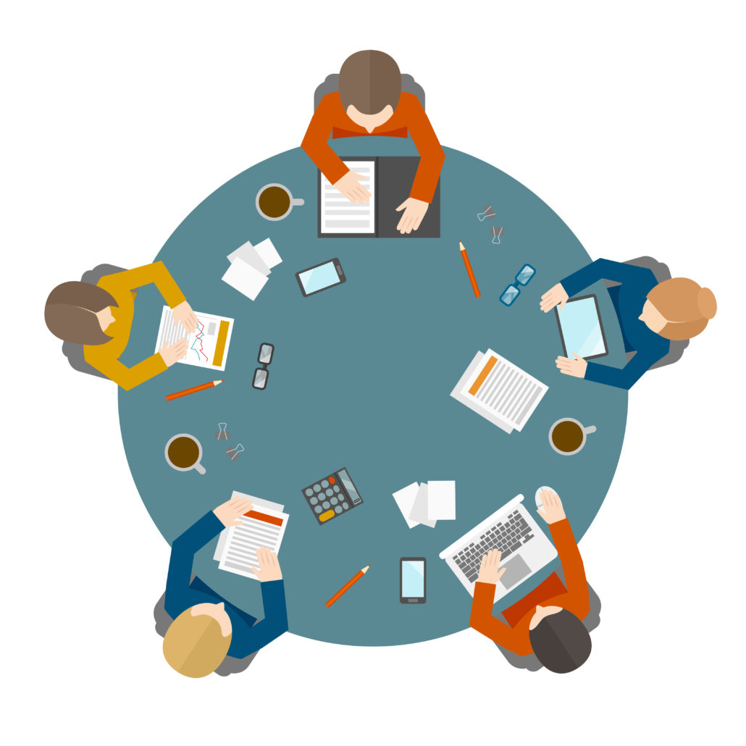
TOP Responses:
Talking and Email

Slide 12
Question #5
5
How do you create a cohesive team or inspire teamwork?

Slide 13
TOP Responses:
Transparency and Trust.
Encourage working together/teamwork.
Notes:
Read off highlighted comments, and talk about having getting buy-in from staff, and areas of ownership.

Slide 14
Question #6
6
Where do you go for advice?

Slide 15
TOP Responses:
Director
Other managers, both in my library and other libraries.
Professional journals/publications

Slide 16
Question #7
7
What is the best piece of advice that you've received as a manager?

Slide 17
TOP Responses:
Focus on staff strengths
Create a team
Take time off, take a vacation
Notes:
Share booklist

Slide 18
Question #8
8
How do you make time to get your own work completed?

Slide 19
TOP Responses:
Make lists, use timers
Go in early
Not effectively, still looking for a way.

Slide 20
Question #9
9
How do you center yourself? What techniques do you use to help you not take your work home with you?

Slide 21
TOP Responses:
Calming music
Working out
Make office a safe space
Notes:
I wanted to pop back to my trello, I watched a ted talk, and an ER talked talked about prioritizing things in Green, Yellow or Red as new information came in. Green – it needs immediate attention, Yellow – this needs attention but not at this very second, Red – these are things that aren't going to get done. Red are things you can't saved, you just don't have time to get to those things so you need to let them go. For my work I have my green list – To do today, I have my yellow list to do tomorrow. I don't have a red list, because I don't write down the red things. These tend to be projects I would love to work on, but I recognize that I don't have the time, so I let the project go to someone else with more time or figure out how to automate it. At home this like, making dinner. I realized that making dinner every night wasn't possible. So now I get some pre-made food for dinner during the week.

Slide 22
Question #10
10
How do you do evaluations?

Slide 23
TOP Responses:
Annually
Form based
Onboarding

Slide 24
Question #11
11
What is your best tip for working with directors?

Slide 25
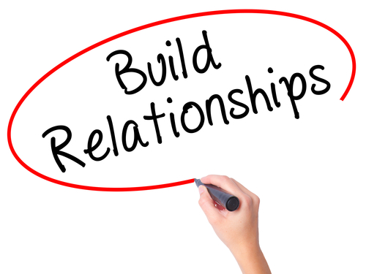
TOP Responses:
Be clear and communicative
Build a relationship
Notes:
https://www.indeed.com/career-advice/career-development/areas-of-improvement-for-employees
https://www.glassdoor.com/blog/guide/areas-of-improvement/

Slide 26
Question #12
12
Do you have a story to share that a new manager would find helpful?

Slide 27
TOP Responses:
Coach or lead more than you manage
Be ready to make mistakes, because you will
Be patient and authentic

Slide 28
Big concept
Being a leader can be lonely, but you don’t have to be alone.

Slide 29
Big Ideas
Listen
Take the time to listen to your staff. Also communicate with them-have meetings, keep them informed of things big and small.
Trust
Learn to delegate. This will empower your staff, they will perform better, and you will have more time to do other things.
Plan
Stay organized. Make plans and know it might take time for them to come to fruition.

Slide 30
Credits
Special thanks to all the people who completed our survey! We appreciate you sharing your knowledge and experience.
Presentation template by SlidesCarnival
Photographs by Unsplash

Slide 31
Thanks!
Questions? Reach out to us at:
jabler@olpl.org
ckepler@oswego.lib.il.us
kstulgate@scpld.org

