Slide 1
Finding common ground
Assessing research consultations across diverse academic libraries
Sierra Campbell
Valerie Neylon
Ed Remus
Rebecca Yowler
Notes:
Val

Slide 2
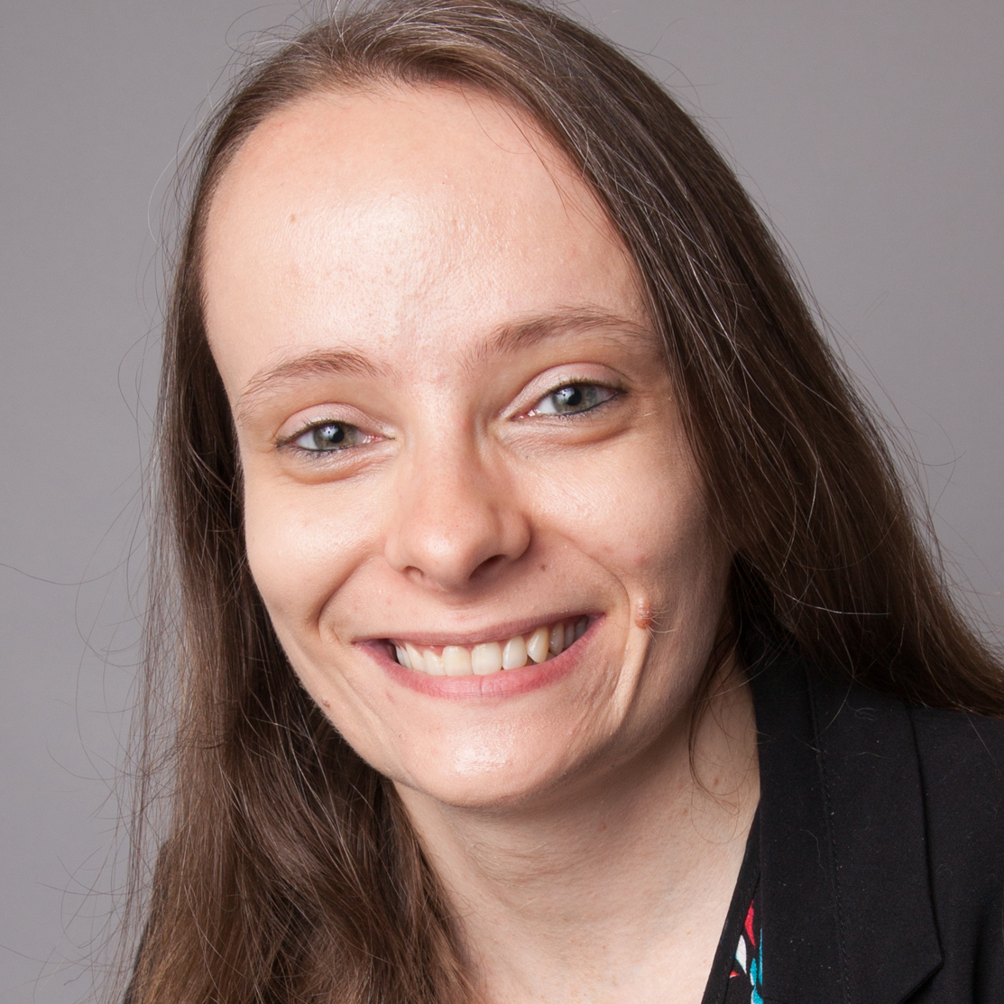
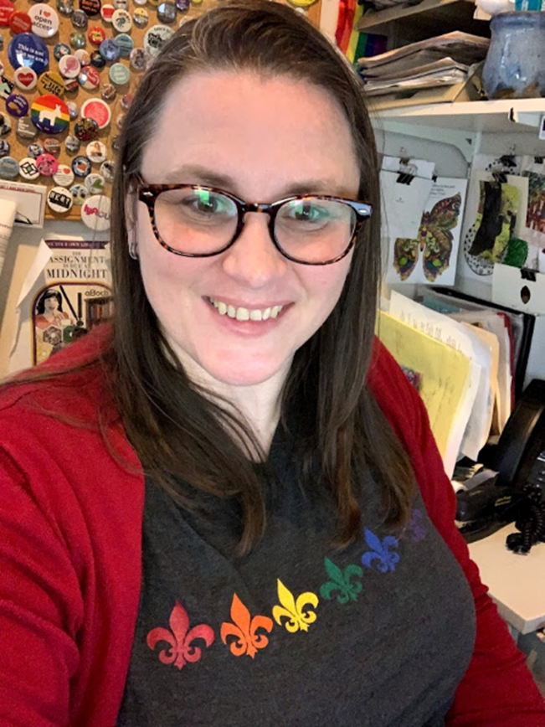
Our research team
Sierra Campbell
Lewis University
scampbell5@lewisu.edu
Valerie Neylon
City Colleges of Chicago, Daley College
vneylon@ccc.edu
Edward Remus
Northeastern Illinois University
egremus@neiu.edu
Rebecca Yowler
Knox College
rayowler@knox.edu
Notes:
Each introduce self

Slide 3
CARLI Counts
“CARLI Counts is a continuing education library leadership immersion program that prepares librarians to make effective use of research findings on the impact of academic libraries on student success for the twin purposes of service development and library advocacy” (https://www.carli.illinois.edu/products-services/prof-devel/carli-counts)
Consortium of Academic and Research Libraries in Illinois
Goal: assess service using IRB-approved research, with a focus on student impacts
Long-term vision: use data collected from assessment to advocate for more staff, continuation of library services
Structure: multiple cohorts since 2018; we were Cohort 3
Notes:
Sierra

Slide 4
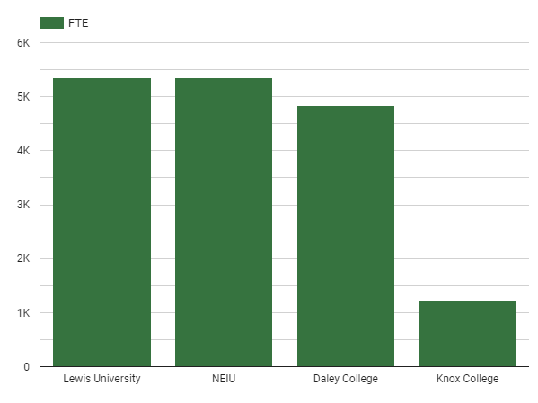
Our institutions
Lewis University
Private Religious University
Northeastern Illinois University (NEIU)
Public University
Daley College
Community College
Knox College
Private Liberal Arts College
Notes:
Ed

Slide 5
Our motivations
Northeastern Illinois University
Knox College
Lewis University
City Colleges of Chicago
Supplementing Tutortrac (course grade) assessment data
Making a test run for a larger-scale assessment project
Determining the future of the “Reference Desk”
Evaluating effectiveness of a consultation model
Continuing an essential service
Accomplishes the goal of student success at the point of need
Assessing our effectiveness as librarians
Advocating for more librarians
Notes:
All speak

Slide 6
Our study
“Research Consultations and Research Confidence at a Diversity of Academic Libraries”
Concept: the research consultation
Operational definition: READ scale 4+
Provider: librarians only, not library staff
Recipient: any library user, not just students
Dependent variable: self-reported research confidence
Notes:
Ed

Slide 7
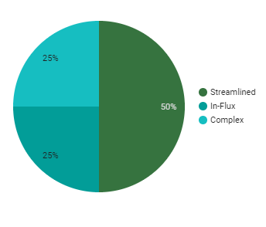
Institutional differences in IRB
Complex
Required numerous revisions
Maximum effort from multiple sources
Streamlined
Required one or no revisions
Could be managed with effort from one person or one person with help
In-Flux
No system in place, or system had experienced changes in personnel or procedure
Notes:
Becca

Slide 8
Our solutions to IRB differences
Northeastern Illinois University
Knox College
Lewis University
City Colleges of Chicago
IRB required multiple rounds of revisions; issues included planning for distressed participants, forgoing claims to subject anonymity
Contacted IRB on Knox Campus
IRB was approval was not required from other campuses, so it could be approved immediately.
Submitted IRB application
Received an OK from the committee to proceed - no problems
Contacted administrator to follow up on IRB as process was in flux
Edited and resubmitted as advised, gained approval
Notes:
All speak

Slide 9
Institutional differences in participant recruitment
Our research consultations vary by factors including:
Whether the consultation takes place at a reference desk, via chat, virtually, and/or via email
Whether the investigator-consultant is the sole or primary consultant, or one consultant among many
Whether investigator-consultants can recruit participants on behalf of non-investigator consultants
Notes:
Becca

Slide 10
Our solutions for recruitment differences
Northeastern Illinois University
Knox College
Lewis University
City Colleges of Chicago
Created a survey option for in-person participants
Recruited participants retroactively (up to 2 months)
Delegated the investigator to recruit on behalf of other consultants (if possible, via student tracking software)
Asked consent during consultation to send survey after the fact.
Sent additional surveys to students who had previously had a consultation that met the criteria and those enrolled in courses requiring consultations
All librarians recruited participants
Used reference analytics to tally those interactions with a level 4 and above
Distributed survey to participants via email after consultation took place
Asked other staff to contribute to the survey by sharing recruitment script
Used ref analytics to determine READ scale level
Used “canned message” in LibChat for informed consent & to share survey
Asked other librarians to participate, but ended up solo
Notes:
All of us speak

Slide 11
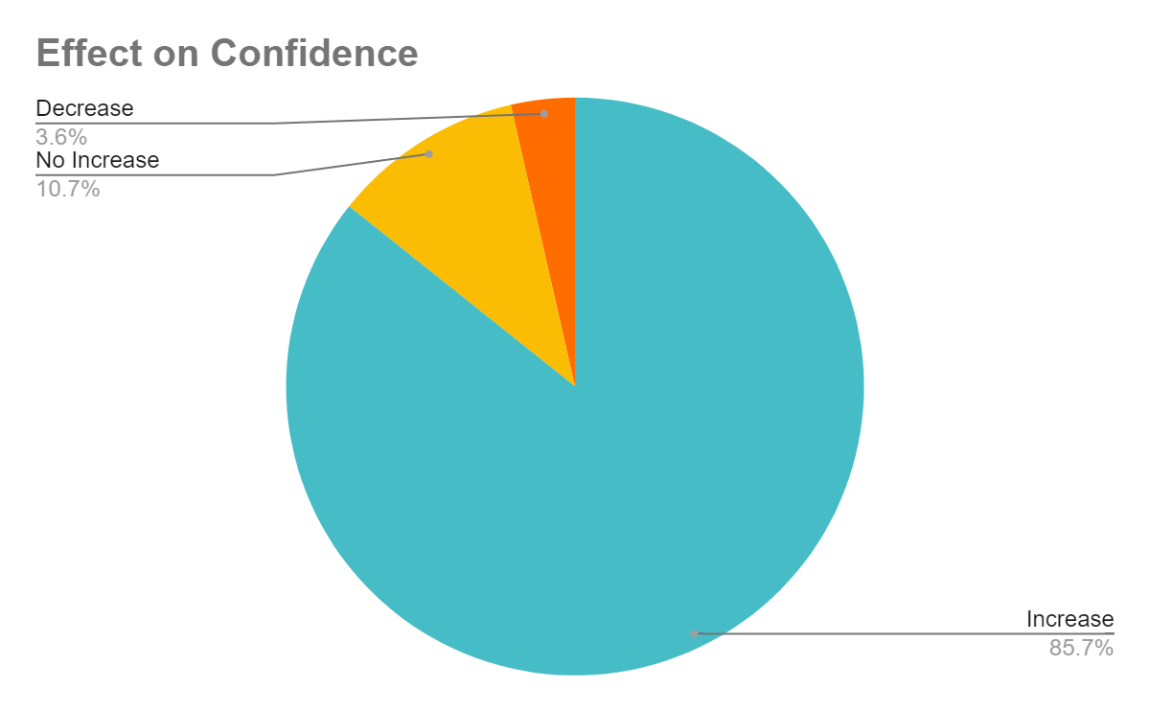
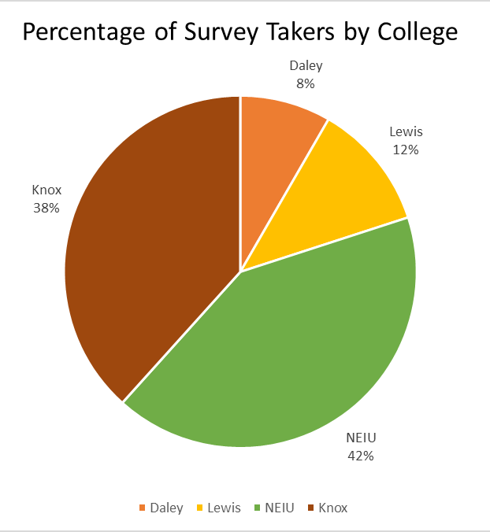
Preliminary Results
Notes:
Sierra

Slide 12
Limitations
Our ‘flexible’ data collection strategy raises some questions:
Is the in-person survey comparatively inconvenient?
Does retroactive recruitment affect response quality?
Does delegated recruitment affect response quality?
Could we have generated a sample size?
Notes:
Ed

Slide 13
Next Steps
Continue to gather data
Present to colleges and college administrations
Knox has created a Peer Research Assistant program based on this study
Consideration about writing a paper
Notes:
Val

Slide 14
Thank you!
Questions?

Slide 15
Appendix
Survey Questions
At which institution did you receive research help?
City Colleges of Chicago - Richard J. Daley College
Knox College
Lewis University
Northeastern Illinois University
How confident were you in being able to conduct your research before receiving research help from the library? (Please rate your confidence on a scale from 1 to 5, with 5 being "Most Confident" and 1 being "Least Confident.")
How confident are you in being able to conduct your research after receiving research help from the library? (Please rate your confidence level on a scale from 1 to 5 with 5 being "Most Confident" and 1 being "Least Confident.")

Slide 16
Appendix
Survey Questions
4. How did the meeting with a librarian take place? (check all that apply)
Video Conference (Zoom, WebEx, Microsoft Teams, Google Meet, etc.)
Virtual Chat
In-Person
Phone
5. How long was the meeting?
0-5 minutes
6-15 minutes
16-30 minutes
31-60 minutes
Over 60 minutes

Slide 17
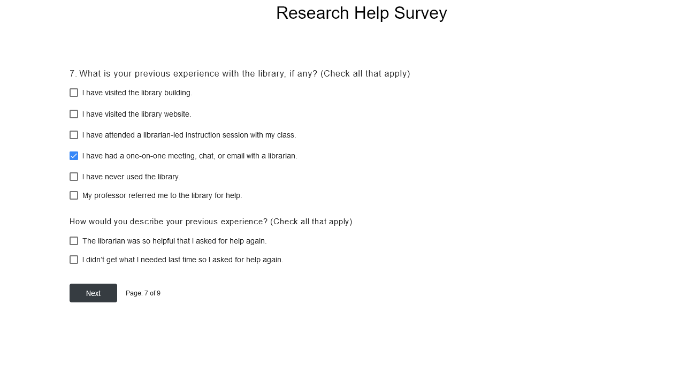
Appendix - Survey Questions

Slide 18
Appendix
Survey Questions
8. What is your current status at your institution?
Undergraduate Student
Graduate Student
Faculty
Staff
9. “Click to Submit Survey”

