Slide 1
The Experiences of Tenure-Track Librarians Who Supervise
A Balancing Act
October 18, 2022

Slide 2
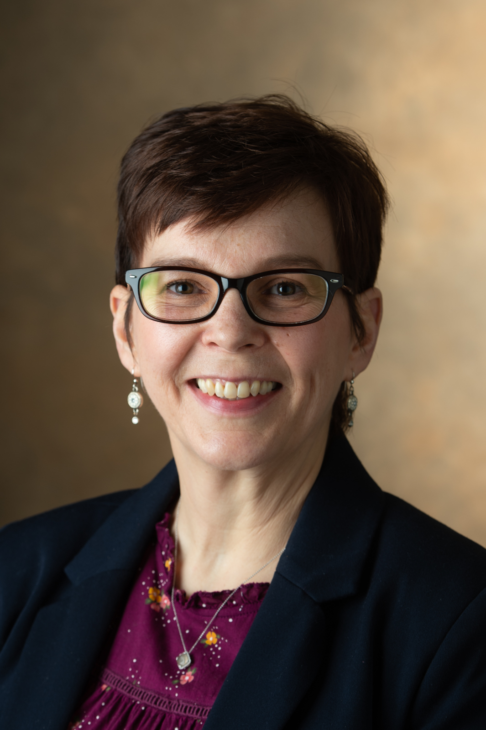
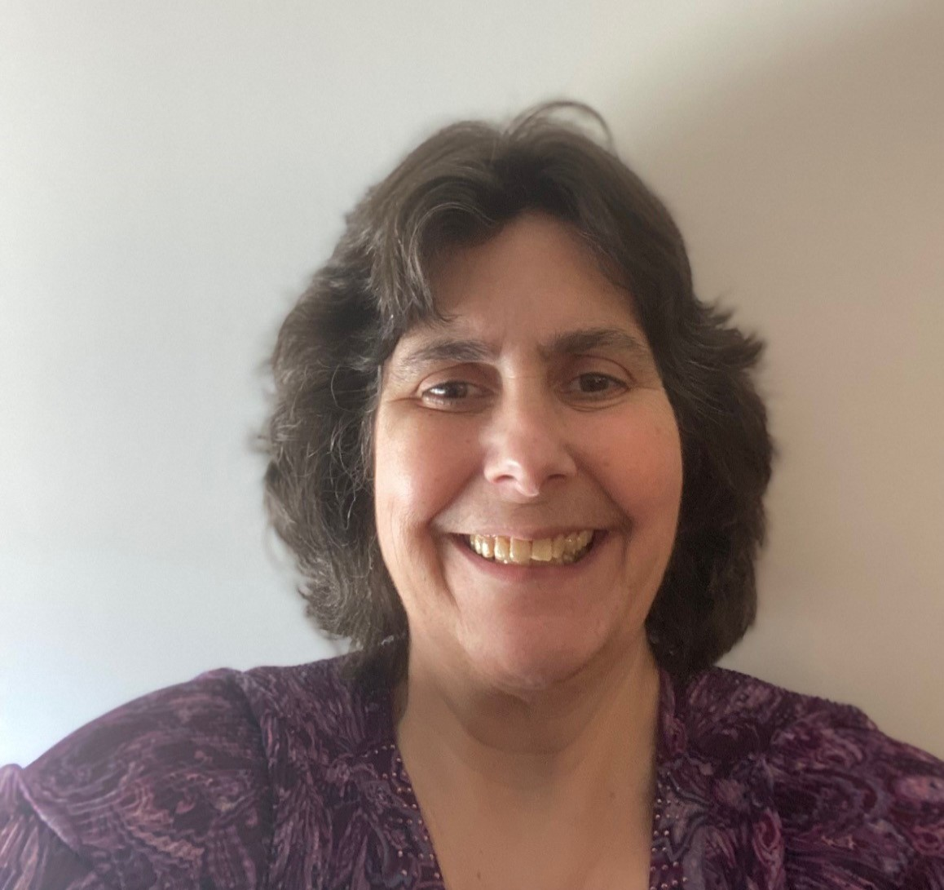
Hello!
Tammie Busch
Asst. Prof.,
Catalog and Metadata Librarian
Southern Illinois University Edwardsville
tabusch@siue.edu
Susan Howell
Asst. Prof.,
Cataloging and Metadata Librarian
Southern Illinois University Carbondale
showell@lib.siu.edu

Slide 3
Agenda
Backstory
Focus group tips
Challenges of tenure-track supervisors
Strategies for success
Lessons learned

Slide 4
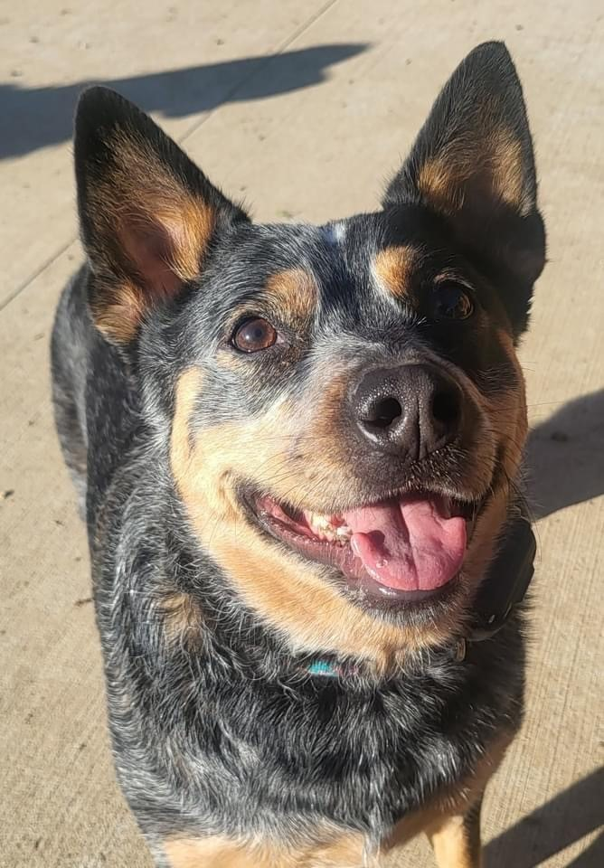
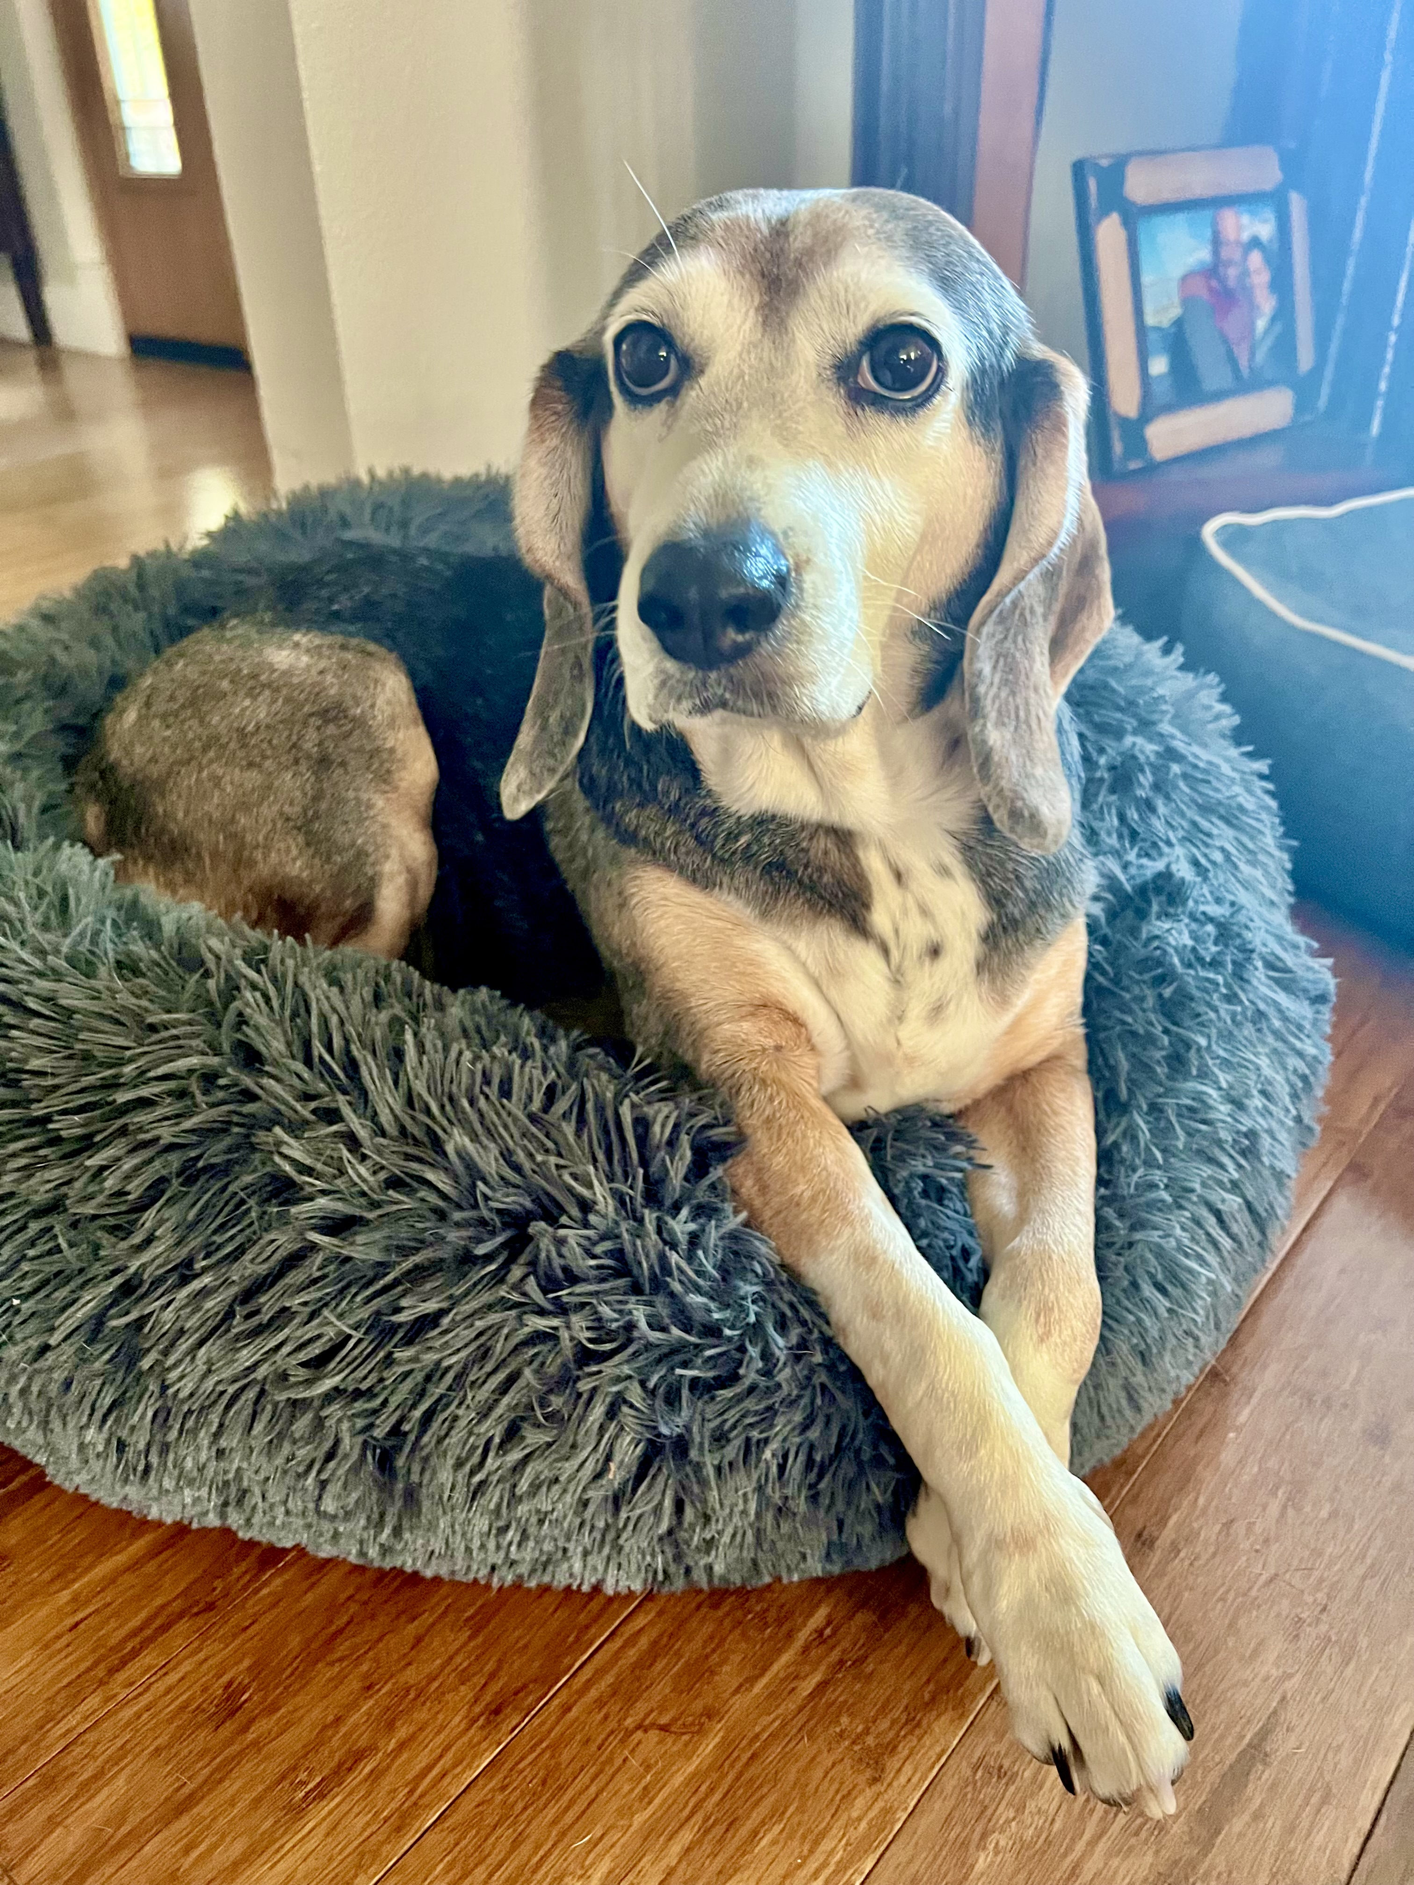
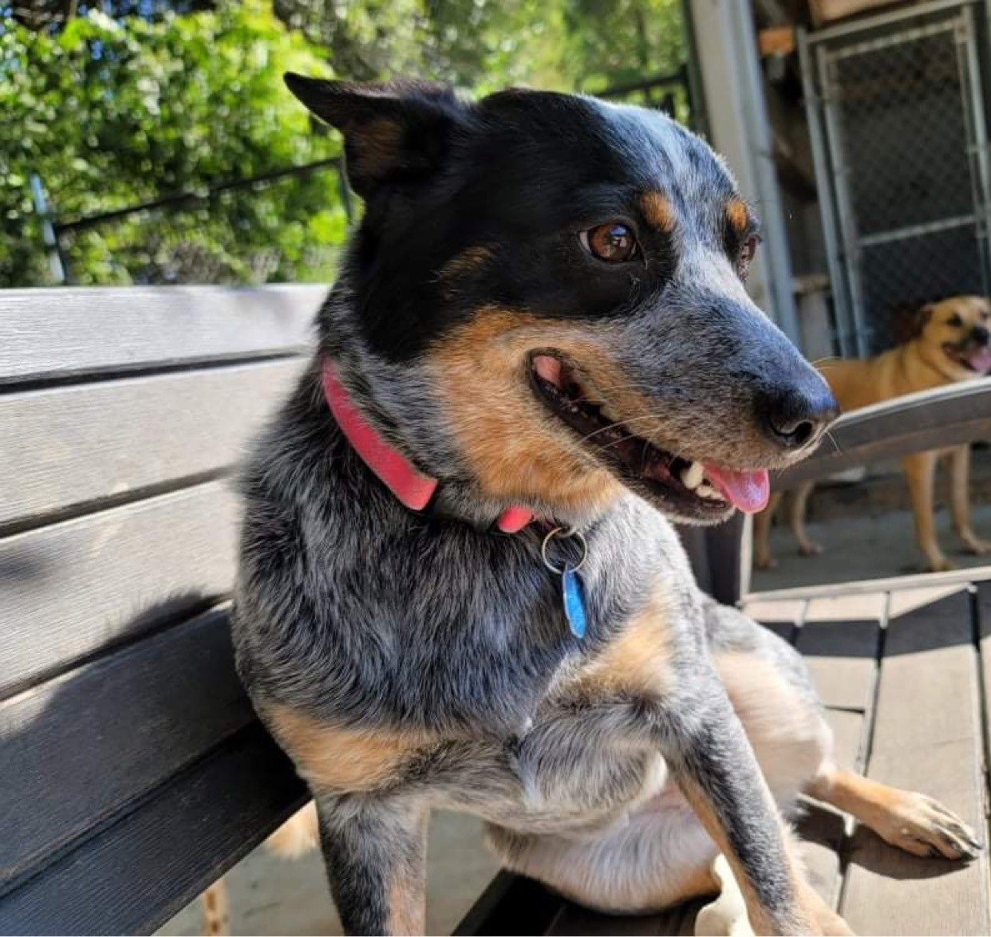
Backstory
Ellie Howell
Sadie Howell
Nancy Busch
Notes:
If you attended the earlier session called “Collaboration, Communication and the Cataloger: Measuring the Impact of Enhanced Cataloging on Discoverability of Library Resources,” you already know a little about how Susan and I met.
As participants in the IMLS grant funded CARLI Counts program, Susan and I met at the in-person orientation for CARLI Counts in February of 2020.
We bonded over our shared challenges as new tenure-track cataloging librarians with supervision responsibilities.
We had both spent many years as paraprofessional library staff prior to transitioning to faculty librarians.
We also bonded over our very important roles as dedicated dog moms.
I expressed to Susan that as I looked around my library, I struggled to see other librarians facing the same challenges I was facing: understaffed, misunderstood, and struggling to find mentorship within my library for guidance with priorities, scholarship, and supervision. Susan agreed.
As part of CARLI Counts, Susan and I had begun developing a research mindset and we wondered if and how others in similar situations were working through these challenges.
A review of the literature exposed there had not been much written about our specific situations.
Since the time that Susan and I had participated in CARLI Counts, I had also been paired with a librarian mentor through the ALCTS Mentoring Program.
Between what we had learned in CARLI Counts in conjunction with guidance from my mentor, Susan and I decided we wanted to further investigate how other librarians in situations like ours were getting along.
We reviewed various research methods to determine the best approach to finding out what people’s experiences were with managing both a department and the rigors of attaining tenure.
We were also doing this at the peak of COVID so that was an additional challenge we had to work around.

Slide 5
Research Question
In what ways do the responsibilities of tenure-track librarians who supervise staff impact the amount of time they are able to devote to the requirements of tenure?
Notes:
With the research question In what ways do the responsibilities of tenure librarians who supervise staff impact the percentage of time they are able to devote to the requirements of tenure? in mind, Susan and I began creating a survey we would disseminate nationally.
But beyond gathering survey data, we also wanted to hear people’s stories.
Obviously, we wanted to hear from people who were currently experiencing the same challenges.
But we also wanted to hear from those who had overcome those challenges and attained tenure.
So, the survey would include a request for participants to contact us if they would be willing to be interviewed.
What did they do that helped them succeed?
In doing this we hoped we would be able to help others like us, and perhaps shed some light on what administrators can do to help support tenure track supervisors.

Slide 6
Farewell, dear survey
Susan & Tammie
Librarian faster than us
Peter van der Sluijs, CC BY-SA 3.0 <https://creativecommons.org/licenses/by-sa/3.0>, via Wikimedia Commons
This Photo by Unknown Author is licensed under CC BY-SA
Notes:
However, in the final stretch of wrapping up the work on our survey, we both noticed an email that came through a listserv essentially asking the same questions we had composed for our survey.
After mourning what we thought was the death of our research project, we realized there was still room for more research in this area.
We just had to take a different approach.
I’m going to turn it over to Susan to talk about how we pivoted to keep our research project moving forward.

Slide 7
Focus Groups
A method used for exploring topics for which not much is already known.
Ability to gather qualitative data in a relatively short amount of time.
Provides a safe environment for participants to share their experiences.
Discussion may spark additional information that may not have been revealed by other methods.
Notes:
As Tammie mentioned, initially we were going to do a mixed methods study with a survey, and then follow up with personal interviews. We had already developed a set of questions for both quantitative (the survey) and qualitative (the interview) research methods. We examined our questions, and went back to the literature for guidance on the best approach to take. We found some great books on qualitative research. Our reading led us to the conclusion that a focus group would allow us to explore a topic for which not much is known. We would be able to collect a lot of qualitative data in a relatively short amount of time. It would also provide a safe environment for our target population (tenure-track and tenured technical services librarians) to have a discussion. The discussion may spark some information that may have been missed had we interviewed participants individually.

Slide 8
Focus Group Logistics
Two groups: Tenure-Track and Tenured.
90-minute sessions.
12 participants per group.
Notes:
We decided to have two focus groups, one for tenure-track supervisors and one for tenured supervisors and allotted 90 minutes for each. We thought the discussion would go better if our participant groups were all at about the same experience level. It might have been interesting to have one group that was mixed to see if that made a difference. Maybe that’s something for future research. The literature was not definitive regarding the optimal number of participants to include in a focus groups. The experts said to expect a no-show rate of 10-50%. We read to keep online groups smaller than in-person (anywhere from six to ten). With these wide variances in mind, we decided to invite 12 participants per group. With no-shows, we figured we would have a manageable group size. Now that we had a plan the next step was to line up participants.

Slide 9
Call for Participation
CARLI Technical Services
AutoCat
OCLC-CAT
Alma-L
ALA Metadata Librarians
Metadata Librarians
SERIALST (Serials in Libraries Discussion Forum)
ACQNET
ACRL
MLA (Medical Library Association Discussion Forum)
ALCTS Metadata Interest Group
Notes:
To recruit participants, we compiled a list of technical services related listservs that we were either members of or those that did not require fee-based membership to post a message. We posted to 11 lists: CARLI Tech Services; AutoCat; OCLC-CAT; Alma-L; ALA metadata librarians; Metadata Librarians; SERIALST; AcqNew; ACRL; MLA; and ALCTS Metadata Interest Group. We started getting responses immediately. It was great! We had no trouble recruiting participants to fill both groups. People were excited for the chance to tell their stories.

Slide 10
Focus Group Tips
Change their name on Zoom.
Address questions and concerns directly.
Right to participate.
Use a moderator.
Get feedback on your questions.
Use a doodle poll.
A google doc can come in handy.
Be prepared for the unexpected.
Notes:
We had IRB approval and wanted to make sure everyone would be comfortable in the Zoom environment. We also wanted to protect everyone’s privacy and an-o-nym-ity as much as possible. We sent instructions to all participants on how to change their name in Zoom before they entered the session. We made ourselves available for questions and concerns for all participants. We answered all emails within 24 hours. Everyone got the research participation form and it stated they have the right to participate at any time, and also the right to leave at any time during the session.
Krueger and Casey (2002) suggest the use of a moderator. Following that advice was one of the best things we could have done. Our Moderator, Marlee Graser, who is the interim Associate Dean and Library & Information Services Discovery & Technology Librarian from SIUE was wonderful. She was great at guiding the discussion, eliciting extra information when needed, and encouraging participation. It also freed Tammie and I to really focus on the conversation and take in everything that was being said without distractions. If you ever decide to conduct a focus group, we strongly recommend getting a moderator. Marlee also had an excellent suggestion for the second focus group, which was to encourage people to contribute to the discussion in the chat. This saved time, and also, may have encouraged people who prefer to use chat rather than their mic to contribute more to the discussion. [Questions] We used a doodle poll to schedule a time for our focus groups. For the tenure-track group we were able to find a time that was available for everyone. For the tenured group there was one person who did not have availability for the time slot we selected. We decided to plan a back-up focus group and offer it to this person if others were also unable to attend. We wanted to give everyone the opportunity to participate.
As I mentioned previously, a review of the literature told us not to expect 100% participation rate. That was not our experience. Everyone showed up Tenure-track groups . This caught us off guard and we ended up running out of time. We had to think on our feet how we were going to get through all the questions. We had already set up a google doc we intended to share at the end of the focus group so participants could share any thoughts or comments they had later. We ended up posting that link in the chat for people that had to leave so they could respond to the questions they missed. There were also two questions we ended up just asking within the google doc. We hated keeping people longer than the time we allotted for the focus group because we know how many constraints people already have on their time. Our participants were really cooperative though. Several indicated in the chat that they were happy to continue on. Every one of them really wanted to share their story. From that response we knew we were onto something. We also knew we needed to be prepared for 100% participation in case that happened again for the second group. Tammie will talk later about the changes we made to prepare for this.

Slide 11
Survey Questions
What is your approach to supervision? How do you define success as a supervisor?
Do you feel as if your administrative/supervisory duties impact your participation in librarianship, service, or scholarship? Which area of impact concerns you the most?
Where are you in the process of applying for tenure? Has the amount of time you devote to tenure changed over the years you've been on the tenure-track?
Do you foresee future situations that may have an impact on your tenure process?
If you had five hours uninterrupted every week, what would you work on?
What would your day look like if you did not supervise?
What support, if any, do you get from your supervisor or library administration? What support would you like to get?
If you have had positions that have become vacant, how have you or your library handled the work assigned to positions under your supervision?
Notes:
These are our focus group questions
Tammie and I finished drafting our questions and asked some of our colleagues to review them to make sure they directly related to our research question. We did get a few suggestions and made some minor changes to them in our final draft.
Our questions were similar for the two groups but not identical. The questions on this slide are the ones we asked the Tenure-Track group. The tenured group was basically asked the same questions, but where appropriate they were asked to think back to when they were tenure-track.

Slide 12
Transcribing and Coding
TechSmith Knomia
Incorporate comments from chat
Renamed all participants for anonymity
Taguette
Code book
Notes:
After conducting the focus groups, we set out to discover what challenges our participants faced and how they dealt with them.
The first step was to transcribe the recordings from the focus groups. We exported the transcript from Zoom into transcription software called TechSmith Knowmia. This software does require a subscription, but luckily Tammie’s institution had one. Transcription software is very helpful for saving time, but just gives you a starting point.
Anyone who has used talk to text knows there was still a lot of editing to be done. We listened to the recordings while reading the generated transcript and made all the necessary edits until the transcript matched the recording. The comments from the chat were added to the transcript at as close to time proximity as possible. Once that was done, we went through and changed all the participants' names to protect their identity.
After reviewing various coding software programs, we decided to use Taguette. Taguette is a free and open-source tool that can be used to help researchers code their qualitative data. We used the online version. You can also download Taguette and use it offline. The online version allowed us to work collaboratively on data and coding.
The first thing we did was familiarize ourselves with Taguette. We created a project and uploaded the scripts for each focus group. Each file was broken down by question.
We were already somewhat familiar with the scripts from the transcription process, but we went through them many times to completely immerse ourselves in the dialog.
We got together and started a codebook with themes we thought we would encounter. This is called deductive coding, where you take a top-down approach creating the tag first, and then look for examples that fit the code. We also wanted to allow for themes to emerge. This is inductive coding where you add tags to themes you discover as you are going through the scripts.
Now we were ready for our trial run. We each took one focus group and started coding. What this means is you go through the script while in Taguette. You use your mouse to highlight a portion of text and then assign a tag to it. It was either a pre-existing tag we created ahead of time, or we created a new tag when we found phrases that warranted a new tag. This was a new experience for both of us, so we went through the transcripts several times before we were satisfied we had everything we needed coded. In addition to this we also kept memos for each question with anything in the transcript that we found noteworthy.
Once we were done coding the first round we went through our codebook and refined our codes. We found some codes could be combined while others needed to be broken down into more tags. We also found that some of the tags we created meant the same thing, but the two of us chose different terminology. We worked together editing the codebook, and then we went back through and coded the same data again.
We reviewed our coding after the second round and synthesized our existing tags once again. After our codebook was refined, we switched groups and coded the next set of scripts.
When we finished coding all the transcripts in Taguette we were able to create reports, and see what tags were used most frequently. We could also export the portions of text that had specific tags. We did not use our practice round for data analysis. We only used our round two documents to export data. We also combined all our memos so all our notes would be in one document indexed by group and question number.

Slide 13
Emerging Themes
Work/Life Balance
Putting out Fires
Toxicity
Not having a voice
Administration does not understand our work
Mentorship (Both having a mentor and being a mentor)
Uninterrupted time to focus
Notes:
In reviewing all this data, several themes emerged. It became apparent that most tenure track supervisors struggled with maintaining a healthy work/life balance. “Putting out fires” demanded a significant amount of attention and dictated the flow of their day-to-day work life. Participants struggled with carving out uninterrupted time to devote to research and large-scale projects. Many have experienced toxicity within their institutions. Several participants felt they did not have a voice at the table when decisions were being made that had a direct impact on the departments and people they managed. Frustration was expressed over having administrators who do not understand the work being done by Technical Services staff and faculty. Having mentors and being a mentor were also especially important to our focus group participants, as was support and being supportive. Also of importance is frustration over not being able to reward staff with anything other than praise and positive evaluations.

Slide 14
Challenges of Tenure-Track Supervisors
Theme | Total | Tenured | Tenure-Track
Change Management/Reorganization | 33 | 16 | 17
Unsupportive Administration | 27 | 11 | 16
Inadequate Staffing | 26 | 5 | 21
Supportive Administration | 24 | 7 | 17
Day-to-day work | 21 | 11 | 10
Multiple Roles | 19 | 5 | 14
Planning and Strategic Vision | 19 | 7 | 12
Soft Skills | 19 | 9 | 10
Staff Training | 18 | 5 | 13
Tenure Mentorship | 16 | 11 | 5
Notes:
Here is a breakdown of the top emerging themes and how many times they were mentioned by tenured or tenure track participants. One thing I found of interest is that supportive administration was mentioned almost as much as unsupportive administration. Tammie will talk more about administrative support in a little while. Change management and reorganization was the theme mentioned the most with almost an equal number of Tenured and Tenure-Track participants responding. Some of the biggest challenges for Tenure-Track Supervisors according to our participants were inadequate staffing, having to fill multiple roles, and staff training.

Slide 15
Change Management, Shrinking/Inadequate Staff, Multiple Roles
__________________________________________________________________
“In addition to my duties, I have to help out with instruction. And stay late during exam hours for the circulation desk and help out public services because we are short staffed so that also is a hindrance when you’re a smaller institution and you have to kind of chip in and lose.”
“I have a non-faculty librarian line that’s open so I’m doing all of that position while it’s open because I don’t have another person at that level.”
“I’m trying to re-distribute work, figuring out how we’re going to make the job of four people into the job of two people.”
"All of us are wearing many different hats."
Notes:
Change management, reorganization, shrinking and inadequate staff, and having to take on multiple roles all go hand in hand as we are asked to do more with less. Here are some of the things our participants had to say about it:
“All of us are wearing many different hats.”
“I have a non-faculty librarian line that’s open so I’m doing all of that position while it’s open because I don’t have another person at that level.”
“I’m trying to re-distribute work, figuring out how we’re going to make the job of four people into the job of two people.”
“In addition to my duties, I have to help out with instruction. And stay late during exam hours for the circulation desk and help out public services because we are short staffed so that also is a hindrance when you’re a smaller institution and you have to kind of chip in and lose.”

Slide 16
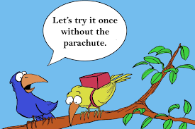
Resistant to Change
“Every time something comes open we’re trying to re-assess the workflows because that is literally the only opportunity we ever get to change something, because it seems like once that workflow is in place and you get those people in place, it can become very entrenched because of the way that culture is.”
Notes:
Another facet to change management is bringing along people who are resistant to change. Here is what one participant had to say:
“Every time something comes open, we’re trying to re-assess the workflows because that is literally the only opportunity we ever get to change something, because it seems like once that workflow is in place and you get those people in place, it can become very entrenched because of the way that culture is.”

Slide 17
Technical Services has Changed
“Technical services has changed through the years, right? We’re more focused on e-resources and less on print. And so our cataloging area has also tried to adjust and accommodate that. I’ve also looked at using different tools to automate a lot of procedures... finding more efficient ways of doing things.”
Notes:
Of course, technical services has changed over time as well. We have moved more to electronic resources, and our print subscriptions have dwindled. We’ve migrated to different integrated library systems, and our workflows have changed. Here’s what one of our participants had to say:
“Technical services has changed through the years, right? We’re more focused on e-resources and less on print. And so, our cataloging area has also tried to adjust and accommodate that. I’ve also looked at using different tools to automate a lot of procedures... finding more efficient ways of doing things.”

Slide 18
Faculty/Staff Divide
__________________________________________________________________
"And the
administrators
have not done anything to smooth over those rela-tionships. In fact, the administrator that’s in the interim position has made it worse.”
“[you] have to make it look like it’s more equitable, so the staff don’t get resentful.”
“New faculty that come in are just going to be
like walking,
punching bags for long standing
resentment.”
Notes:
Several participants described their work environments as toxic. For many it was due to the divide between faculty and staff, and the lack of effort from the Administration to alleviate some of the tensions to create a more favorable work environment.
One participant said, “And the administrators have not done anything to smooth over those relationships. In fact, the administrator that’ s in the interim position has made it worse.”
Some were even told they “Have to make it look like it’s more equitable, so the staff don’t get resentful.”
Some participants had experiences where they bore the brunt of staff resentment. Staff members said things to them like,
“You don’t know anything; you don’t deserve your job.” and “We know more than you. We don’t need you. Why do we need this position?”
“New faculty that come in are just going to be like walking, punching bags for long standing resentment.”
I was civil service at my institution before I became faculty, and I can really relate to all these statements. I’ve lived on both sides of the fence. To me it feels like the administration pits us against each other. I do everything I can to try to create a team atmosphere in my department, but still, I feel guilty if I work from home or take a research day. It’s really difficult.

Slide 19
Not Having a Voice
“I was not included in the selection process, or even asked, hey, could this person work from home.”
“Basically, swooped in and said here’s what’s wrong with your unit and you have someone retiring and I think you don’t need to fill that position” Don’t you hate it when they swoop in? I know I do!!
“It was reworked into another place in the library without discussion with me.”
“I’m a bit of a pitbull when it comes to my people.”
Notes:
Another common theme was not having a voice in decisions that are being made about our departments or the people we supervise. Here is what some of our participants had to say:
“I was not included in the selection process, or even asked, hey, could this person work from home.”
“Basically, swooped in and said here’s what’s wrong with your unit and you have someone retiring and I think you don’t need to fill that position” Don’t you hate it when they swoop in? I know I do!!
“It was reworked into another place in the library without discussion with me.”
One of my favorite quotes is “I’m a bit of a pitbull when it comes to my people.” I can totally relate to that. Especially having been in civil service I know how important it is to my people to know I have their back.

Slide 20
“[It's like] putting out one fire and on to the next.”
Notes:
Another challenge that our participants talked about is how so much of our day is attending to situations that arise in the moment. One person stated it’s like “putting out one fire and on to the next.” Instead of being able to lead our departments with vision, we find ourselves in a reactive mode where we just respond to one problem and go on to the next. Many respondents felt this challenged their ability to complete their day-to-day work, let alone make time for research and large-scale projects.
Those are some of the challenges and common themes that emerged from our focus groups. Now, I’m going to turn it over to Tammie so she can talk about some of the ways our participants met these challenges, and what helped them to be more successful.

Slide 21
Strategies for Success
Prominent themes
Administrative support
Mentorship
Advocacy
Other themes
Embrace your autonomy
Cross-train your staff
Tenure Committee support
Ideas Strategy Success Funnel Concept by Jernej Furman Attribution 2.0 Generic (CC BY 2.0)
Notes:
Despite the challenges our participants faced on their road to tenure as supervisors, they did have some strategies for success.
In addition to embracing their autonomy as a supervisors and department heads, cross-training staff, and the support they received from their tenure committees, three prominent themes emerged between our tenured and tenure-track participants that have been vital to their success: administrative support (responses to this question could be a presentation or article by itself), mentorship, and advocacy.

Slide 22
Administrative support
Encouraging us to take research time
Practicing transparency
Leadership training
Adequate staffing
Listening/Understanding
Providing mentorship
Tenure committee support
Department reorganizations
This Photo by Unknown author is licensed under CC BY-NC-ND.
Notes:
As Susan mentioned, the responses about supportive administration versus unsupportive administration were about equal. For the purpose of our research project, administration is defined as one's direct supervisor on up.
What are our administrators doing to make us feel supported?
According to our participants, they are encouraging us to take research time during the work week and making sure that we have a clear roadmap of what we need to do to attain tenure.
They are practicing transparency and shared governance.
They are ensuring the faculty tenure and promotion committee is doing its job.
They are making sure we have leadership training so we can continue to grow our supervisor skill sets.
They are making sure our departments are adequately staffed.
They listen to us when we need to revise job descriptions.
They are reorganizing departmentally to lessen our burden as supervisors.
They are taking time to understand what we do.
They are collaborating on research with us, making sure we have a mentor, or providing that mentorship themselves.

Slide 23
Mentorship in the literature
“Mentoring is not specific to technical services librarians; but, given that they tend to be few in number in any given library, it might be argued that they have greater need of purposive mentoring than their public services colleagues (Hill, 2007, p. 166).”
What is most helpful in carrying out scholarly research successfully?
"By far the most common theme was the ability to collaborate on research projects and publications with peers or mentors (Ackerman et al., 2018, p. 560).
This Photo by Unknown author is licensed under CC BY-NC-ND.
Notes:
Our literature review found that insufficient mentoring hampers scholarship progress (Hughes, 2018 p. 10-11).
One article pointed out that “mentoring is not specific to technical services librarians; but, given that they tend to be few in number in any given library, it might be argued that they have greater need of purposive mentoring than their public services colleagues (Hill, 2007 p. 166).”
Additionally, “active mentoring has the ancillary benefit of expanding the community of colleagues who have an interest in and some knowledge of technical services librarians and the work they do (Hill, 2007 p. 173).”
A survey by Goodsett and Walsh found that formal mentoring programs “provided increased understanding of institutional culture and improved communication and time management skills, all of which are crucial for librarians pursuing tenure (2015, p. 927).”
In another survey conducted by Ackerman, Hunter, and Wilkinson in 2016, respondents were asked to provide information about what most helped them to carry out scholarly research successfully.
The most common theme that emerged from that question was the "the ability to collaborate on research projects and publications with peers or mentors (Ackerman et al., 2018, p. 560).

Slide 24
Participant thoughts on mentorship
Supervision and tenure mentorship
Formal and informal relationships
Co-authors
Guidance
Cross-departmental collaboration
This Photo by Unknown author is licensed under CC BY-NC-ND.
Notes:
What did our focus group participants have to say about mentorship?
They said they feel more successful when they are provided mentorship with both supervision and scholarship.
Some of these mentoring relationships are formal pairings because of official university or library level programs, but our participants expressed happiness with informal mentorship as well.
Our participants said mentorship can look like co-authorship on an article, but also can look like a colleague just helping you “get through the red tape … and stay on track.”
Our participants said that without mentorship, they might be “given no direction on what it is your portfolio should look like.”
What mentorship can do for our new colleagues is ensure they don’t feel as if they “just have to latch on to somebody and hope they are willing to take you along on the ride.”
According to our participants, what is not helpful is the sentiment that “I have tenure and I struggled so you need to get through your own struggle.”
Mentorship can be simply reaching out to or investigating a cross-departmental collaboration with that colleague who is the only TS librarian and may be feeling a little like an island.
As a result of the deprioritization of technical services departments, a library may have several public services librarians, but only one technical services librarian.

Slide 25
Tenured Focus Group Participant #2
“I moved into a tenure track position and had no idea what to do and I'm the only cataloger. I would have loved to have had some sort of mentorship or collegial support in terms of, you know, writing. We have a bunch of reference librarians who co-author papers all the time. I didn't have that opportunity, and I really wished that I could have somehow been connected with somebody to get me started on that process.”
This Photo by Unknown author is licensed under CC BY-SA-NC.
Notes:
One librarian indicated ““I moved into a tenure track position and had no idea what to do and I'm the only cataloger—I would have loved to have had some sort of mentorship or collegial support in terms of, you know, writing. We have a bunch of reference librarians who co-author papers all the time. I didn't have that opportunity, and I really wished that I could have somehow been connected with somebody to get me started on that process.”

Slide 26
Advocacy Advice
__________________________________________________________________
“I think we need to not forget to be advocates of our own needs in all of the areas. I think maybe the help is out there, but we just kind of have to find it and ask for it.”
“I think advocacy, not only for your department, but also your time is really, really important. And I started to learn that after a couple of years … that's when I started blocking out time for research and stuff.”
“I saw myself as an advocate for my department and my staff, but I had to start seeing myself as an advocate for myself as well and my time. And once I started doing that, I feel like I was able to get resources and support that I needed instead of just waiting for my supervisor to hand it to me.”
Notes:
However, while we are waiting for administrative support and mentorship, we can’t stop advocating for ourselves.
According to our tenured participants, if administration isn’t asking about the work we do, we must let them know what we do and how important our work is to students and faculty.
And we must advocate not only for our departments but also our time.
“I think we need to not forget to be advocates of our own needs in all of the areas. I think maybe the help is out there, but we just kind of have to find it and ask for it.”
“I think advocacy, not only for your department, but also your time is really, really important. And I started to learn that after a couple of years … that's when I started blocking out time for research and stuff.”
“I saw myself as an advocate for my department and my staff, but I had to start seeing myself as an advocate for myself as well and my time. And once I started doing that, I feel like I was able to get resources and support that I needed instead of just waiting for my supervisor to hand it to me.”

Slide 27
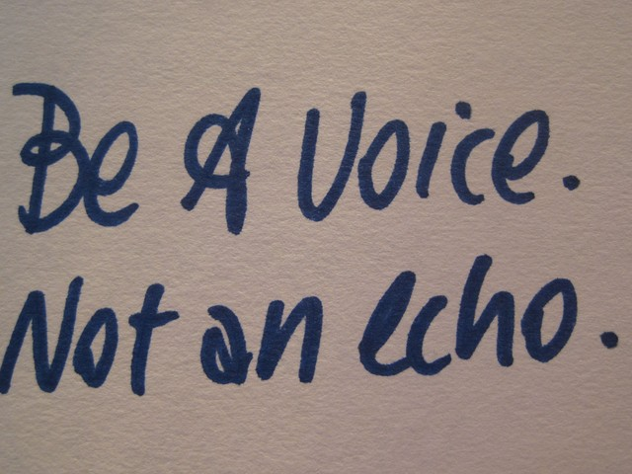
Advocacy Strategies
Document
Reassess
This Photo by Unknown author is licensed under CC BY-SA-NC.
Don’t give up!
This Photo by Unknown author is licensed under CC BY-SA.
This Photo by Unknown author is licensed under CC BY-NC-ND.
Notes:
Some other ways our participants practiced advocating for themselves, and their departments include documentation.
One participant spoke of keeping a white paper prepared articulating what was needed to keep her department operational.
Our participants also suggested that when a position becomes open, consider whether you still need it.
One librarian who did this spoke of choosing not to refill a serials check-in position in order to get more resources for their electronic resources librarian.
And, as one librarian articulated, if you are at risk of losing a position you really need, despite how difficult or challenging it can be to get your dean to really grasp the importance of our work, don’t stop trying to help them understand it.
Because as one participant said, “it’s not just the title. It's all the other things that person did because all of [are] were wearing many different hats.”

Slide 28
Lessons Learned
1. Virtual groups have been shown to have higher cancellation and no-shows. Has the pandemic changed this?
2. Have a backup plan if you run short on time.
3. Encourage the use of chat.
This Photo by Unknown author is licensed under CC BY-NC.
Notes:
In terms of lessons learned, our most valuable lessons came in the form of what we learned about conducting focus groups.
Focus group expectations
Virtual groups have been shown to have higher cancellation, no-show, and attrition rates than face-to-face groups (Matthews et al., 2018; Rupert et al., 2017) with studies providing examples where online participants were more likely to withdraw, both prior to the start and during the group (Kite & Phongsavan, 2017; Tuttas, 2015).
Do not rely on this information.
As Susan mentioned, we had 100% participation for the tenure track group. We wonder if working through a pandemic has changed this.
The literature was not definitive regarding the number of participants.
We were told to expect a no-show rate of 10-50%.
We were also told to keep our online group smaller than the in-person focus group (anywhere from six to ten).
With all this information in mind, we invited 12 participants to the tenure-track group and 13 participants to the tenured group.
We did not have 100% participation for our tenured group, but we still had 11 out of 13 participants (85% participation rate) attend the tenured focus group, with one participant committing to attend the makeup focus group we scheduled but did not need.
Despite the challenges of figuring out the magic number, the literature indicates there does not seem to be a difference in data quality between face-to-face and online focus groups.
This makes focus groups a good option for gathering qualitative data because online focus groups are accessible and convenient and there are no physical distancing requirements.
Time crunch backup plan
As Susan and I confessed, we are new to qualitative research.
We thought we had allotted enough time but realized quickly that we were going to go over our anticipated time limit.
Thankfully, several participants agreed to stay past the original end time. And having that Google doc prepared beforehand allowed all our participants to weigh in on all the questions.
Encourage use of chat
We learned a great deal from our first focus group.
In the first group, we did not discourage people from using chat, but we made the mistake of saying “we want to hear your voices.”
We think people took this as the use of chat was discouraged.
In the second focus group, we still told participants we wanted to hear their voices, but we encouraged them to use chat if they felt like it.
This did allow us to hear the voices of people who may have been hesitant to speak up or felt like what they had to add wasn’t significant enough to say out loud.
This approach yielded more data and kept us on track for the time we allotted.

Slide 29
Conclusion
There are alternatives to pushing through the discomfort.
Most of us enjoy our roles as supervisors despite the extra burden it puts on the tenure process.
Notes:
Notable differences between the two groups
As expected, there were notable differences between the two groups, most noticeably was the lack of concern with the tenured group about remaining anonymous during the focus group.
Additionally, there was a sense from the tenured focus group participants that if we push through the discomfort all be fine.
However, as technical services departments continue to be deprioritized, I argue that the things we heard from the untenured participants combined with the literature remind us that there are other alternatives to pushing through the discomfort.
Certainly, advocacy is important, but we also need help.
We need our library administration to work harder to listen and try to understand the unique challenges we face in technical services.
We also need our more seasoned colleagues to offer up mentorship either formally or informally.
Success as supervisors
A bright spot for me that came out of the focus group data was despite that every single participant expressed that they did not go into librarianship wanting to be a supervisor and despite that we are often feeling overwhelmed with our dual roles, many of us are just as invested in our supervision role as our faculty role.
Several participants spoke of their dedication to their staff and the joy they find in mentoring them.
One of our questions asked about our participants’ approach to supervision and how they defined success as a supervisor.
Participants indicated that supervision success looks like seeing their staff feel fulfilled and satisfied with their work.
But success also looks like watching staff members grow, become autonomous, finding their own success and moving on to new positions—despite the void it might cause in their department.

Slide 30
Some Things to Think About
What are your strategies for success?
How do you support your Technical Services colleagues?
What other questions do you have?
This Photo by Unknown author is licensed under CC BY-SA.

Slide 31
References
Ackerman, E., Hunter, J., & Wilkinson, Z. T. (2018). The availability and effectiveness of research supports for early career academic librarians. The Journal of Academic Librarianship, 44(5), 553-568.
Goodsett, M., & Walsh, A. (2015). Building a strong foundation: Mentoring programs for novice tenure-track librarians in academic libraries. College & Research Libraries, 76(7), 914-933
Hill, J. S. (2007). Technical services and tenure: Impediments and strategies. Cataloging & classification quarterly, 44(3-4), 151-178.
Hughes, C. (2018). A Change of Pace: Successfully Transitioning to Tenure-Track Librarianship. Library Leadership & Management, 32(4).
Kite, J., & Phongsavan, P. (2017). Insights for conducting real-time focus groups online using a web conferencing service. F1000Research, 6.
Krueger, R. A., & Casey, M. A. (2002). Designing and conducting focus group interviews (Vol. 18).
Matthews, K. L., Baird, M., & Duchesne, G. (2018). Using online meeting software to facilitate geographically dispersed focus groups for health workforce research. Qualitative Health Research, 28(10), 1621-1628.
Rupert, D. J., Poehlman, J. A., Hayes, J. J., Ray, S. E., & Moultrie, R. R. (2017). Virtual versus in-person focus groups: Comparison of costs, recruitment, and participant logistics. Journal of Medical Internet Research, 19(3), e6980.
Tracy, S. J. (2019). Qualitative research methods: Collecting evidence, crafting analysis, communicating impact. John Wiley & Sons.
Tuttas, C. A. (2015). Lessons learned using web conference technology for online focus group interviews. Qualitative Health Research, 25(1), 122-133.

