Slide 1

Data Storytelling
Structures, Strategies, and
Troubleshooting
Kate McDowell, University of Illinois
kmcdowel@Illinois.edu
Notes:
Explain the project: introducing a framework

Slide 2





Slide 3











Slide 4
Data Storytelling Framework
Narrative strategies
Narrative structures
Troubleshooting data storytelling dynamics

Slide 5
Data Storytelling Framework
Narrative strategies
  Character
  Setting
  Plot
Narrative structures
  Enigma
  Hero’s Journey
  Equilibrium
Troubleshooting data storytelling dynamics
  Teller
  Tale
  Audience
  Between teller and audience
  Between audience and tale
  Between teller and tale
Notes:
If you use this later, please acknowledge my work. www.katemcdowell.com
And let me know! Questionnaire and opportunity to stay in touch at the end

Slide 6

What’s more comfortable for you:
Data or Story?

Slide 7
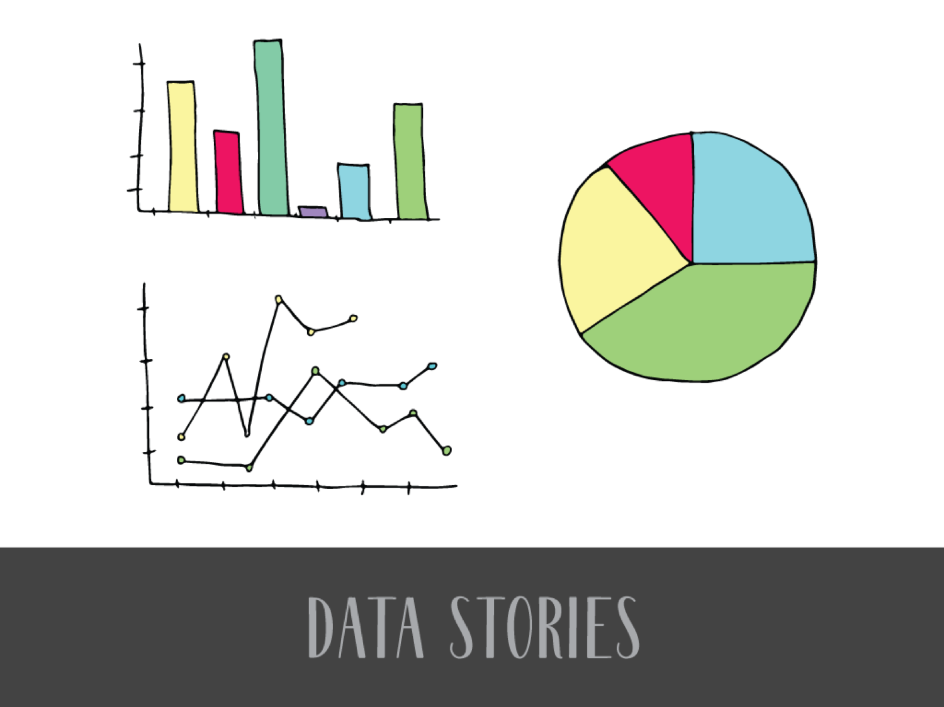
Notes:
Data stories are presentations that are based on data and use narrative elements.
Well-evidenced stories, data serves as evidence
Narrative elements like structure of folktale.
Example: The Three Little Pigs, but structures like having three attempts to solve a problem, 2 failures and a 3rd success,
Famous examples:
John Snow cholera—constructed a story from tracking data about well water usage
Challenger disaster (Tufte)—showed what went wrong by re-visualizing data, from disaster to better information
Hans Rosling, Gapminder—corrects many erroneously negative assumptions about the world, moving audience from less informed to more informed by data

Slide 8
What’s the biggest obstacle to telling your data stories?

Slide 9
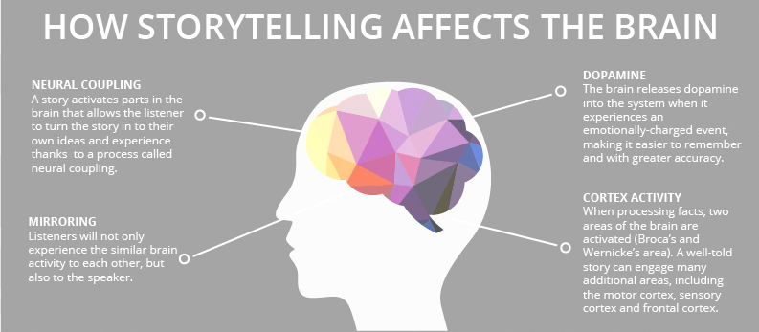
Notes:
https://www.onespot.com/blog/infographic-the-science-of-storytelling/
From the infographic "The Science of Storytelling," by OneSpot.

Slide 10
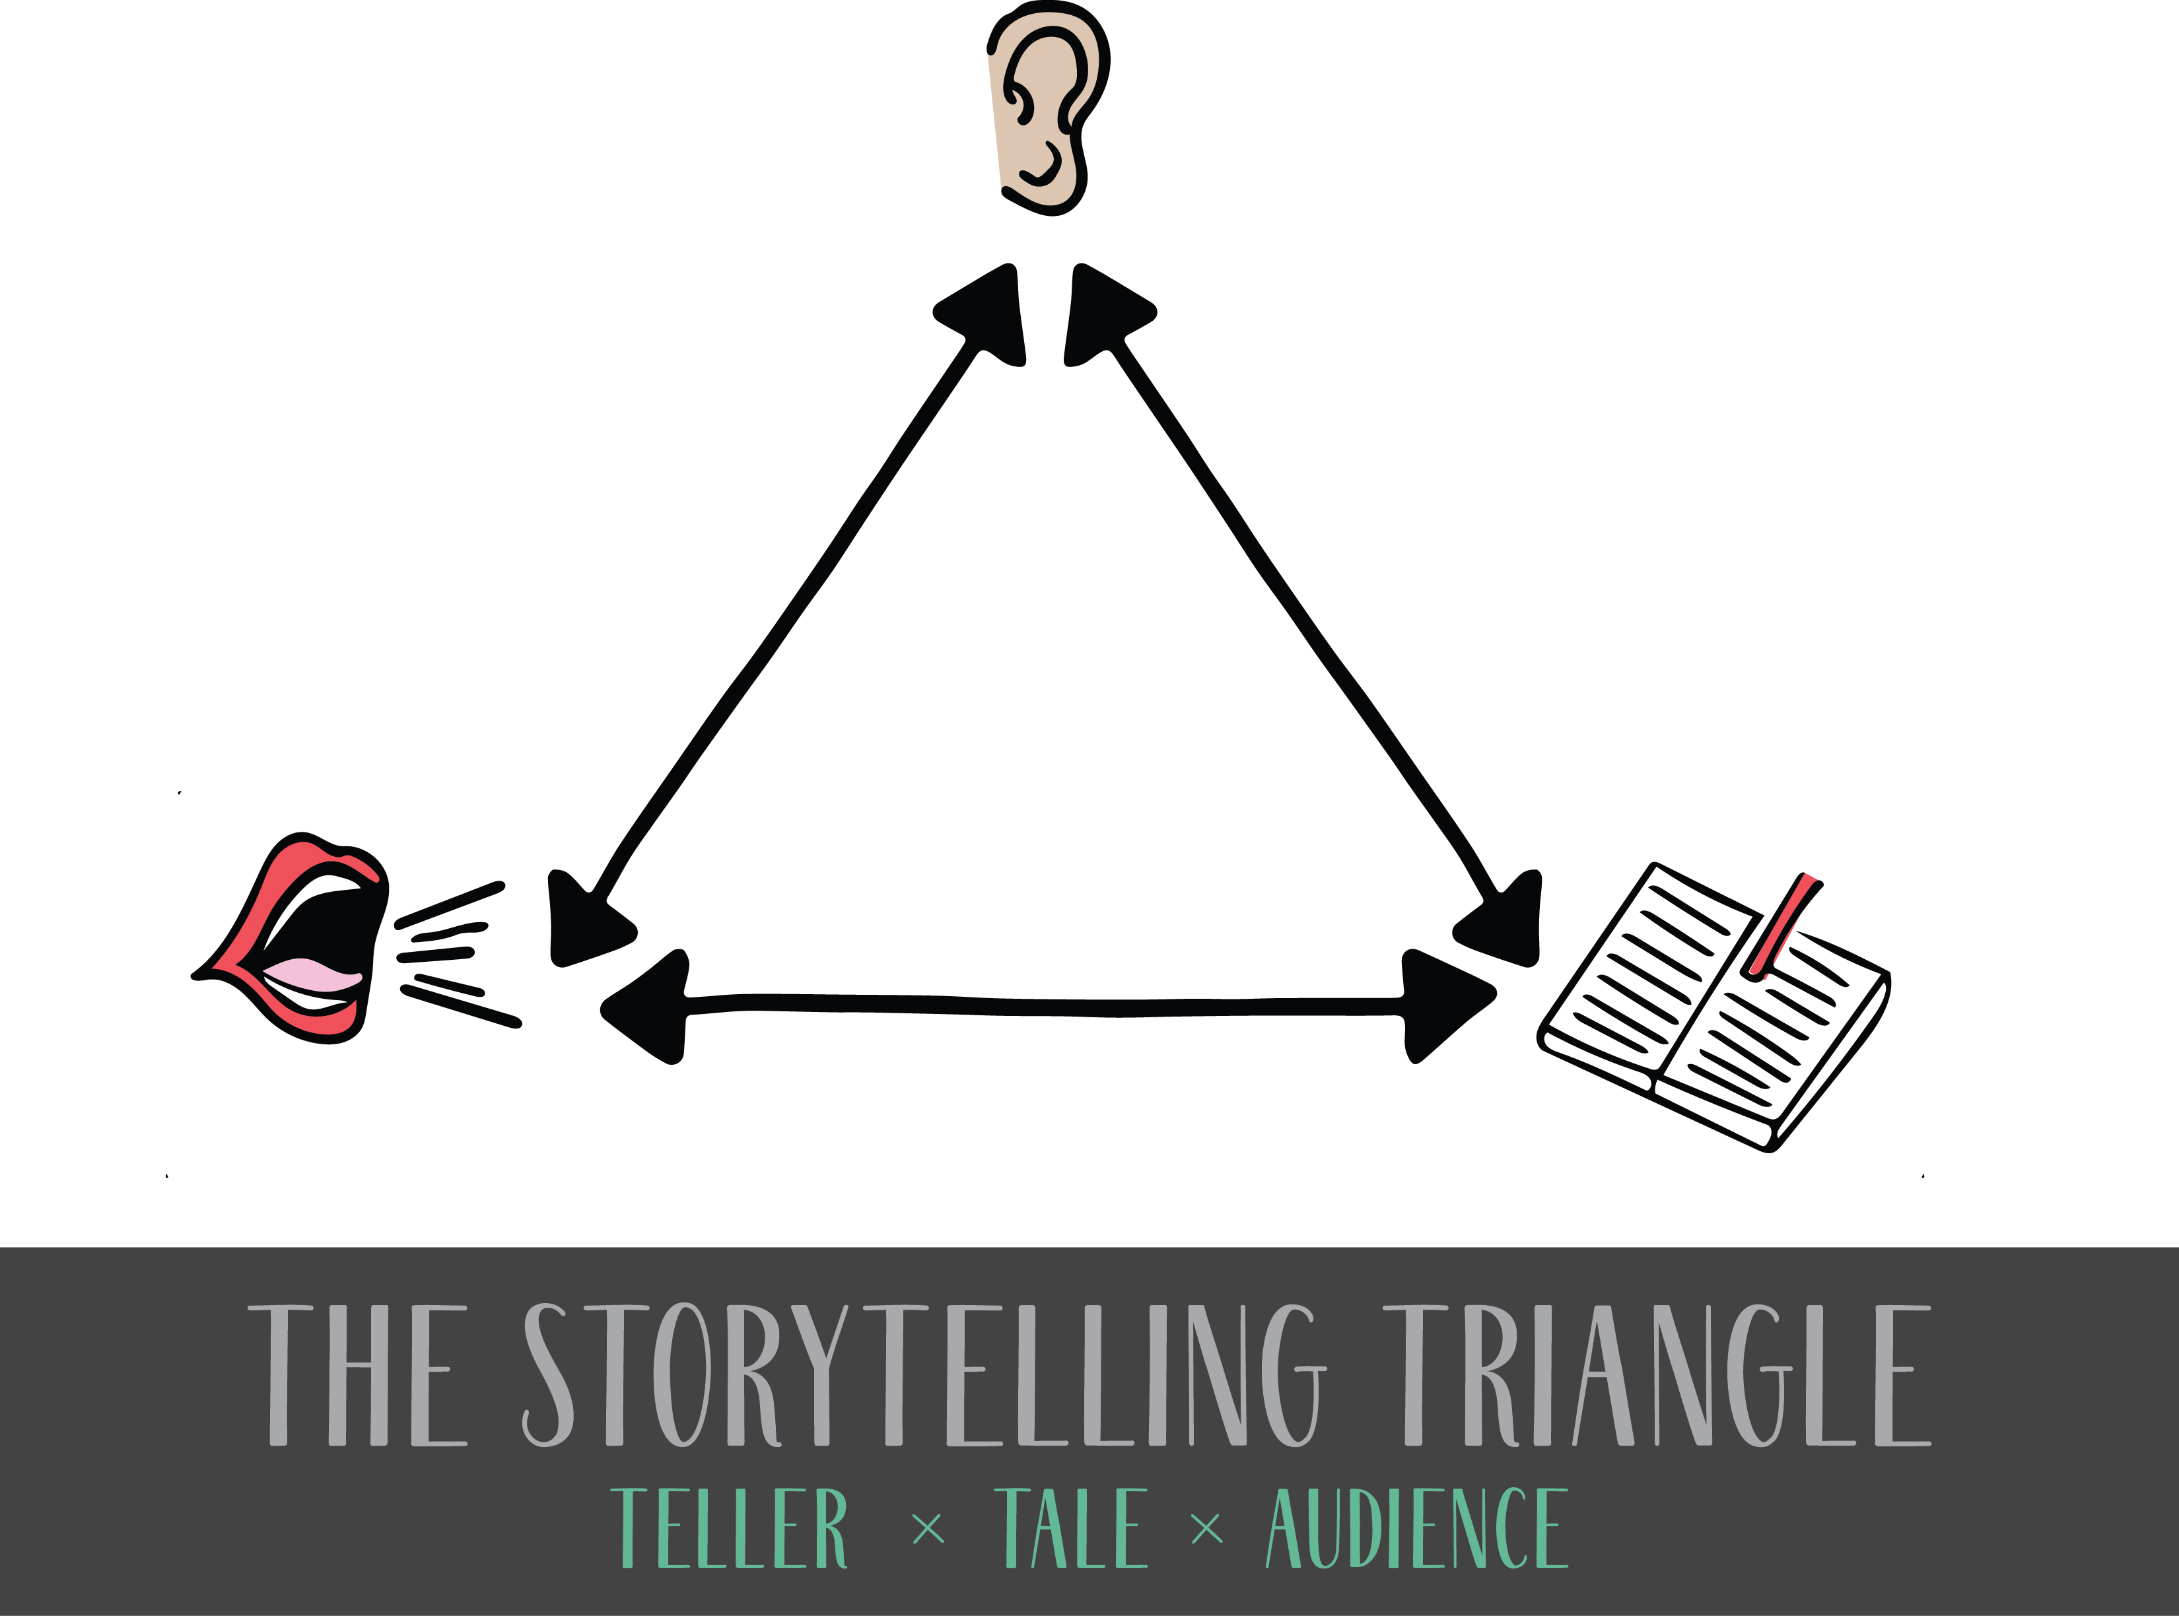

Slide 11
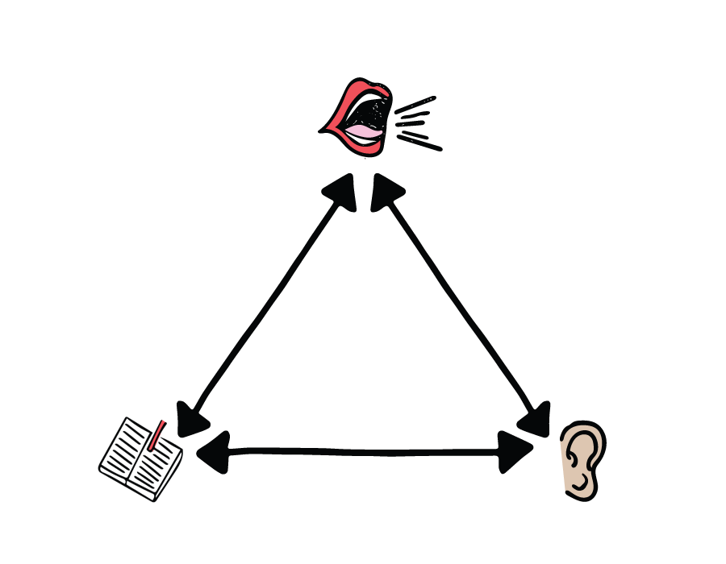

Slide 12

Narrative Strategies
Thinking in story ways

Slide 13
Narrative Strategies
Character
Setting
Plot

Slide 14
Narrative Strategies, Character
If it adjusts or transforms, develops or shifts, then it has potential to serve as the data character.
Notes:
For instance, in a data story illuminating gender discrimination, the key transformation from (seemingly) accepting second-class citizenship to fighting for equal rights starts the search for character, which was defined as data about women’s participation in social movements. In another data story based on the same data, the character might be data indicating slow change, such as the change in pay gap between women and men. In this story, the character may be defined as the pay gap with its glacial transformation. While the character might also be change in men’s relative pay privilege, or change in women’s lived socioeconomic experience based on the pay gap, the pay gap itself can serve as the data character that the audience follows over time.
Another common character in data stories is the audience’s belief, and the intended change in that belief over time based on the data presented. For example, a data story took up the issue of legal bans on plastic straws. The opening of the story explored the environmental benefits of instituting straw bans, but there was a twist when the teller revealed data about the negative consequences for people in hospitals or with disabilities—for whom plastic bendable straws were invented—supported by evidence of the history of the invention. This story made a compelling argument for re-evaluating bans by first leading the audience to a familiar place of belief—data showing that plastic straws are bad for the environment—and then leading them to a less familiar understanding—plastic straws are lifesaving in some contexts. The transformation is that of the audience’s perspective about the data presented. When a data story is constructed with the expectation of changing the ideas or opinions of the audience, then concepts may serve as characters. However, caution is in order; the change in the audience’s mindset might not be what the teller expects, since they are free to interpret the data for themselves.

Slide 15
Narrative Strategies, Setting
Setting is the minimal context necessary to understand the character and sequence of actions in the story.
Notes:
only that which is important to understand the transformation of the data character. A data story about a scientific discovery, for example, might need the branch of science involved, the way the data was collected, and/or the historical moment of the discovery as setting. A scientific discovery story may also need what was previously known and some translation of the “emotional gravity” of what the new finding reveals. (Martinez-Conde & Macknik, 2017). The minimal necessary setting will depend on how familiar the audience is with that data or its usual context already and, again, playing around with some possibilities would be a good starting point.

Slide 16
Narrative Strategies, Plot
A plot shows the audience not only what happens over time but how it relates to other information and what it might mean.
Plot Strategy | Applications
Change over time in data | When the story is about change over time
Comparison or parallel changes | When two types of data have some correlation or relationship such that one changes or seems to change in relation to the other
Discovery or inquiry process | When the story of how data lead to new information is as important as the new information
Shift in audience’s understanding | When commonly held ideas are contradicted by evidence derived from new data
Notes:
The plot is the action, meaning what changes, has changed, or should change over time as the audience comes to understand the meaning of this data. It is what happens, the sequence of events—often struggles or suspenseful questions—that the character goes through.

Slide 17
Narrative Strategies
Character
  If it adjusts or transforms, develops or shifts, then it has potential to serve as the data character.
Setting
  Setting is the minimal context necessary to understand the character and sequence of actions in the story.
Plot
  A plot shows the audience not only what happens over time but how it relates to other information and what it might mean.

Slide 18
Narrative Structures
Successful examples from courses and consulting

Slide 19
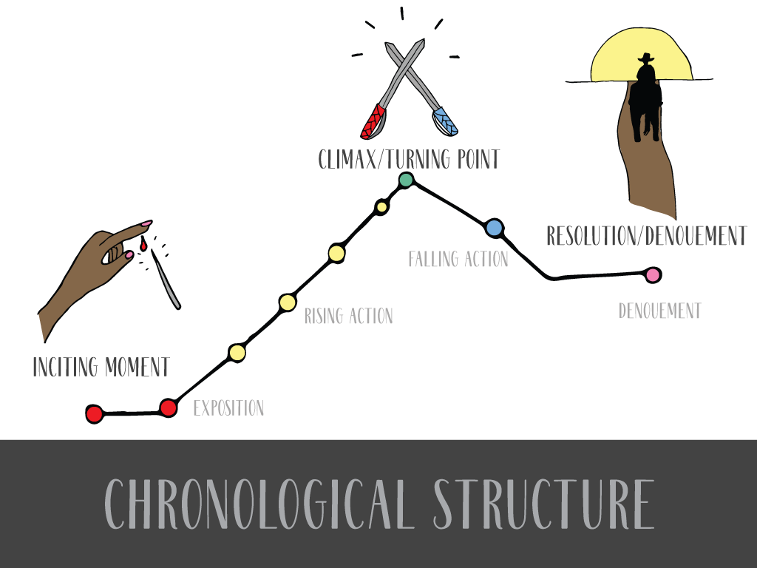
Notes:
Structure in business: here’s a problem, here’s why you should care, here the solution

Slide 20




Slide 21
Narrative Structures
Narrative Structure | Emotional Impact | Originating theory
Enigma | Mystery, suspense, intrigue and satisfaction of coming to understanding | Roland Barthes’ S/Z
Hero’s journey | Awe at transformation, joy of watching a hero triumph | Joseph Campbell’s The Hero With a Thousand Faces
Equilibrium | Stability and resilience despite challenges, reassurance of continuity | Tsvetan Todorov’s The Fantastic, and the Japanese folktale “The Stonecutter”
Notes:
Enigma: The emotional experience is that of suspense and intrigue followed by the satisfaction of coming to understanding. This is the narrative structure used in library storytelling when a librarian asks the young audience: “What do you think will happen next?” This enigma structure of suspense and surprise or satisfaction may be an overarching story arc or a micro-structure repeated many times within a narrative.
Hero’s Journey: Good examples are data stories about the science of successful space flight, such the underappreciated heroic role of U.S. astronaut Michael Collins who piloted a command module around the moon while crewmates Neil Armstrong and Buzz Aldrin set foot on its surface. However, the hero’s journey structure is only effective for that subset of data stories with those characteristics. Attempting to manufacture awe and wonder can backfire and risk losing the audience’s interest or trust. Unlike the enigma structure, which may span a full story or recur in the course of a story, the hero’s journey works at the macro level of the whole story, spanning the full narrative arc from beginning to end.
Finally, the equilibrium narrative structure is about cycles, journeys from stability to disruption and on to a new equilibrium or stability, changed by the disruption. Japanese story called The Stonecutter, in which a man who is a stonecutter makes a series of wishes and goes through a series of transformations only to ultimately return full circle to his mountain home (Sturm, 2008). The emotional impact of the equilibrium structure is resilience or stability despite challenge.

Slide 22
Troubleshooting
Data Storytelling
What goes wrong and how to fix it

Slide 23

Troubleshooting data storytelling
Teller
Tale
Audience
Between the teller and the audience
Between the audience and the tale
Between the teller and the tale

Slide 24
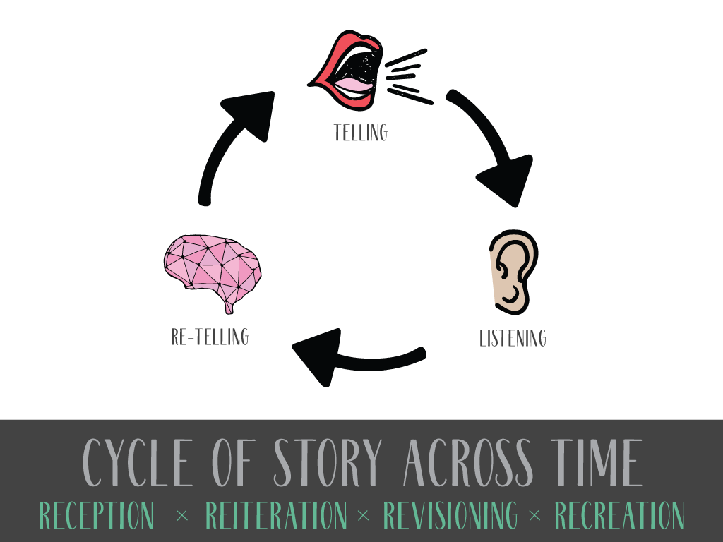
Notes:
New degree, name, admin structure… all have to LAST
Good leaders tell stories and listen, changing roles as needed,
But they help the group collaboratively define a collective story
That is good enough to be retold on its own, that stands up to scrutiny, and ultimately stands the test of time.
I’m interested in stories that have lasted. Folklore, hundreds and thousands of years

Slide 25
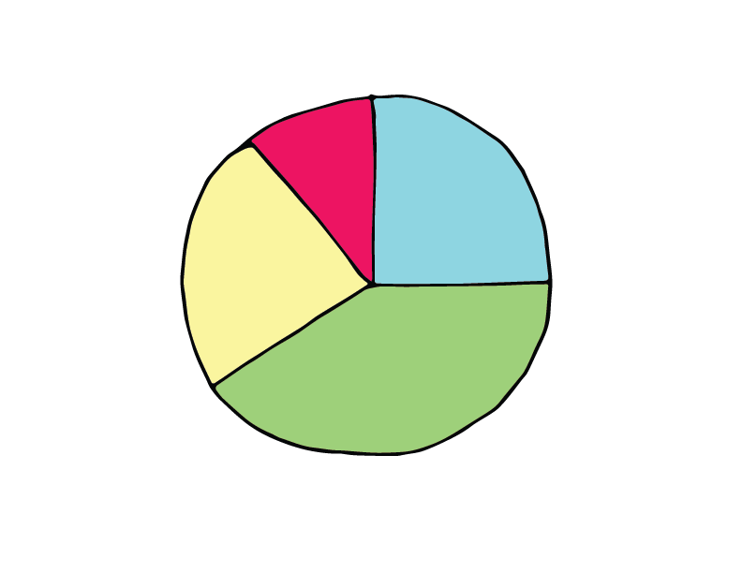



Slide 26
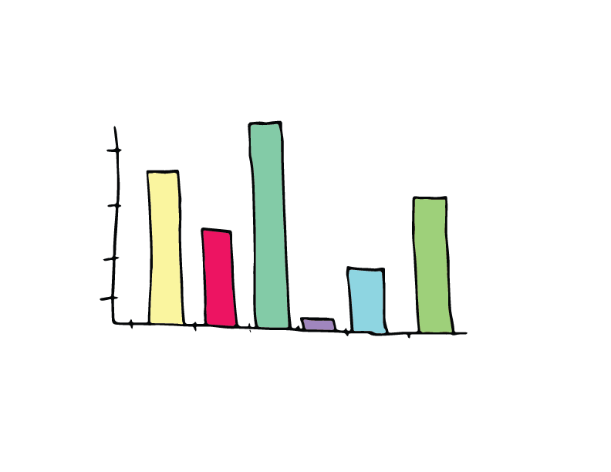

Slide 28
What’s the biggest obstacle to telling your data stories?

Slide 29
Obstacles to telling data stories
Not enough data
Don’t have the data needed
Too much data
Too little focus on story, using data as communication
Too much focus on storytelling, not enough connection to data
Too much focus on data, disconnected from storytelling
Too little time to gather or interpret data
Too little time to practice stories
Other?

Slide 30
kmcdowel@illinois.edu, @katenarrative

Slide 32

Who is the storyteller?
Who tells your stories?
What roles do they have in the organization?
What obstacles are there to those tellers telling your stories effectively?

Slide 33


Notes:
Structures also help you remember, and remembering helps you tell by heart. Not by rote, not just memorizing words and reciting them, but bringing a story to life with you language in a way that shows your audience your passion.

Slide 34
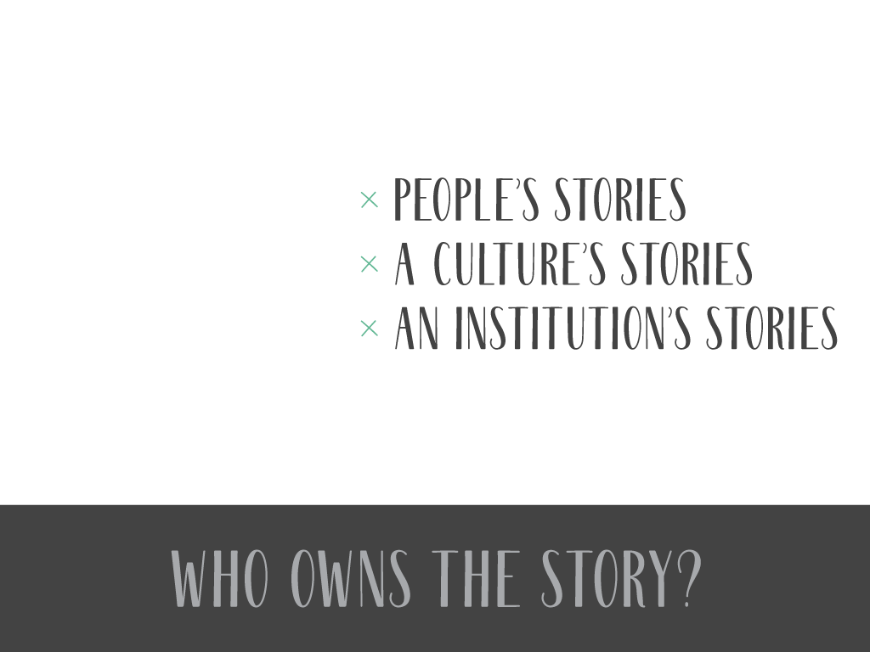

Notes:
Ways to involve stakeholders in sharing stories

Slide 35
Developing stories
What’s one story that you would like to be able to tell more effectively?
What information problem are you trying to solve? What are the data sources?
What changes, has changed, or needs to change over time in this data?
What’s the shortest version?
  What happens? What’s the struggle?
  What’s the information? How is it meaningful?
  What context is needed? What context can be cut?

Slide 36
Easier to Tell Harder to Tell
One character
One setting
A plot with fewer moments of trouble and struggle
One time period
Multiple characters, particularly multiple protagonists
Multiple settings, especially if action occurs in them at the same time
A plot with many events, especially misdirects that appear to lead to an ending too early
Long periods of time

Slide 37


Slide 38
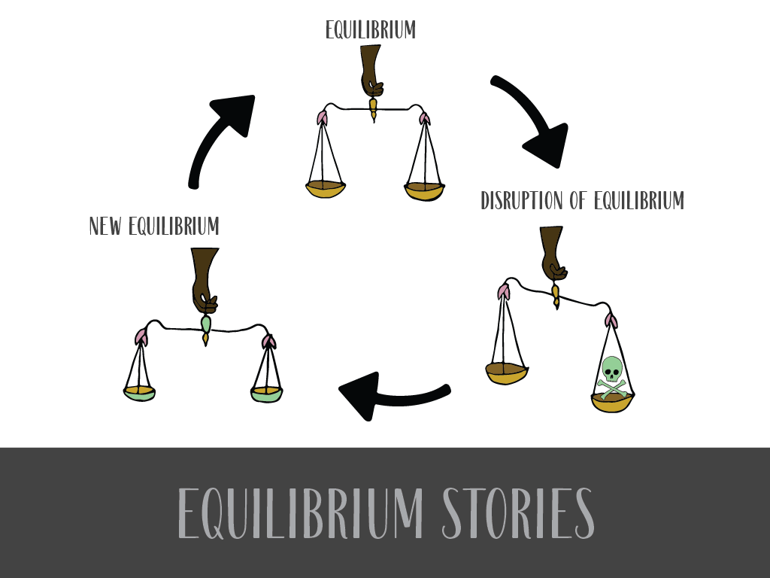
Notes:
3 strucutures. First one: Equlibrium. Find trouble? Good, now find the resolution.

Slide 39

Notes:
Feeling is that of a still pool, disrupted, and then still again.

Slide 40
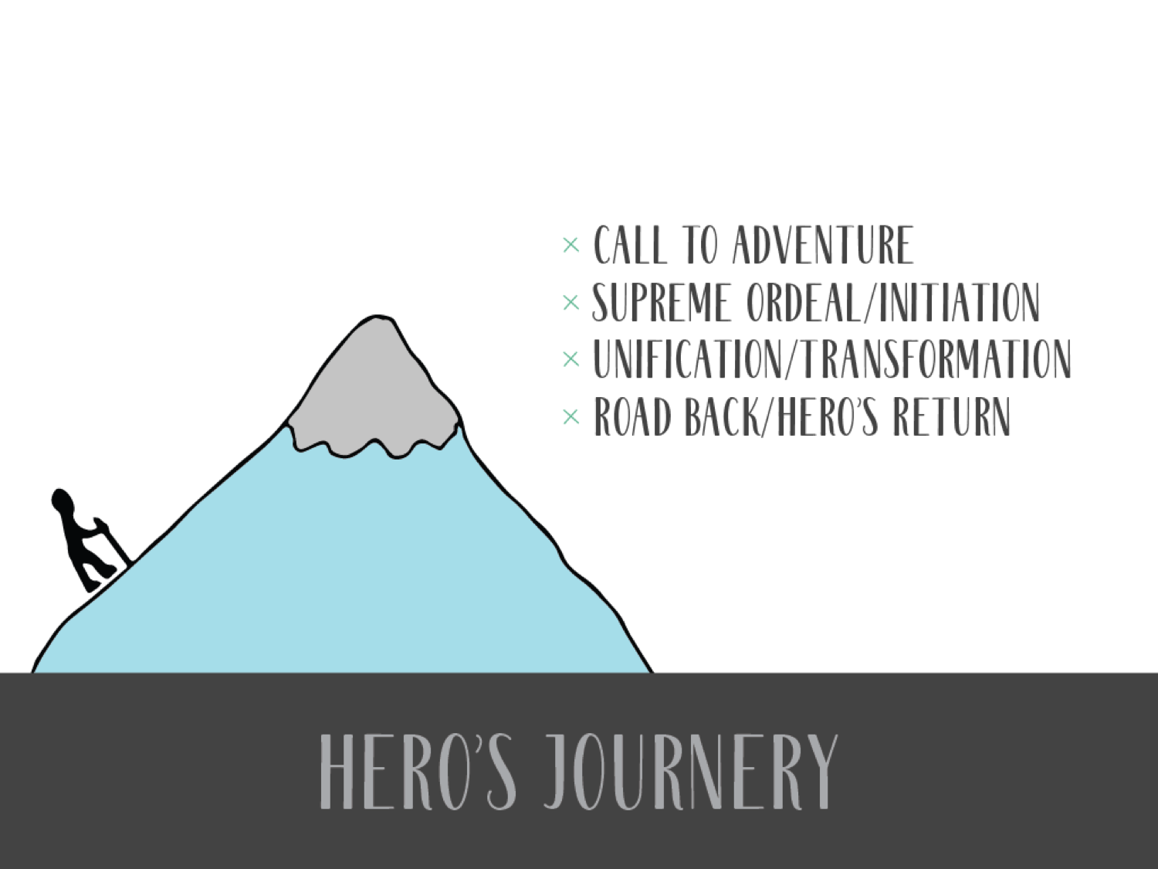

Slide 41

Notes:
Jerk. Superheroes, not most of us. Nobody will trust you. People who can just fly. Feeling is that of awe.

Slide 42
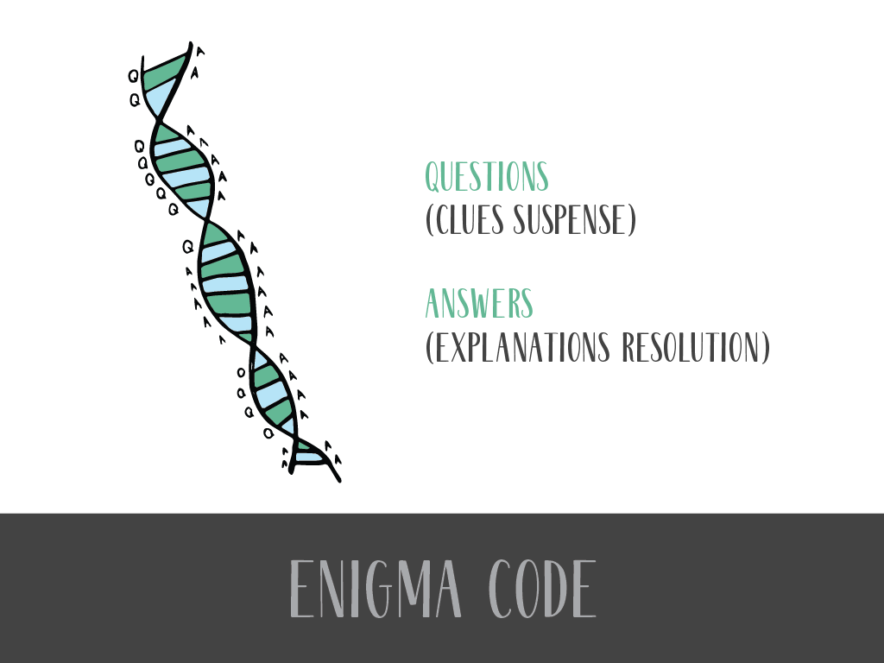
Notes:
Leading an audience through information. Revealing more as you go.
Mystery and Revelation
Primary mystery: “Why are you telling me this now?”

Slide 43

Notes:
Feel is that of a detective adventure

Slide 44
inquiry
uncertainty
data
question
information
mystery
solution
Notes:
Feel is that of a detective adventure

Slide 46
Notes:
New degree, name, admin structure… all have to LAST
Good leaders tell stories and listen, changing roles as needed,
But they help the group collaboratively define a collective story
That is good enough to be retold on its own, that stands up to scrutiny, and ultimately stands the test of time.
I’m interested in stories that have lasted. Folklore, hundreds and thousands of years

