Slide 1
Crafting for a Cause
Leveraging Community Partnerships to
Provide Meaningful Service Experience
for Tweens and Teens
ILA Annual Conference
Tuesday, October 18, 2022 2:45-3:45 pm

Slide 2
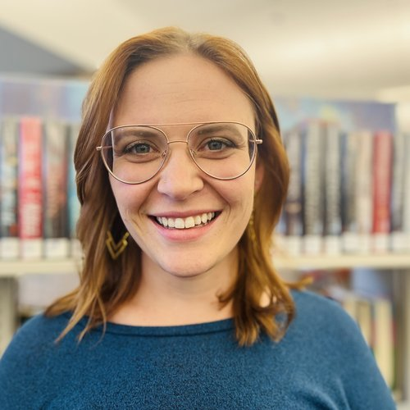
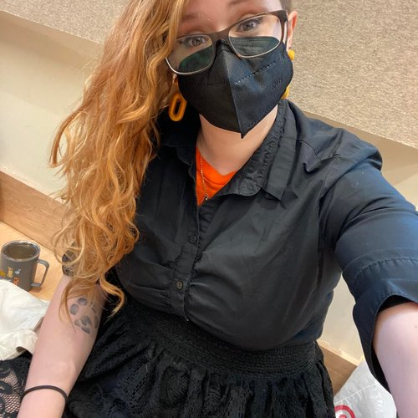
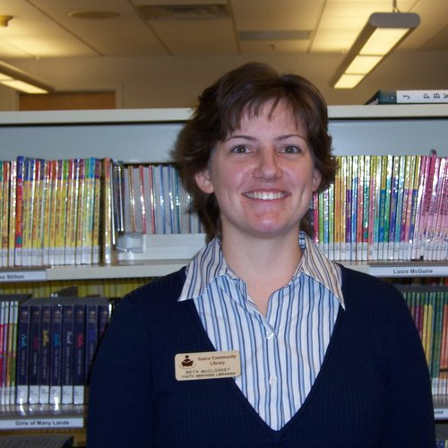
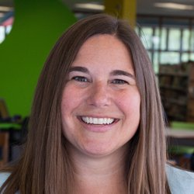
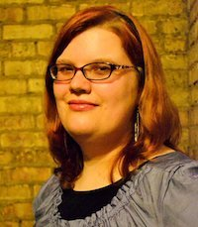
Presenters
Amanda Klenk (she/her)
Teen Services Coordinator
Downers Grove Public Library
Beth McCloskey (she/her)
Youth Services Librarian
Itasca Community Library
Eti Berland (she/her)
Youth School Engagement Librarian
Wilmette Public Library
Dannie Moore (they/them)
Assistant Children’s Services Manager
River Forest Public Library
Kristi Miller (she/her)
Manager of Youth & Teen Services
Westmont Public Library

Slide 3
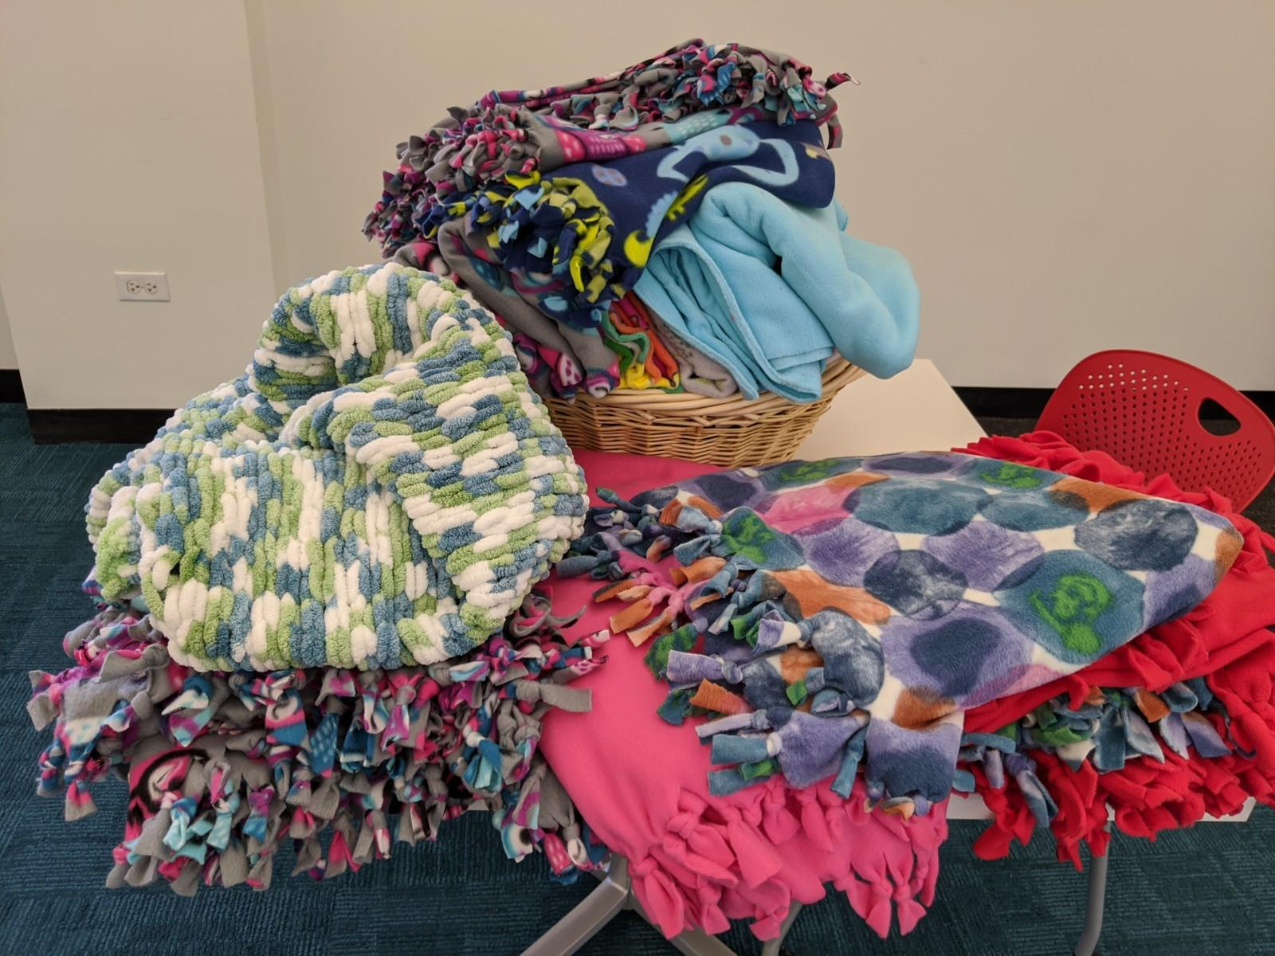
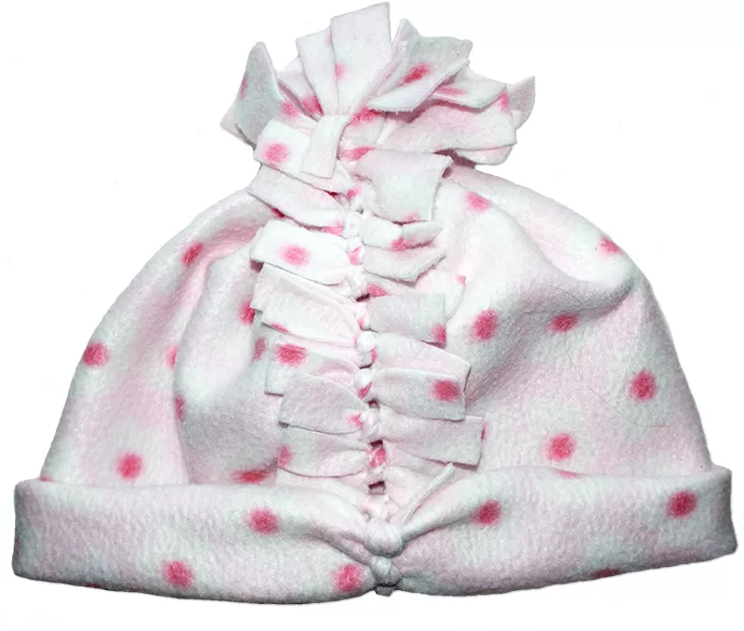
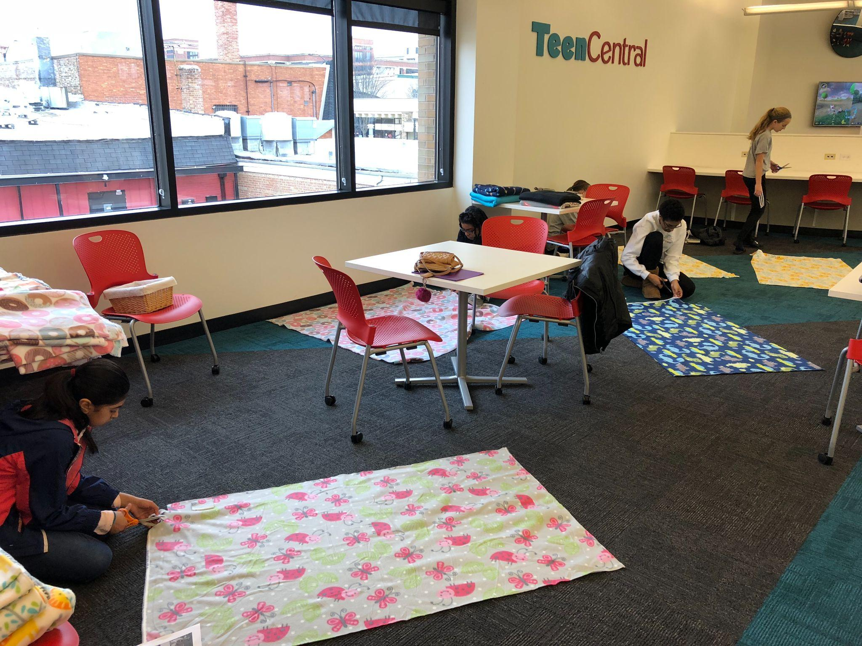
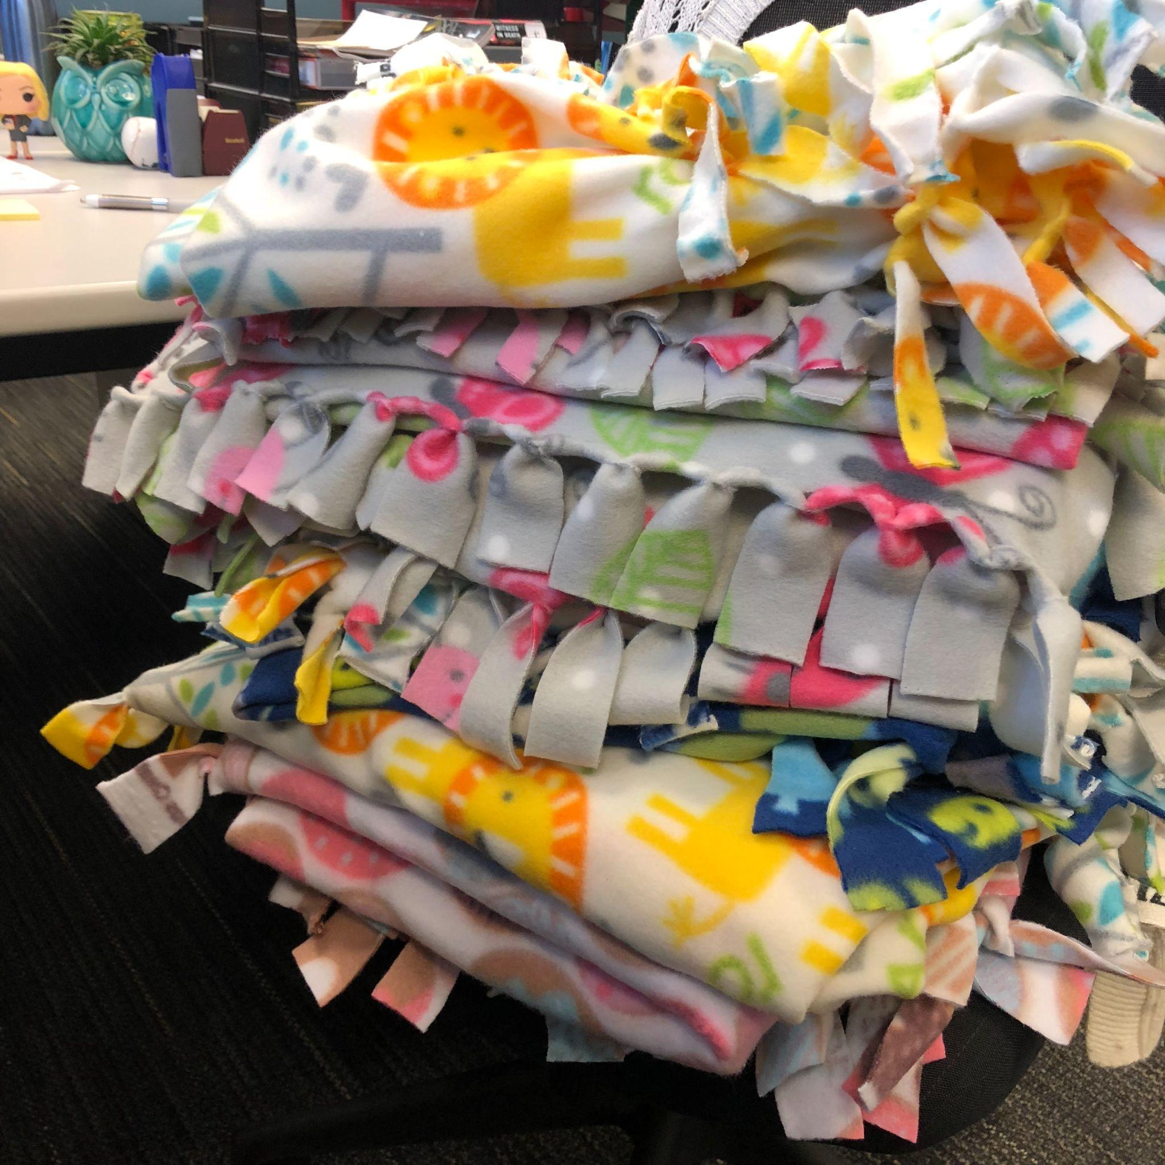
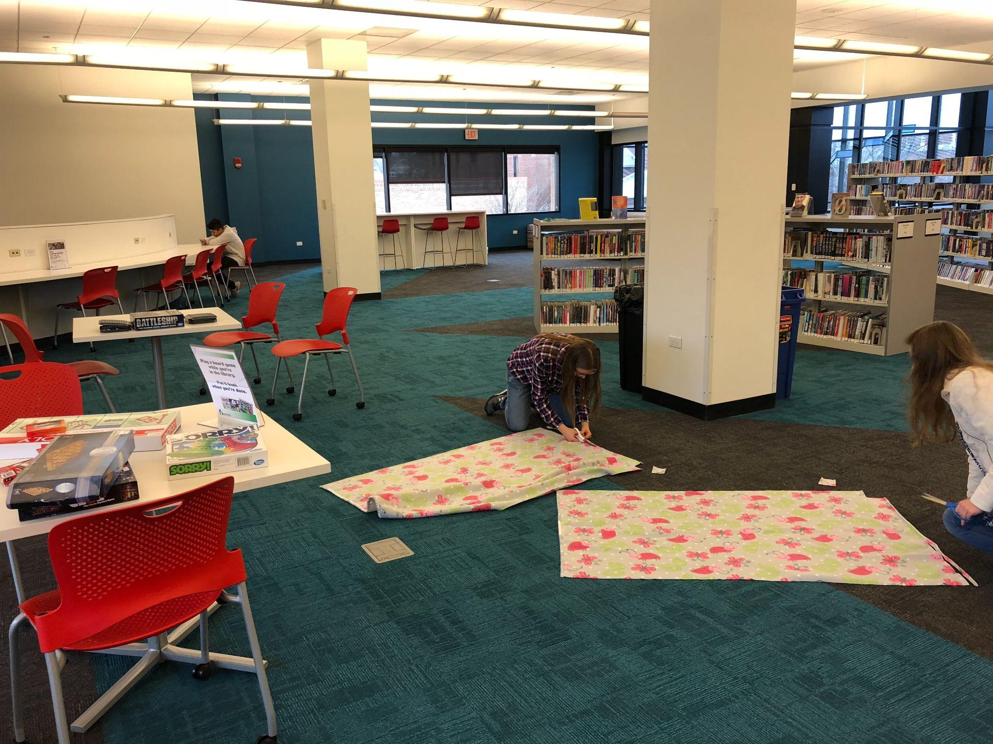
No-Sew Projects
Fleece Blankets
Fleece Hats
Fleece Scarves
Paracord Bracelets
Fleece hat example
Blankets made to donate
Teens @ DGPL work on their fleece blankets to donate to Project Linus
Blankets made to donate, Nov. 2019
Teens @ DGPL work on their fleece blankets to donate to Project Linus
Notes:
Project Linus / No Sew Blankets
What is it: National organization (with local chapters). Blankets are collected locally and distributed to children in hospitals, shelters, social service agencies, or anywhere that a child might be in need of a big hug.
First ran as make to take & donate. Each teen got to make two blankets, one to take home and one to donate to Project Linus. Had 9 teens make blankets. 1st service project; gave them the option to make one for themselves. Haven’t done that again…teens do want to volunteer and give back (and sometimes need the opportunity to volunteer). Dannie will explore ways to engage your teens later, but you’ll see through our different projects that there is a lot of flexibility in how to do that based on what will work at your library. At Downers, I’ve found that having the project available for a week or two allows for students to work.
Ran again as a passive program the next year. Teens could make a blanket with supplies that were out for one week. 16 blankets were made and donated.
No Sew Scarves
Passive program. Fleece and supplies were out for (3 days, long weekend off school). 110 scarves were made by 31 teens and donated to DuPage Pads and used for our in house pantry, The Cupboard.
No Sew Hats
Passive Program. Fleece and supplies were out for (1 week). 36 hats were made and donated to our in house pantry, The Cupboard. Instructions and templates will be made available on our resource document.
Paracord Bracelets
Upcoming service project at DGPL. Using the instructions from Operation Gratitude.
Perks of no sew projects:
Low level of skill/knowledge needed to participate
Basic tools needed that most libraries have available (rulers, scissors)
Can be done for local or national organizations
Things to Consider:
Fleece can be expensive
Look for deals at stores
See if a store or community member would be willing to donate if your budget doesn’t allow you to buy yards and yards of fleece. We had some fleece donated during a project.
Start with one of the smaller projects (like scarves or hats) that doesn’t require as much fleece
Tie into seasonal/holiday needs
Paracord bracelets are being done in November to honor Veterans Day.
Hats and Scarves were made when most needed in the winter
Starting with national organizations or established partners can be an easy way in to service projects for your teens.
Project linus is always accepting donations
DGPL has an established partnership with DuPage Pads that made it possible for us to donate. Having an in house option, like our Cupboard, makes it easier to see the needs and see an immediate impact
Hand off to Beth about quilting squares

Slide 4
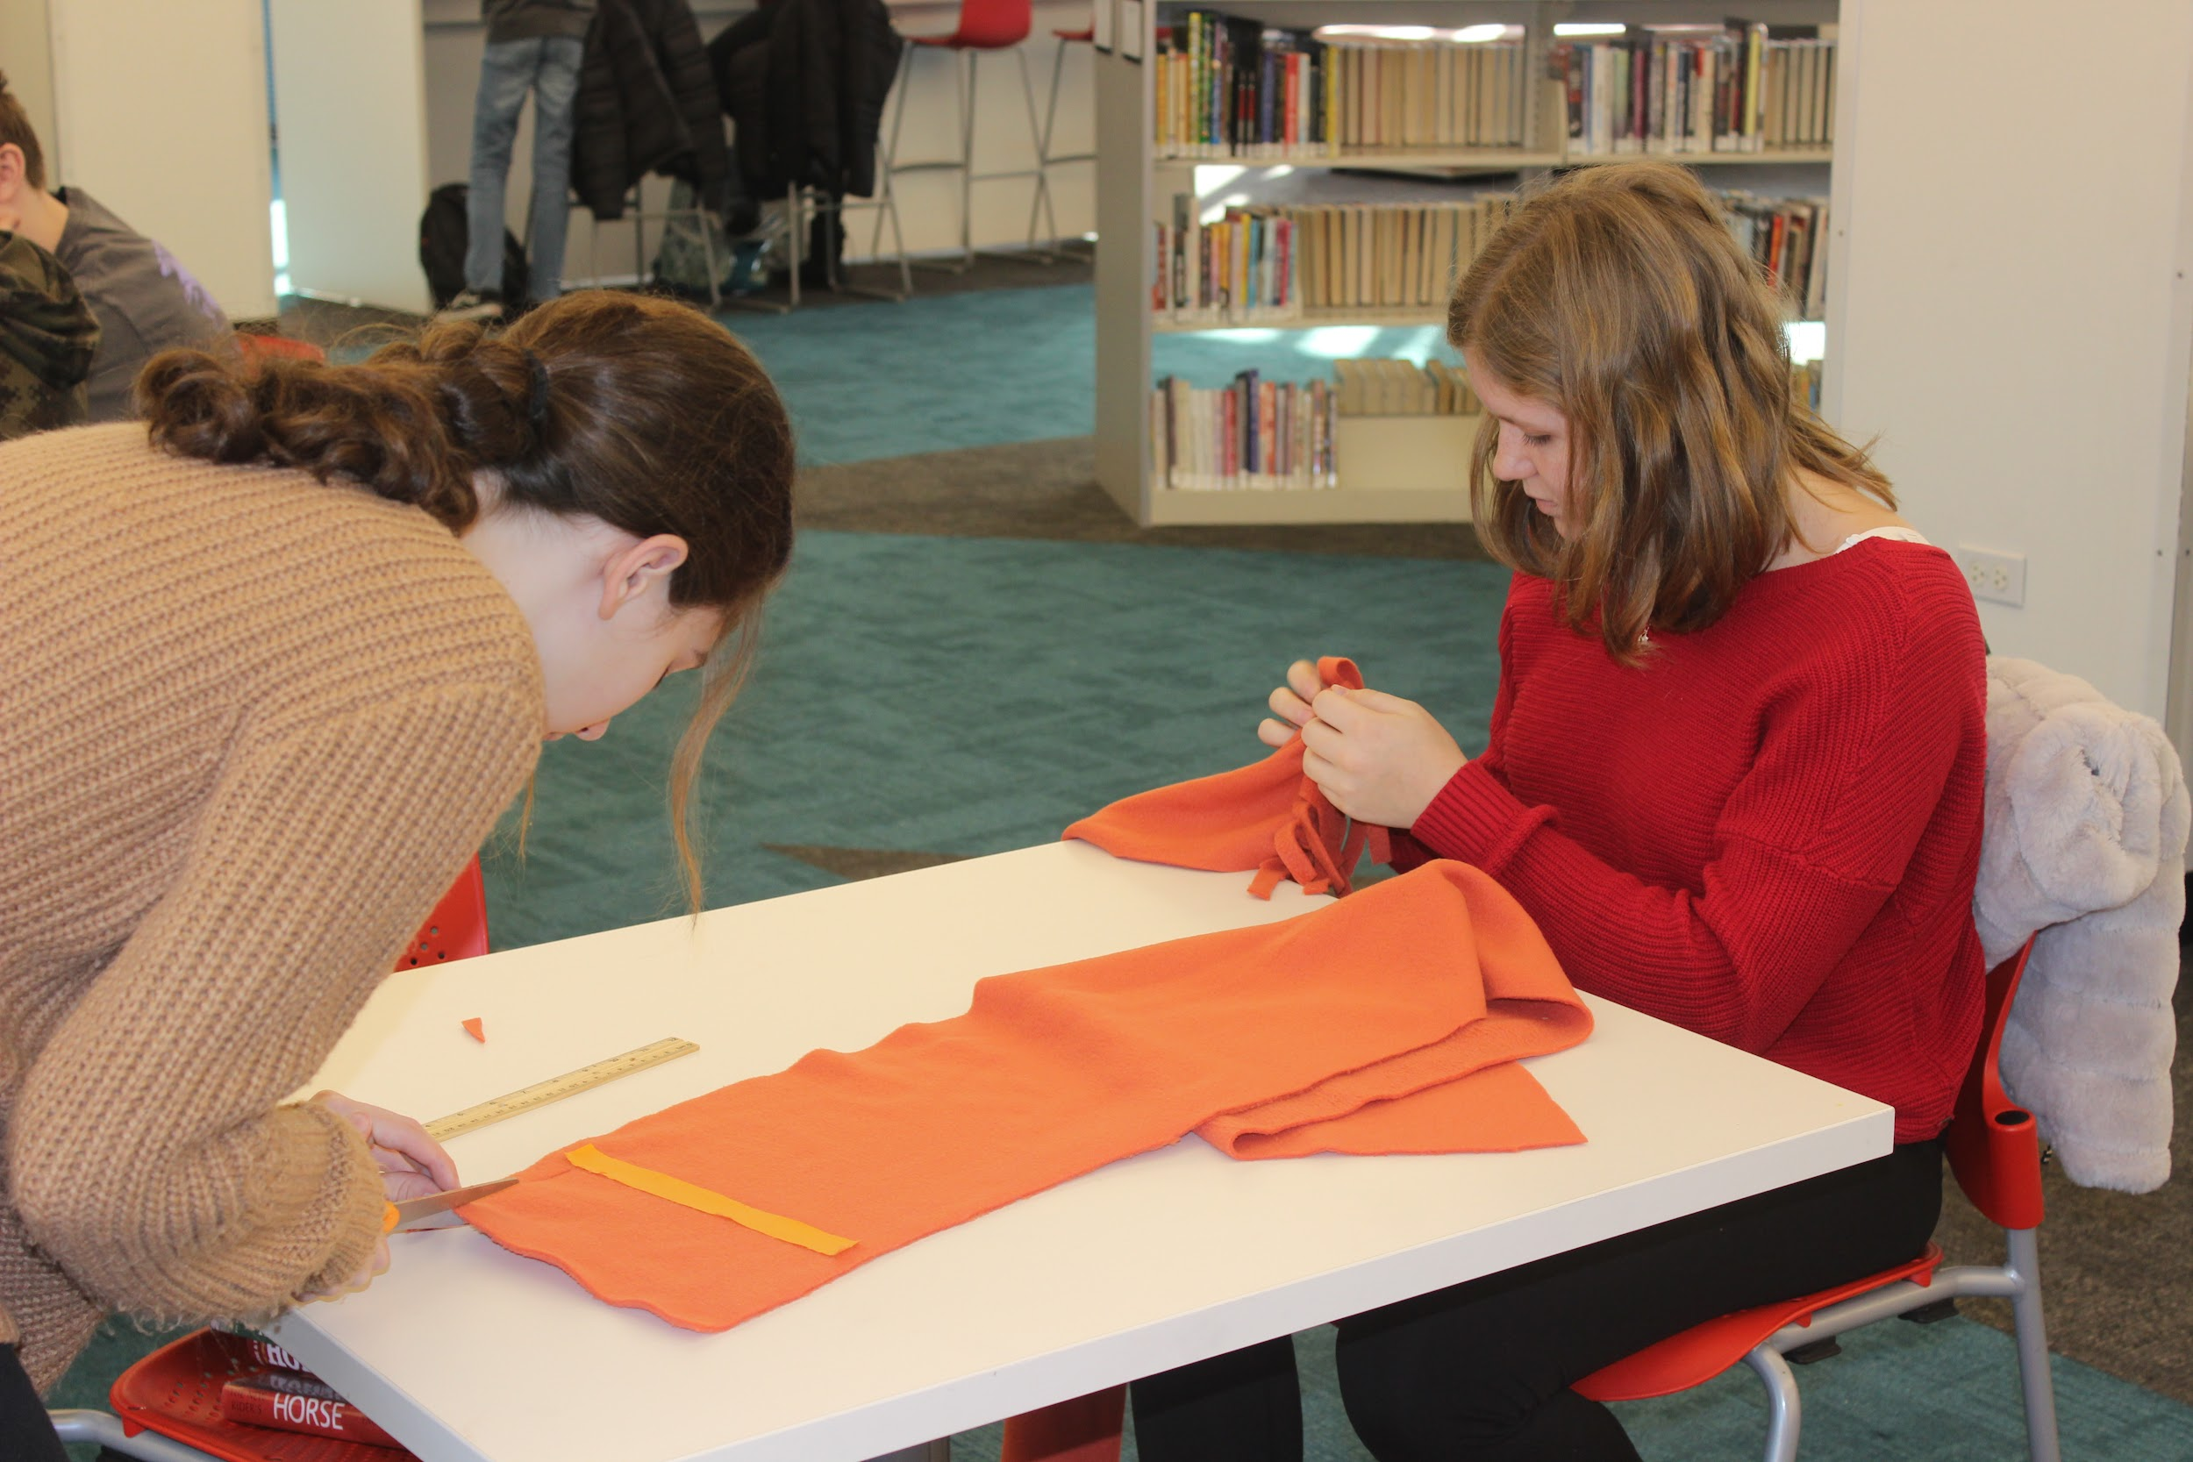
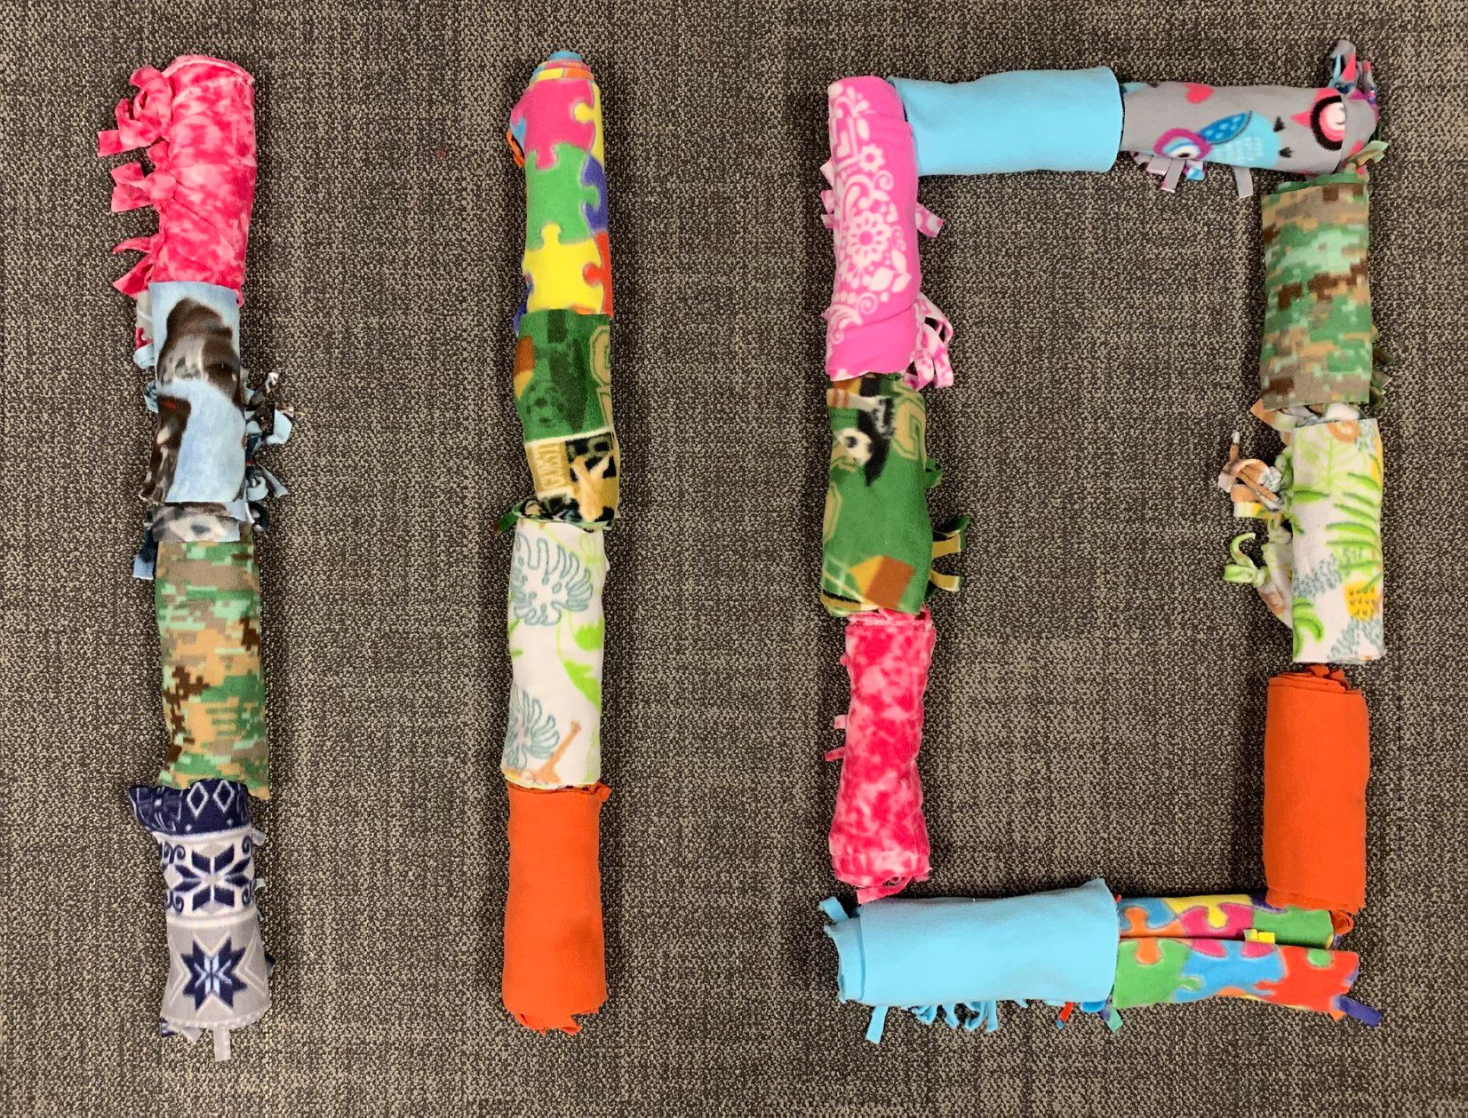
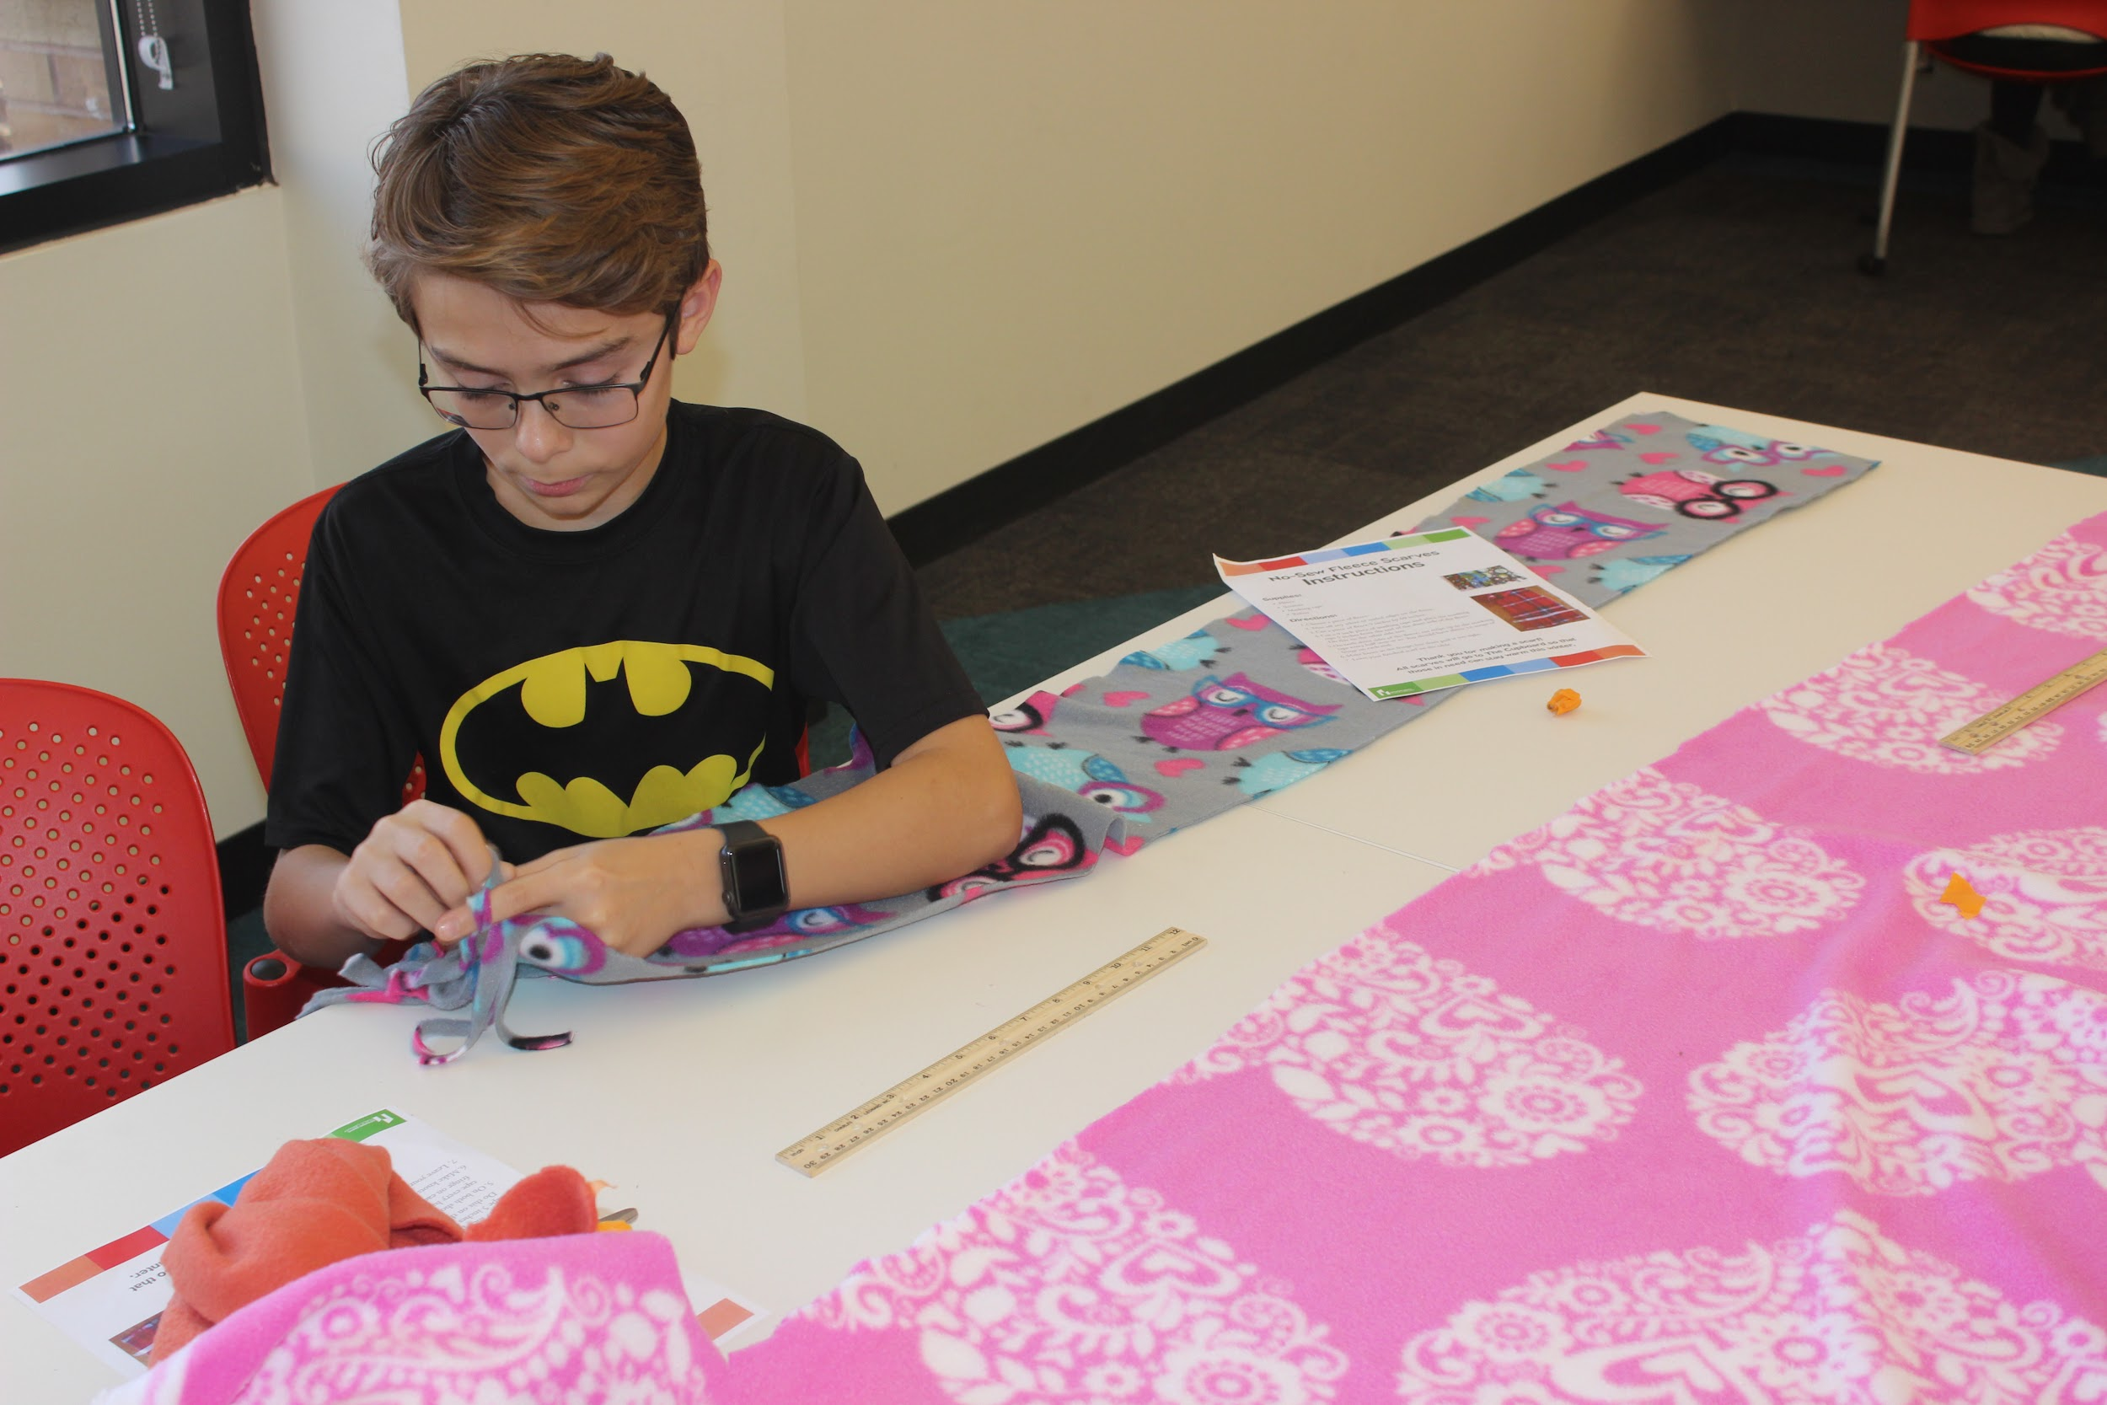
Social media post to share how many scarves were made to donate to DuPage Pads and the DGPL Cupboard
Teens @ DGPL working on no-sew scarves

Slide 5
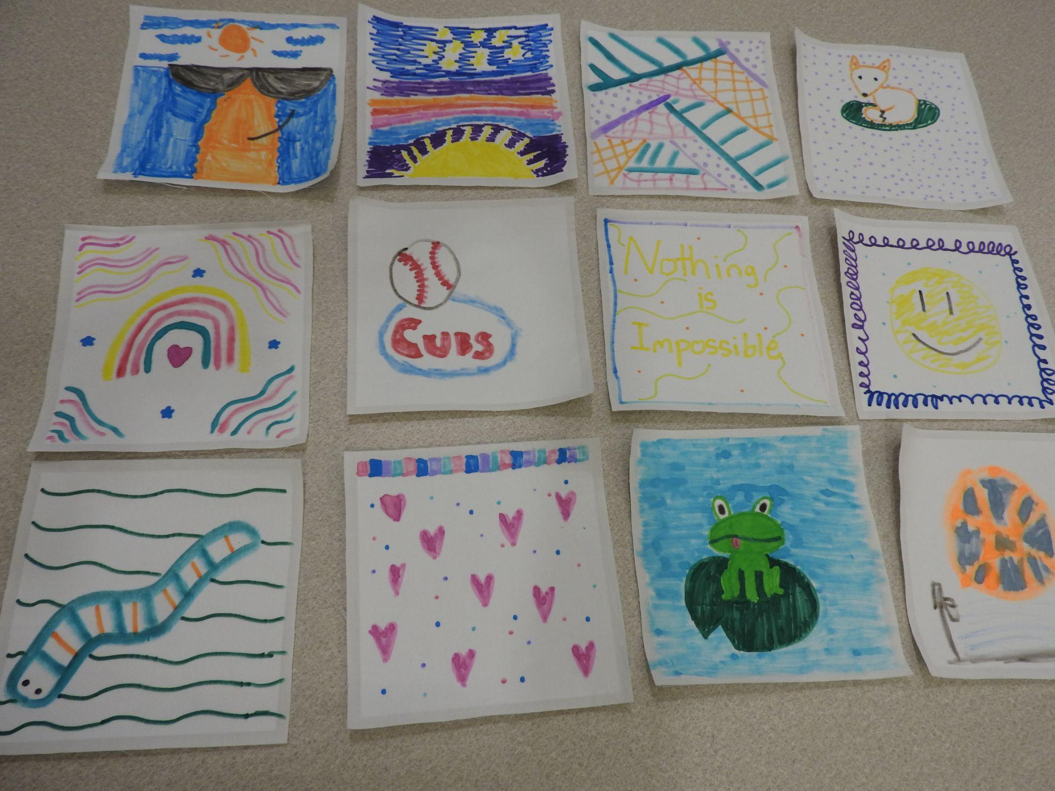
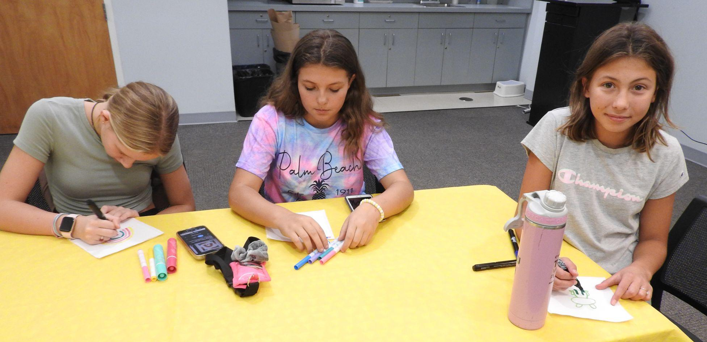
Decorating quilt squares for a local quilting group

Slide 6
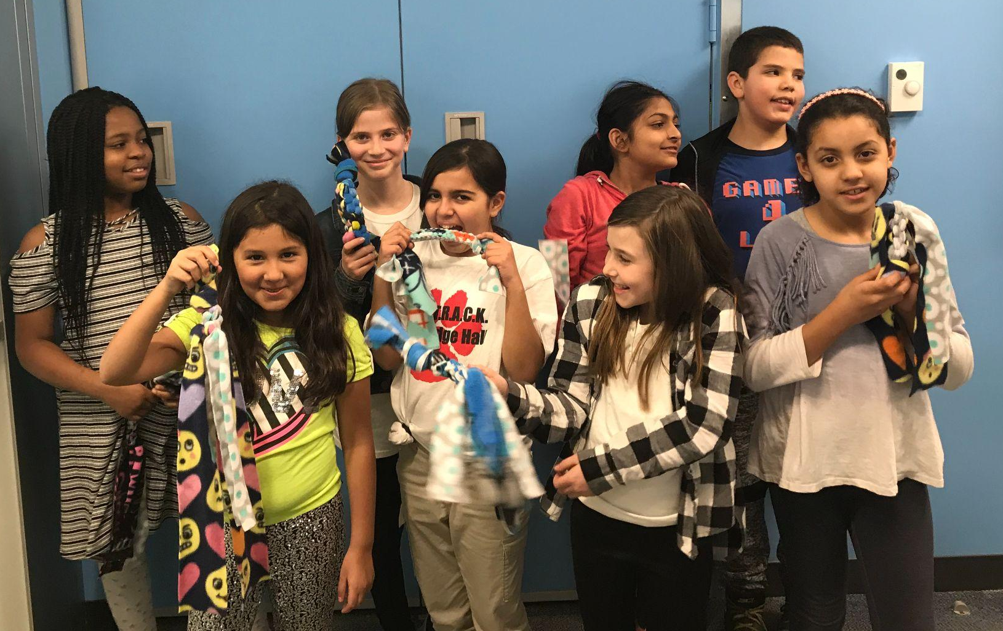
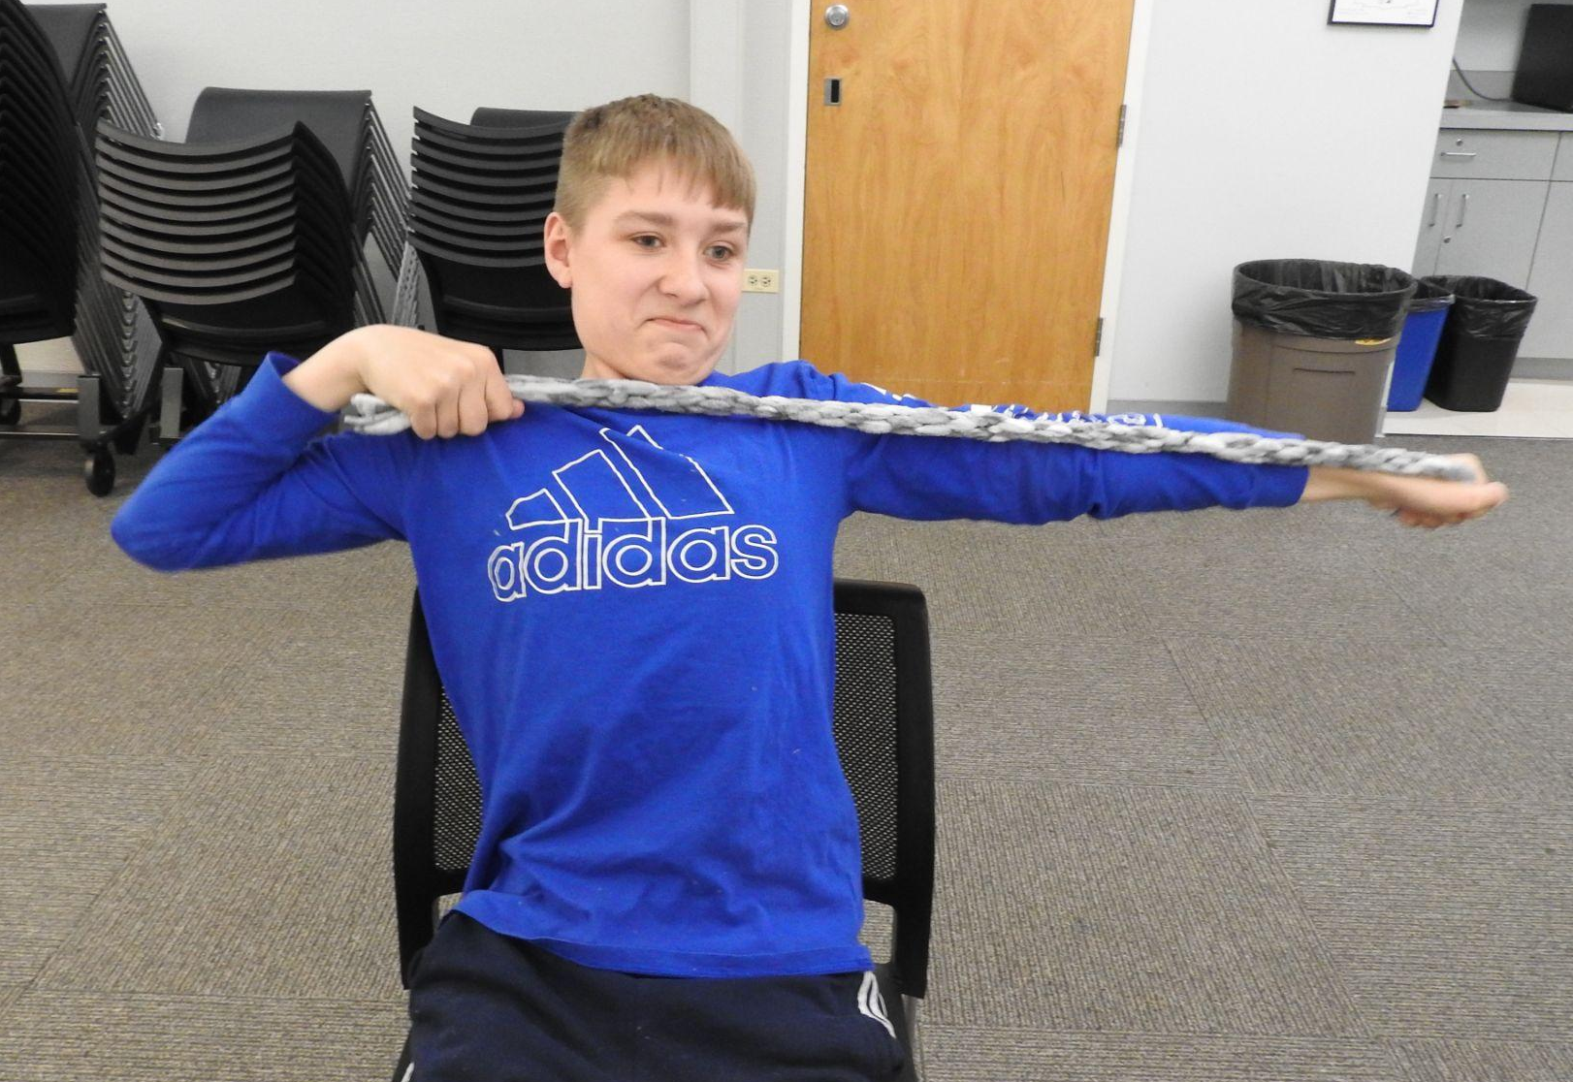
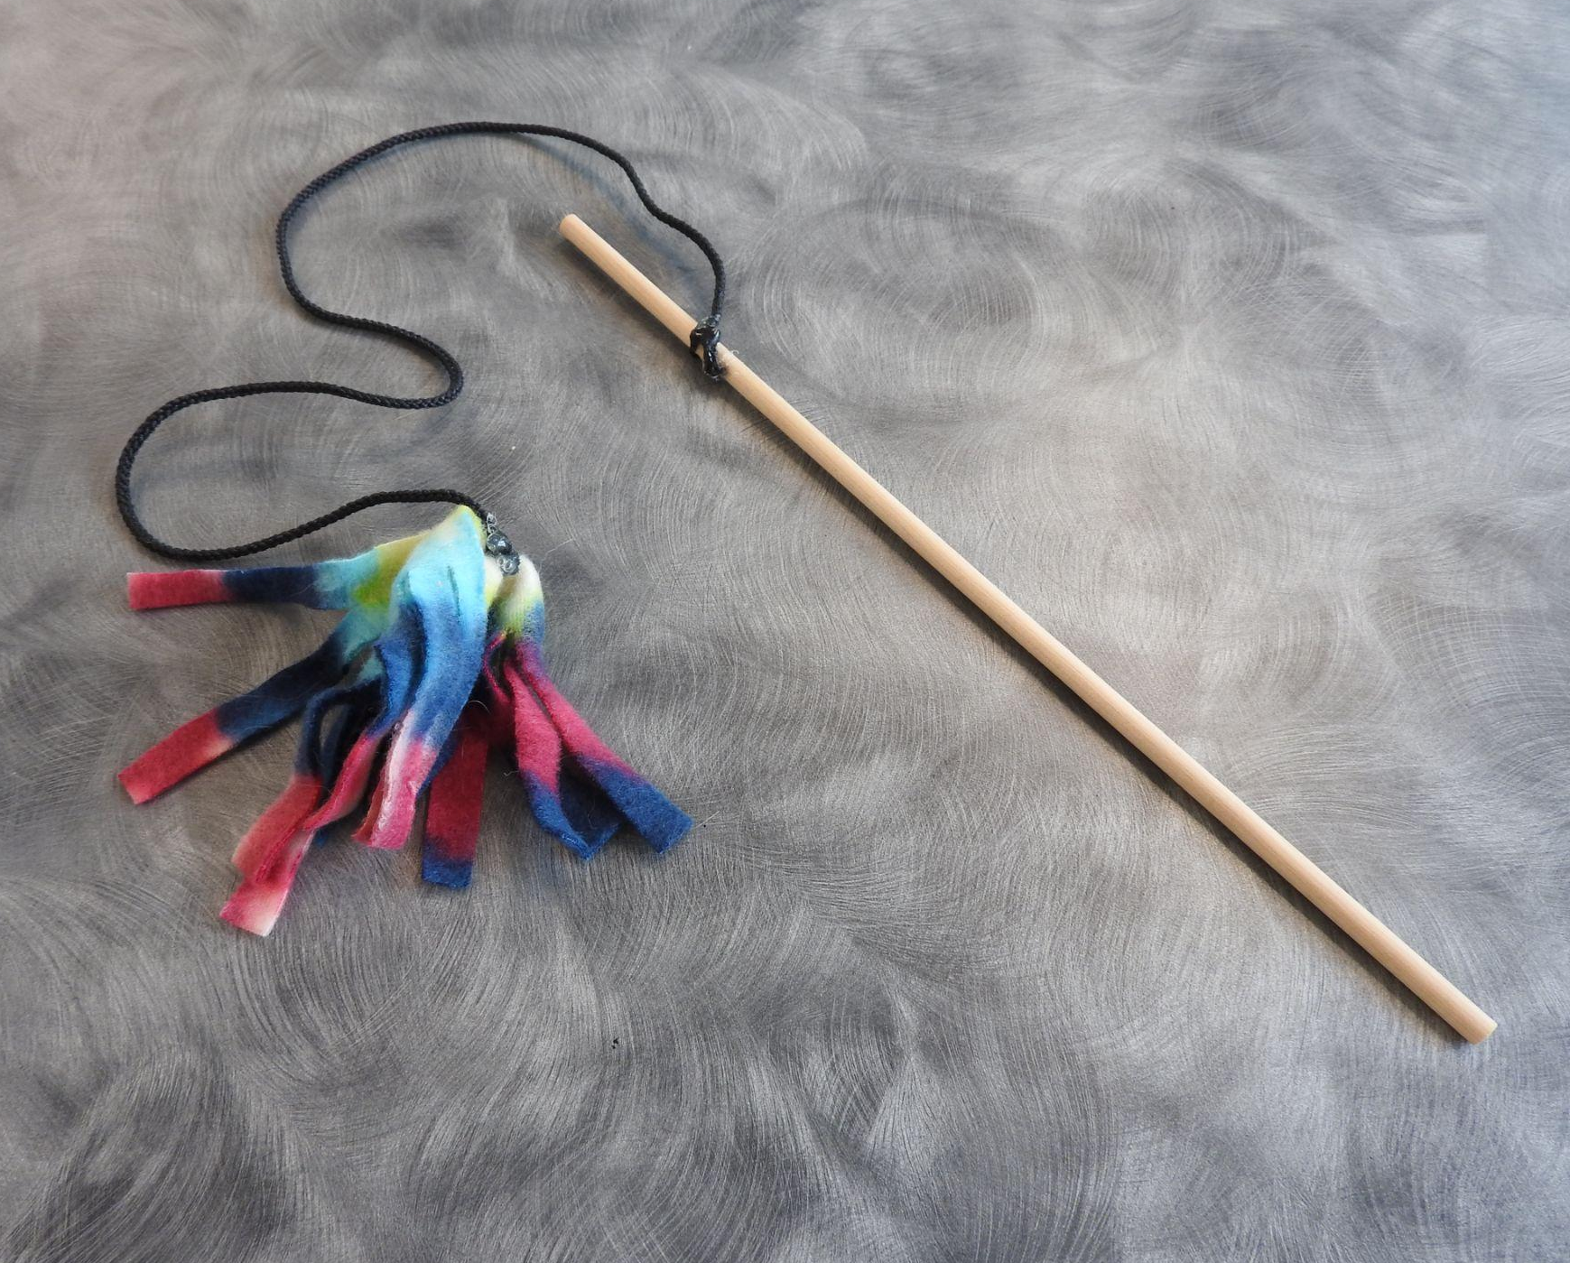
Animal Toys

Slide 7
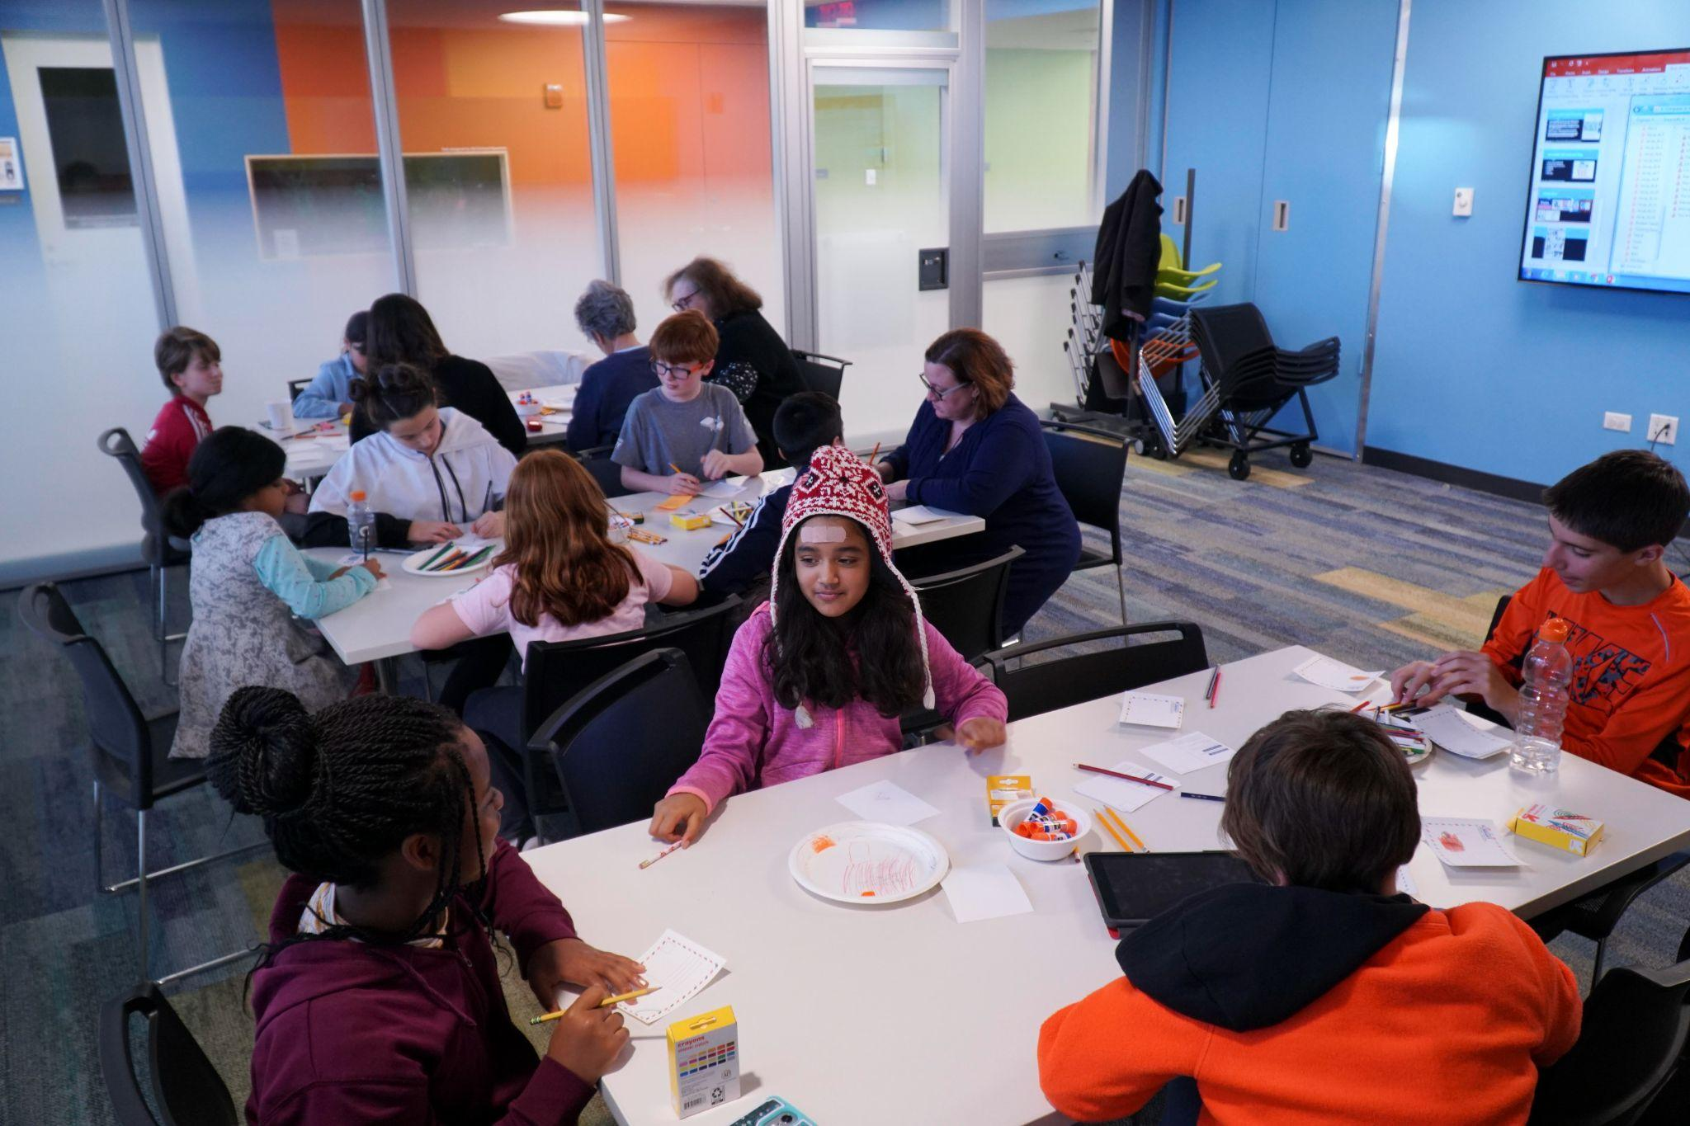
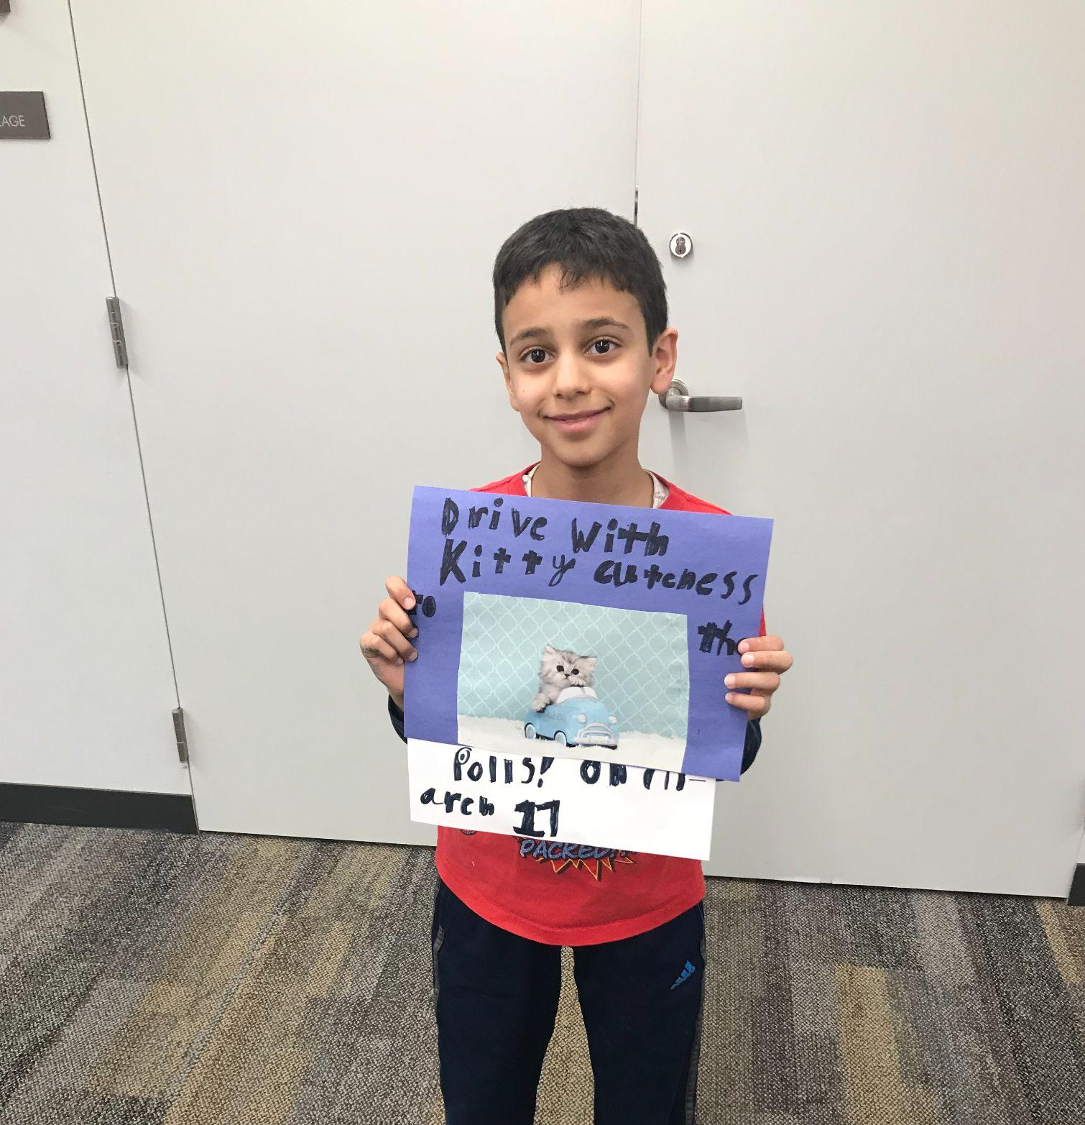
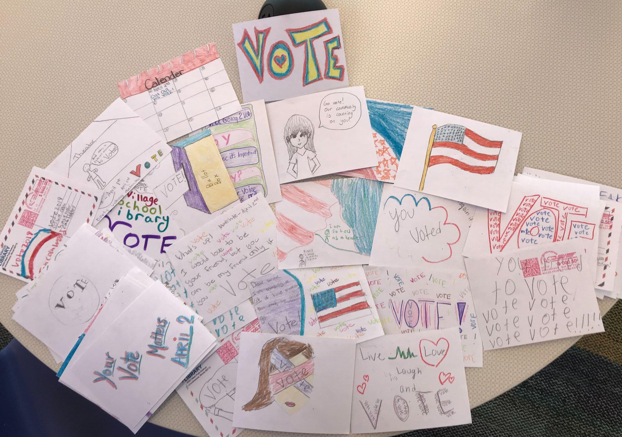
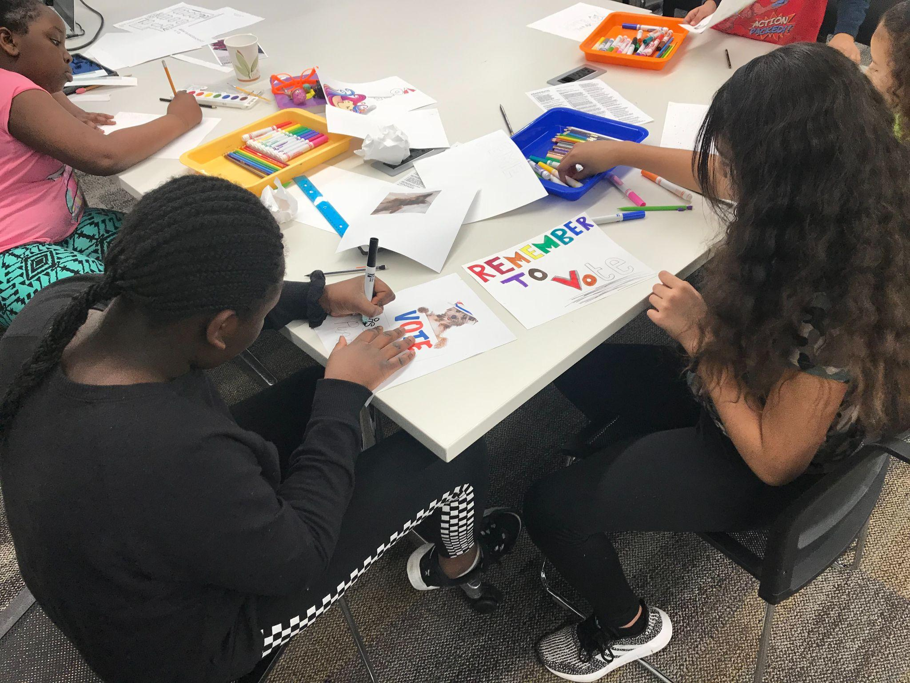
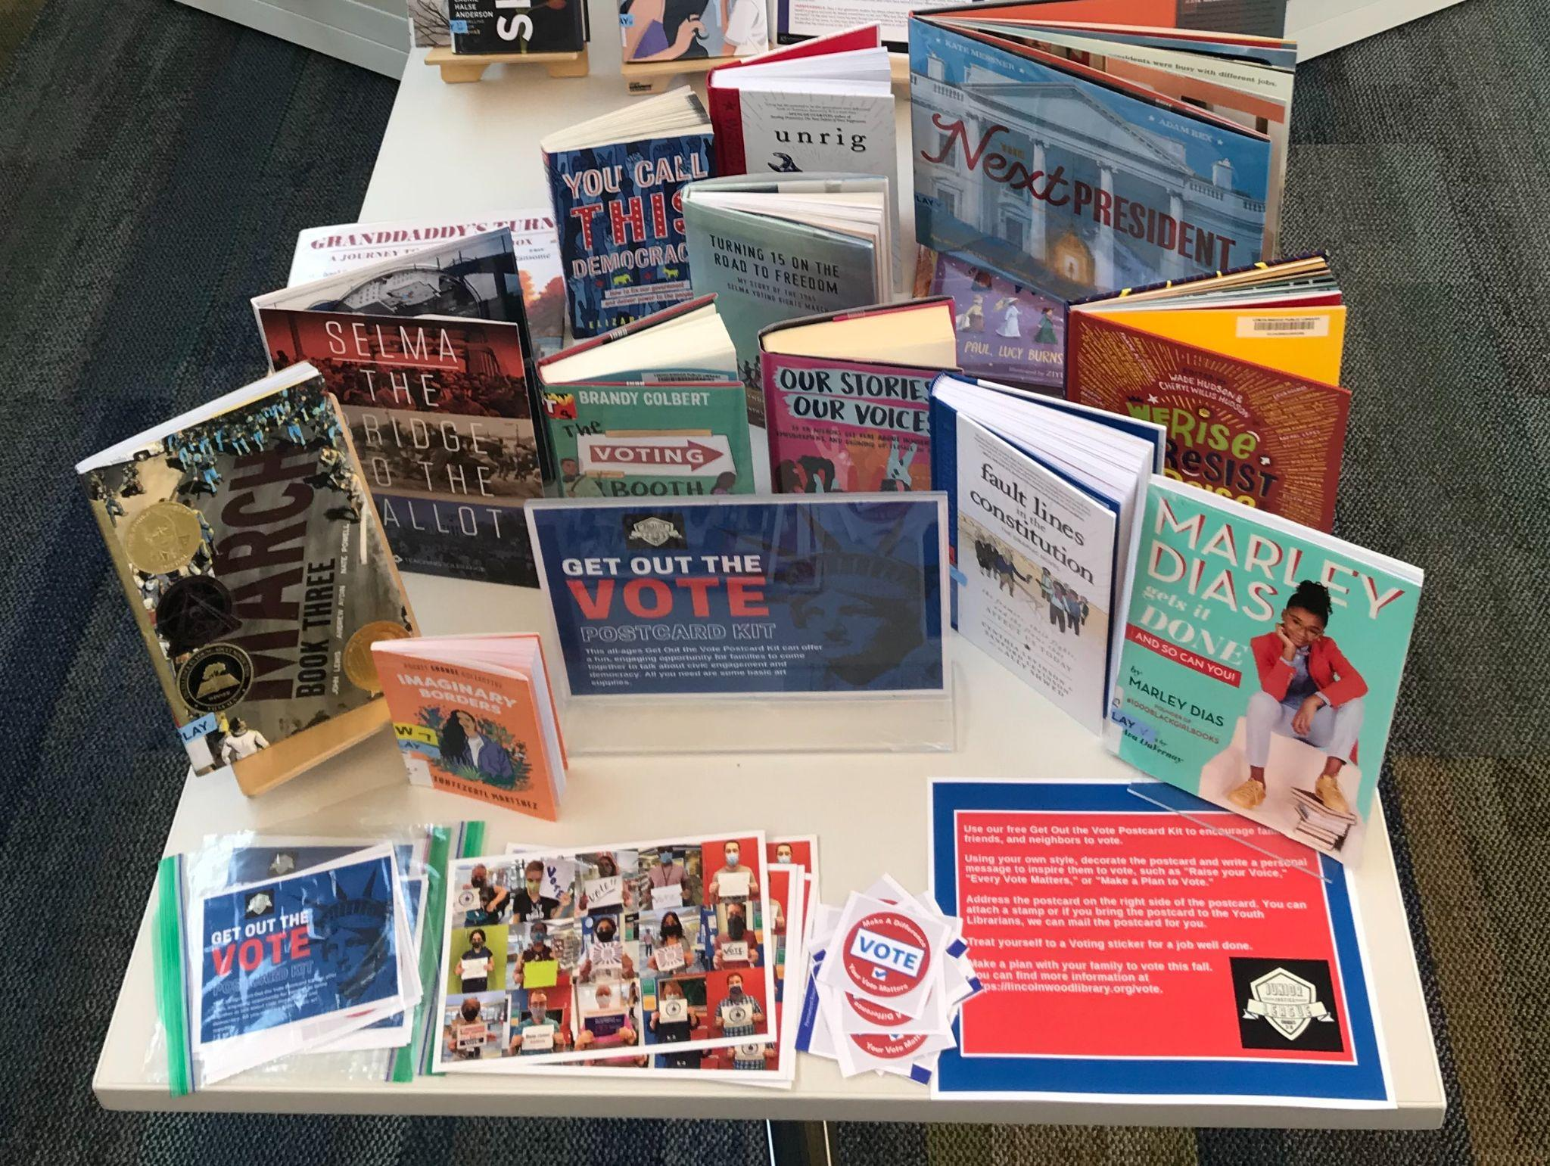
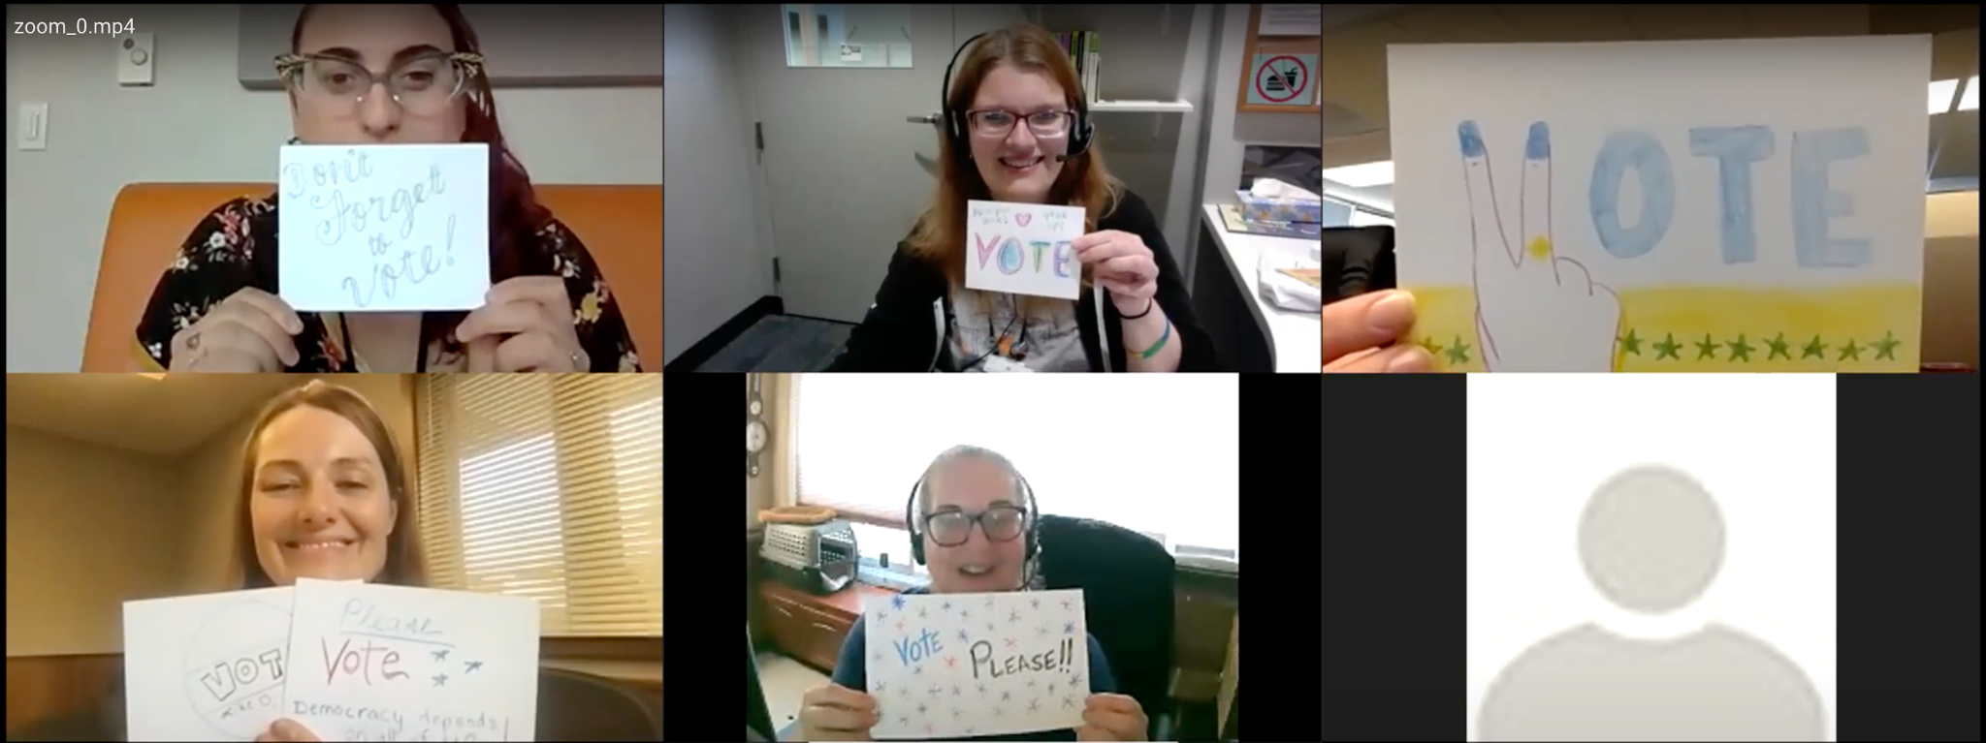
Civic Engagement - GOTV

Slide 8
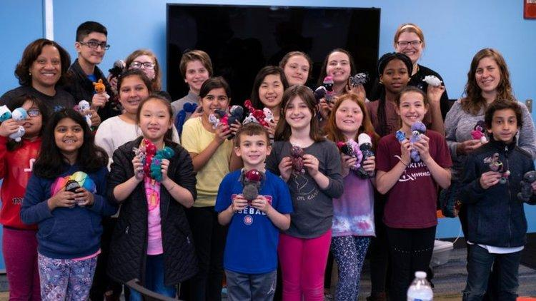
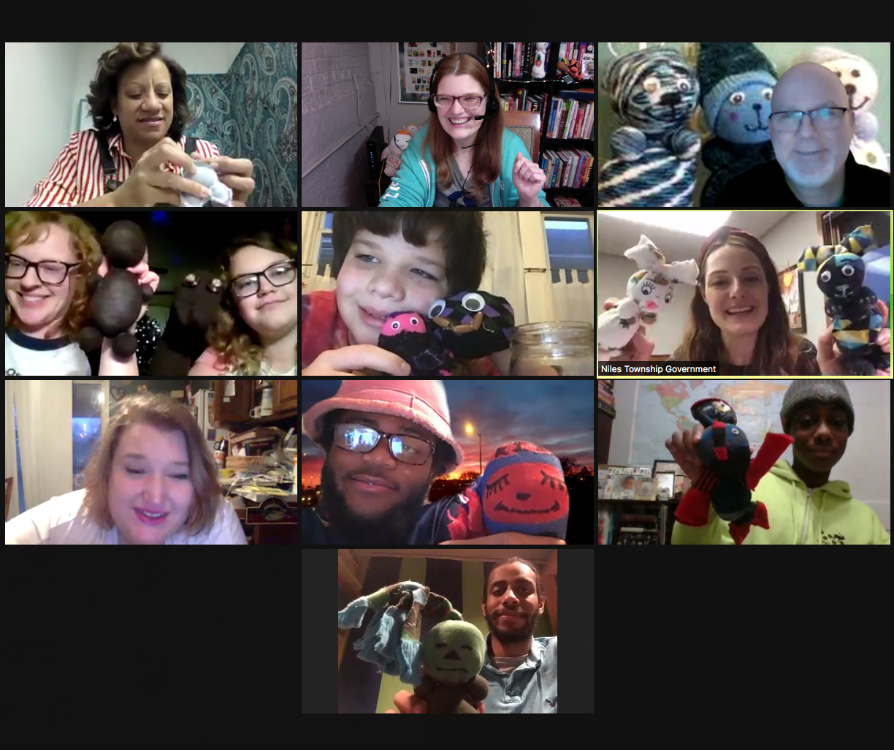
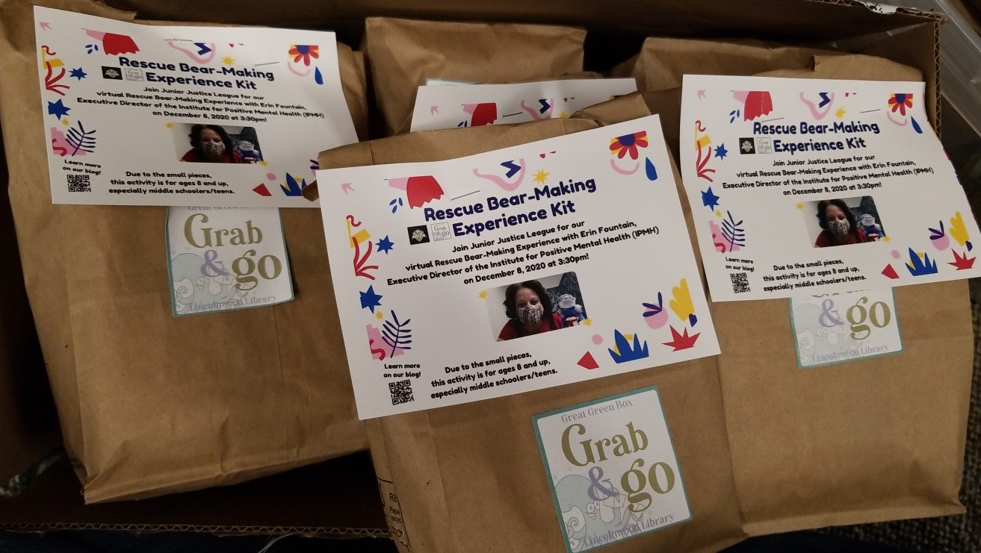
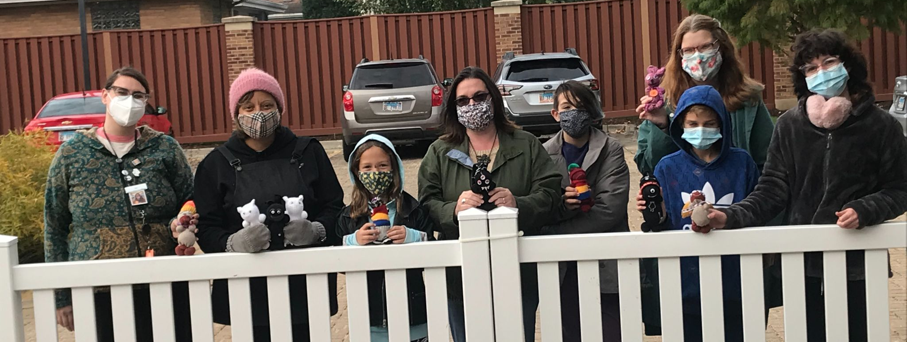
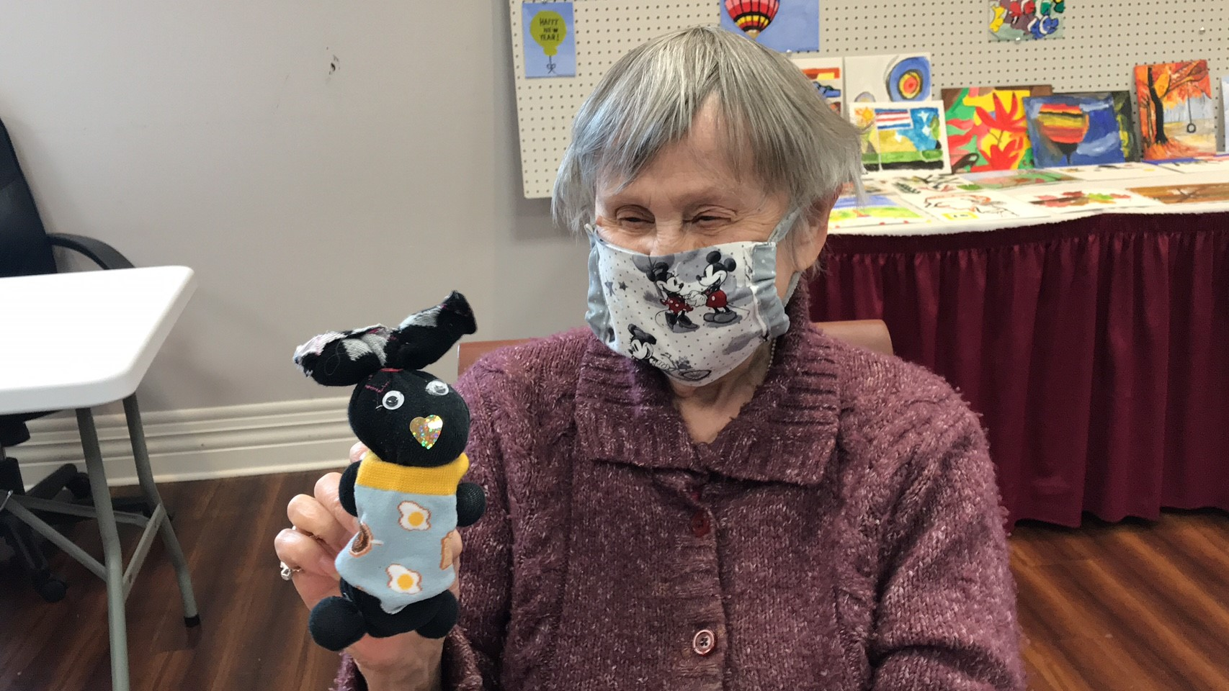
Rescue Bears with Erin Fountain, Institute for Positive Mental Health
Rescue Bears were donated to a local
senior living memory care unit.

Slide 9
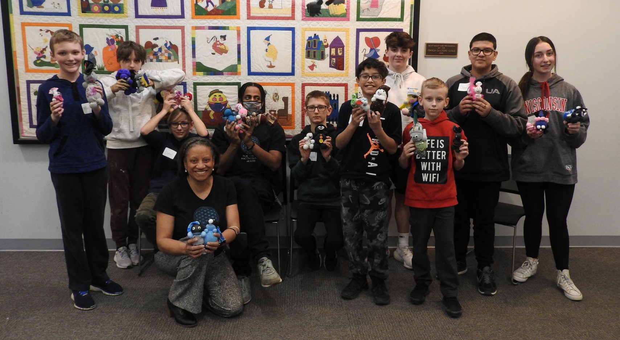
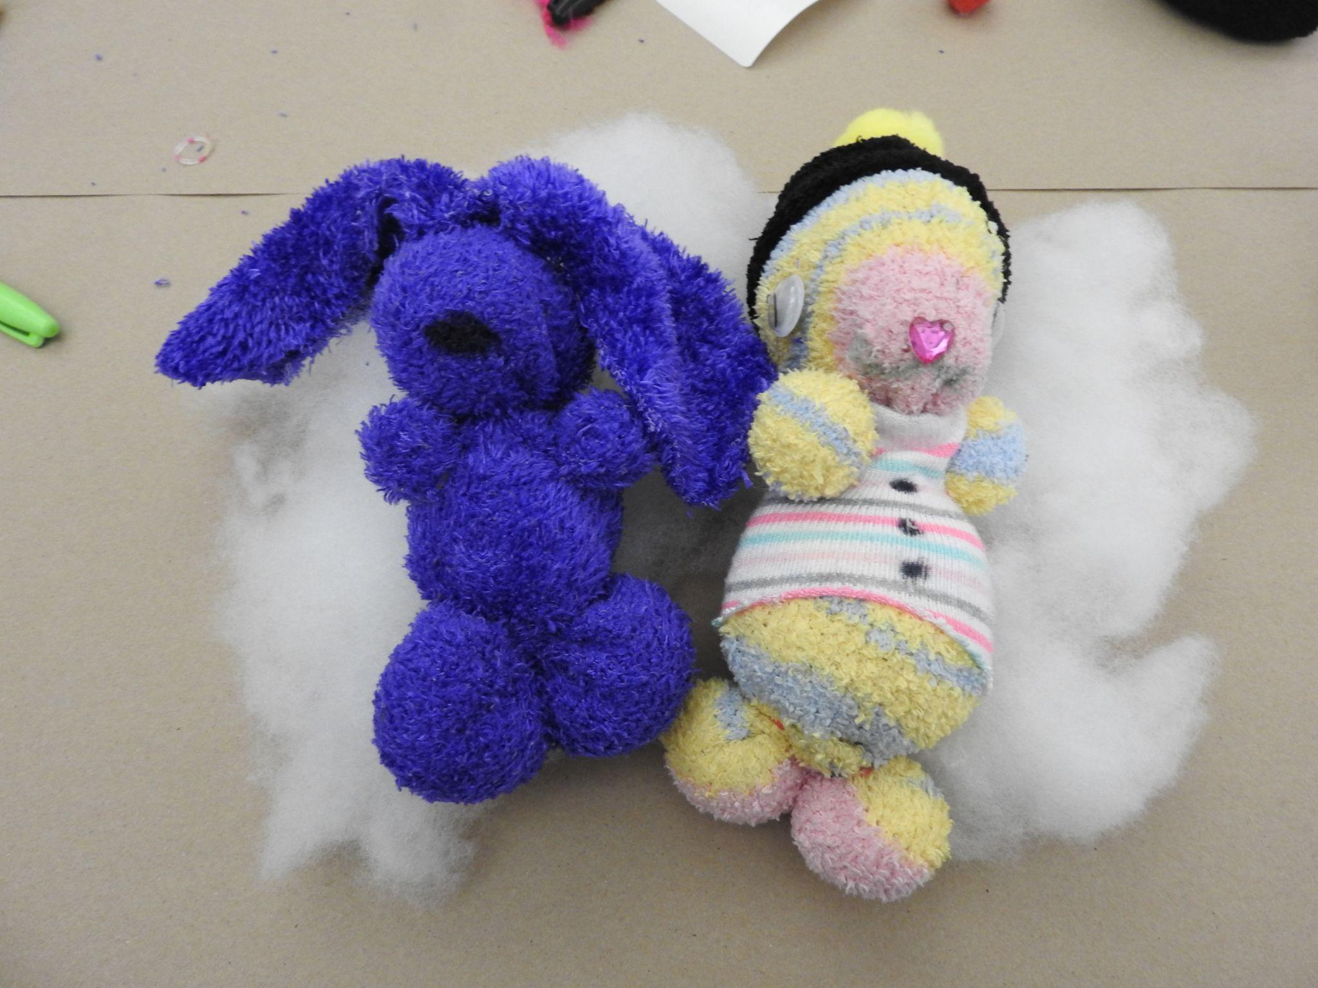
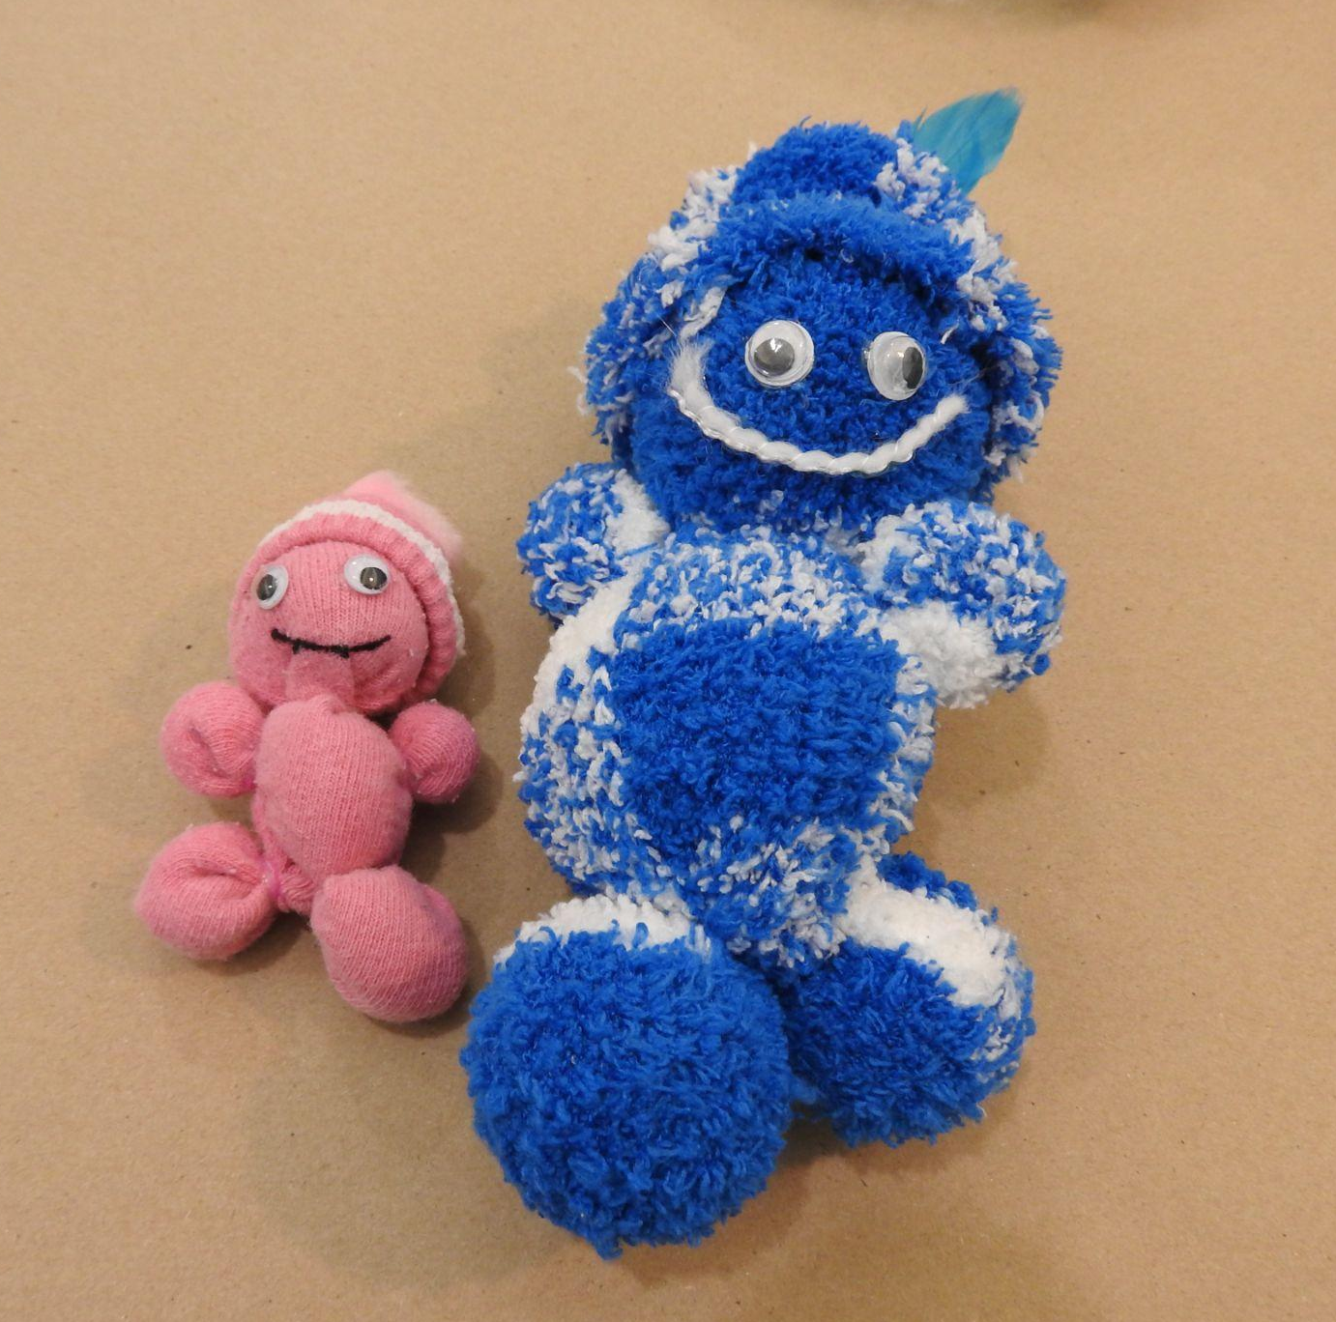
Rescue Bears with Erin Fountain, Institute for Positive Mental Health

Slide 10
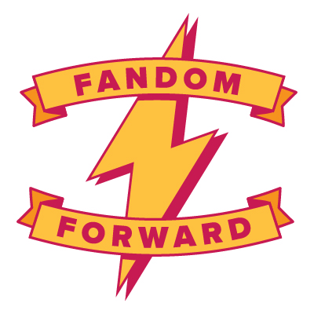
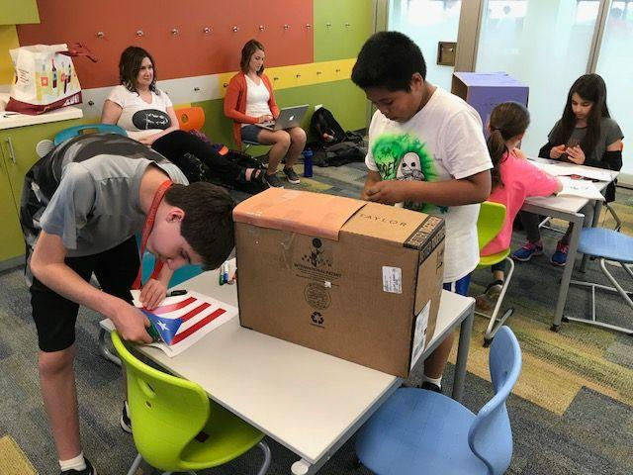
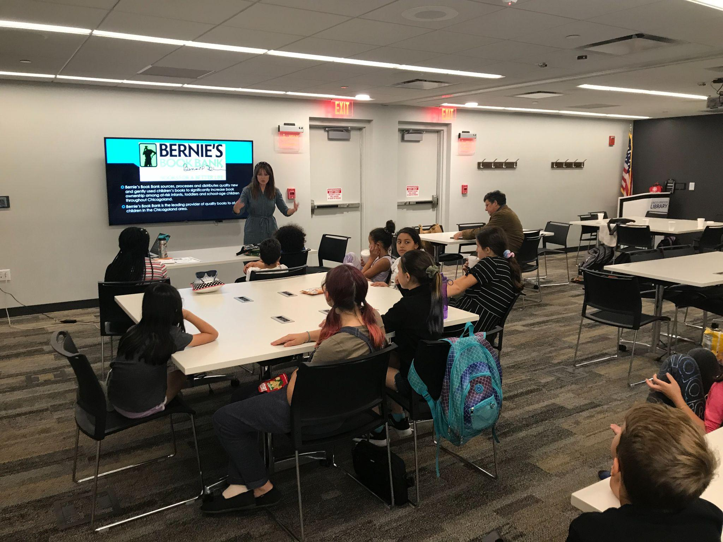
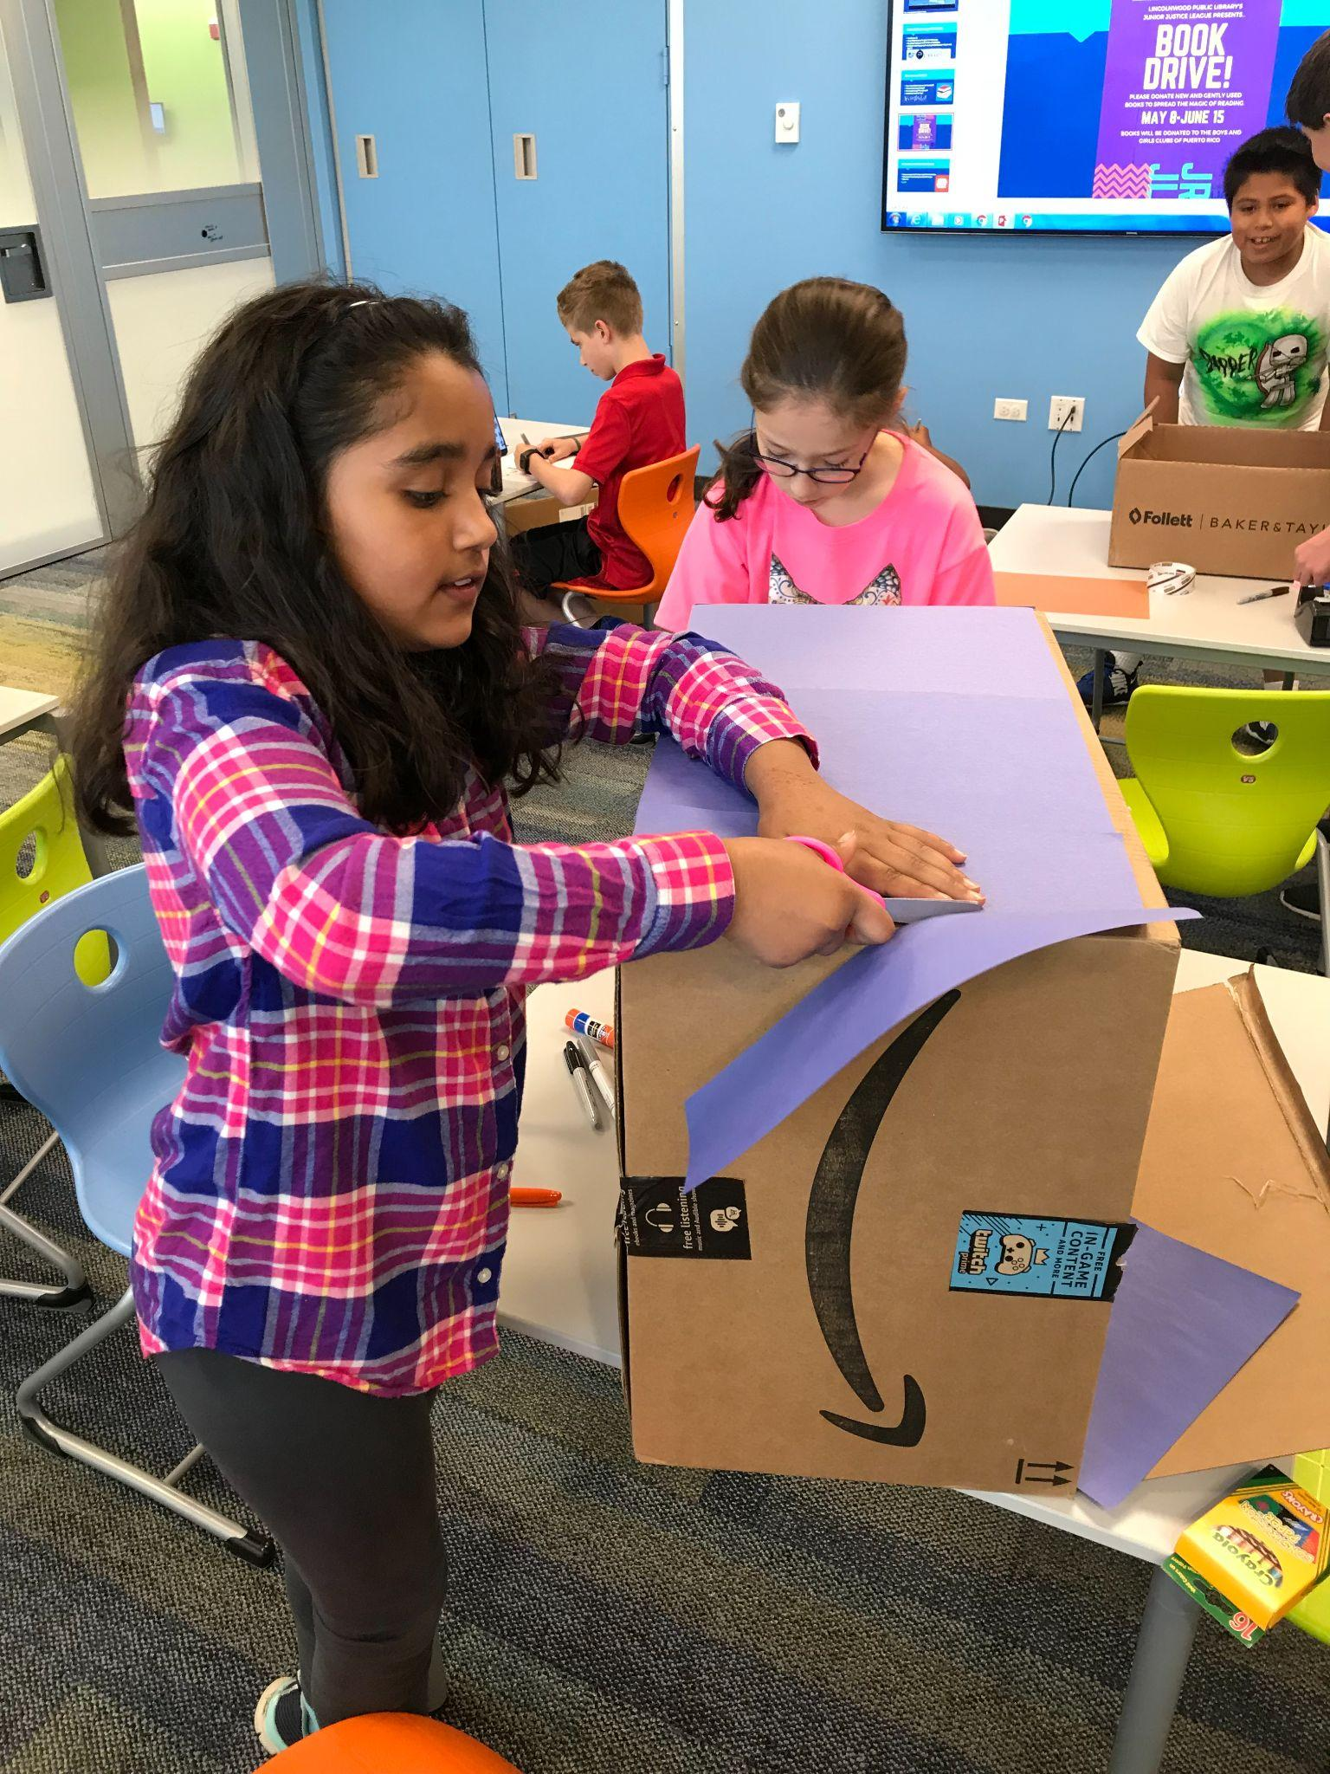
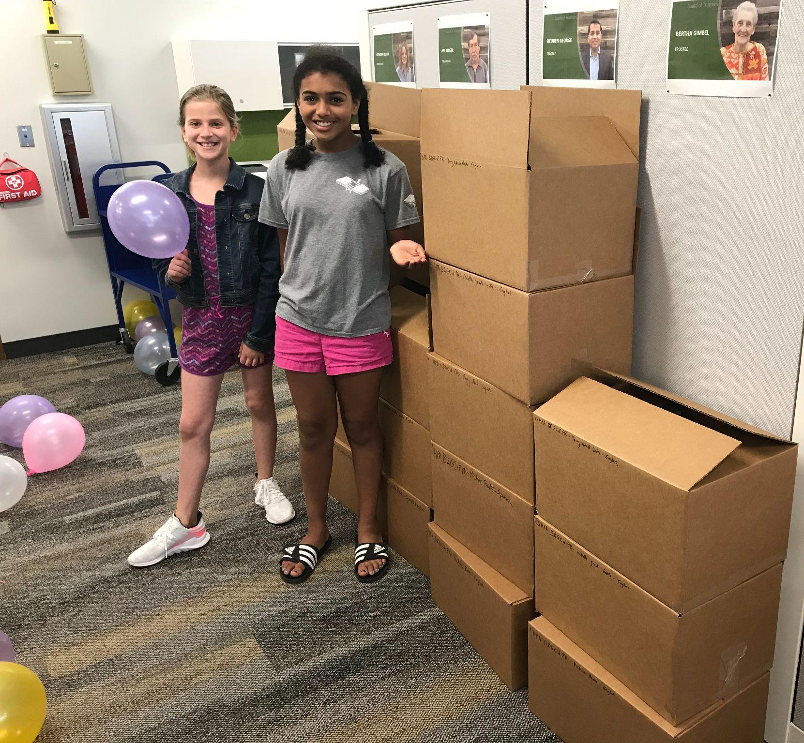
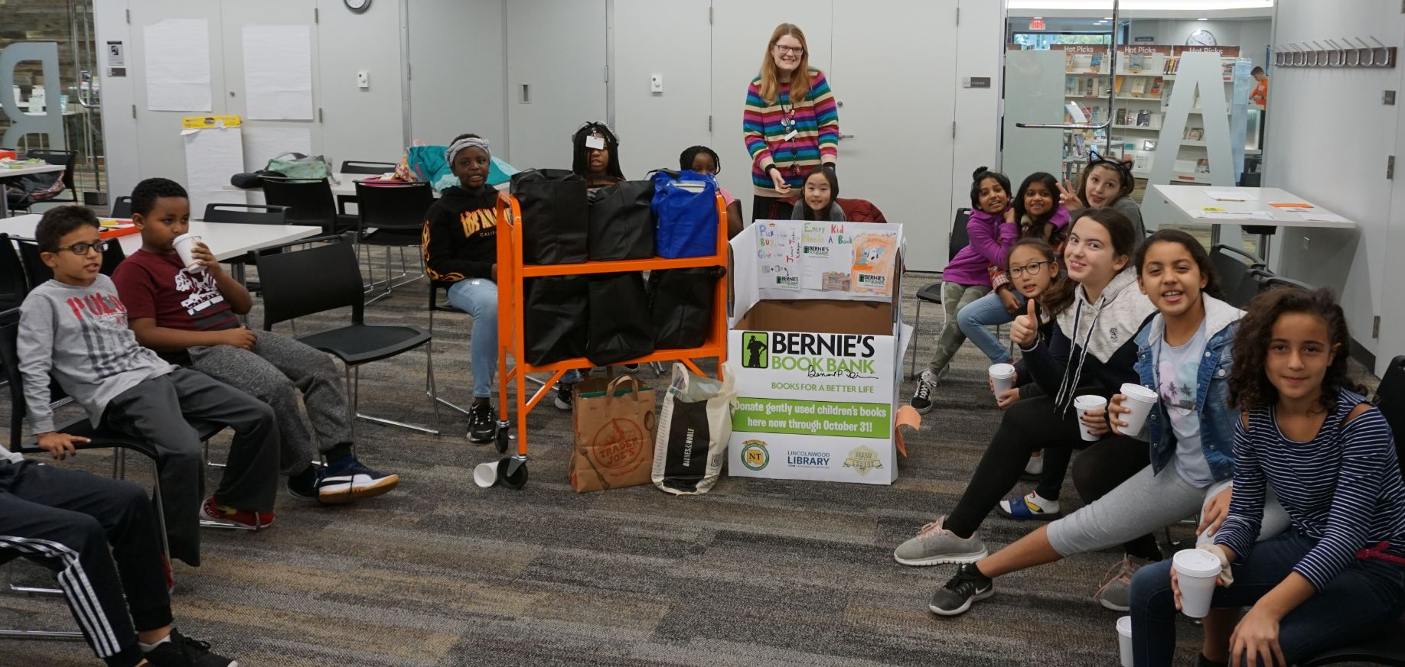
Book Drives
Friends of the Library

Slide 11
Hurricane Relief in Puerto Rico Resources
Taller Sallud: https://www.tallersalud.com
World Central Kitchen: https://wck.org/
Boys & Girls Club of Puerto Rico: https://bgcpr.org/en/
Local organizations

Slide 12
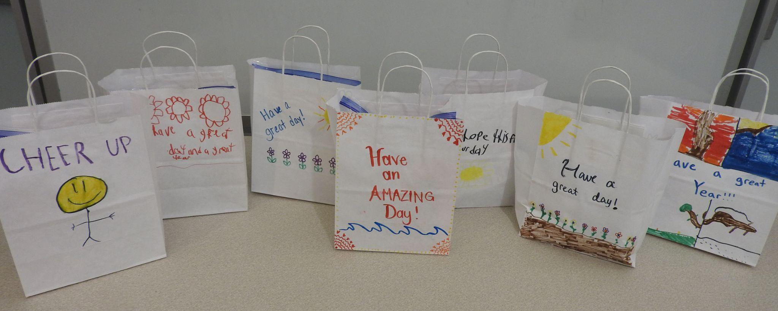
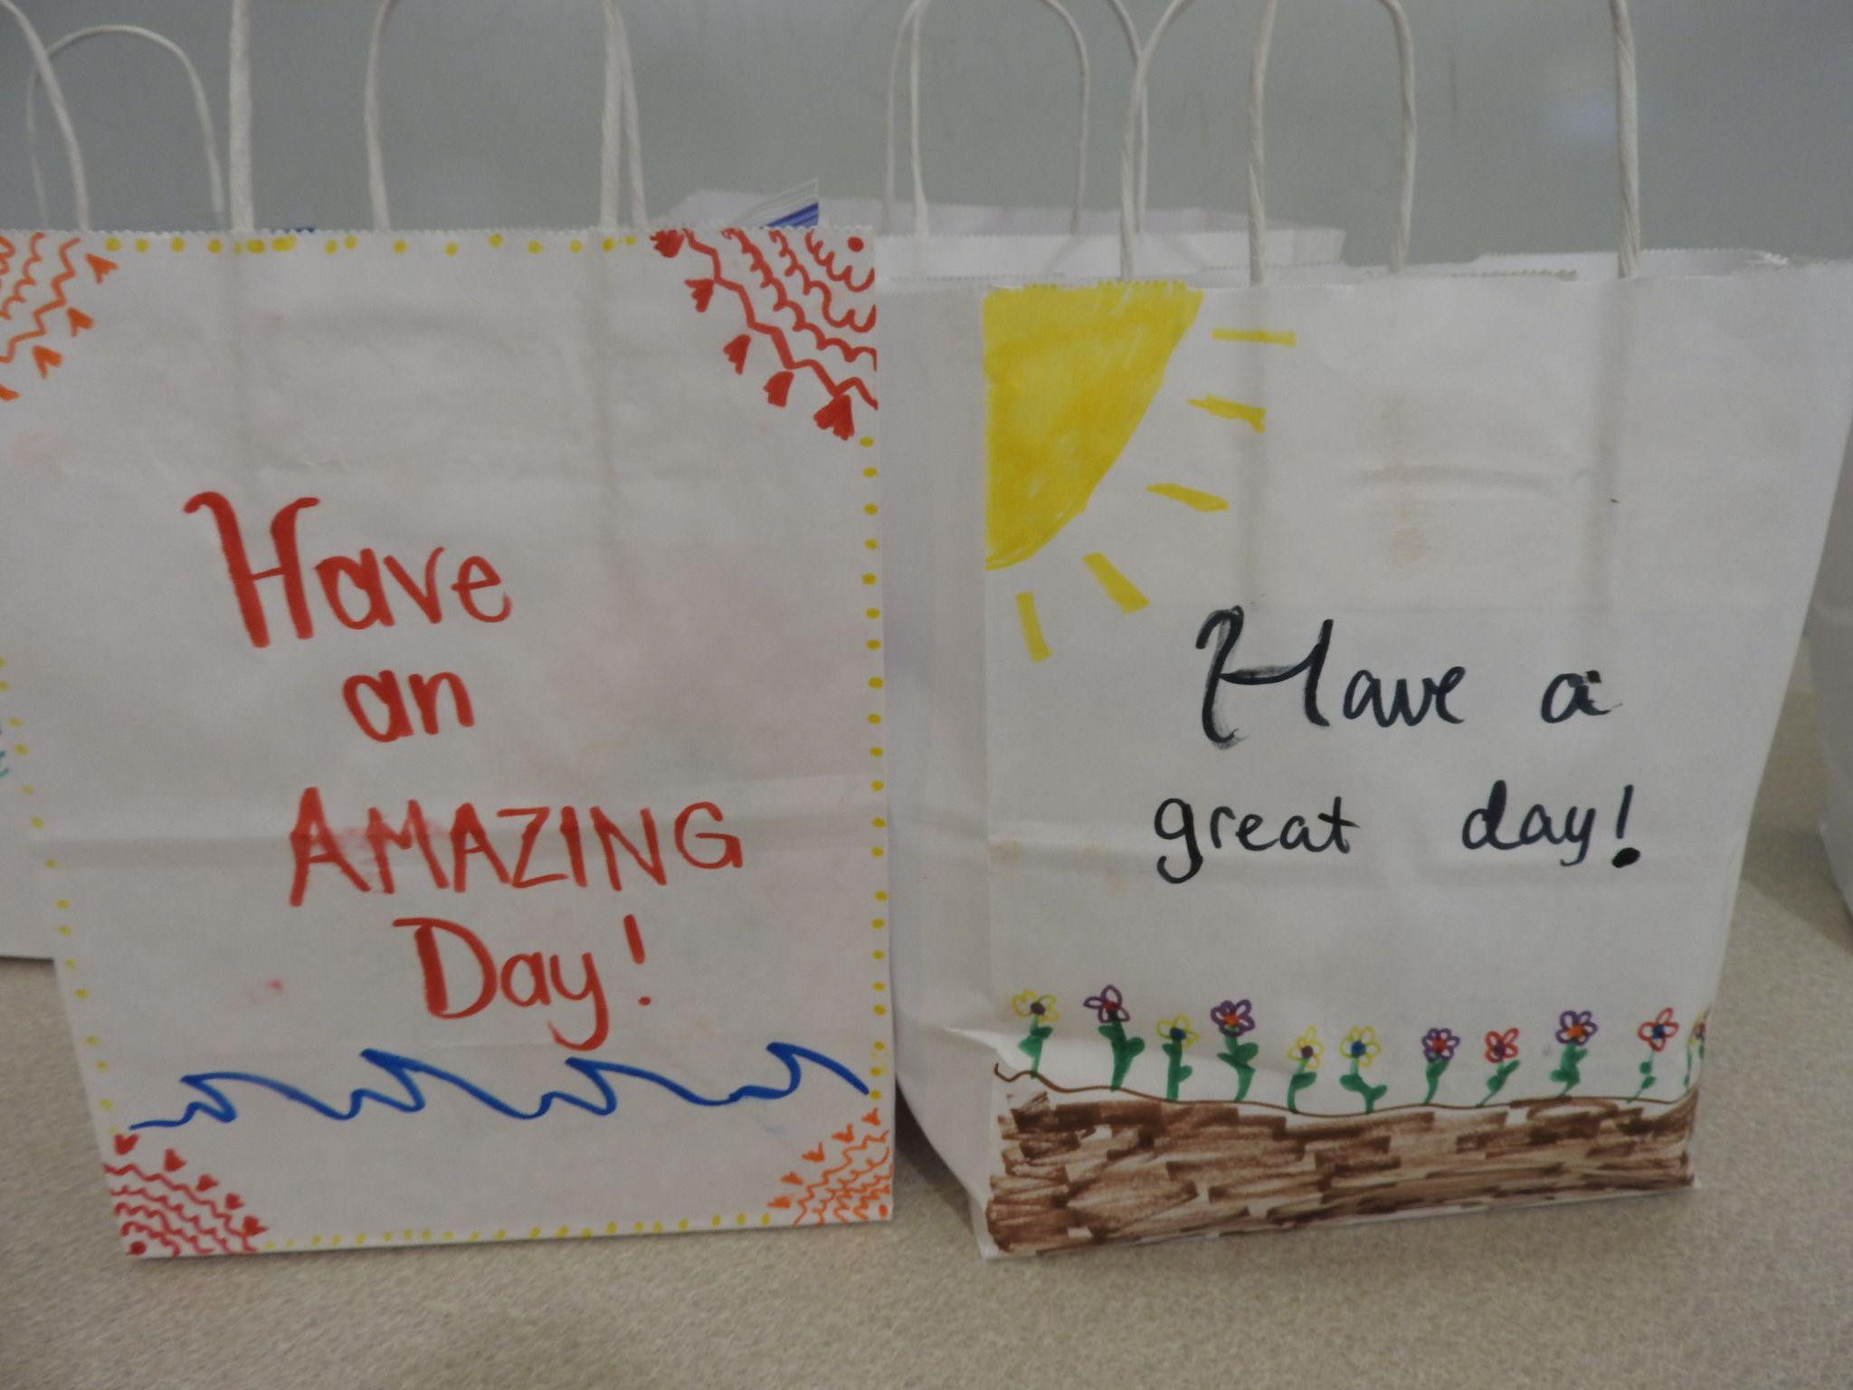
Decorated gift bags for those experiencing homelessness (inside is a gallon Ziploc bag with toiletries from the dollar store)

Slide 13
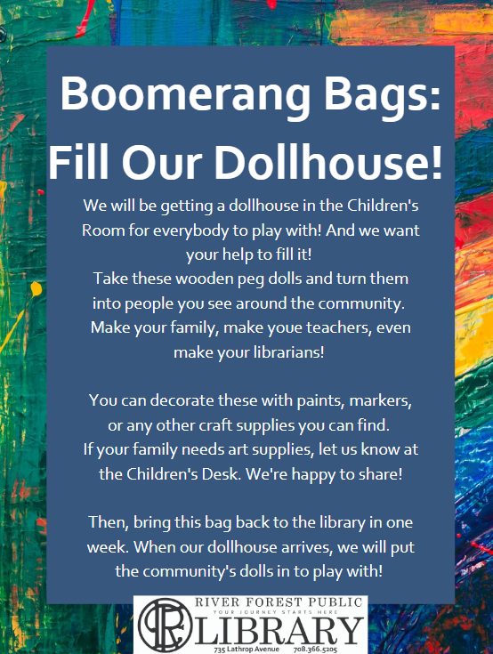
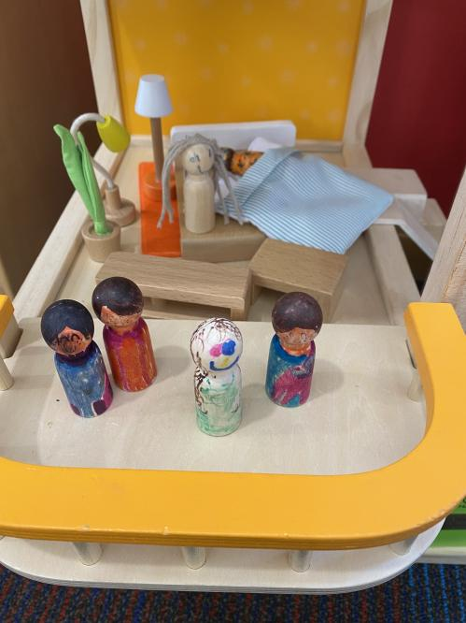
Boomerang Bags

Slide 14
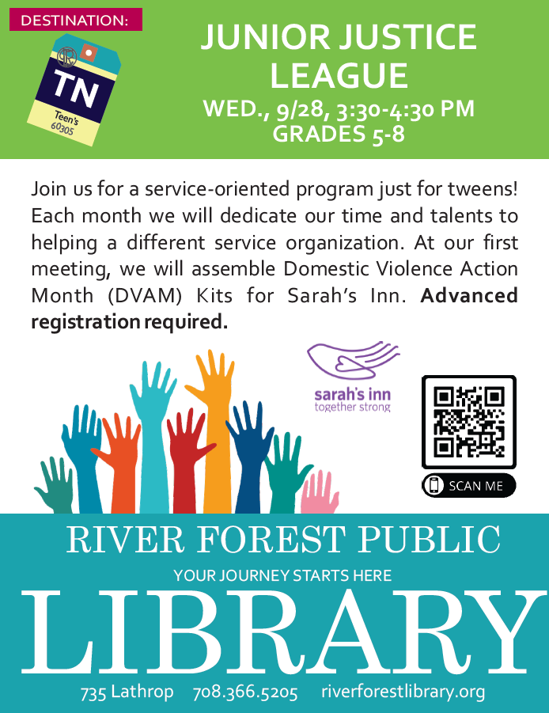
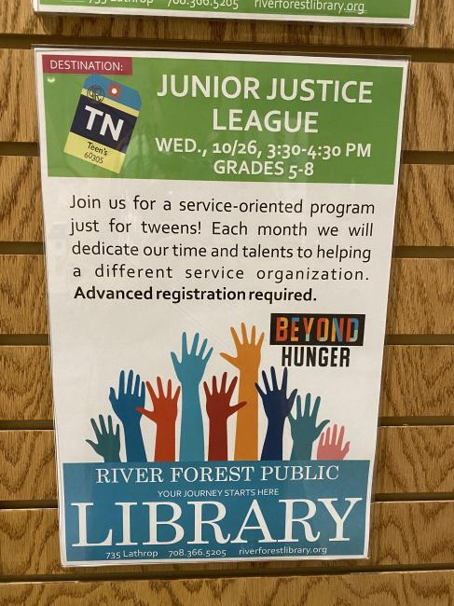
Engaging Kids and Teens - HOW?!
Notes:
WORD OF MOUTH - this is the chance for you to use all of those relationships with your middle schoolers and teens. Don’t require the registration (makes them feel special being asked). Give them opportunities to work on projects outside of the (boomerang bags, selecting their own projects with dosomething.org, drop-in sessions, registered sessions, take & make kit bags)

Slide 15
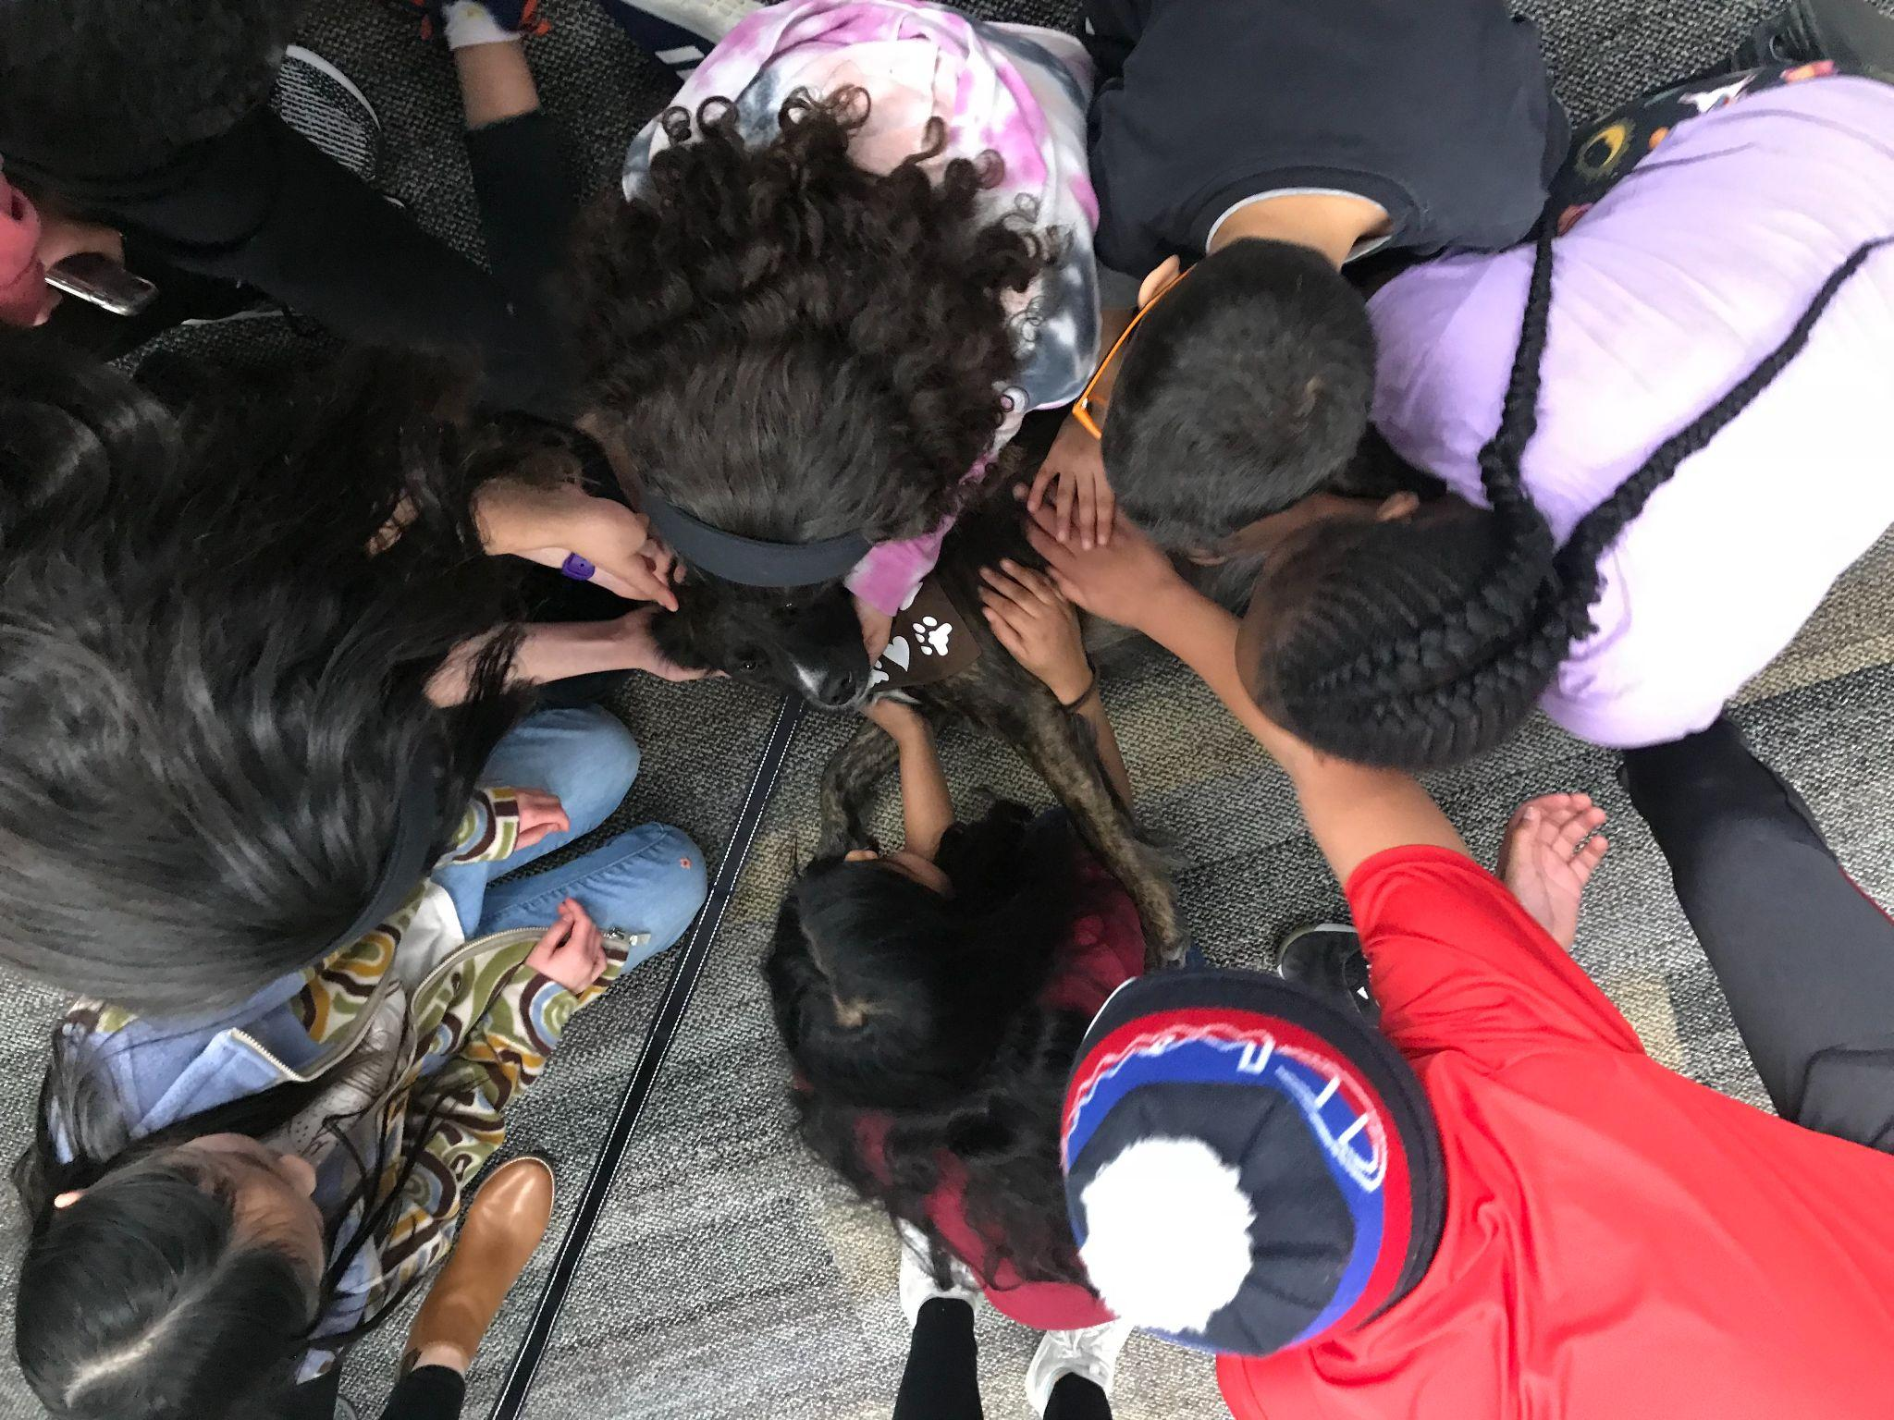
Reflections
What are some challenges you’ve encountered?
What would you do differently in the future?
How have you changed your projects/programs as a result?

Slide 16
Questions?

Slide 17
Presenters
Amanda Klenk (she/her)
Teen Services Coordinator
Downers Grove Public Library
aklenk@dglibrary.org
Beth McCloskey (she/her)
Youth Services Librarian
Itasca Community Library
bmccloskey@itascalibrary.org
Eti Berland (she/her)
Youth School Engagement Librarian
Wilmette Public Library
eberland@wilmettelibrary.info
Dannie Moore (they/them)
Assistant Children’s Services Manager
River Forest Public Library
moore.danielle54@gmail.com
Kristi Miller (she/her)
Manager of Youth & Teen Services
Westmont Public Library
kmiller@westmontlibrary.org
Resources & Contacts: https://tinyurl.com/2mswhhxs

