Slide 2
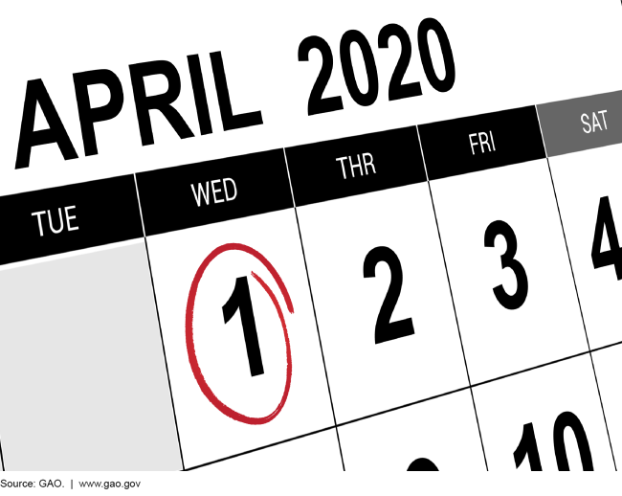

Slide 3
Census authorized by Article, Section 2 of the United States Constitution.

Slide 4
George Washington University's Institute of Public Policy found that at least $34 billion in federal funding for programs that directly assist Illinois residents is tied to census figures.

Slide 5
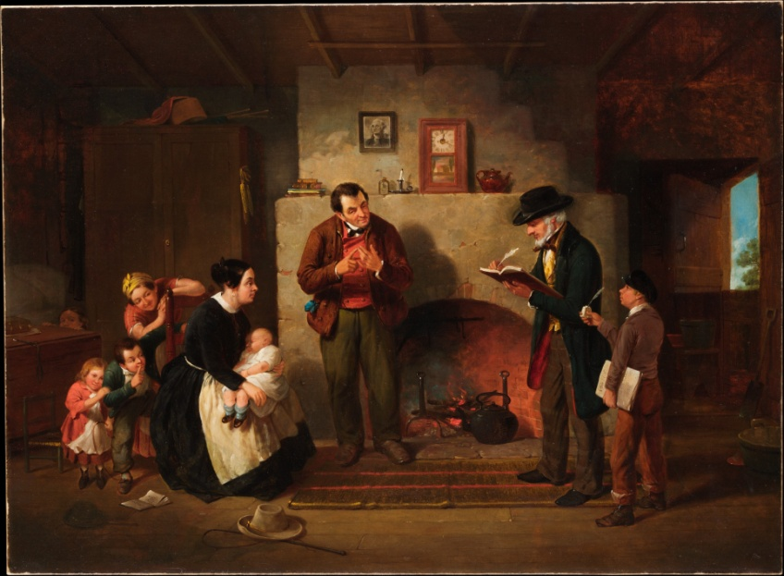
Taking the Census 1854
Taking the Census 2020

Slide 6
Census Timetable
March 12-20: Invitation to respond online to the 2020 census.
March 26-April 3: Reminder postcard.
April 8-16: Reminder letter and paper questionnaire.
April 20-27: Final reminder postcard before in-person follow up.
December 31, 2020: State totals reported.
March 31, 2021: Census Bureau transmits redistricting files to states.

Slide 7
Every household will have the option of responding online, by mail or by phone.
95% of households will receive their census invitation by mail.

Slide 8
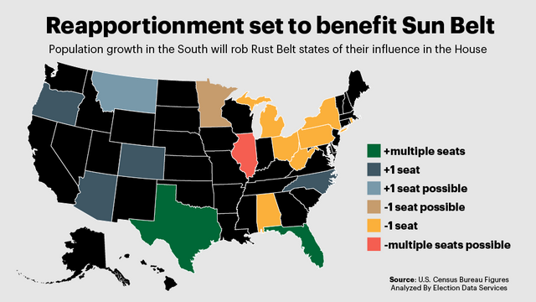
Notes:
Illinois will lose at least one, and possibly two, seats after the next round of reapportionment. It would mark the fifth consecutive decade in which the Illinois delegation has shrunk.

Slide 9
Department of Commerce v. New York
The federal government says that the Department of Justice wants data about citizenship to better enforce federal voting rights laws.
Asking about citizenship will lead to an inaccurate count, because households with undocumented or Hispanic residents may not respond.
A decision in the case is expected by summer.
Source: “Argument analysis: Divided court seems ready to uphold citizenship question on 2020 census”; SCOTUSblog, April 23, 2019.
Notes:
The last time a citizenship question was on the census was 1950. The Illinois Complete Count Committee is operating under the assumption that the citizenship question will be on the census form.

Slide 10
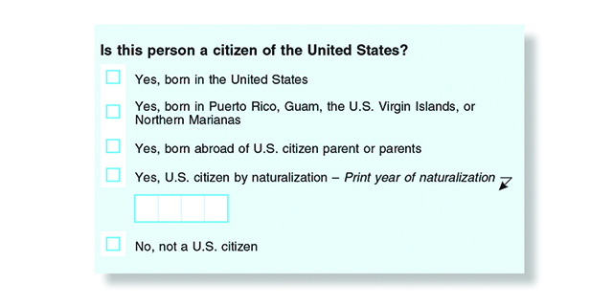
“The (Census) bureau estimates 6.5 million people will not respond to the 2020 census themselves if a citizenship question is included. (Source: Supreme Court Appears To Lean Toward Allowing Census Citizenship Question; NPR, April 25, 2019.)

Slide 11
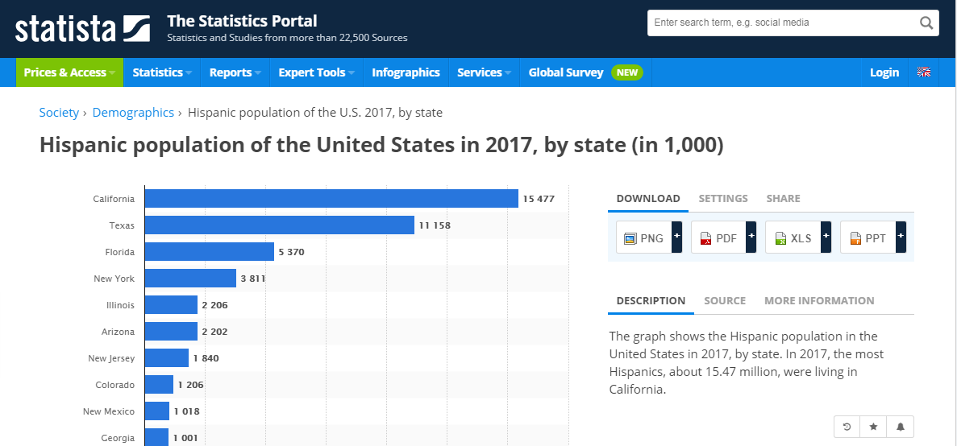

Slide 12
According to United States Code, Title 13 (Census), Chapter 7 (Offenses and Penalties), Sub-Chapter II, if you're over 18 and refuse to answer all or part of the Census, you can be fined up to $100. If you give false answers, you're subject to a fine of up to $500.

Slide 13
Hard to Count Populations
Children under age 5
Homeless
Lower income
Lower education
English language learners
Veterans
Minority communities
College students
Foreign born Illinois residents
“Snowbirds”
Farm
Renters
Notes:
Foreign born Illinois residents (documented and undocumented)
“Snowbirds”: Retirees spending summer in Illinois and winter in warmer climates
Farm families residing in rural counties
Persons living in large housing units or apartment complexes
Since the 2020 census will be conducted mostly online, households with poor Internet access will likely also be undercounted.

Slide 14
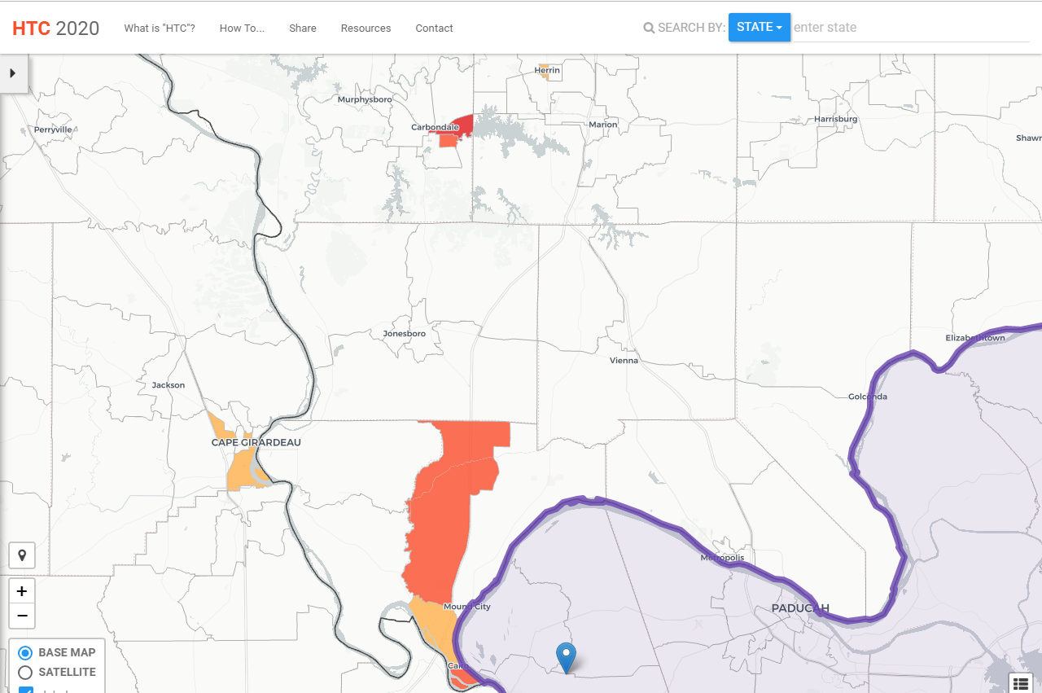
https://www.censushardtocountmaps2020.us/

Slide 15
The 2020 Census presents an opportunity to increase
public awareness and use of Census data.
ALA is ensuring that libraries are informed and
represented in the policy discussions and planning
process.
ALA The 2020 Census will impact libraries and libraries'
technology resources as staff work to assist people in
participating in the Census.
ALA is advocating for a fair, accurate, and inclusive
Census that recognizes the roles libraries will play in
this vital civic effort.
Notes:
The 2020 Census presents an opportunity to increase
public awareness and use of Census data.
ALA is ensuring that libraries are informed and
represented in the policy discussions and planning
process.
ALA The 2020 Census will impact libraries and libraries'
technology resources as staff work to assist people in
participating in the Census.
ALA is advocating for a fair, accurate, and inclusive
Census that recognizes the roles libraries will play in
this vital civic effort.

Slide 16
http://www.ala.org/advocacy/sites/ala.org.advocacy/files/content/ALACensusBrief.pdf

Slide 17
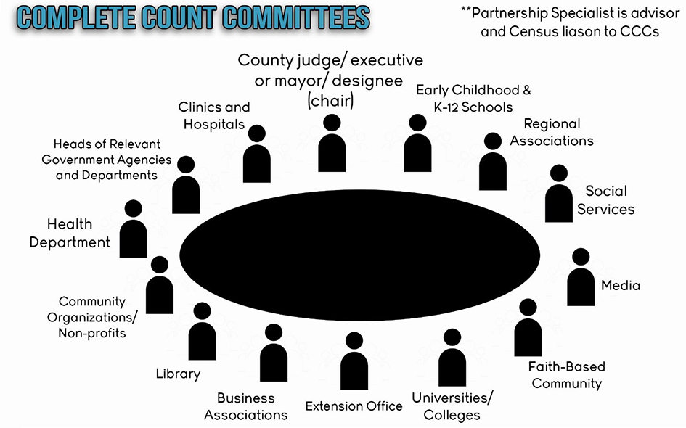
Image: Kentucky Youth Advocates

Slide 18
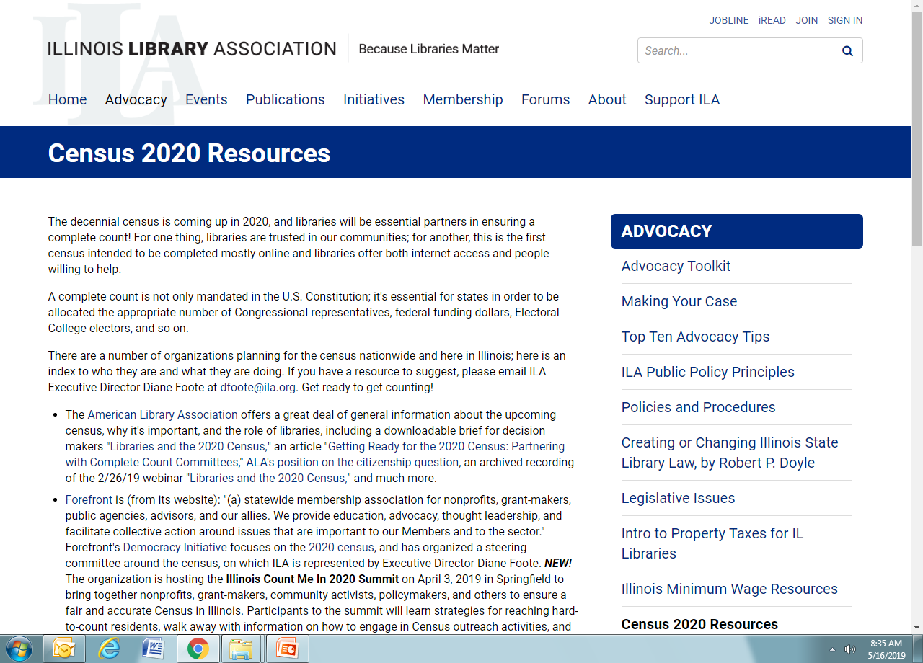

Slide 19
Letter to Illinois Library Directors
April 2019
Greg McCormick
Director
Illinois State Library

Slide 21
Poster
Contest
Posters will be accepted for submission from May 1-June 17, 2019. Submissions are to be sent to the Illinois State Library.
Posters will be judged on creativity and the best use of census messaging.
Judging Divisions will be: grades 4-6, grades 7-9, and grades 10-12.
Poster messaging may be in English, Spanish, Polish, Hindi, French or Chinese. If in a language other than English, an English translation shall be provided.

Slide 22
Census Contact:
Joe Natale
Illinois State Library
217-558-1745
jnatale@ilsos.gov

