Slide 1
“Because Facts Matter”
Teaching Information Literacy as a Civic Responsibility

Slide 2
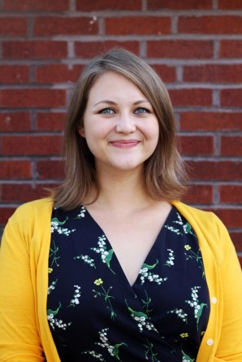
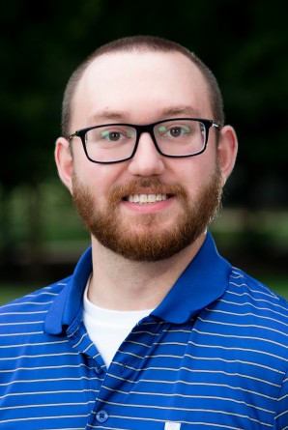
Speakers
Elora Agsten
Research Services Librarian Illinois College- Schewe Library elora.agsten@ic.edu
Ryan Flynn
Director of Special Projects for Career Readiness and Experiential Learning Illinois College ryan.flynn@ic.edu

Slide 3
Learning Goals for this Session
At the end of this session, we hope you will…
be able to identify and explain common misinformation strategies.
be able to implement similar techniques in classes or workshops with their students or community members and will have developed a list of departments they could coordinate with to do this work.
have evaluated and discussed the use of information literacy education in the larger context of civic and community engagement.
Notes:
Ryan

Slide 4
Our “Why”
Higher education has a moral obligation to help its community find reliable information.
Misinformation is increasingly a concern for faculty/staff, but also to our students, who typically phrase their concerns as “deciding if something is reliable or not” or determining “bias.”
A collaboration between a library and an office of community engagement felt like a unique approach to begin addressing this issue.
Notes:
Ryan

Slide 5
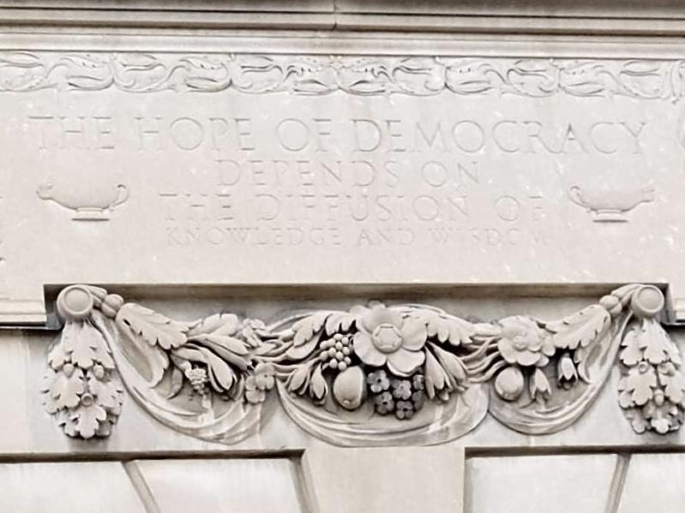
Brief history:
Educated citizenry: an Enlightenment idea that carried over to the early United States
Washington: 1790 Inaugural Address
Jefferson: Rockfish Gap Report (1818)
Movement toward public education (mid 19th century)
Progessive era education reform (early 20th century)
John Dewey
Jane Addams
Now?
Nancy Kranich- 2001- Libraries and Democracy: The Cornerstones of Liberty
Ronald J. Daniels- 2021- What Universities Owe Democracy
“The Hope of Democracy Depends on the Diffusion of Knowledge and Wisdom.” Inscription near the Main Library entrance at the University of Illinois Urbana-Champaign.
Notes:
Elora

Slide 6
“Since a democratic society repudiates the principle of external authority, it must find a substitute in voluntary disposition and interest; these can only be created by education. But there is a deeper explanation. A democracy is more than a form of government; it is primarily a mode of associated living, of conjoint, communicated experience.”
John Dewey. Democracy and Education. 1916. (page 89)
Notes:
Elora

Slide 7
Misinformation false or inaccurate information that is often designed to deceive or purposely misinform.
Disinformation: false or inaccurate information that is often designed to deceive or purposely misinform (but usually from a state actor or other well-funded source).
^^We tend to use this one
Notes:
Ryan

Slide 8
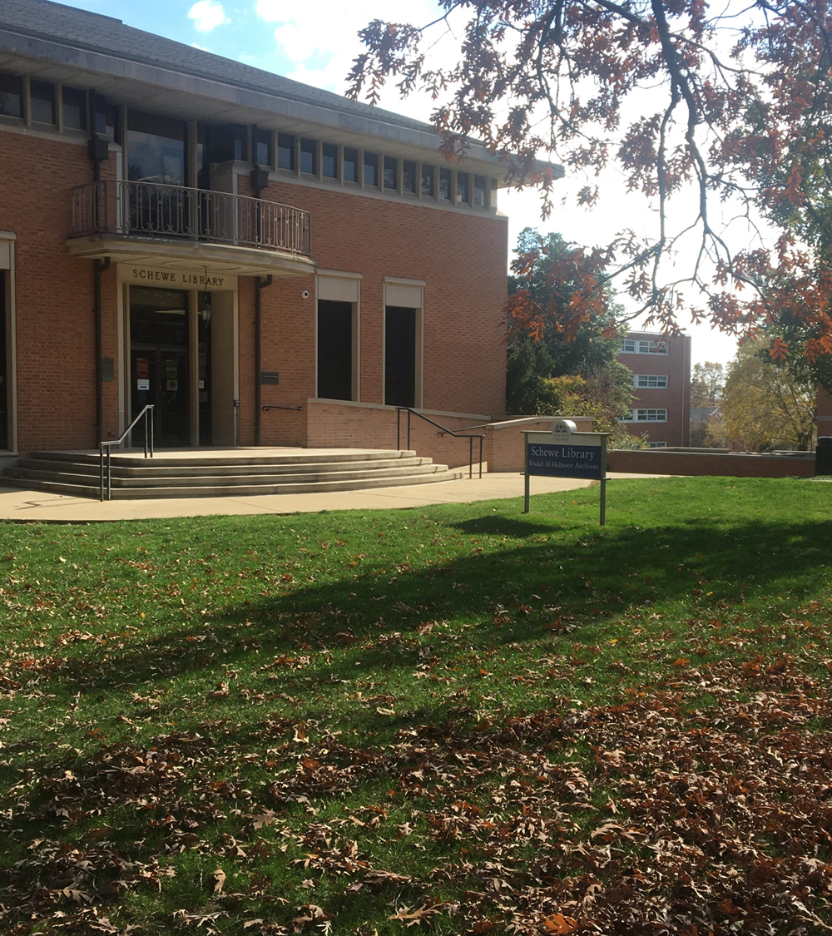
Information Literacy at Illinois College
In 2020, we launched a multi-project initiative to teach students about information literacy and how it relates to thoughtful civic engagement.
This initiative includes:
Campus convocation in fall 2020
A LibGuide hosted on the Schewe Library website
Workshop series for first-year seminar courses in fall 2021
Voter education table in fall 2022
“Misinformation of the Month” flyer series
Notes:
Elora

Slide 9
Initiative’s Learning Outcomes:
help students identify misinformation and how they can do a quick and easy fact check
discuss with students the ways their online lives intersect with their communities
establish a connection between digital information literacy and civic engagement. How we understand information in our digital lives affects how we interact with our communities
Notes:
Ryan

Slide 10
Pedagogy for learning sessions:
Campus Convocation
Fall 2020 (Campus-wide lecture series required for graduation)
50-minute pre-recorded presentation
Focused on COVID-19 misinformation
Included two real-time online fact-checking demonstration
Brief reflection and assessment afterward for students
Workshop series for first-year seminar courses
Fall 2021- 50-minute workshop in nine, individual courses
Basic introductions to misinformation and why it occurs
What is reliable news?
Visual recognition of misinformation
Library and news resources
More discussion and active learning activities
Students divided into groups and fact checked claims
Notes:
Ryan

Slide 11
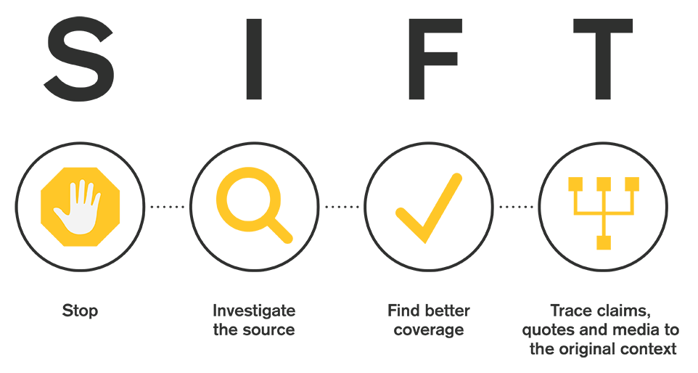
Building a student toolbox
Basic news literacy skills
SIFT- evaluation method
Easy to learn. Easy to use.
Developed by Mike Caulfield at the University of Washington’s Center for an Informed Public.
Recognizing common characteristics of misinformation
A kernel of truth
Inflammatory language
“For us or against us” rhetoric
Visual features
Notes:
Ryan

Slide 12
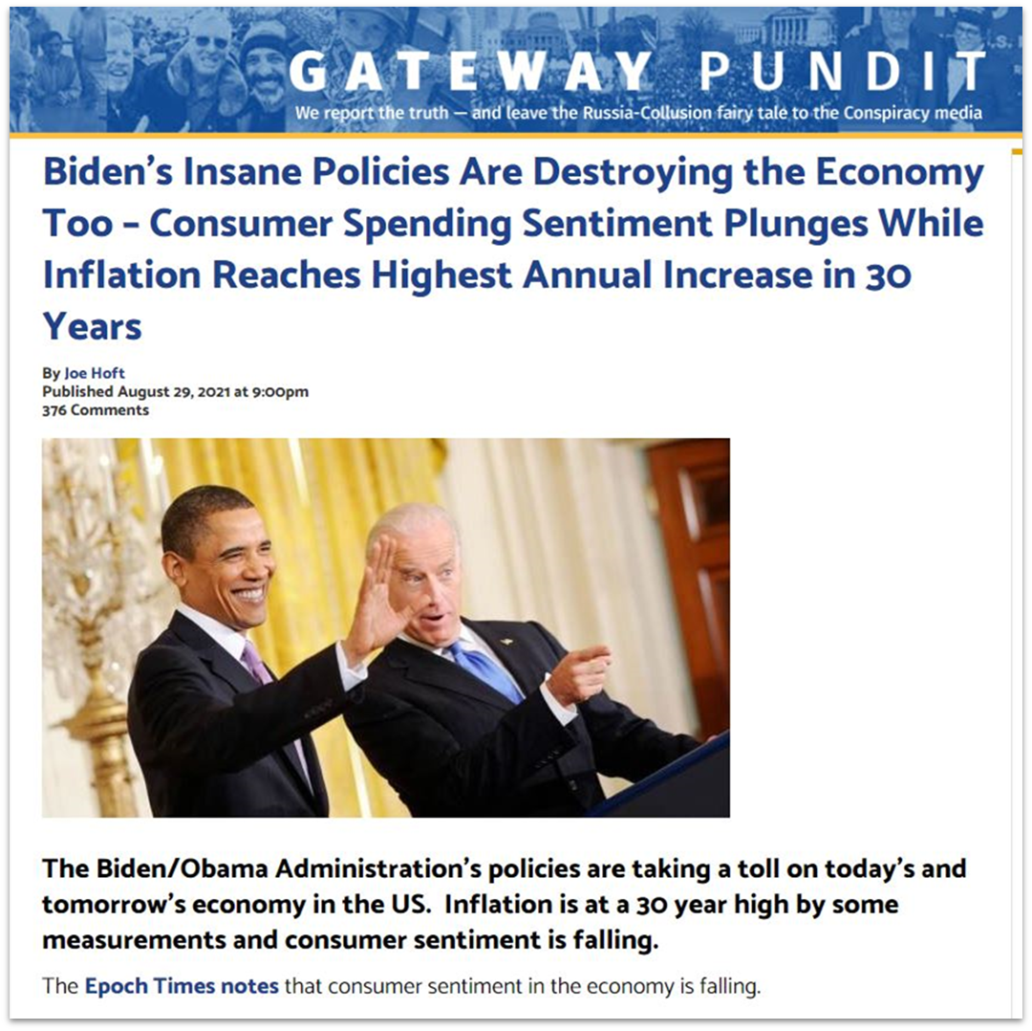
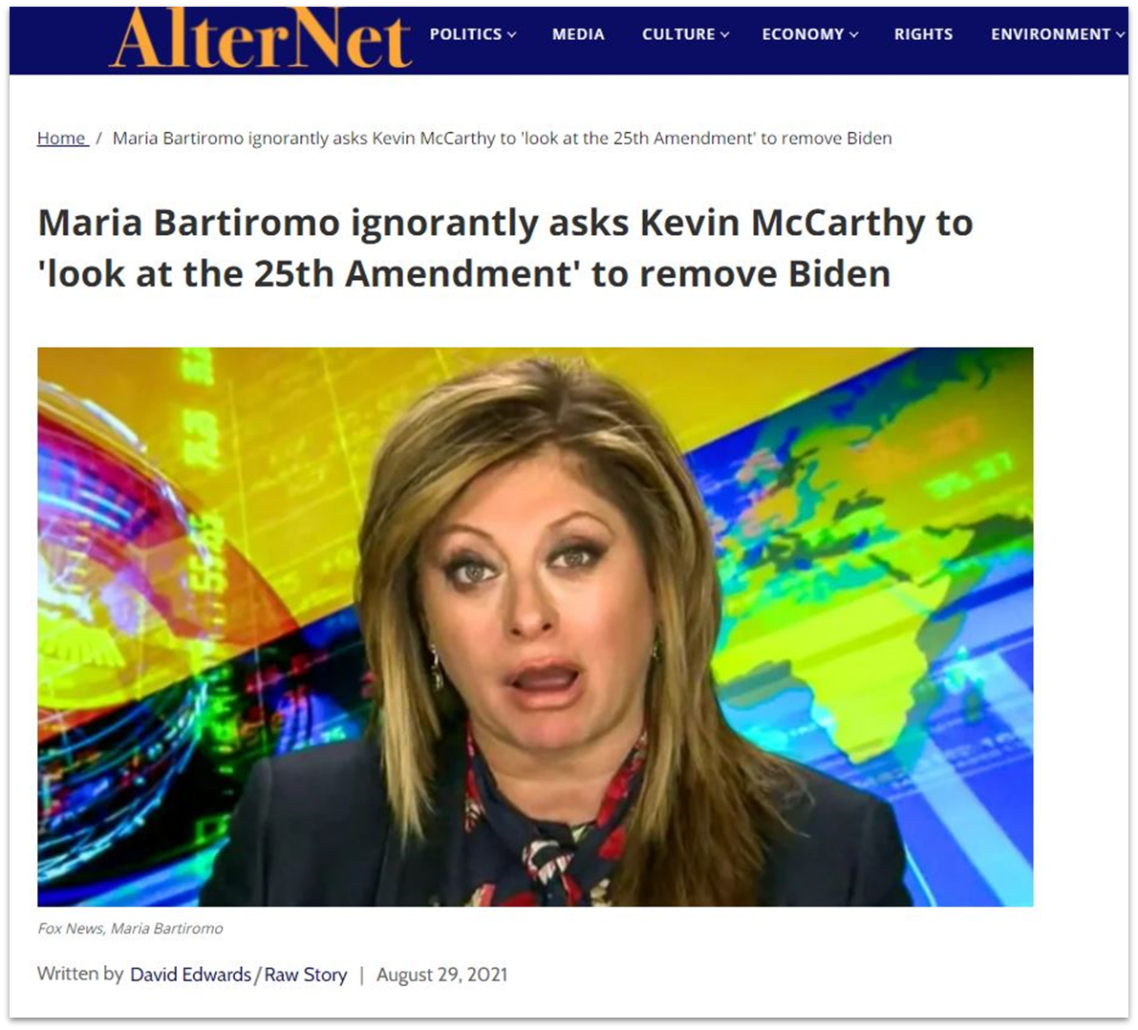
Example Misinformation from FYS Workshops
Notes:
Elora

Slide 13
Outcomes
Qualitative:
We found that students were ready and capable of doing quality fact-checking research, and were eager to learn new tools
“Overall, the presentation encouraged me to be more thorough in checking validity of information and if sources are reputable.”
“The SIFT method is going to be very good to remember in just everyday life. It will help me be a more conscious reader.”
“This convocation was helpful in how to think about news sources. While it is impossible to be completely unbiased there are things you can look for to help you make sure you are consuming news actively.
Quantitative:
Convo: 87 students
Workshops: 9 classes; 147 students
Notes:
Both

Slide 14
Obstacles Addressed During Planning
Political polarization, i.e. “misinformation only exists in the third person”
Resolved by…
Emphasized misinformation aspect and techniques over the political consequences of misinformation
Showed examples of what misinformation presents itself on both sides of the political spectrum
Finding time and convincing faculty to give up class time
Resolved by…
Utilizing the structure already built for our first-year seminar program.
Workshops are already a required feature of the program and allows faculty to include other staff/faculty with meaningful skills/information for new students.
Notes:
Both

Slide 15
Where we are now
Elora:
FYS workshops, single session instruction, and a for-credit library research course themed around misinformation.
Ryan:
Full election season mode; workshops and events on voter education and registration.
Together:
We spoke at a Faculty Symposium to continue to get feedback on further initiatives from our colleagues.
We’ve started embedding misinformation work in these voter programs, encouraging students to think deeply about campaigns and candidates.
We’re also starting a “Misinformation of the Month” flyer series, having a student worker collect various misinformation from social media, debunking the claims, and posting our work around campus for student consumption.
Notes:
Both

Slide 16
Activity: Consider your community

Slide 17
Questions?

Slide 18
Think of questions later?
Contact us as elora.agsten@ic.edu or ryan.flynn@ic.edu

